Slide 1

Connected Coolers Technician
Application Guide
October 2024
© 2024 Vision Group

Slide 2
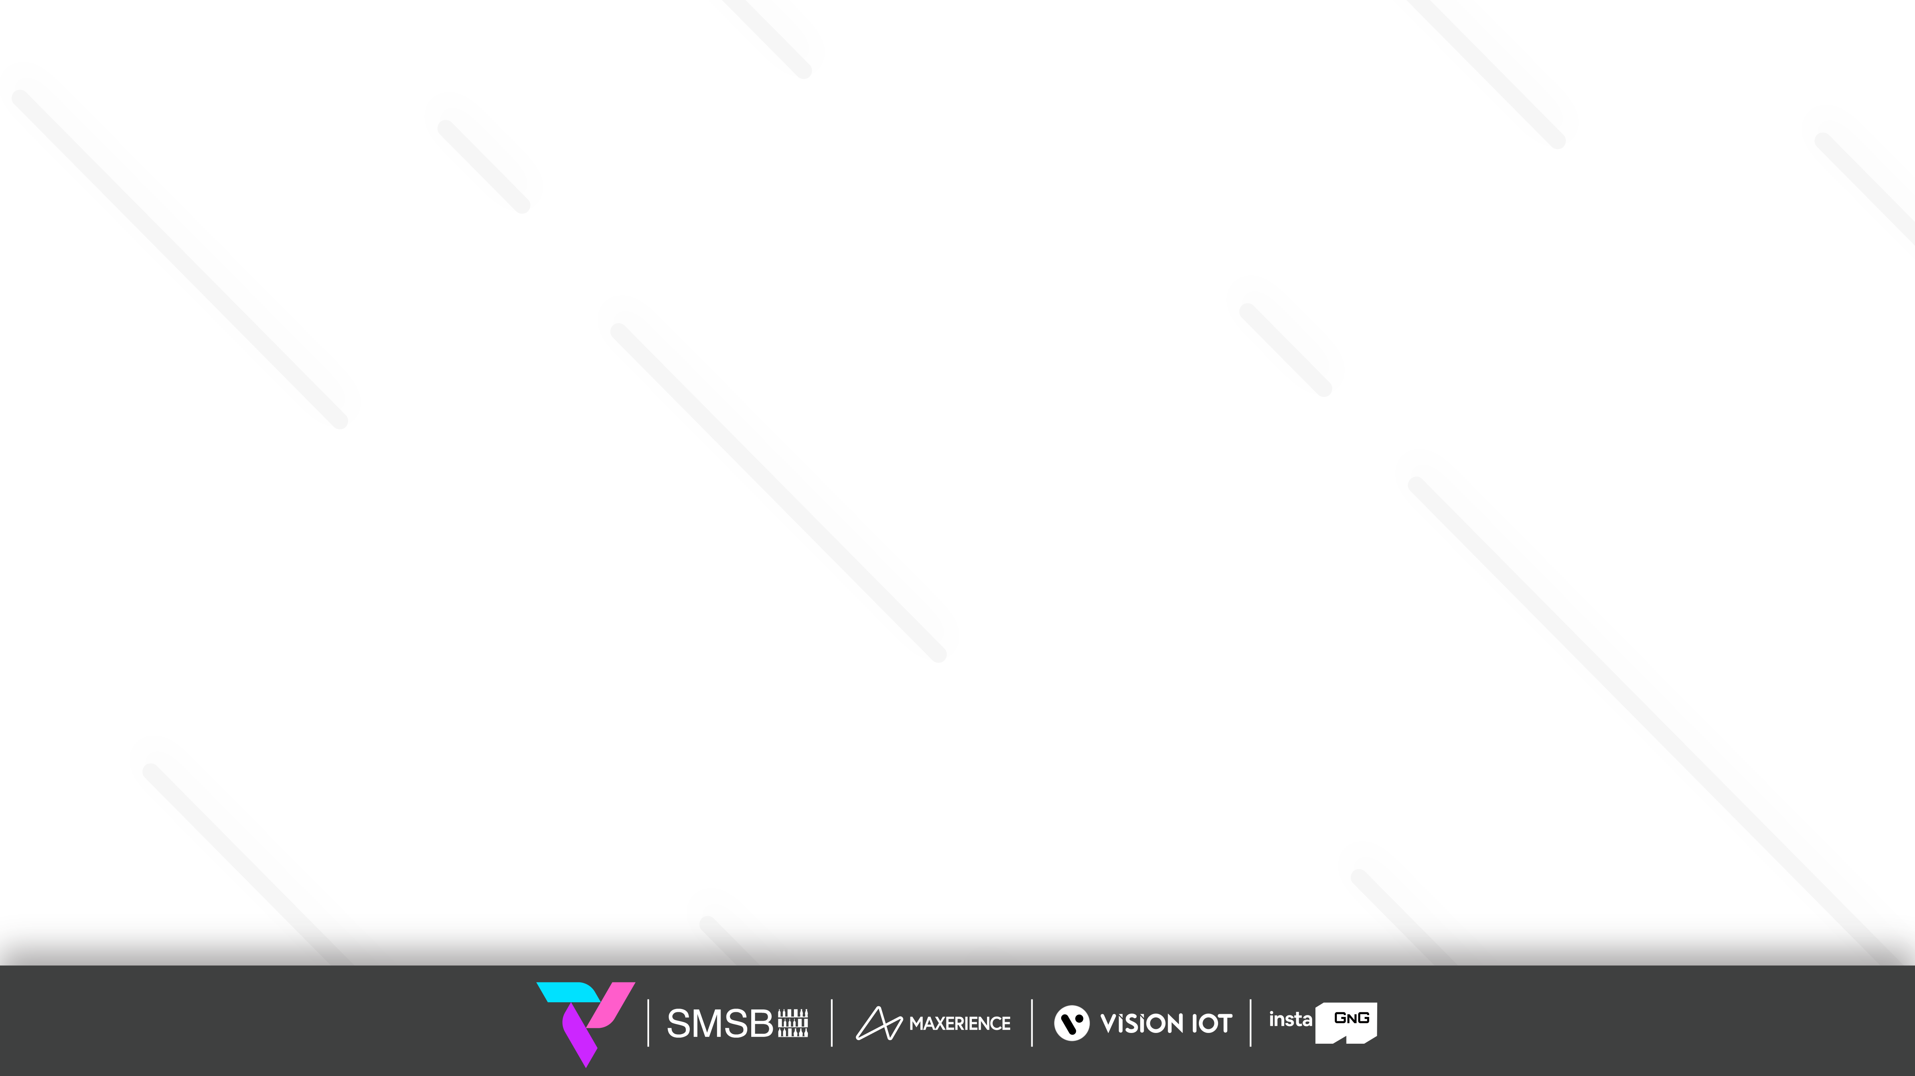
APPLICATION FEATURES
CONNECT – Connect with the Whitelisted cooler using Cooler SN or Equipment SN.
ASSIGN CONTROLLER TO CCEP – Assign the CCEP Client to the device.
CONTROLLER STATUS – To check the Gateway device’s Last cellular status.
ERROR MESSAGES – For controller error, msg easily diagnoses the fault and identifies a solution.
CHANGE CONTROLLER SETTINGS – For Checking Smart Device Last Communication Status.
APPLY DEFAULT SETTINGS – For the user apply Default settings of different cooler models and controller types.
ADD/REPLACE CONTROLLER – For users to have a new add controller or replace controller for the available asset.
REMOVE CONTROLLER ONLY – For users who have removed the controller.
UPGRADE FIRMWARE – This option is enabled if the device has the latest FW available.
DISCONNECT – Disconnect the device that is connected.
© 2024 Vision Group

Slide 3
APPLICATION INSTALLATION
Please remember the following instructions: Download the Applications for Android and iOS from below respective links below and install them on the device.
Remember to delete the previous version of the application before installing a new version.
ANDROID APK LINK:
Connected_Coolers_Technician_v5.3_Android
iOS APK LINK:
Connected_Coolers_Technician_v4.24_iOS
© 2024 Vision Group

Slide 4
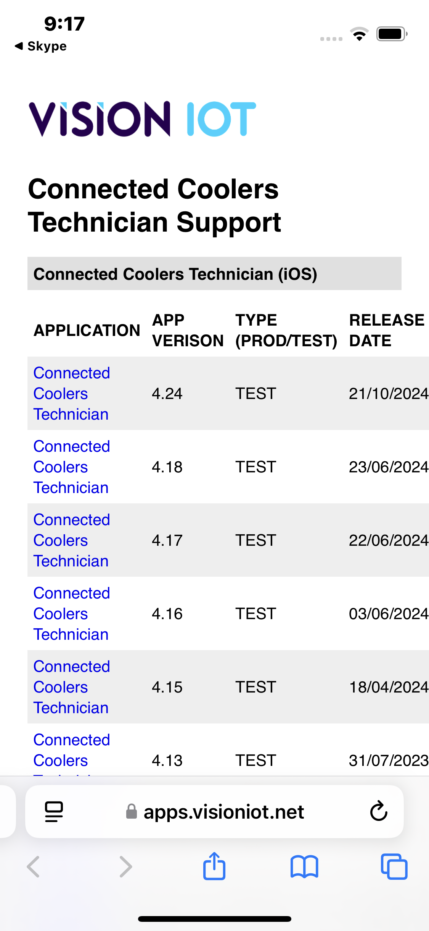
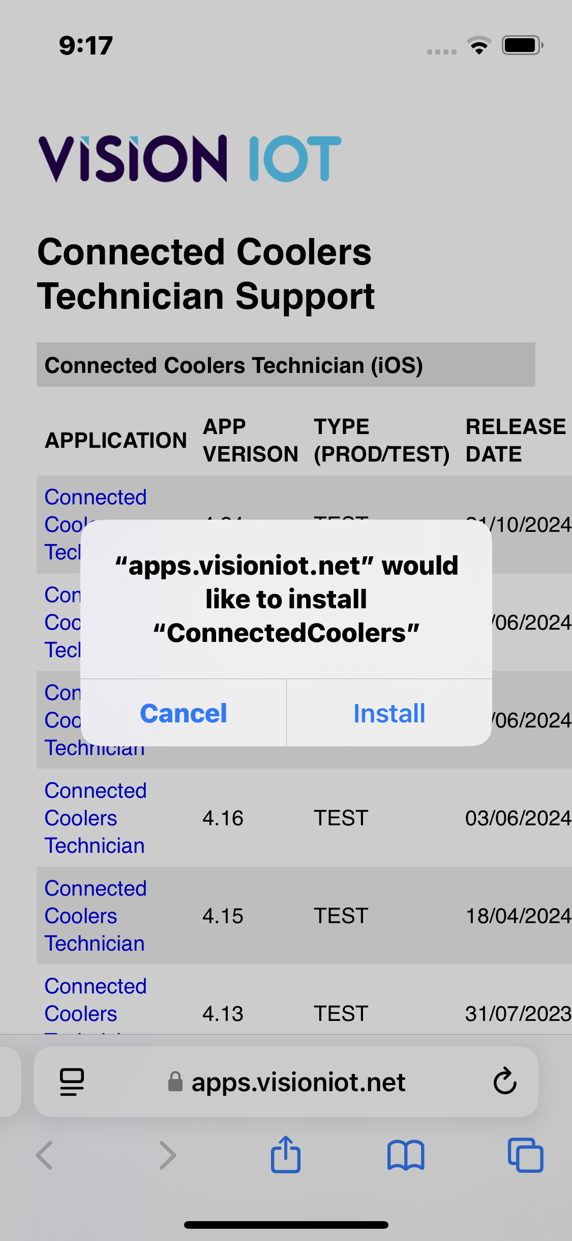
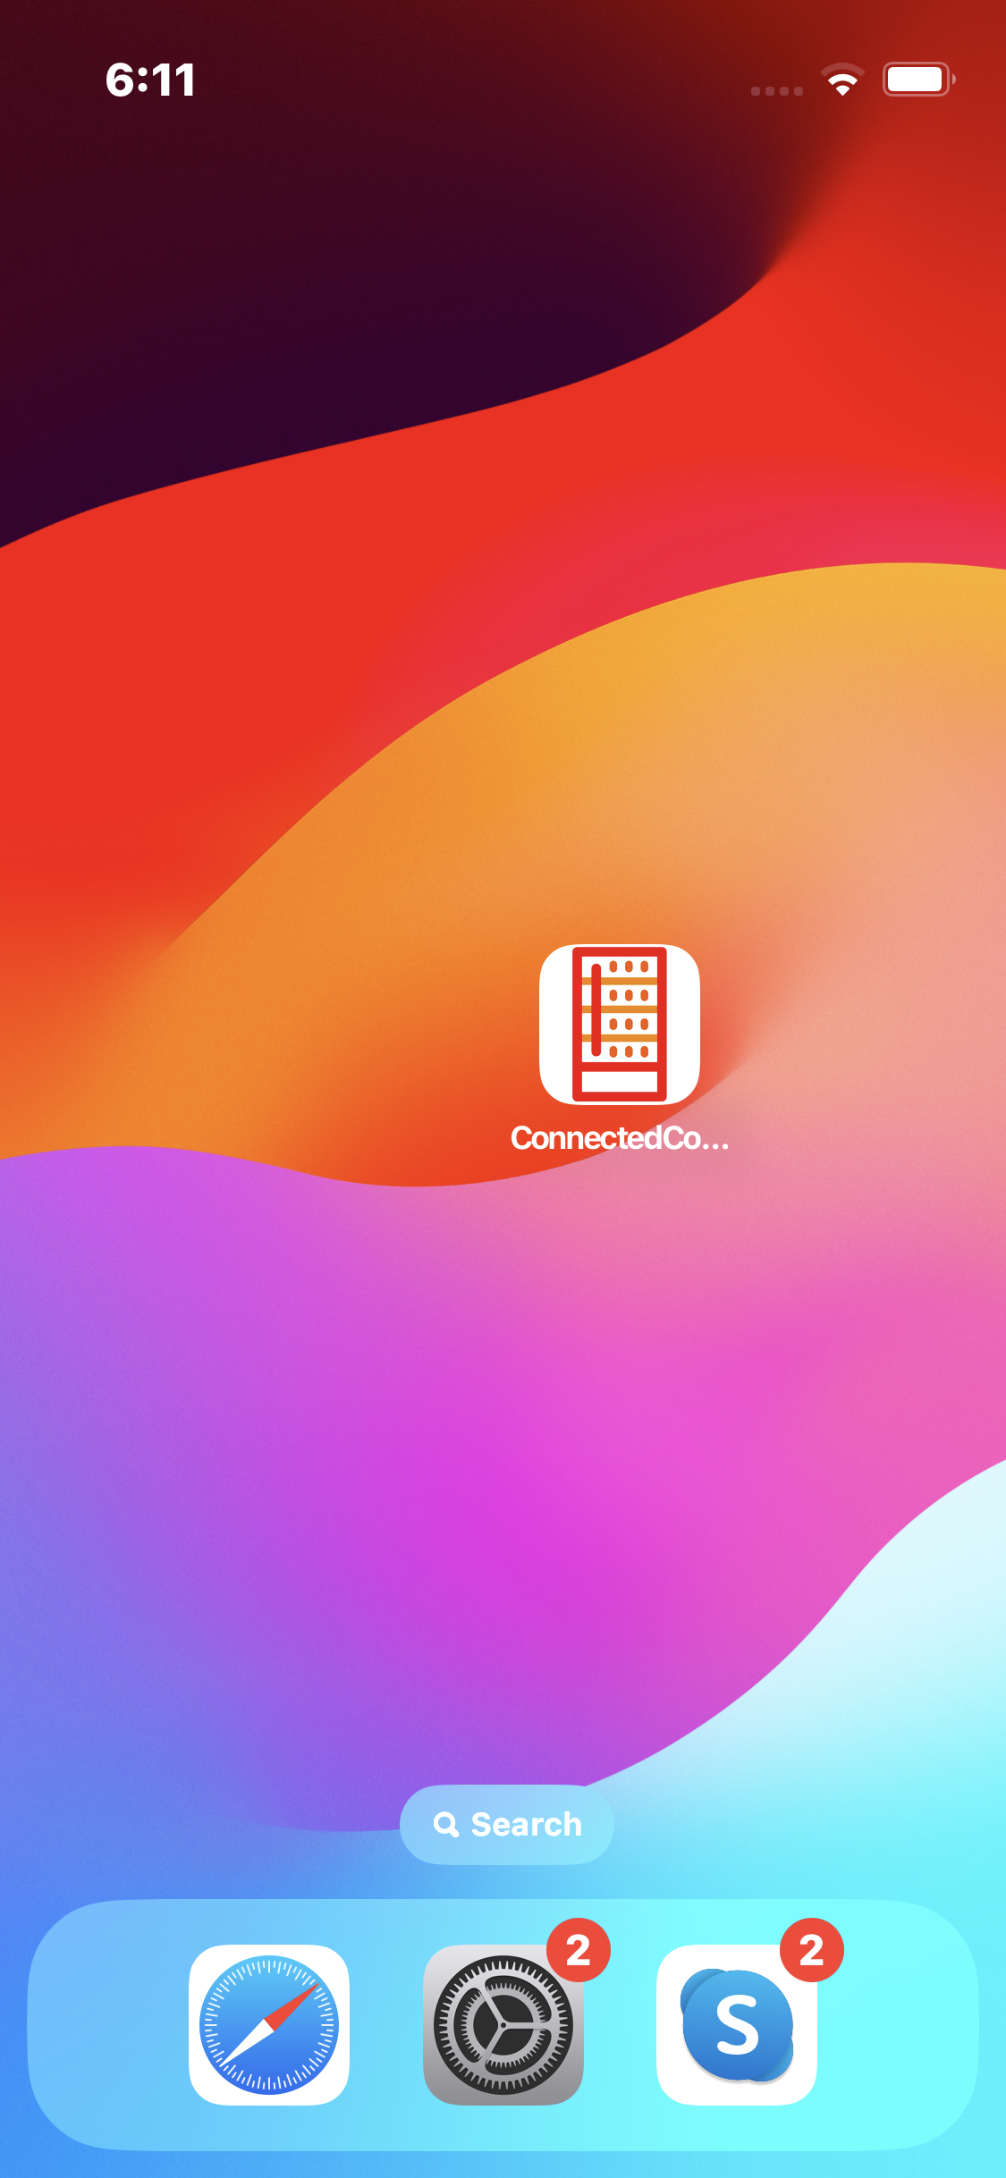
APPLICATION INSTALLATION (Cont’d)
Download the Applications by tapping on the marked area in the first image, the device will ask to install it to the device, press install and wait to install the APK file in the device.
© 2024 Vision Group

Slide 5
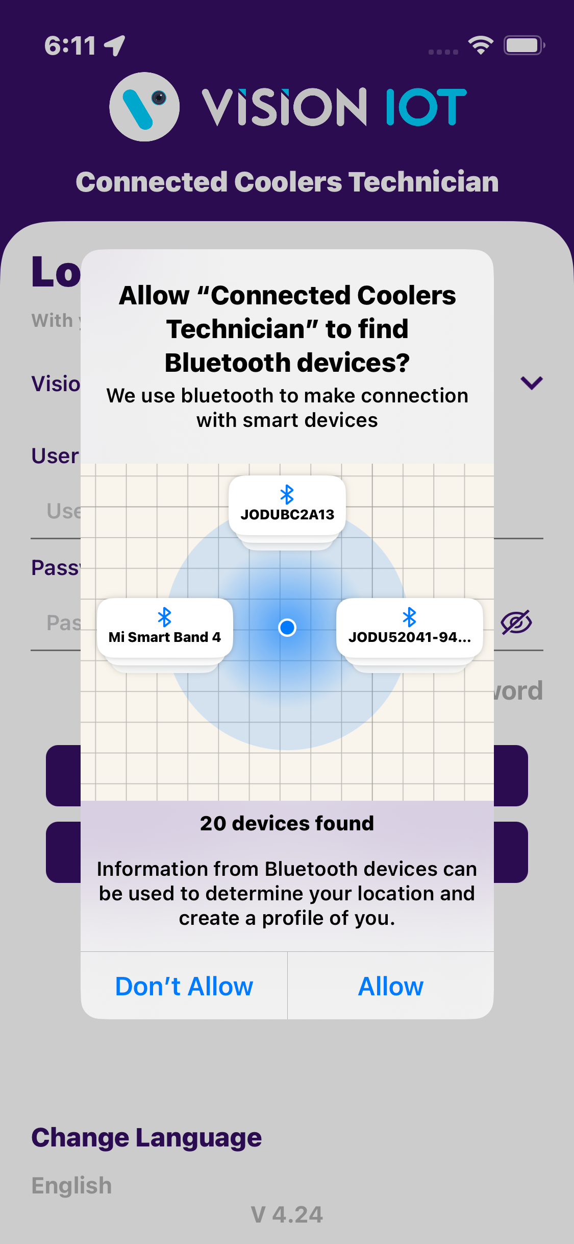
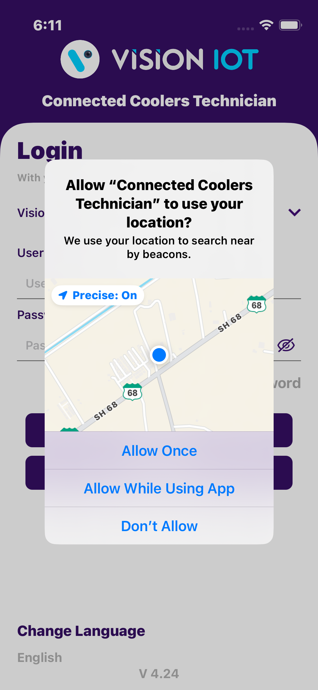
APPLICATION PERMISSION
After initial Installation & launch, the Application will ask for permission to access.
LOCATION PERMISSION
For Location - Choose Allow While Using App on iOS 13 and above and for Android OS 10 and Above.
Then Go to the Settings > Application List > Location > Allow Location Access option is “Always”.
BLUETOOTH PERMISSION
Access the Bluetooth (to scan barcodes) – the first prompt on the Outlet screen -> Choose “OK”.
© 2024 Vision Group

Slide 6
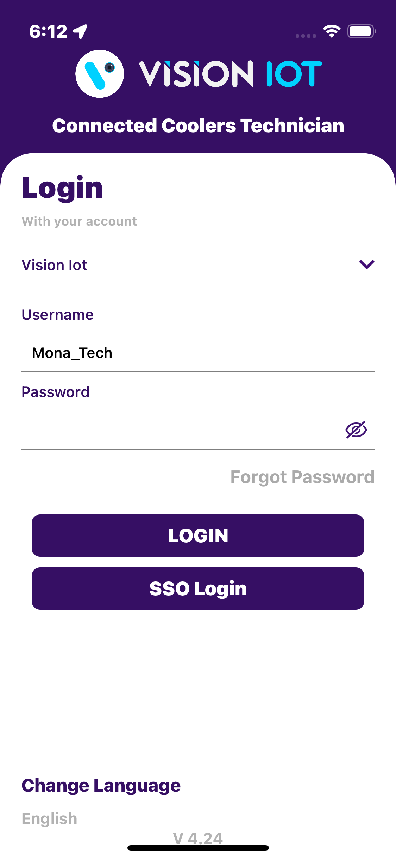
LOGIN
After successfully installing the Connected Coolers Technician Application. Open the Application, and the application will redirect to the Login Page and log in with valid user Credentials.
Users can access two types of login supported, one is Normal “Login” and another one is “SSO Login”.
Server: For CCEP client used only the Vision Iot server.
Bluetooth also should be enabled as well as location services.
The application requires an internet connection for initial login.
After the initial Login the application can work and the same username & password as the one in the online login is used.
© 2024 Vision Group

Slide 7
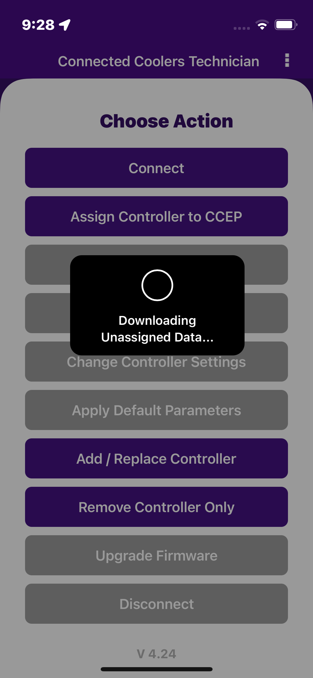
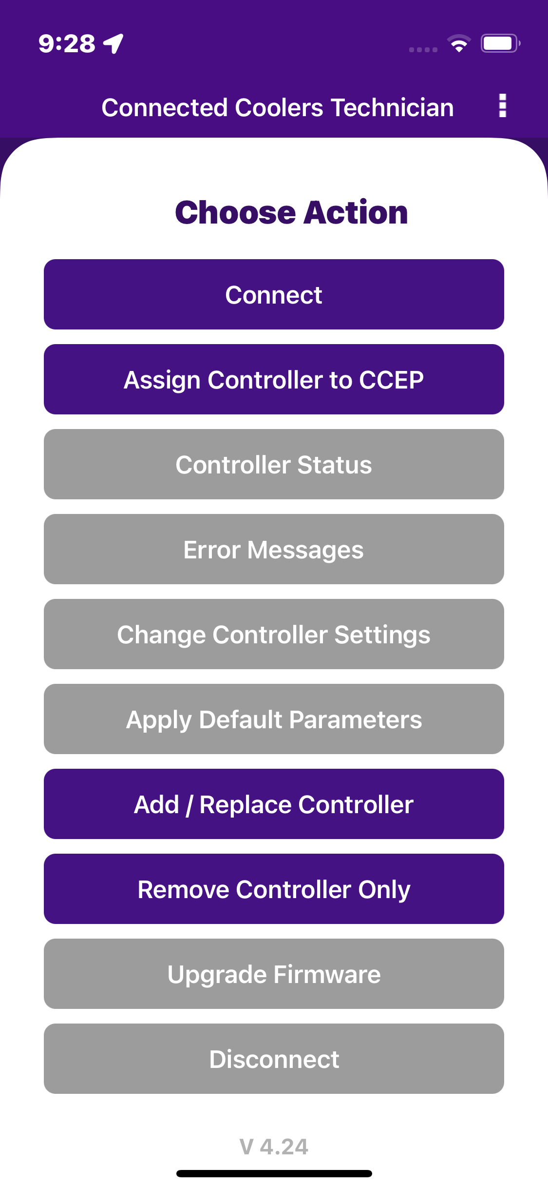
LOGIN (Cont’d)
Provide valid credentials and tap on the Login button, please be advised that the application will need some time to download data from the cloud.
Note
Internet connectivity is required during login otherwise login will fail, and the application will show network errors.
© 2024 Vision Group

Slide 8
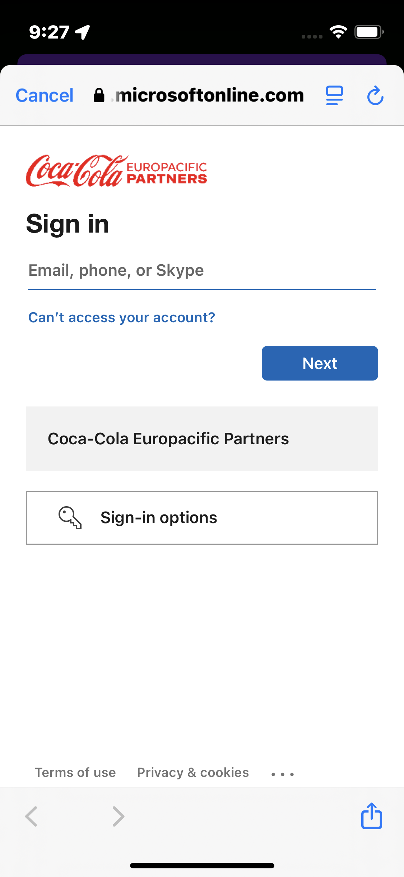
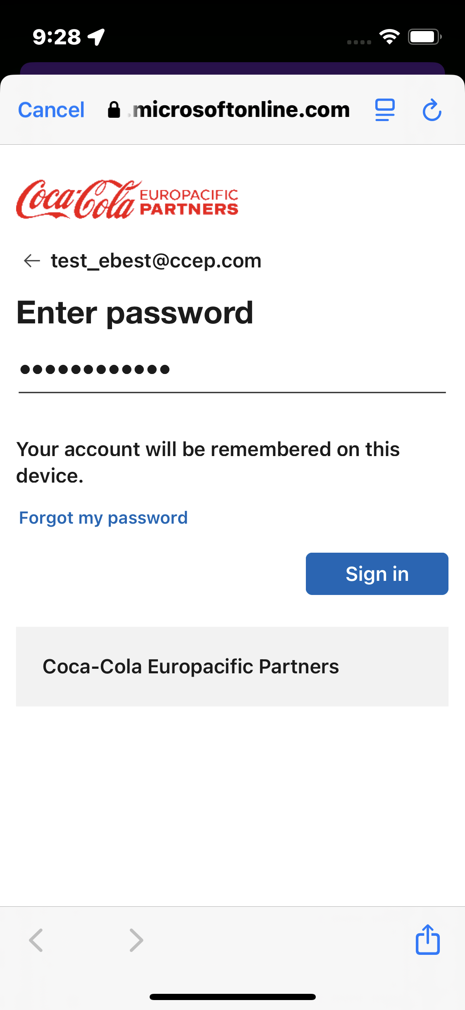
SSO LOGIN
Enter valid credentials and tap on the “SSO Login” button. The application will download the necessary data from the cloud, once the data, the application directly redirects to the home page.
Server: For CCEP client used only the Vision Iot server.
© 2024 Vision Group

Slide 9
CONNECTED COOLER TECHNICIAN – CHOOSE ACTION
After successful login, the following screen will appear. Please CHOOSE ACTION from the list as per the required operation.
CONNECT – Connect with the Whitelisted cooler using Cooler SN or Equipment SN.
ASSIGN CONTROLLER TO CCEP – Assign the CCEP Client to the device.
CONTROLLER STATUS – To check the Gateway device’s Last cellular status.
ERROR MESSAGES – For controller error, msg easily diagnoses the fault and identifies a solution.
CHANGE CONTROLLER SETTINGS – For Checking Smart Device Last Communication Status.
APPLY DEFAULT SETTINGS – For the user apply Default settings of different cooler models and controller types.
ADD/REPLACE CONTROLLER – For users to have a new add controller or replace controller for the available asset.
REMOVE CONTROLLER ONLY – For users who have removed the controller.
UPGRADE FIRMWARE – This option is enabled if the device has the latest FW available.
DISCONNECT – Disconnect the device that is connected.
© 2024 Vision Group

Slide 10
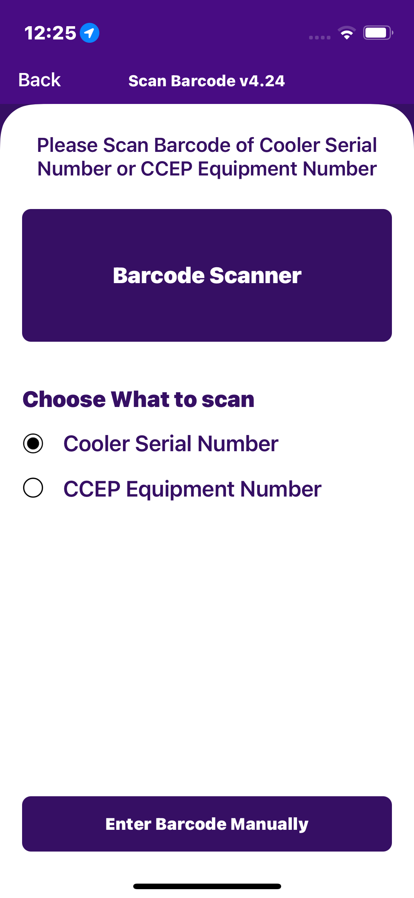
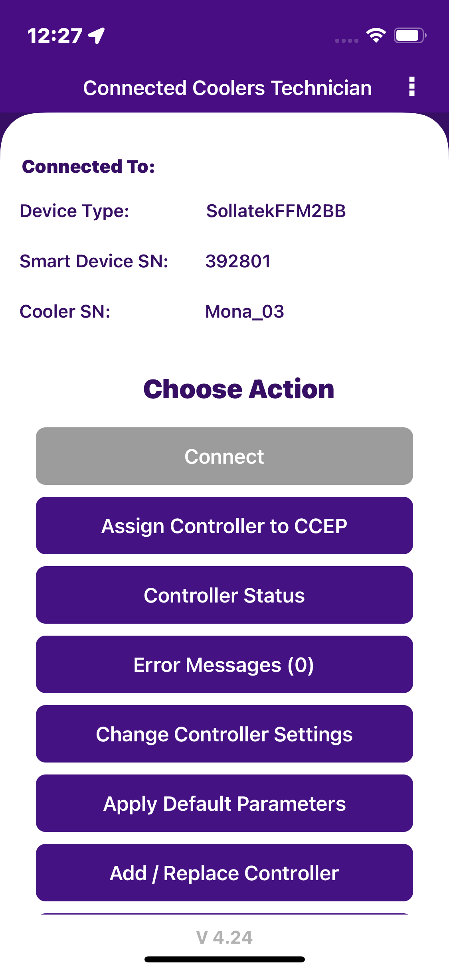
CONNECT
After successful login select Connect to the Device is for as to initiate a connection with the controller.
Please enter manually or scan the barcode for the cooler serial number. (see the second image).
After that device connected successfully. (see the Third image)
Note: This application supported only Sollatek FFM2BB and FDEX2.
© 2024 Vision Group

Slide 11
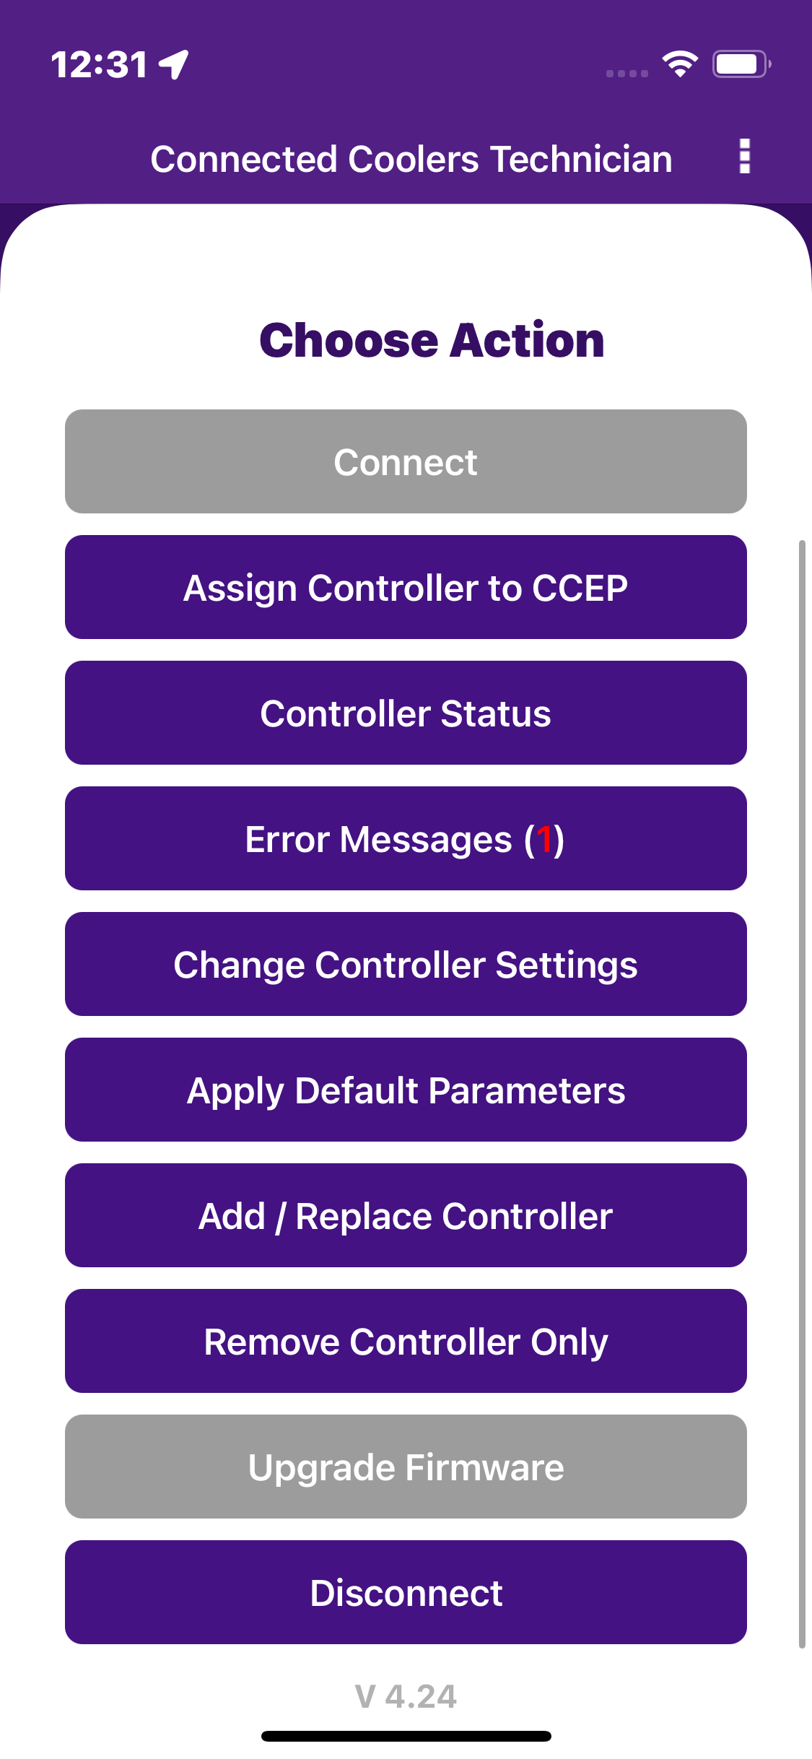
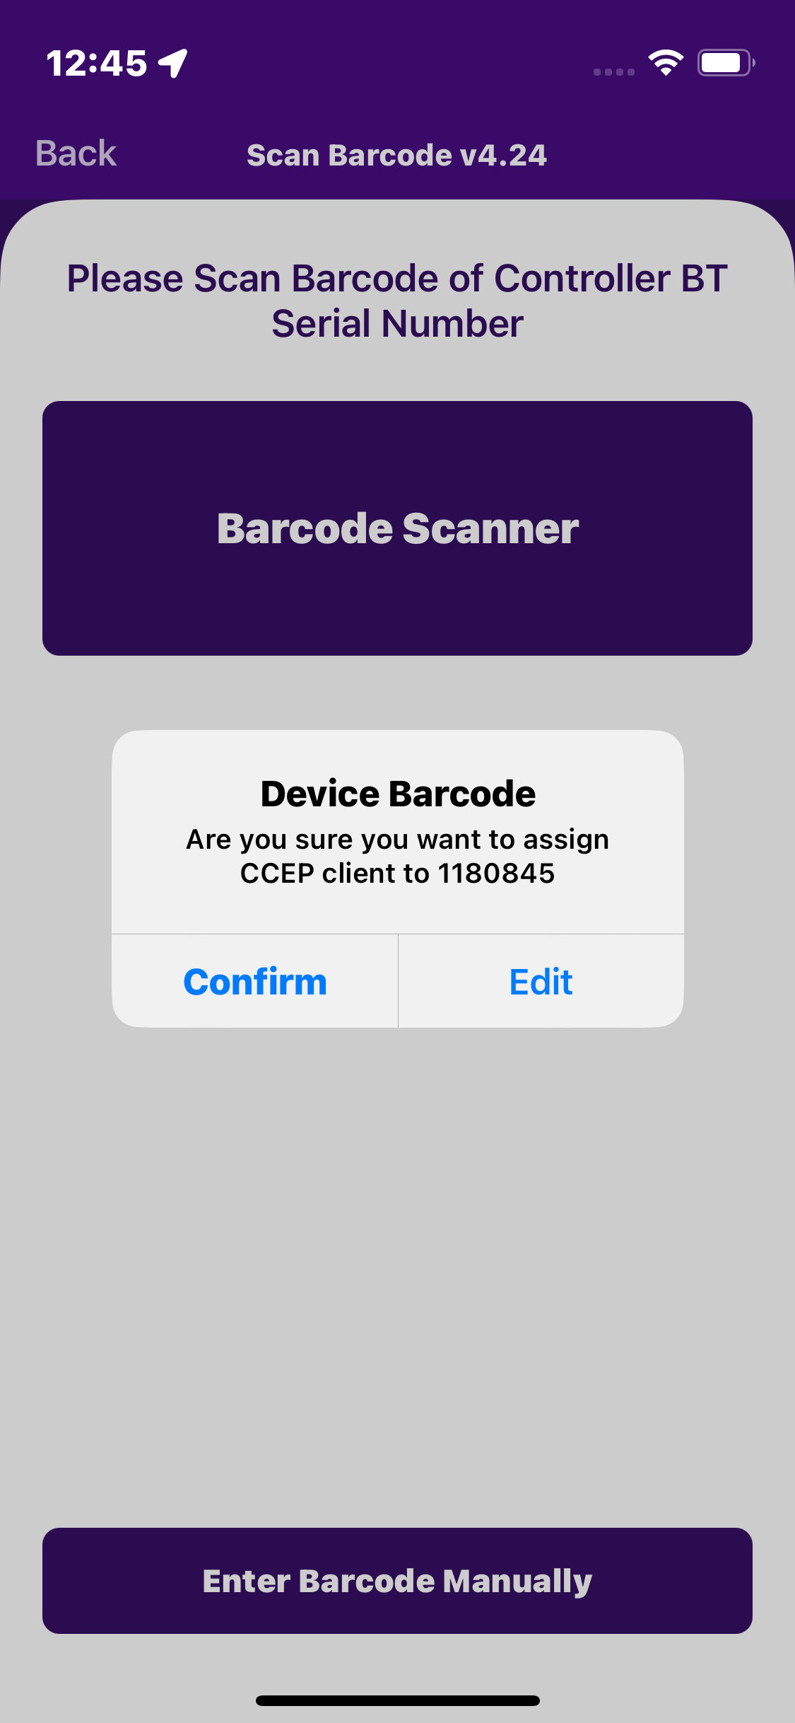
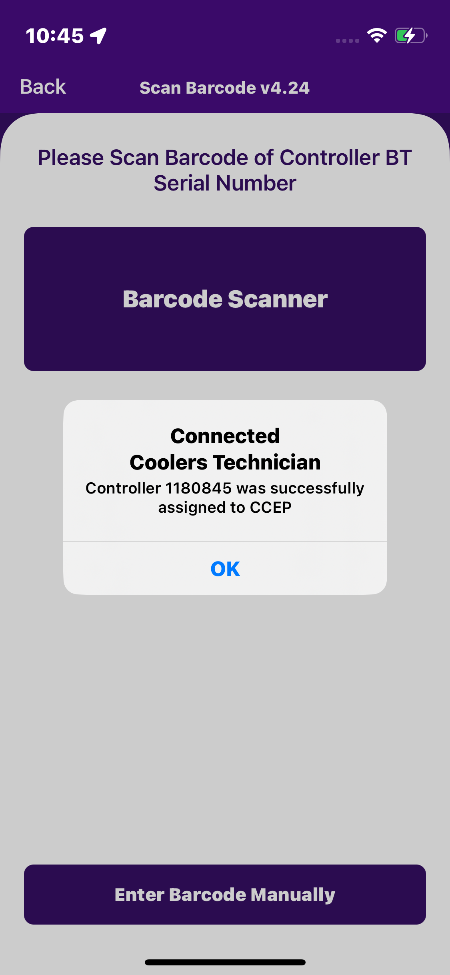
ASSIGN CONTROLLER TO CCEP
After a successful connection with the device, select the Assign controller to CCEP option scan the barcode and manually enter the device serial to assign the CCEP controller.
Next step: After manual entry of the Serial number or scan of the barcode, a popup is generated, and it requires a confirmation.
If the device already assigned the client, see the popup message “already assign the CCEP” else the popup message “Controller was successfully assigned to CCEP”.
© 2024 Vision Group

Slide 12
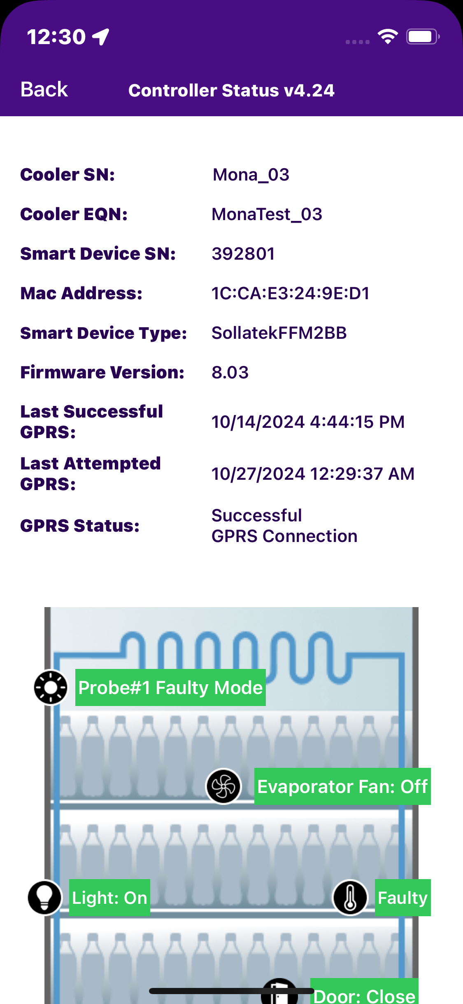
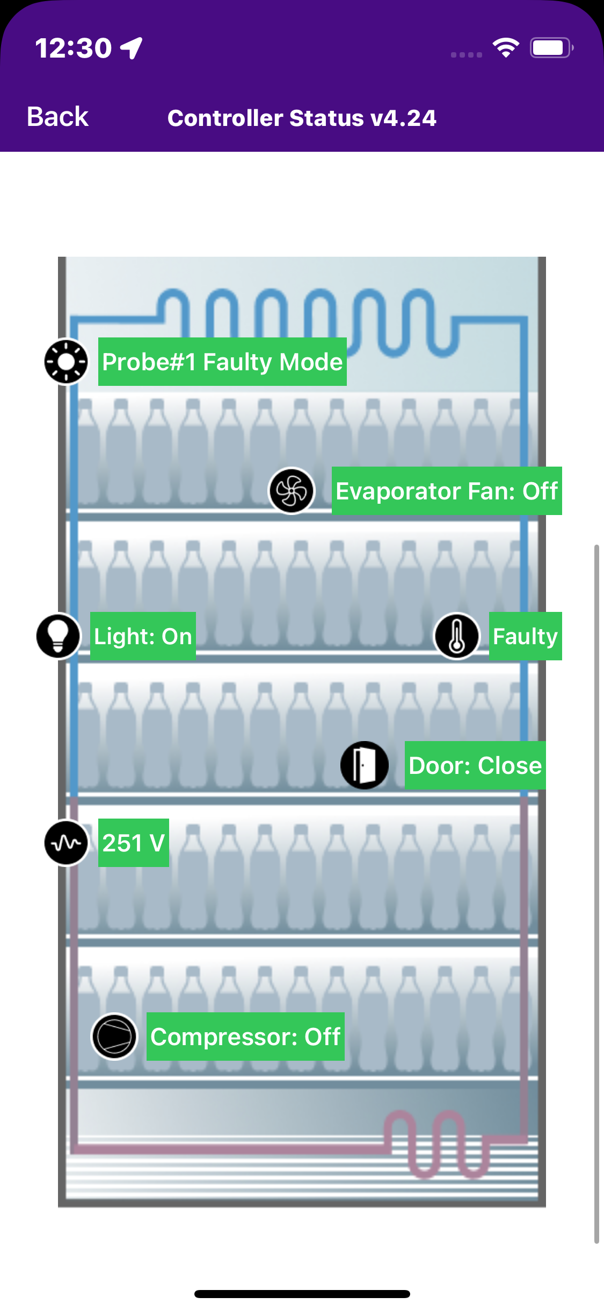
CONTROLLER STATUS
The date and time the controller last communicated with the portal should be displayed (It should be a ping data transaction to confirm the connection is successful with the portal).
© 2024 Vision Group

Slide 13
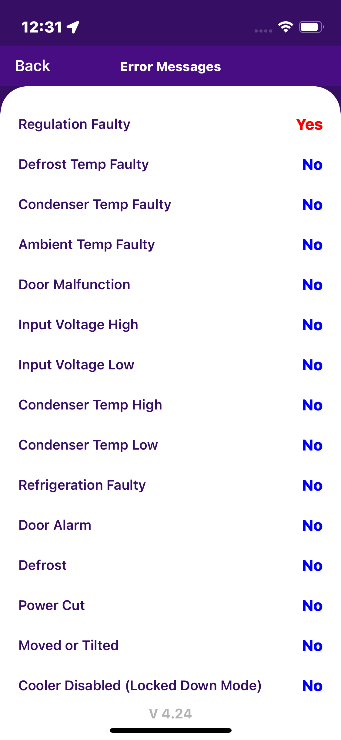
ERROR MESSAGE
Any error messages coming from the controller, the user can easily diagnose the fault and identify a solution.
If any error is there in the controller, then the Application shows the status as “Yes” else Application shows the status as “No”.
© 2024 Vision Group

Slide 14
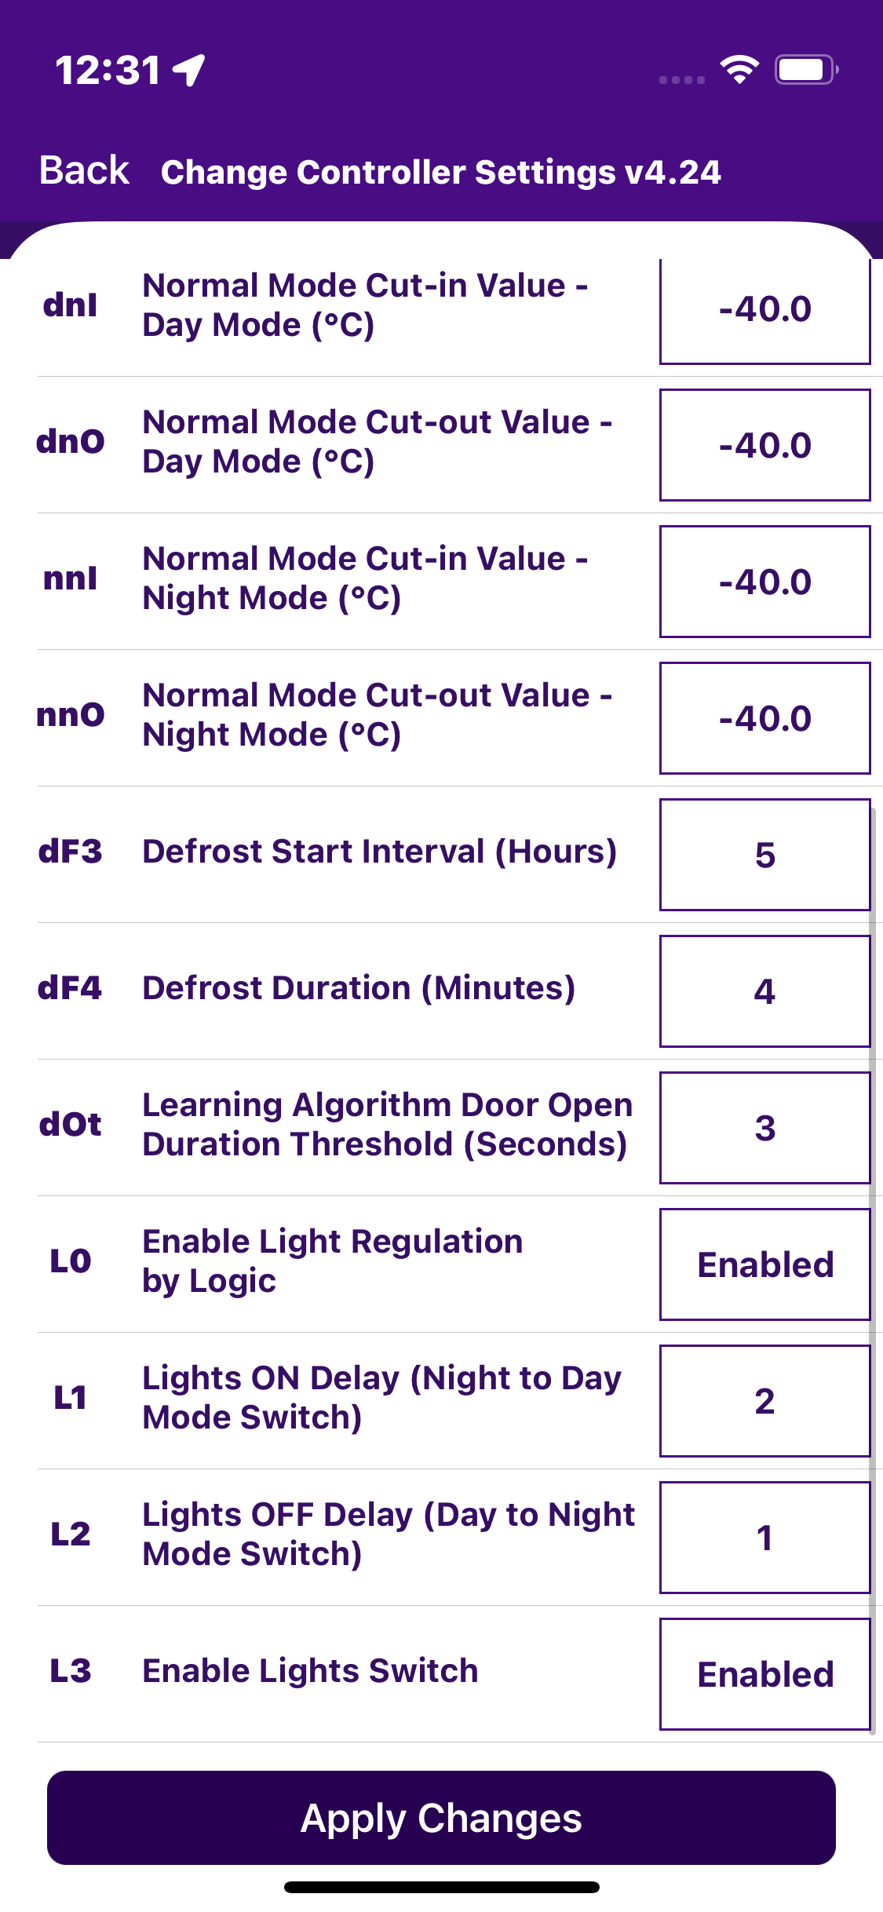
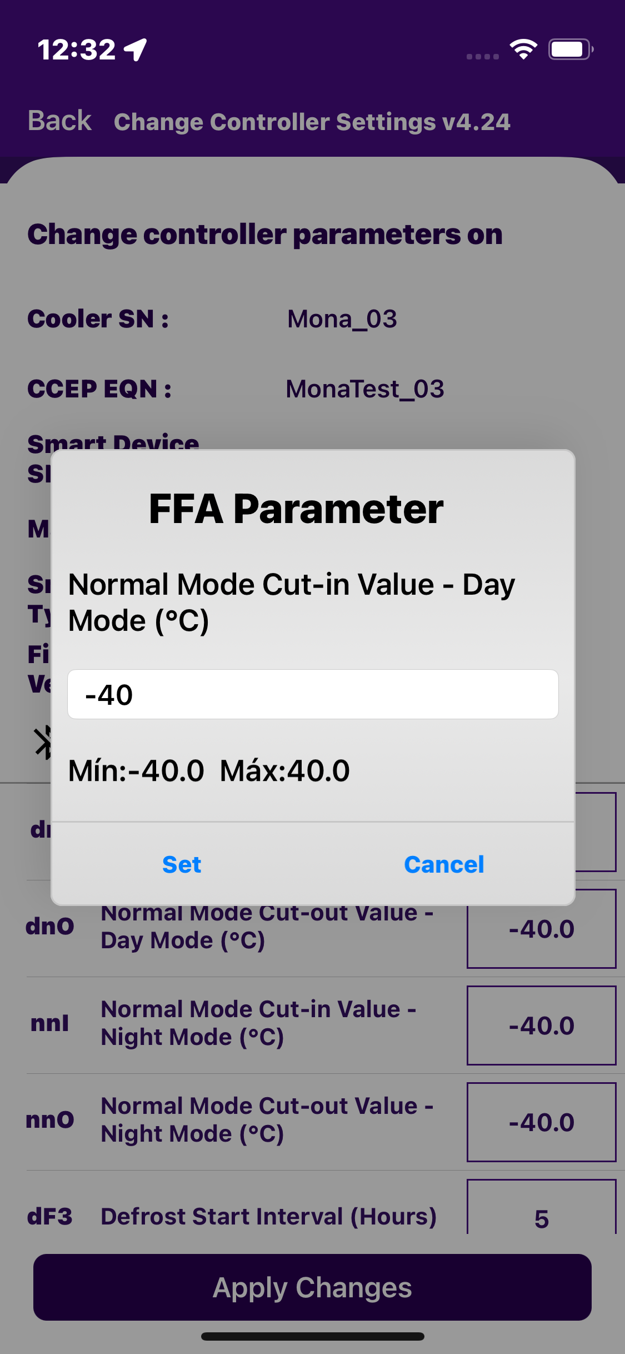
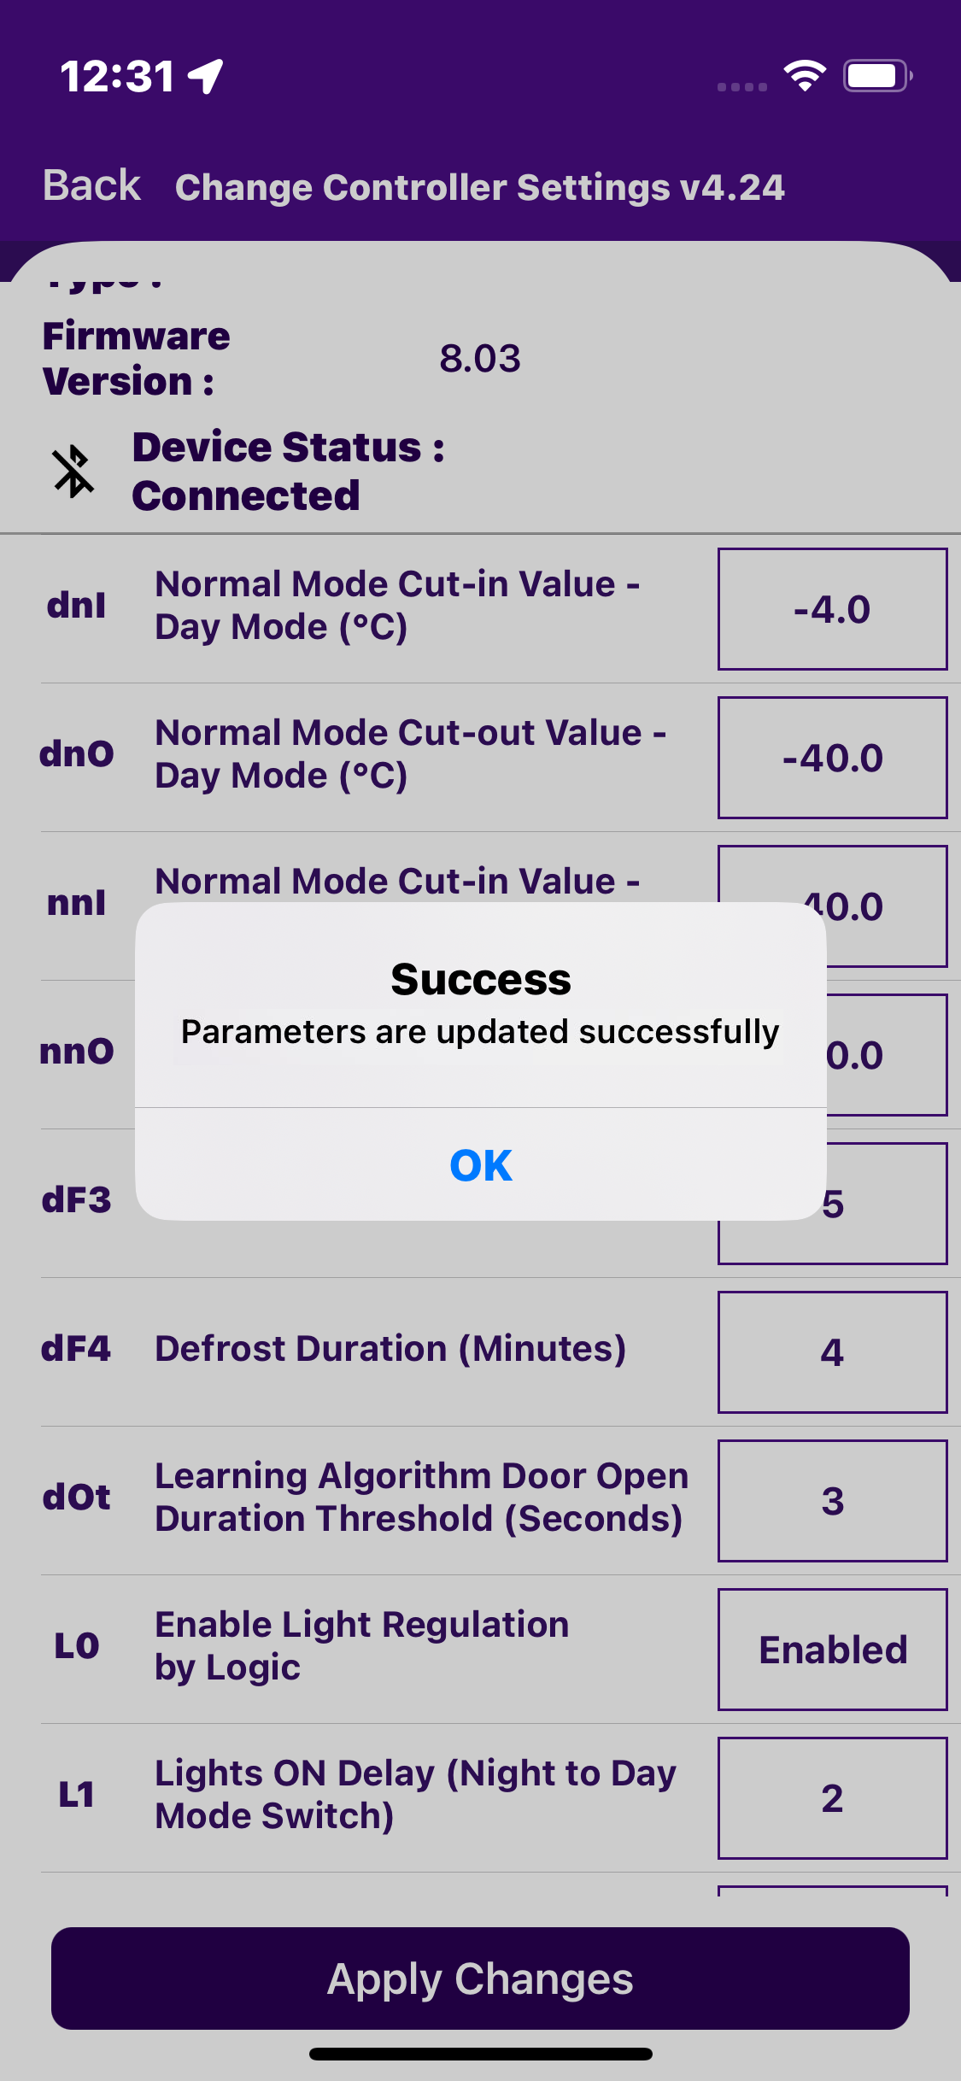
CHANGE CONTROLLER SETTING
Users can change all available settings for FFA / FDE controllers according to requirements. After changing the setting, the user should click on the “set” shown in the image.
© 2024 Vision Group

Slide 15
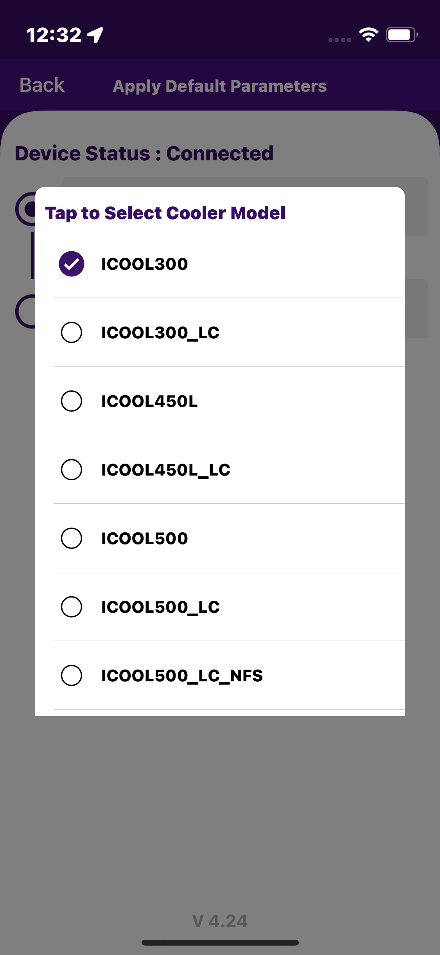
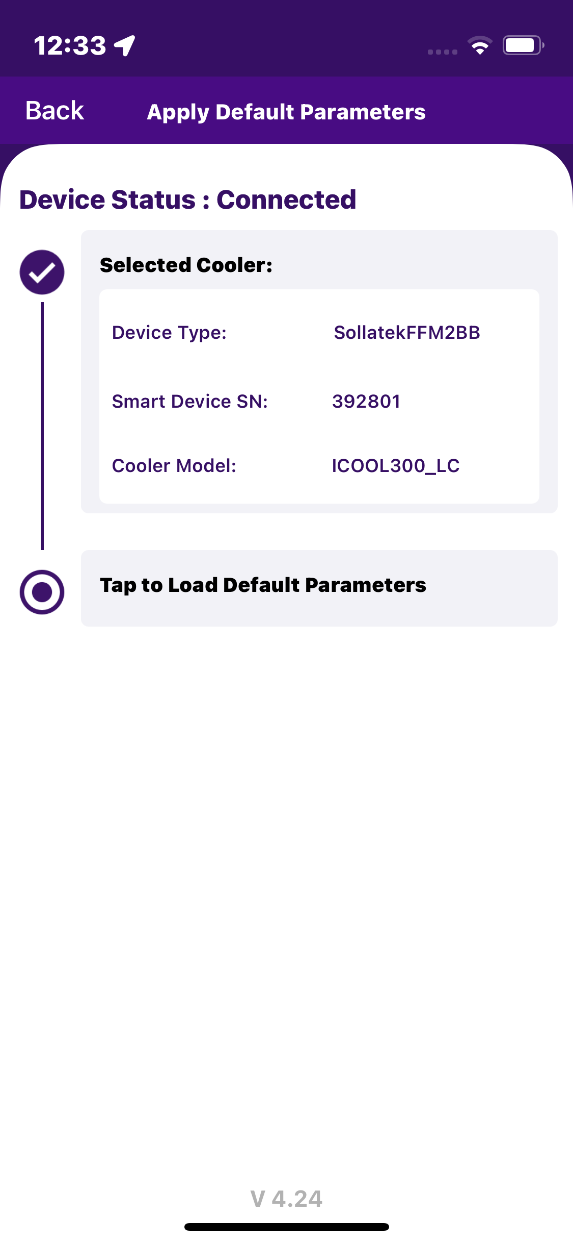
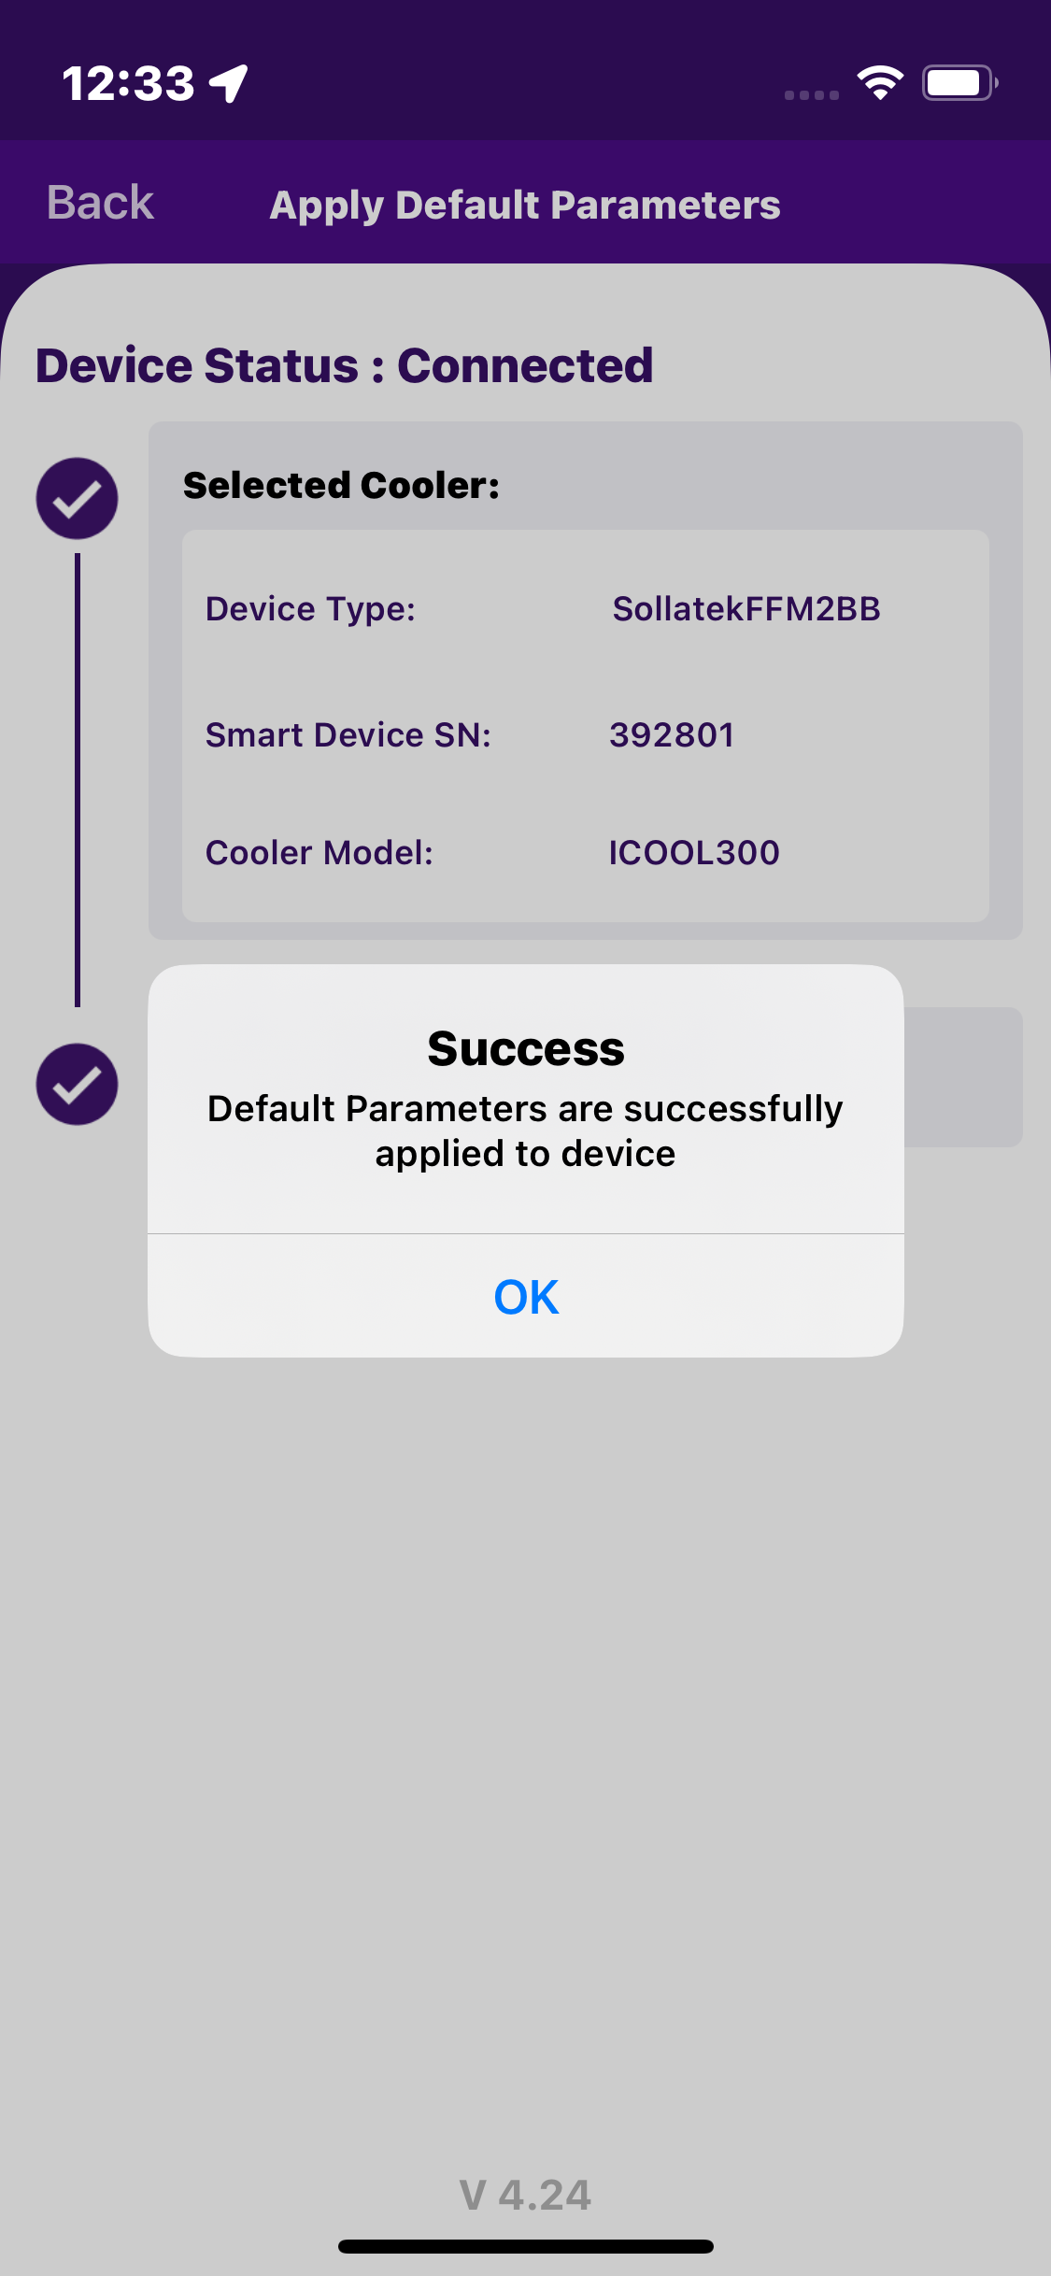
APPLY DEFAULT SETTING
Users click “Apply Default Setting” parameters, then select “Tap to select cooler model”. Here In the application, FDEX2 have 2 cooler models supported and the FFM2BB device has 19 cooler models supported.
© 2024 Vision Group

Slide 16
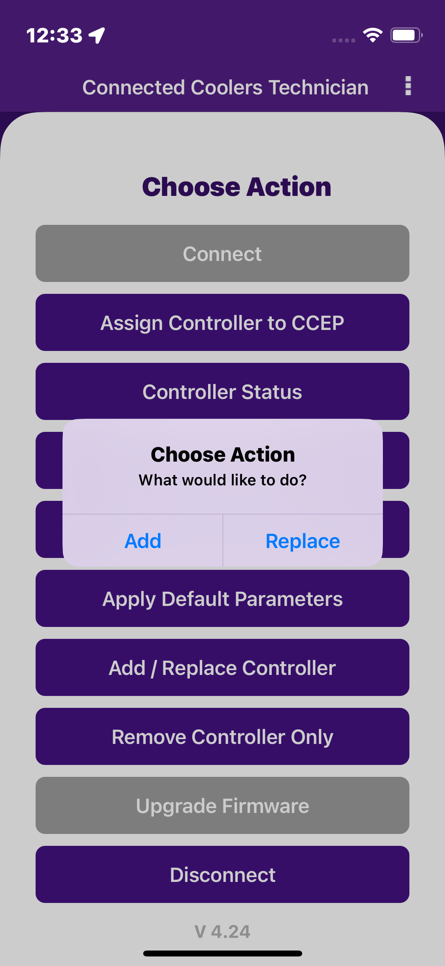
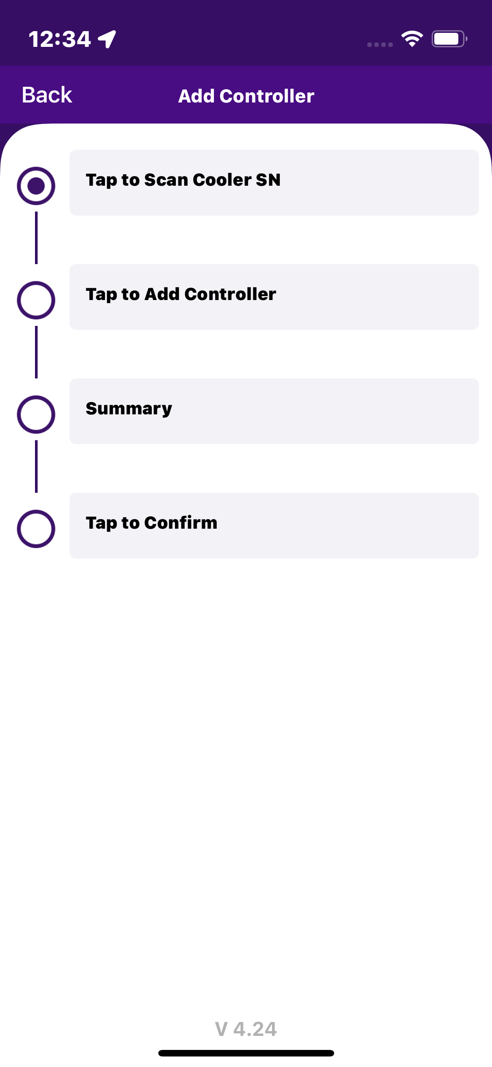
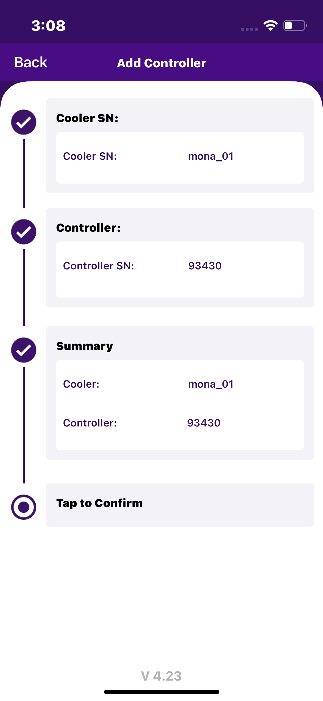
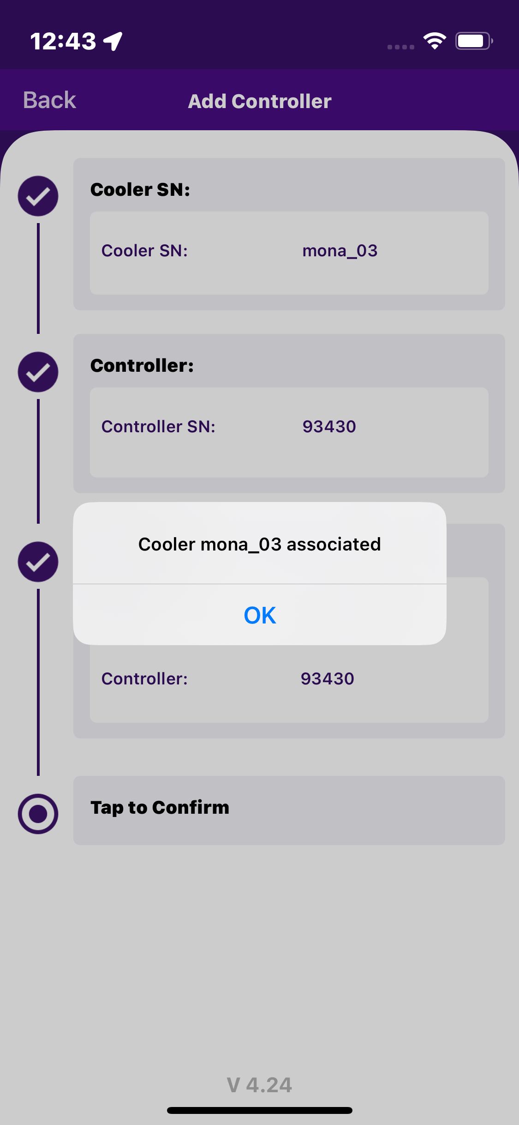
ADD CONTROLLER
When the user clicks on “Add/Replace Controller” next pop-up shows “ Add or Replace”, After that When the user clicks on the Add button. Click on “Tap to scan cooler” scan or enter manually. After that Tap on Add Controller – which will add Controller. Check all details to add the controller seen as “Summary”. The last screen user has seen the pop-up message “Controller Associated”.
© 2024 Vision Group

Slide 17
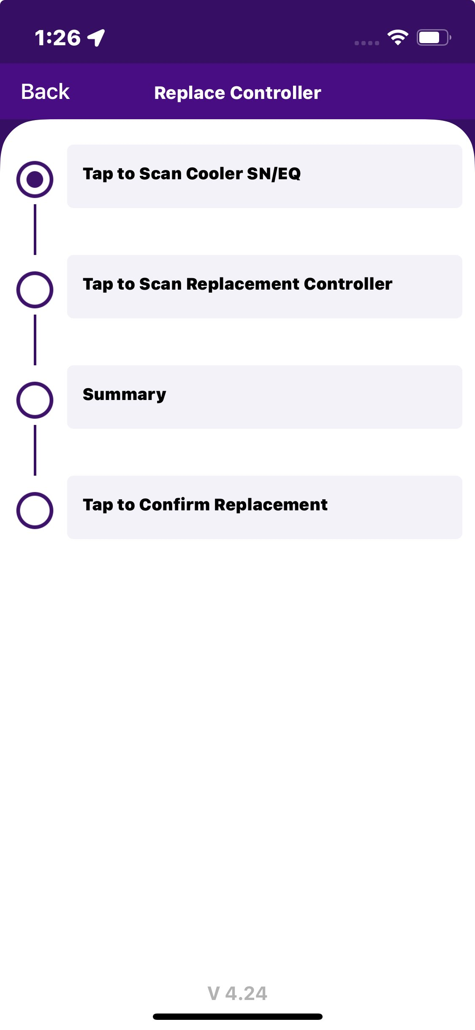
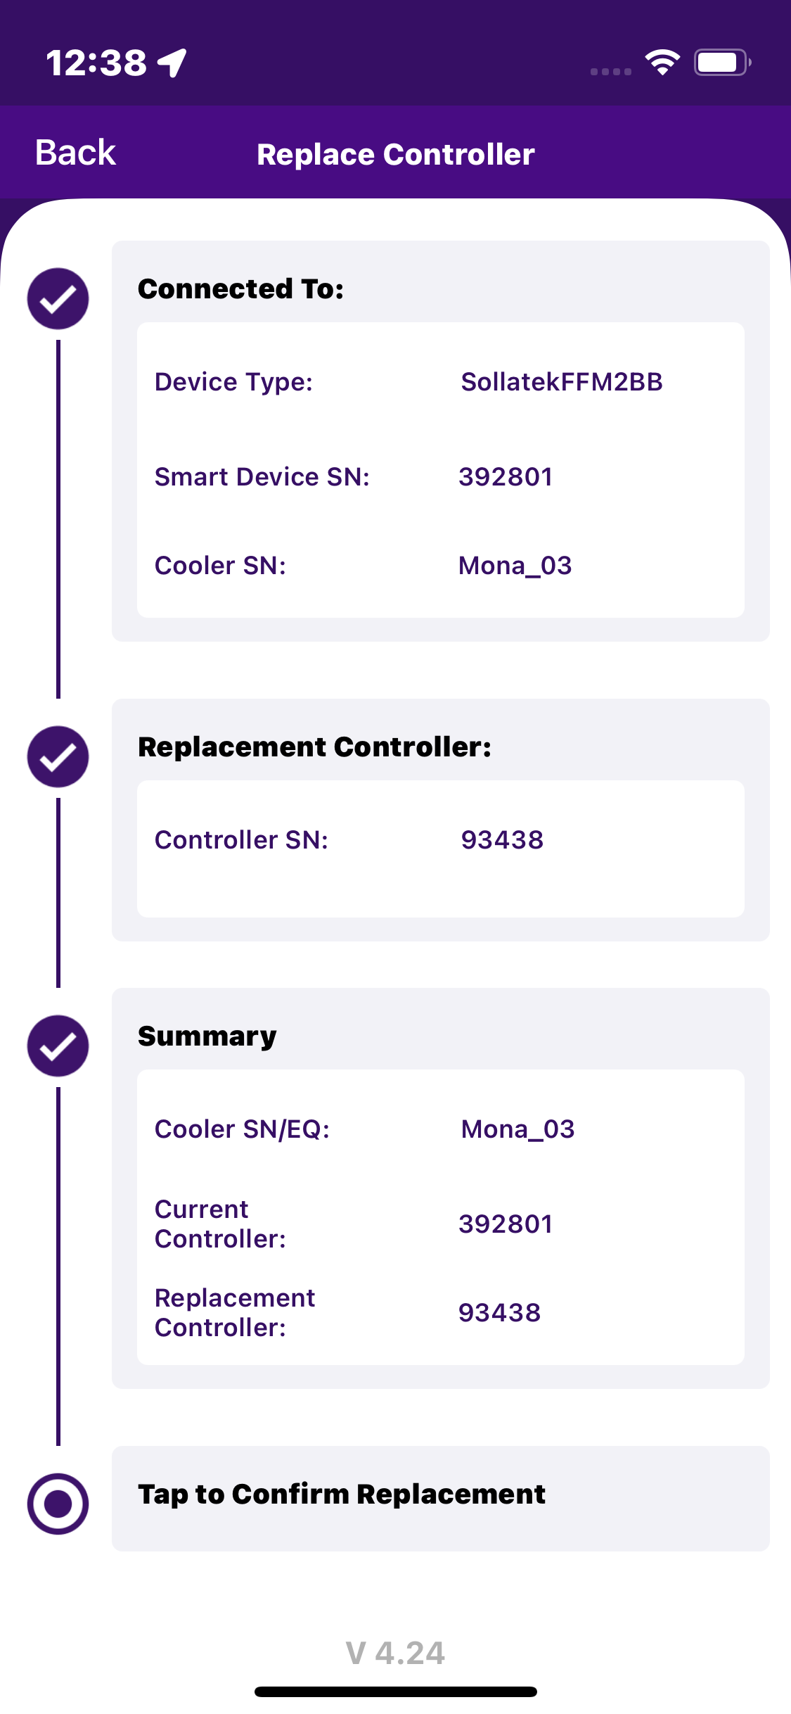
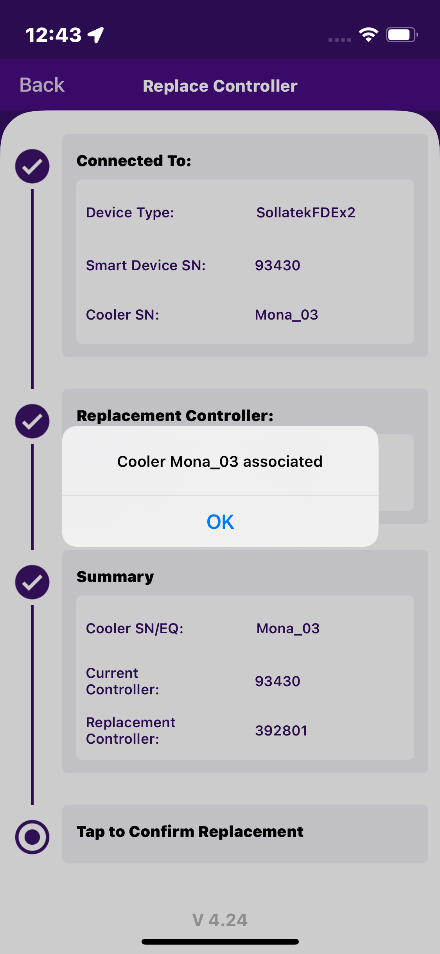
REPLACE CONTROLLER
When the user clicks on “Add/Replace Controller” next pop-up shows “ Add or Replace”, After that When the user clicks on the “Replace” button. Click on “Tap to scan cooler/EQN” scan or enter manually. After that Tap on Replace Controller – which will replace Controller. Check all details to replace the controller seen as “Summary”. The last screen user has seen the pop-up message controller replacement success and shows the message Cooler Associated.
© 2024 Vision Group

Slide 18
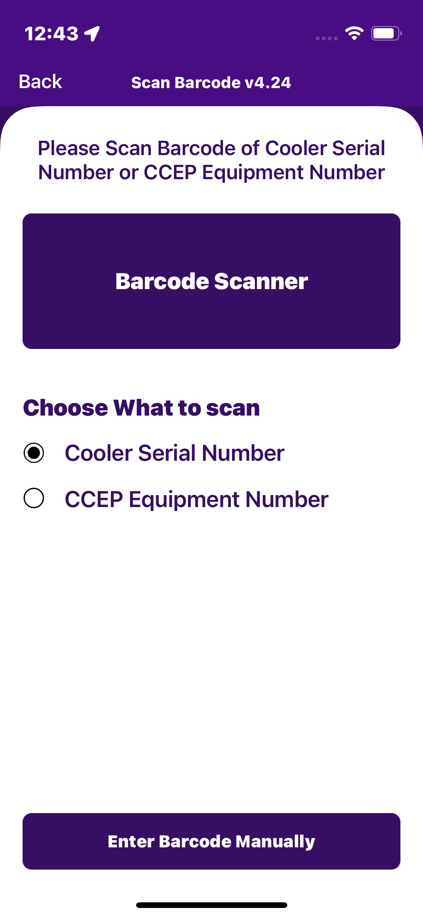
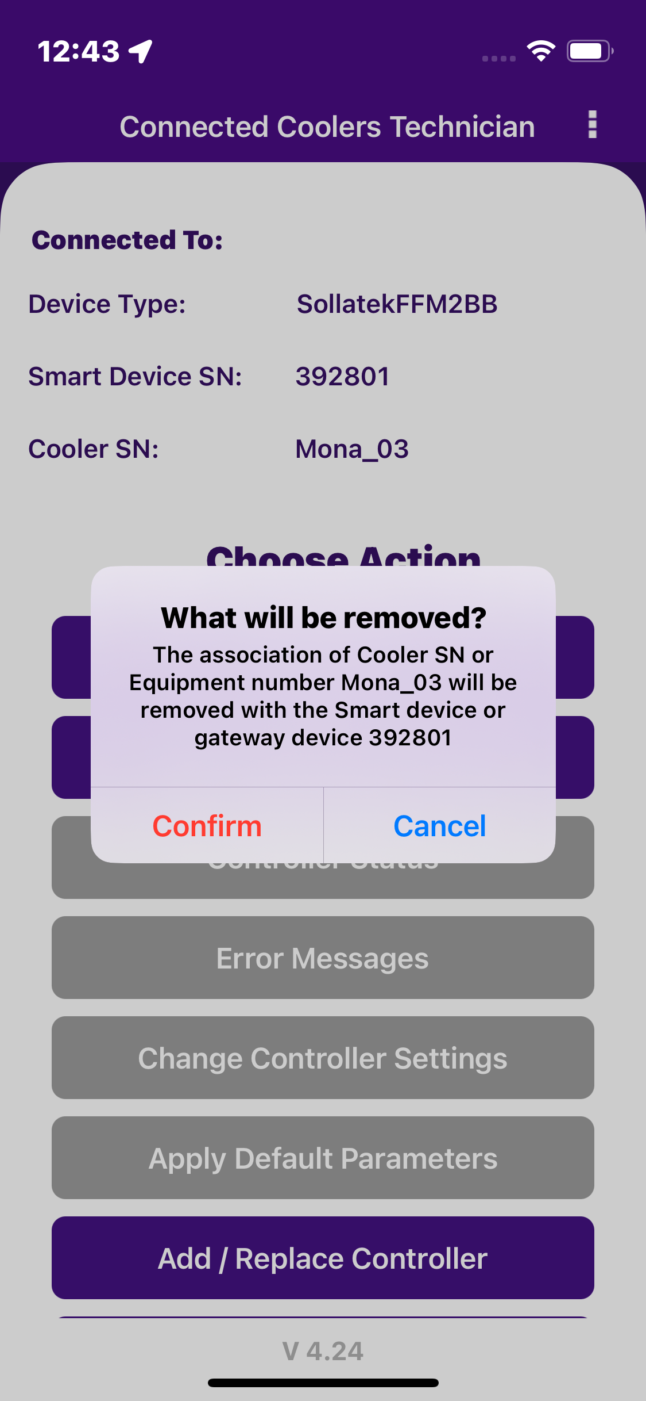
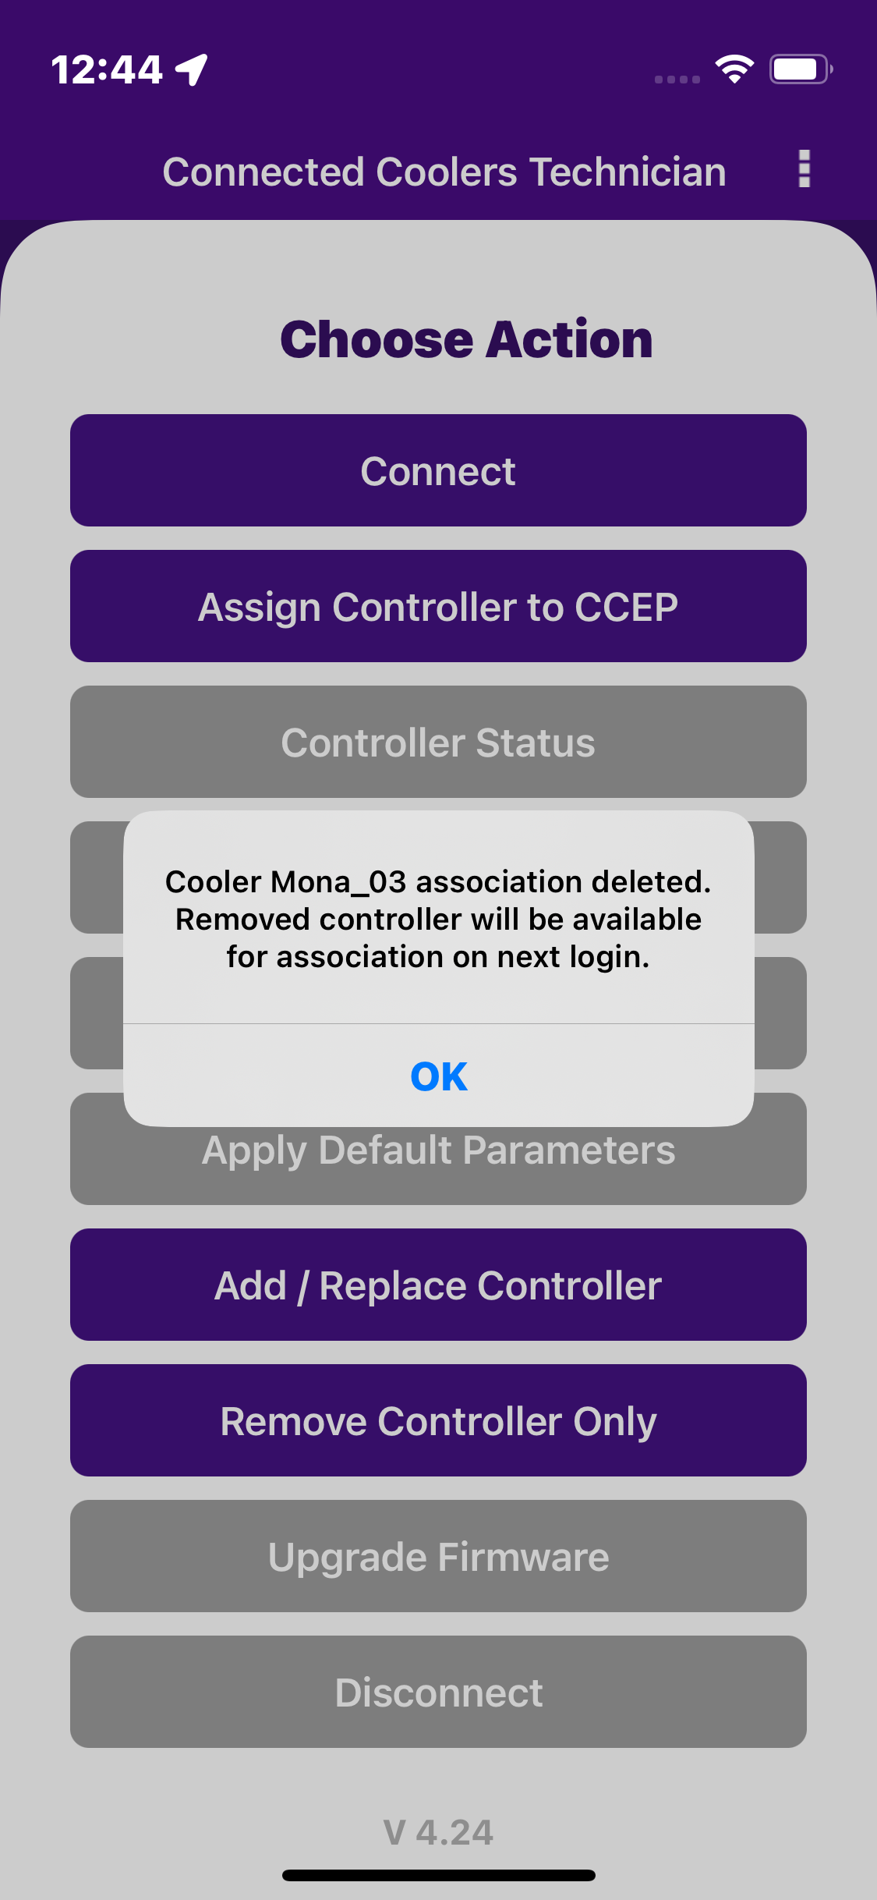
REMOVE CONTROLLER ONLY
After successfully connecting the device, click on the “Remove Controller Only” button. The first step should be to scan the cooler serial number or enter manually cooler serial number to establish the details of the current controller (looked up from the Vision IOT platform based on the cooler that is scanned). Click on the “Remove association” button. The association was removed, and a confirmation Pop-up generated “cooler-association deleted”.
© 2024 Vision Group

Slide 19
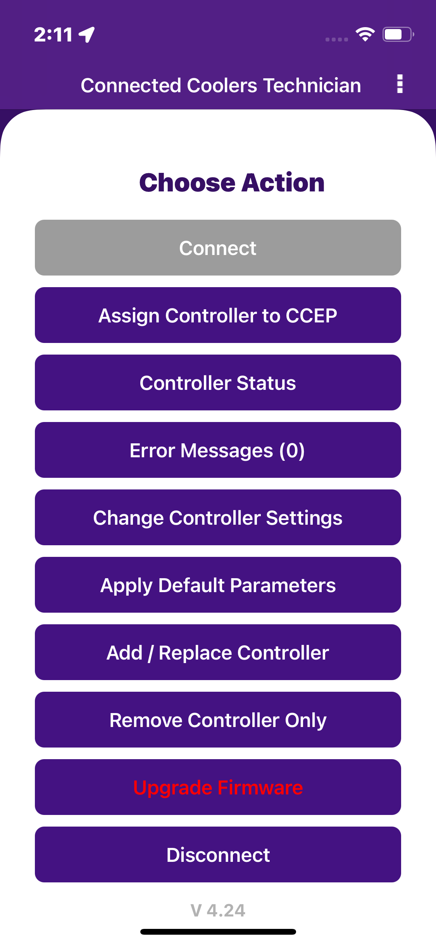
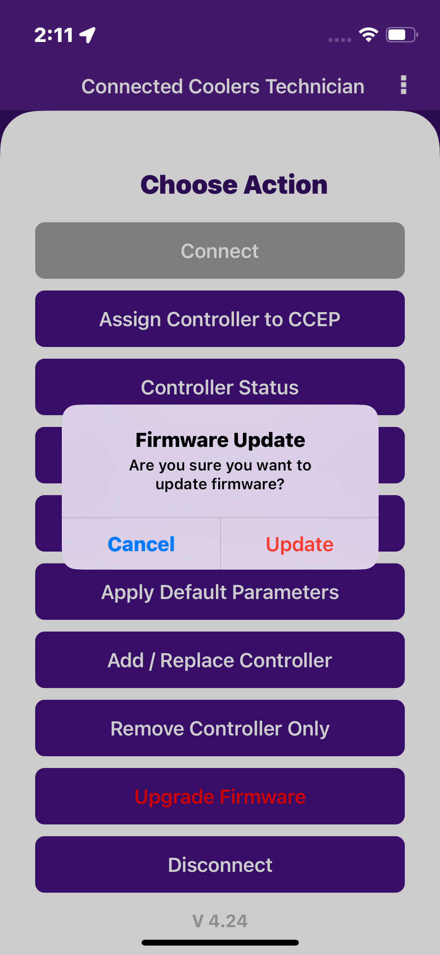
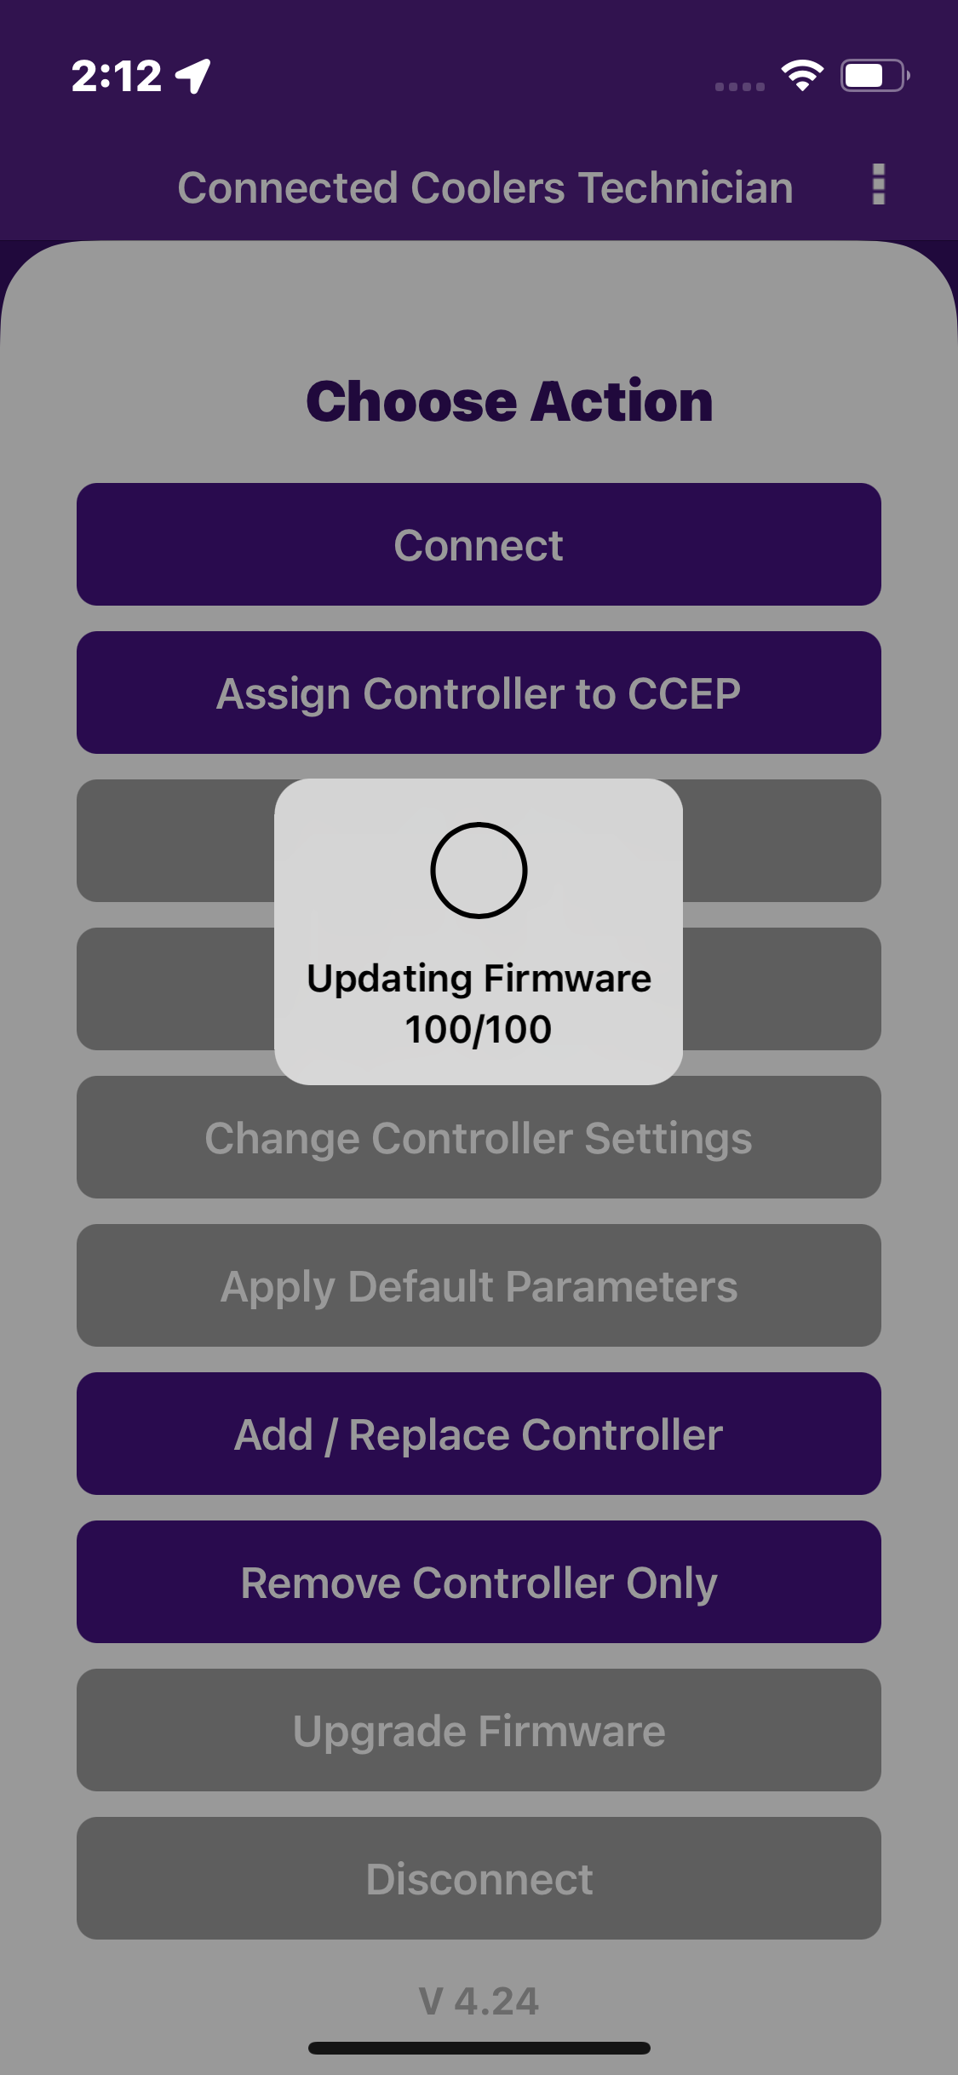
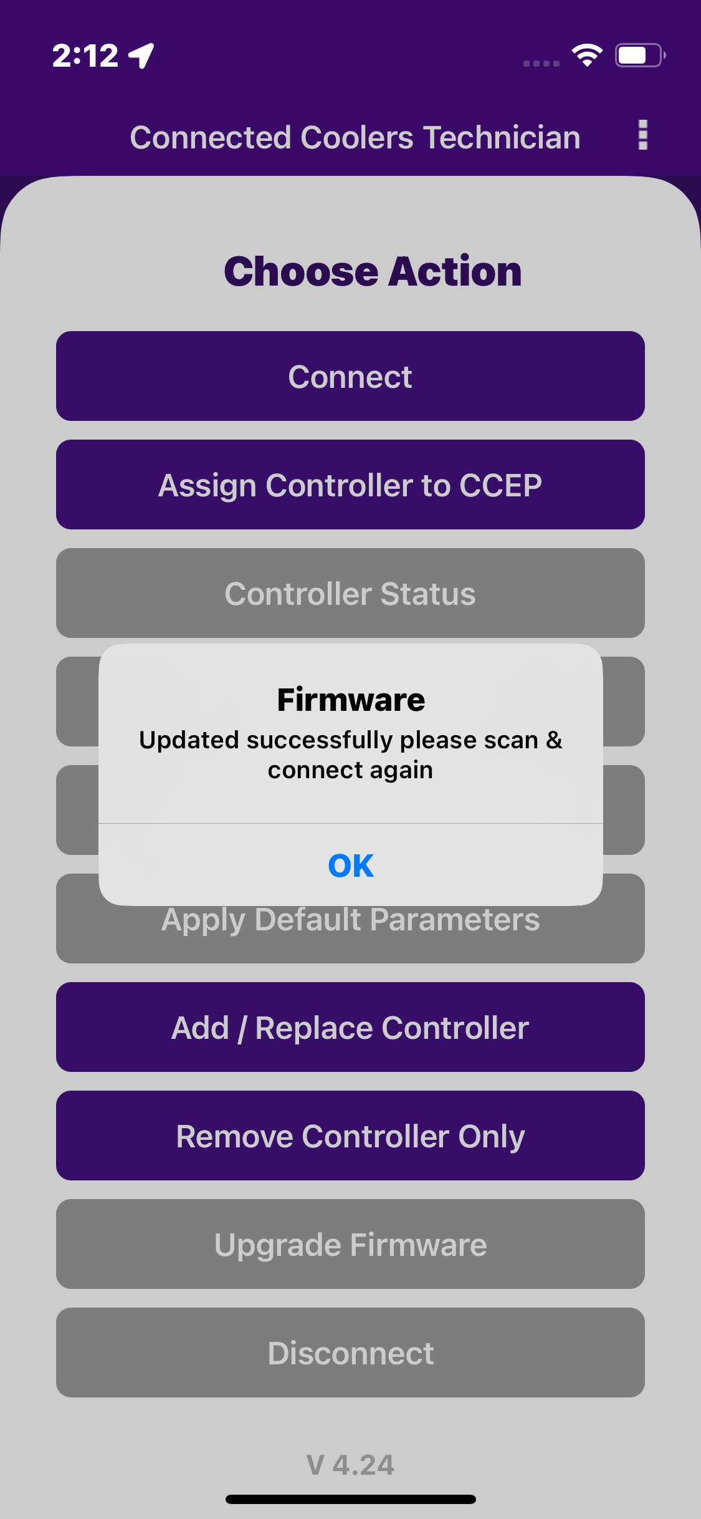
UPGRADE FIRMWARE
If the firmware is already up to date, the button is Disable and click the button one pop-up generated is “The firmware is already up to date”. If new firmware is available, the “Upgrade Firmware” button is highlighted in “red”.
When the user clicks on the “upgrade firmware” button, the latest firmware from the Vision platform should be updated to the cooler. When FW upgrade in progress generated “Updating Firmware". When the firmware upgrade is completed successfully label update Firmware Updated.
© 2024 Vision Group

Slide 20
DISCONNECT
When the user presses the disconnect button, it should disconnect the controller/device from the application.
Application returned to the home page with the default active buttons.
© 2024 Vision Group

Slide 21
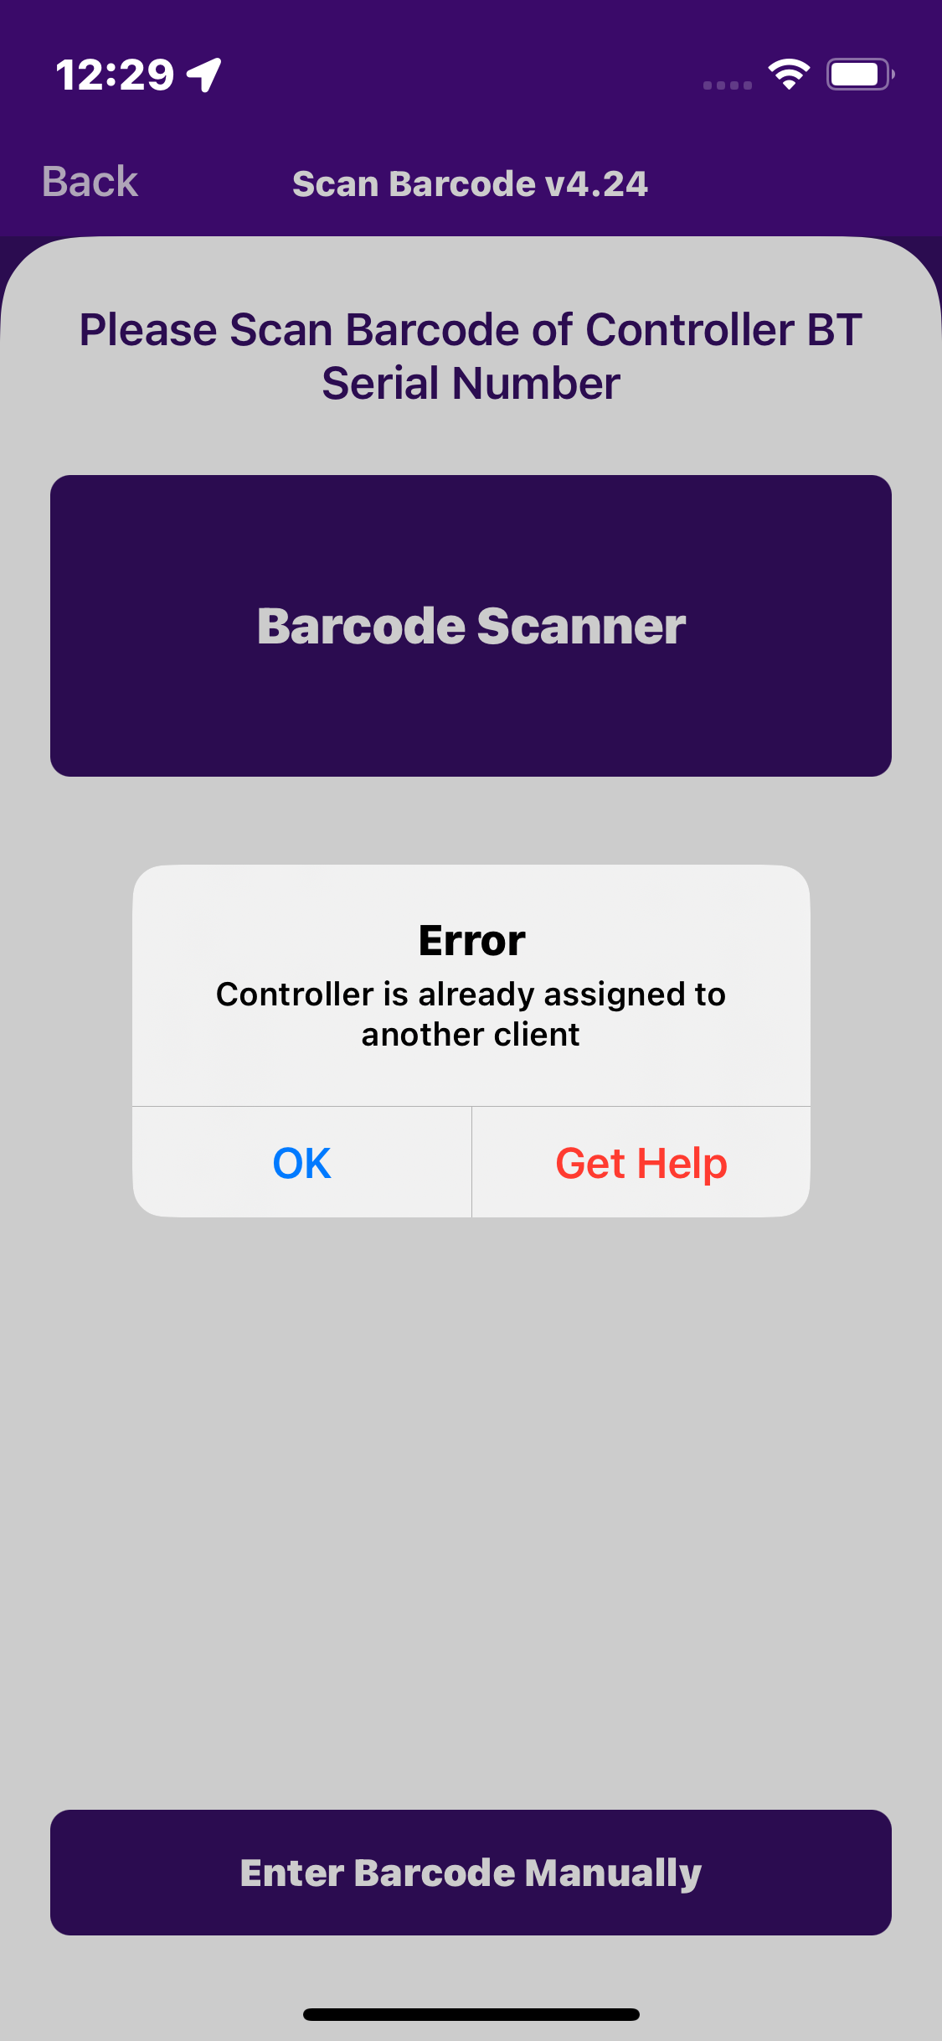
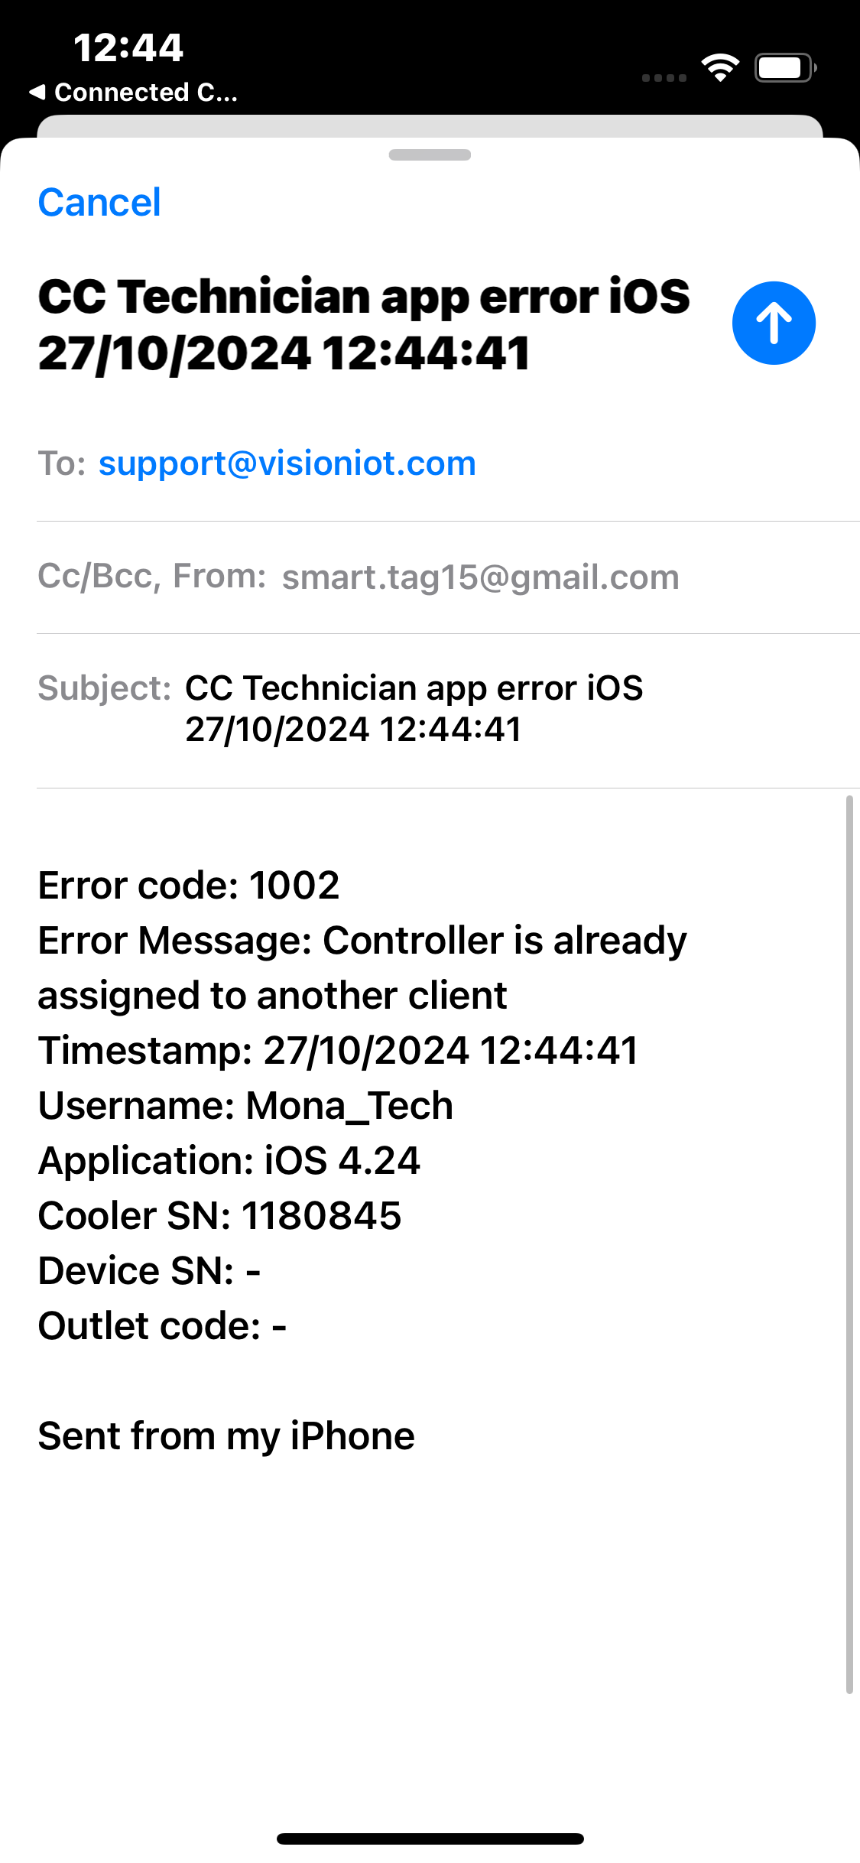
GET HELP FUNCTIONALITY
If a user gets any error in the application, click on the “Get Help” button.
When the user clicks on “Get help” in the application, it will redirect the user to the default email application on the mobile device and generate one email.
If the mail application didn’t log in, then one pop-up generated is “No mail application is available”.
© 2024 Vision Group

Slide 22
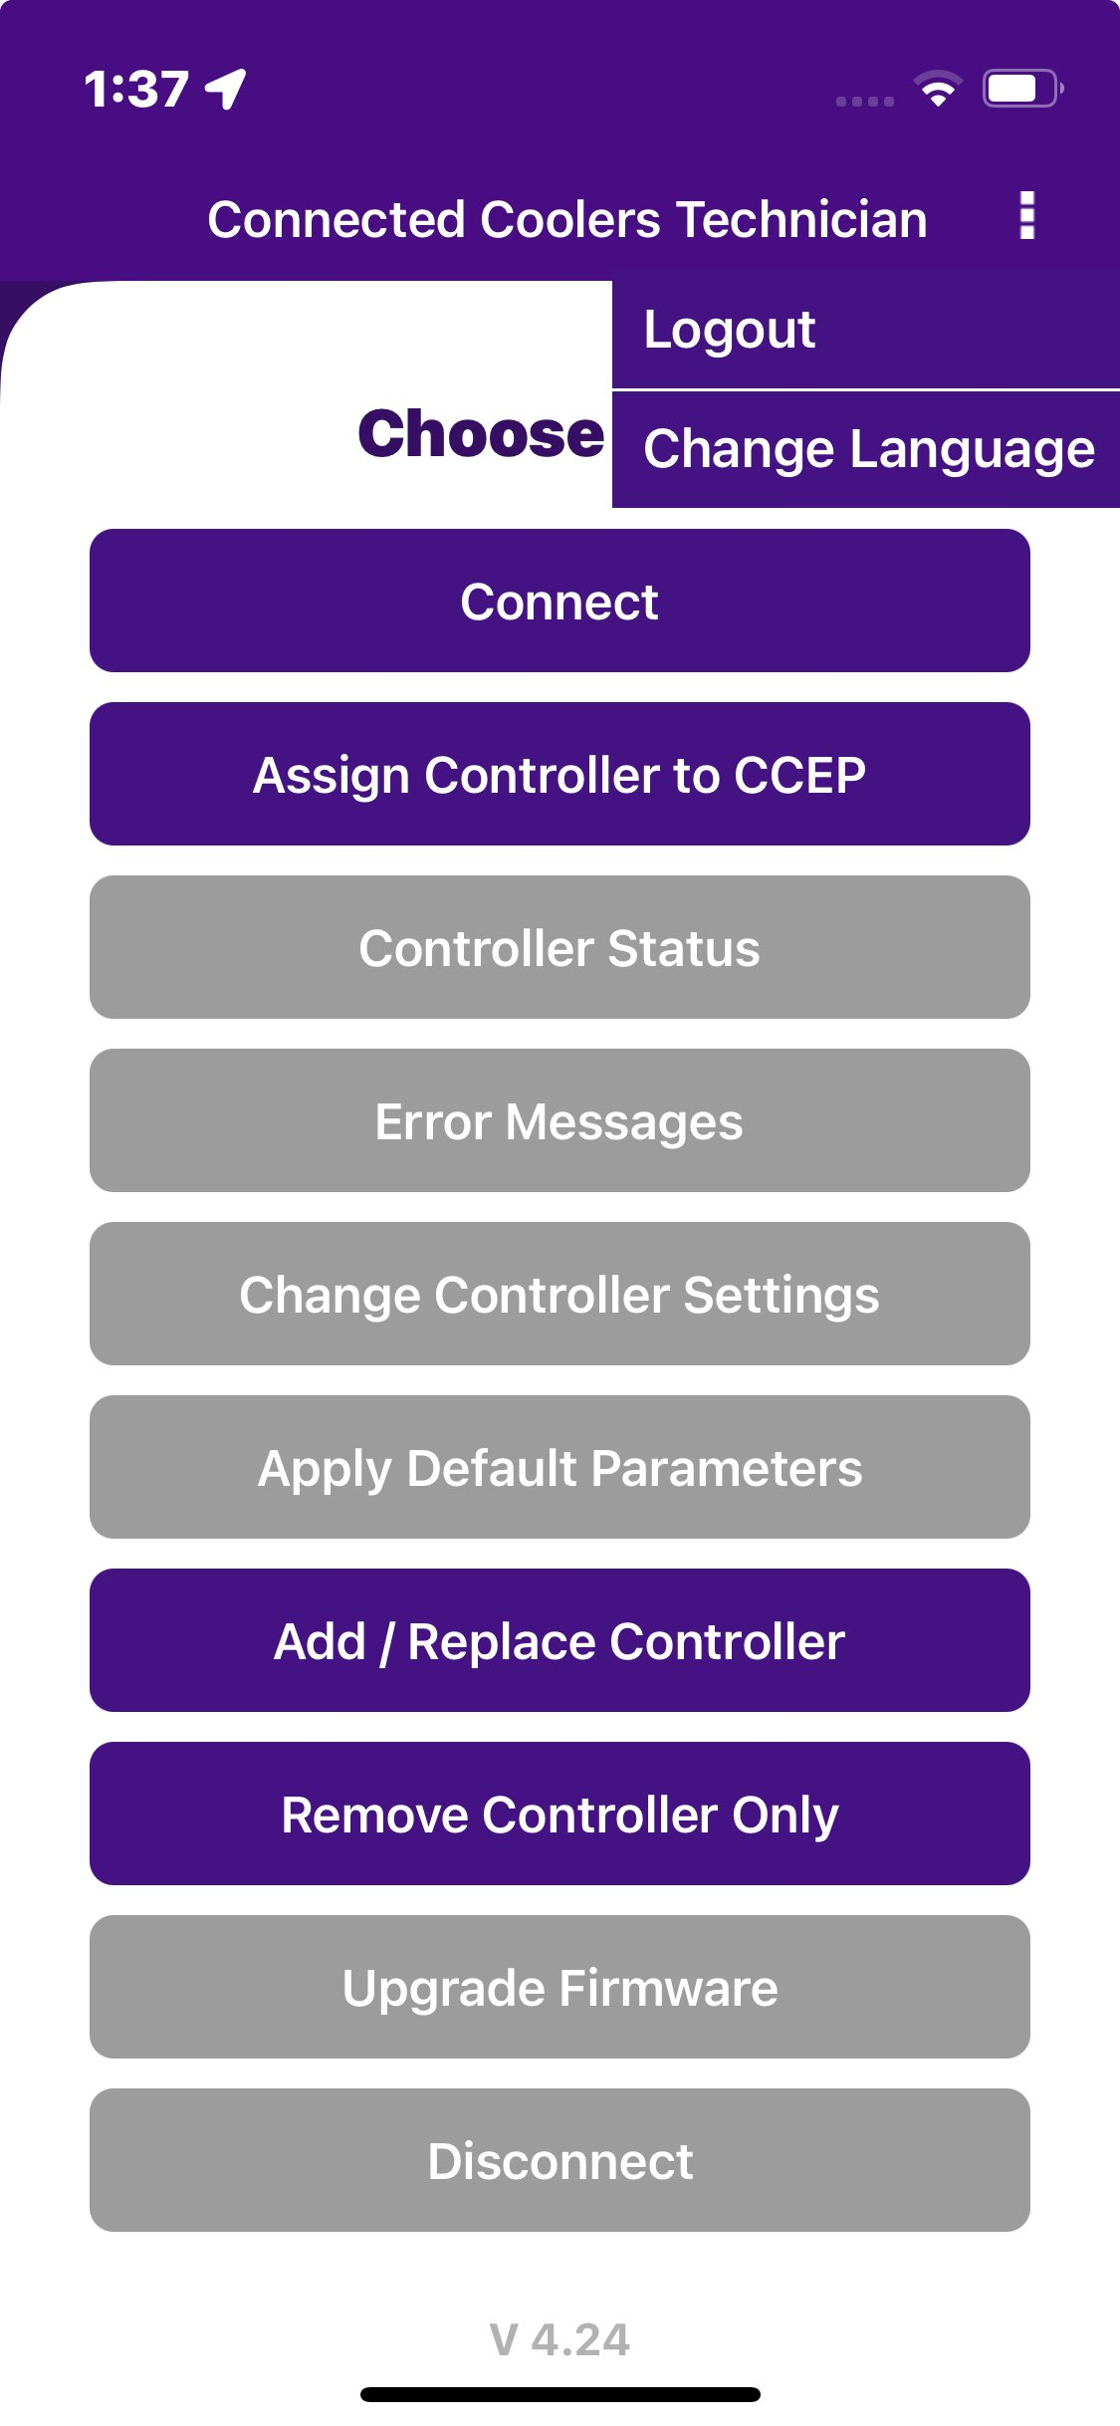
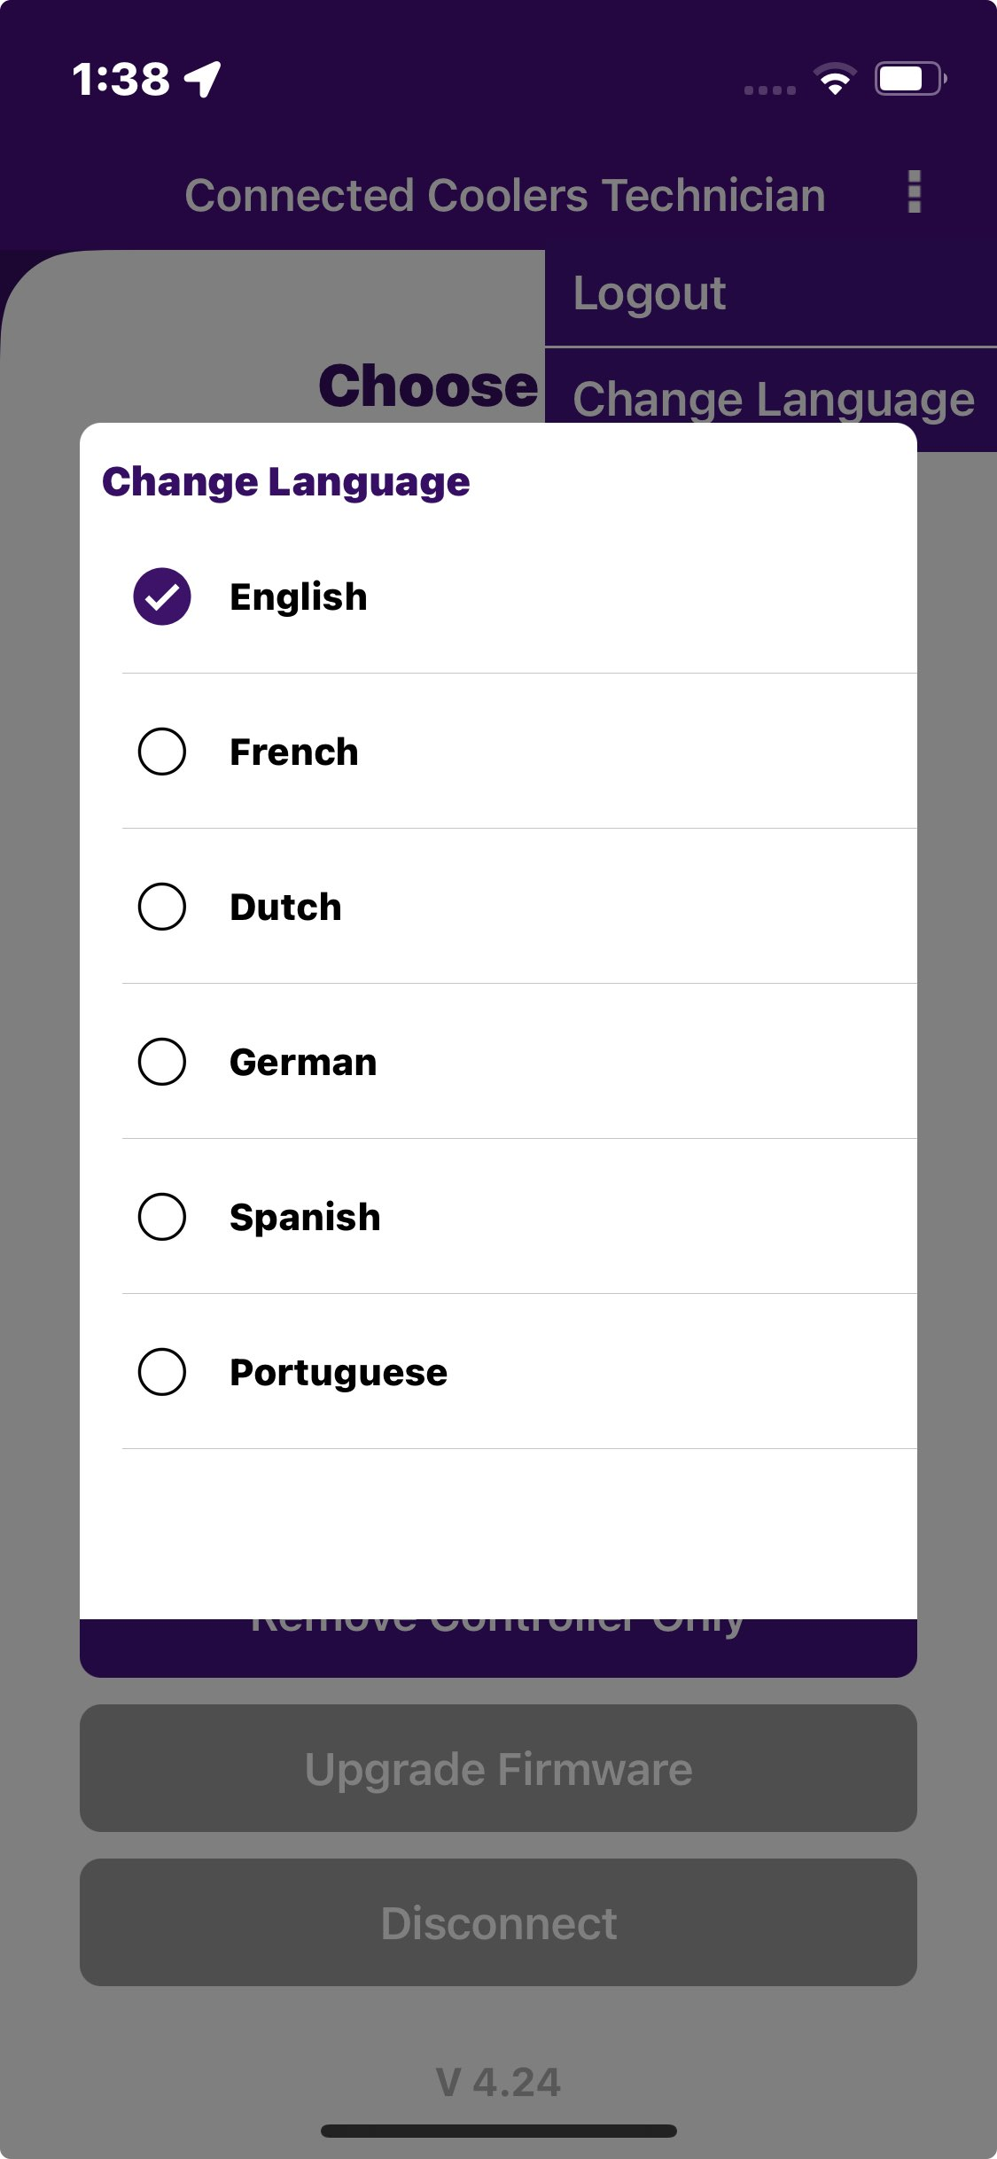
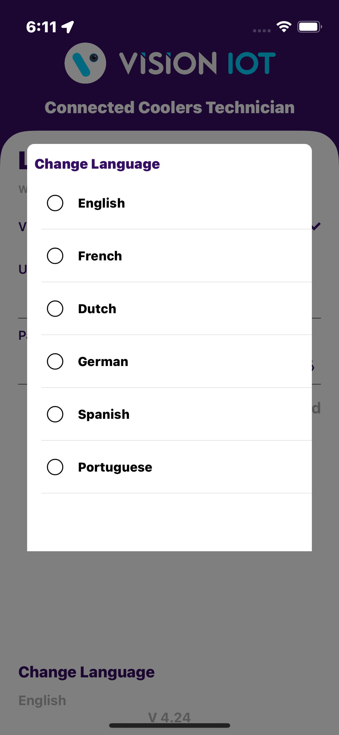
CHANGE LANGUAGE
In this application, the default language of the device is English or allows the user to manually change language [English, Dutch, German, Spanish, Portuguese ] which remains the same in the application.
© 2024 Vision Group

Slide 23
MESSAGES – SCAN COOLER MESSAGES
Detailed Message | MESSAGE CODE | Remark
Cooler SN or Technical ID <Cooler SN> is associated with Gateway <GW SN> | Error 101 | If Cooler is available in the portal and not associated with any smart device but associated with any gateway.
Cooler SN or Technical ID <Cooler SN> is associated with Smart Device <SD SN> | Error 102 | If Cooler is available in the portal and not associated with any gateway but associated with any smart device.
Cooler SN or Technical ID <Cooler SN> is associated with Gateway <GW SN> and Smart Device <SD SN> | Error 103 | If Cooler is available in the portal but associated with Smart Device and the gateway.
Cooler SN or Technical ID <Cooler SN> does not exist in portal | Error 104 | If the cooler does not available in the portal.
© 2024 Vision Group

Slide 24
MESSAGES – SCAN COOLER MESSAGES (Cont’d)
Detailed Message | MESSAGE CODE | Remark
Duplicate Cooler SN on cloud, try with the Technical ID or check with the Support Staff | Error 110 | Duplicate Cooler SN on a cloud, try with the Technical ID or check with the Support Staff
Duplicate Technical ID on cloud, try with the Cooler SN or check with the Support Staff | Error 111 | Duplicate Technical ID on a cloud, try with the Cooler SN or check with the Support Staff
Duplicate Technical ID on system try with the Cooler SN or check with the Support Staff | Error 111 | If Duplicate Technical ID on system, try with the Cooler SN or check with the Support Staff.
Cooler SN or Technical ID <Cooler SN> is on system but not assigned to user client | Error 112 | If the cooler is available in the portal but is not assigned to the user client.
© 2024 Vision Group

Slide 25
MESSAGES – SCAN COOLER MESSAGES (Cont’d)
Detailed Message | MESSAGE CODE | Remark
Controller cooler SN or Technical ID was successfully assigned to CCEP | Error 1000 | If Controller cooler SN or Technical ID was successfully assigned to CCEP.
Controller cooler SN or Technical ID is already assigned to CCEP | Error 1001 | If Controller cooler SN or Technical ID is already assigned to CCEP.
Controller Cooler SN or Technical ID <Cooler SN> is already assigned to another client | Error 1002 | If Controller Cooler SN or Technical ID <Cooler SN> is already assigned to another client
Controller is not available in the system | Error 1003 | If Controller is not available in the system
© 2024 Vision Group

Slide 26


Thank You!
support.iot@visiongroupretail.com
+1-833-593-0144 (USA Tollfree Number)
© 2023 Vision Group

