Slide 1

DASHBOARD
APPLICATION GUIDE
FEB 2024
© 2024 Vision Group

Slide 2

APPLICATION FEATURES
COOLER DETAILS – To view details of the cooler, choose from Details, Graph, and Relogram data.
COOLER SUMMARY – To view a summary of the cooler, including maps, average temperature, average door swing, light on hours, out-of-stock percentage, planogram compliance percentage, purity trend percentage, and fullness trend percentage, access the graphical dashboard view for scanning.
SCREEN vs DEVICE TYPE |  | PENCIL SMART VISION | SMART TAG AON
SUMMARY | OUTLET MAP | ✓ | ✓
 | AVERAGE TEMPERATURE | ✓ | ✓
 | LIGH ON HOURS % | ✓ | ✓
 | AVERAGE DOOR SWING | ✓ | ✓
 | OUT OF STOCK % | ✓ | ⮾
 | PLANOGRAM COMPLIANCE % | ✓ | ⮾
 | PURITY TREND % | ✓ | ⮾
 | FULLNESS TREND % | ✓ | ⮾
DETAILS | DETAILS | ✓ | ⮾
 | GRAPH | ✓ | ✓
 | RELOGRAM | ✓ | ⮾
© 2023 Vision Group

Slide 3
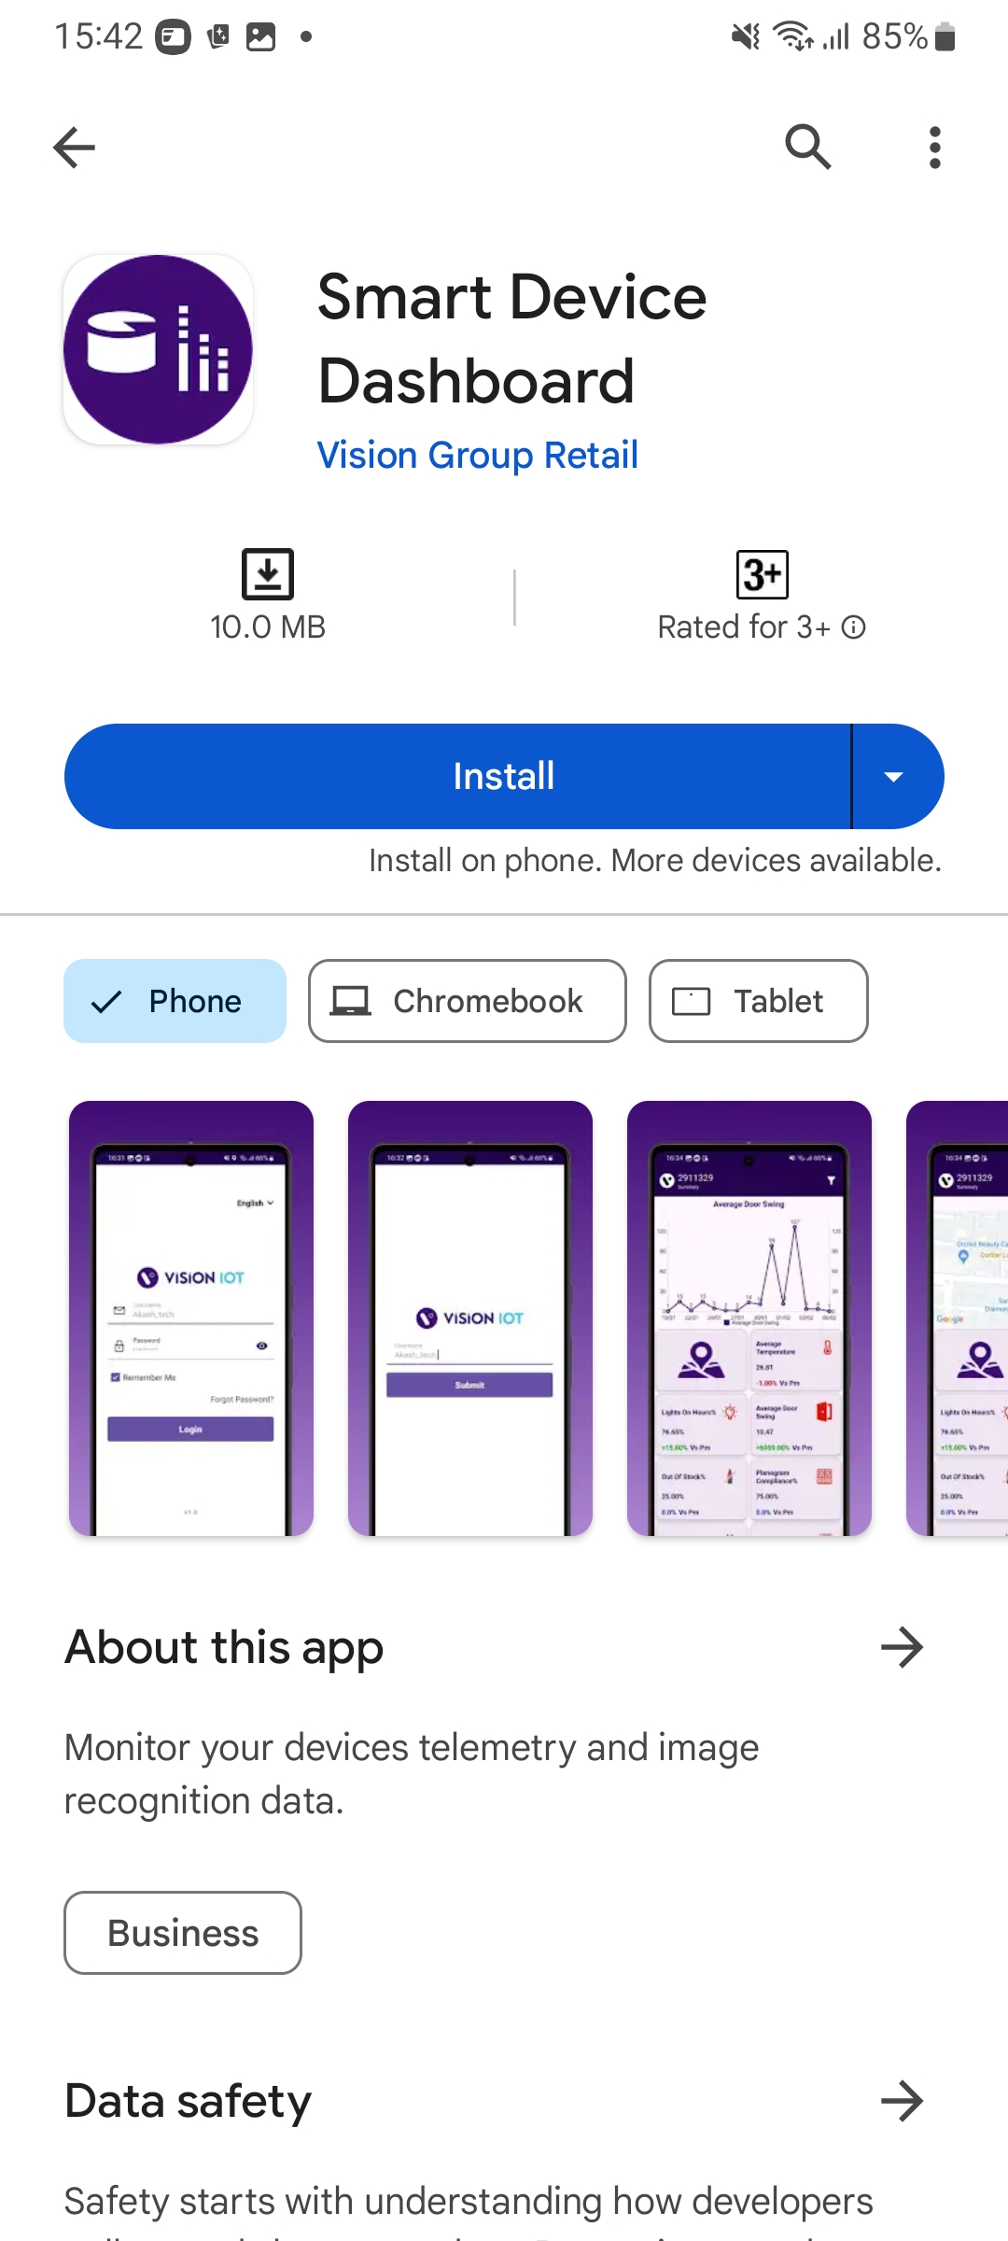
APPLICATION INSTALLATION
Install the “DASHBOARD” application from the Play Store.
URL: https://play.google.com/store/apps/details?id=com.visioniot.dashboardapp
The Dashboard application is compatible only with Smartphones having Android V9.0 and above.
Open VISION IOT’s Dashboard Application.
Log in to the application using the credentials provided by your administrator.
Suggested Note: Before installing every new version, Logout and delete the previous version.
Note: Please ensure Bluetooth, mobile Wi-Fi, or Mobile Data are ON in the device.
© 2023 Vision Group

Slide 4
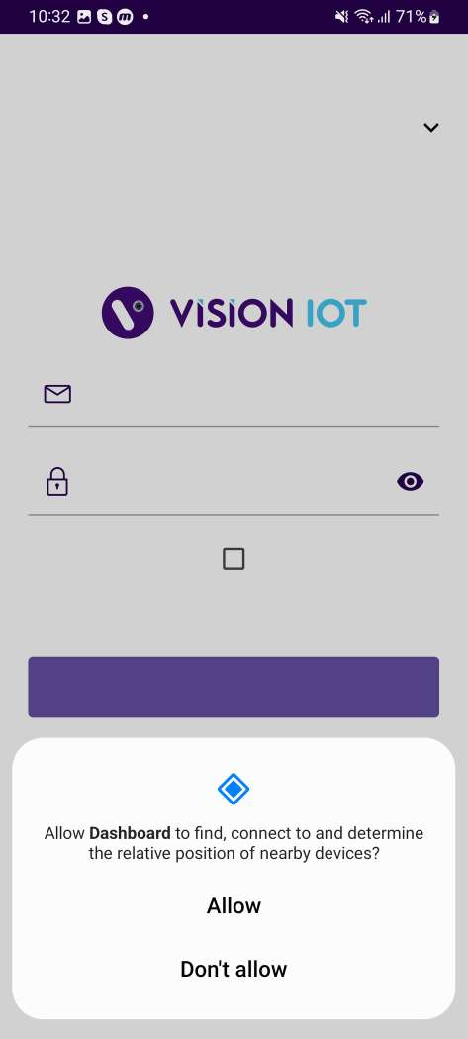
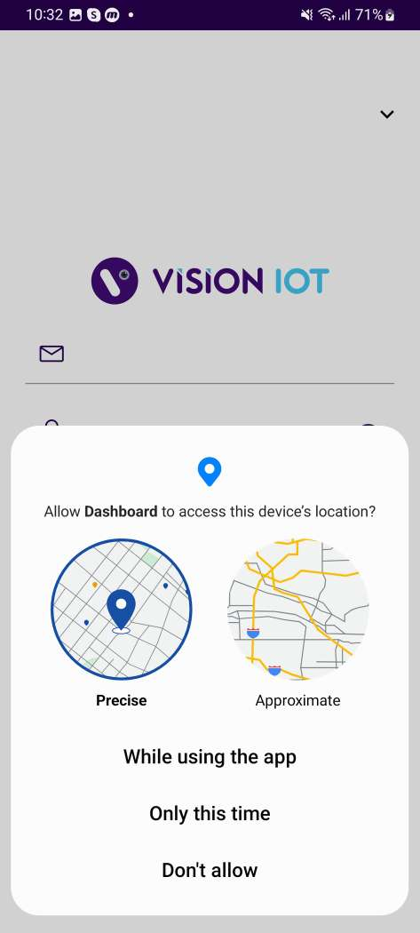
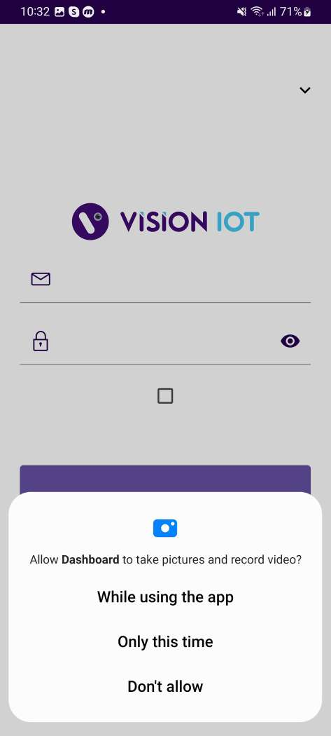
APPLICATION PERMISSION
Upon installation, the Application will request permission to access the camera, Near By and location.
Choose Server: The application will work with the Vision IOT server by default.
PERMISSIONS
For Location (so beacons can be found) - Choose Allow While Using App on as per Handset OS.
Then Go to the Phone Settings > App Permissions > Location > Allow Location Access option is “Always”.
© 2023 Vision Group

Slide 5

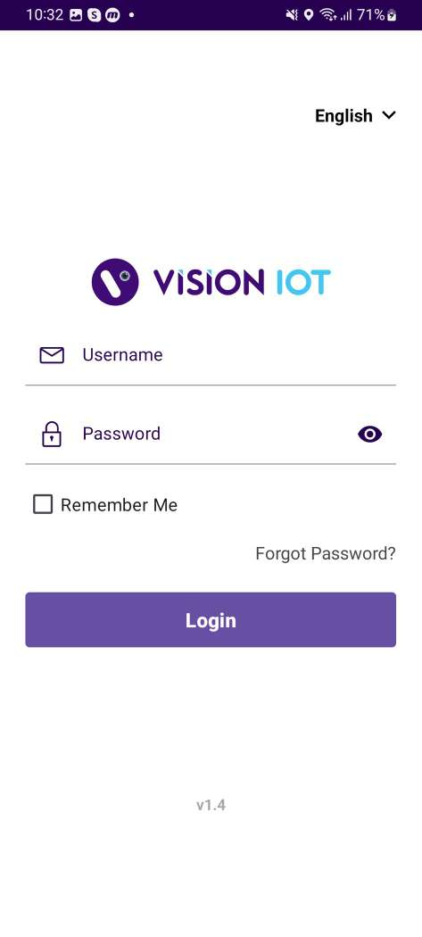
LOGIN
After installing the Dashboard Application, open it and the user will be redirected to the Login Page. Follow the login instructions in the above slide to log in for respective servers with valid credentials.
Please ensure that Bluetooth is turned on and that location services are enabled.
To log in, the application needs an active internet connection.
Devices must have at least 4GB of RAM and Bluetooth version 4.2 or higher.
The minimum required operating system version is 9.0 or above.
© 2023 Vision Group

Slide 6
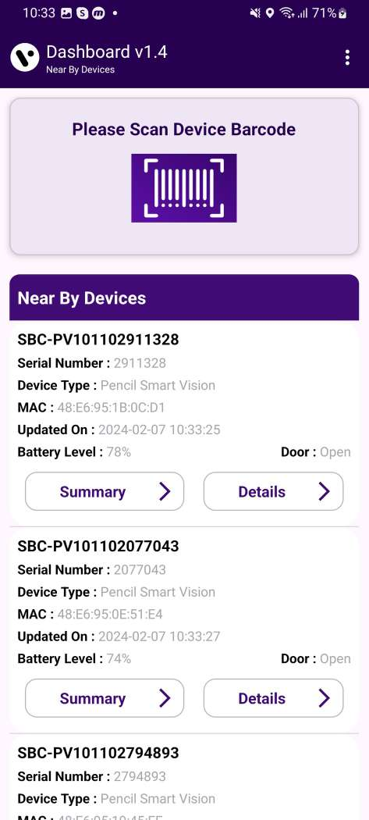
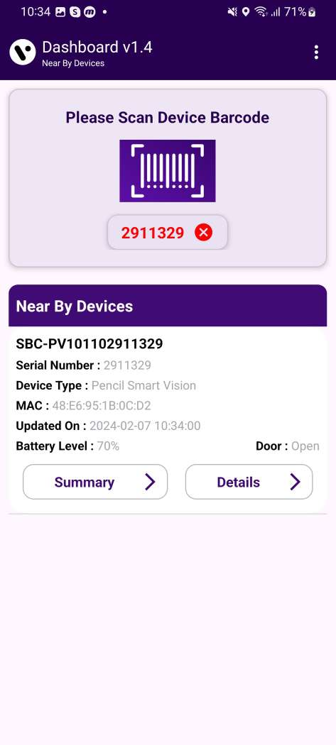
HOME SCREEN
After successfully logging in, nearby Devices Smart Tag AON and Pencil Smart Vision are visible on the screen. Users can Scan the Smart Device barcode using a barcode scanner.
© 2023 Vision Group

Slide 7
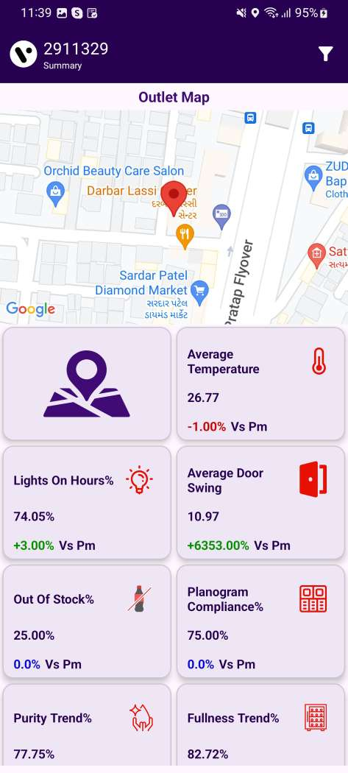
SUMMARY SCREEN
After successfully logging in, nearby Devices Smart Tag AON and Pencil Smart Vision are visible on the screen. Users can Scan the Smart Device barcode using a barcode scanner.
For the executive summary page, The following data will use the Latest Asset Purity Data for calculation:-
Fullness %
Planogram Compliance %
Out of Stock %
Purity%
© 2023 Vision Group

Slide 8
SUMMARY SCREEN – Insight
OUTLET MAP
AVERAGE TEMPERATURE
LIGHT ON HOURS
AVERAGE DOOR SWING
© 2023 Vision Group

Slide 9
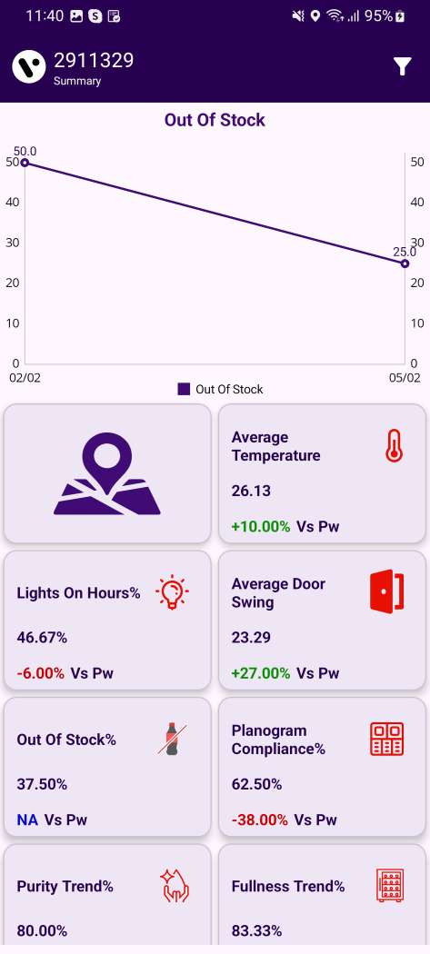
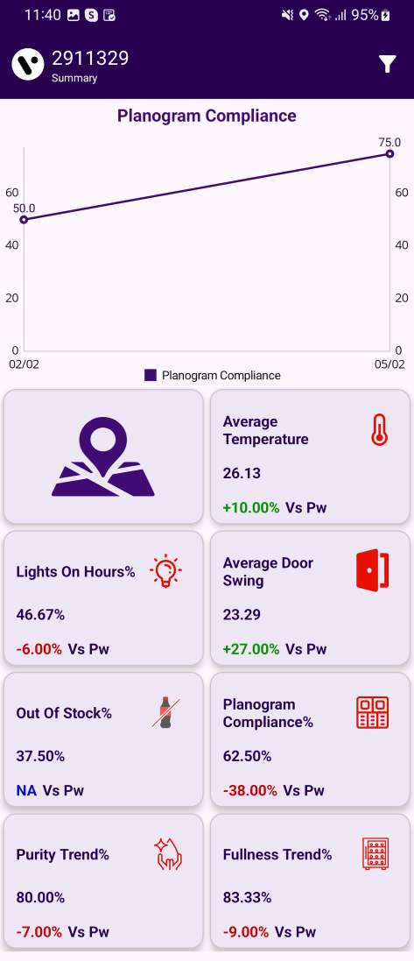
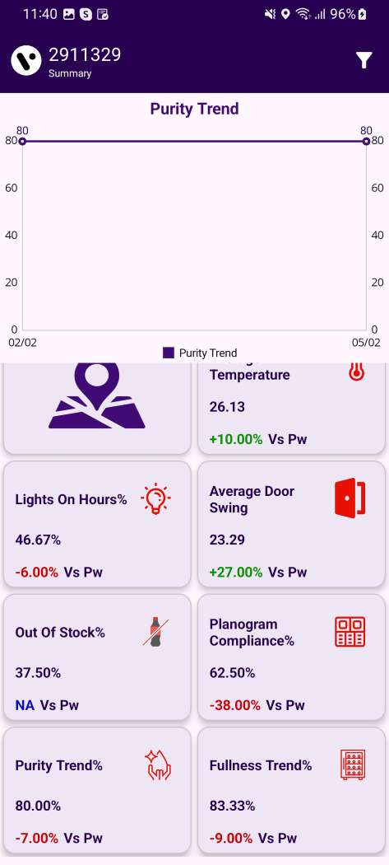

SUMMARY SCREEN – Insight
OUT OF STOCK
PALNOGRAM COMLIANCE
PURITY TREND
FULLNESS TREND
© 2023 Vision Group

Slide 10
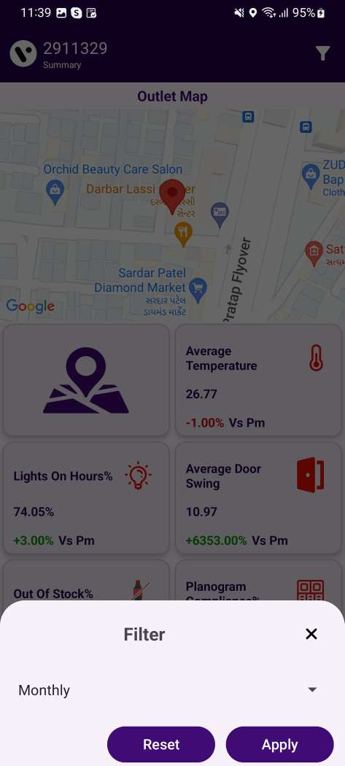
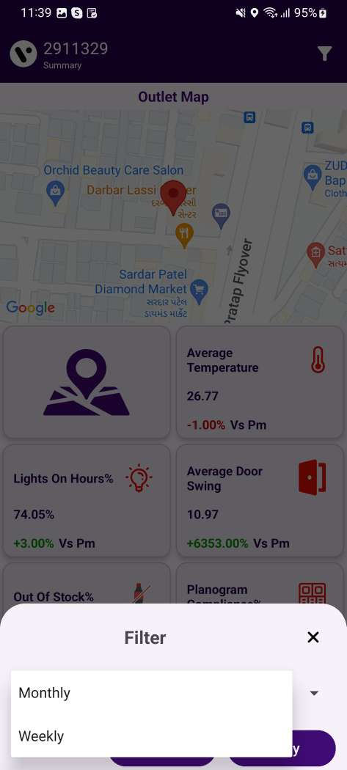
SUMMARY SCREEN – DAYS FILTER
Users can filter the summary screen by week or month.
© 2023 Vision Group

Slide 11
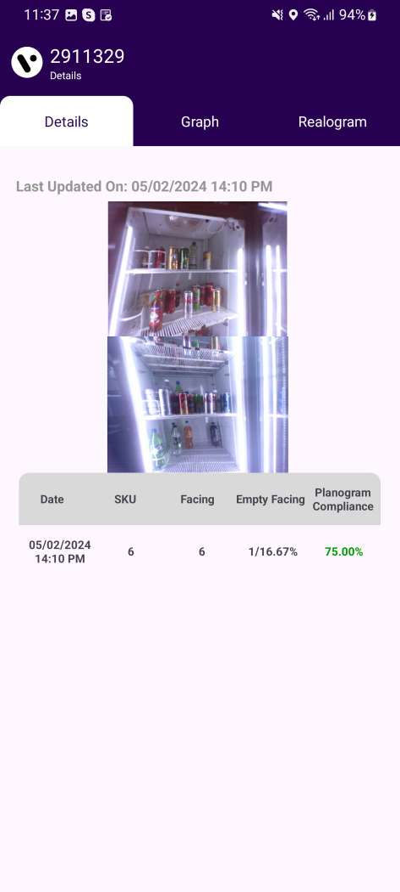
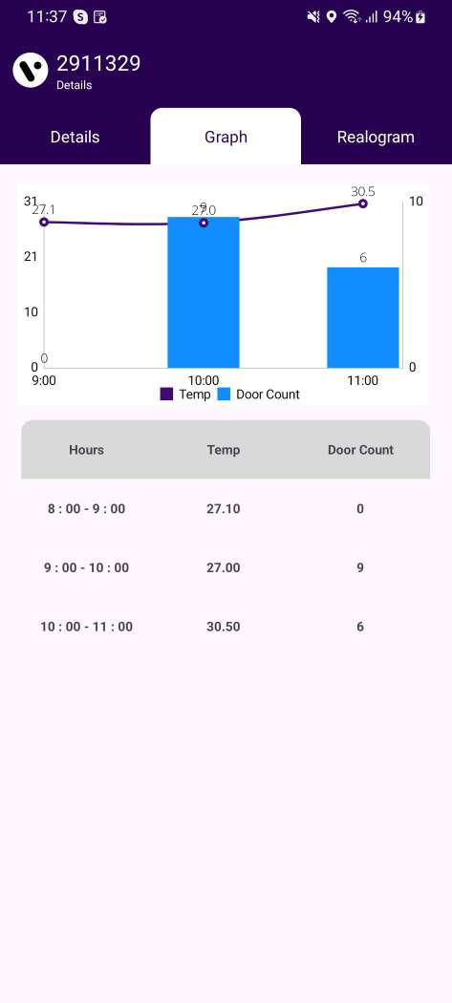
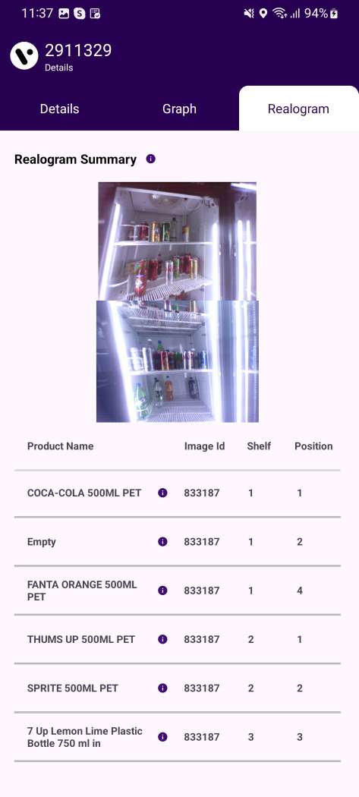
DETAILS SCREEN
In the dashboard application for Pencil Smart Vision, the Details Screen displays information in Detail, Graph, and Relogram Tabs. However, for the Smart Tag AON device, only the Graph Tab is visible.
© 2023 Vision Group

Slide 12
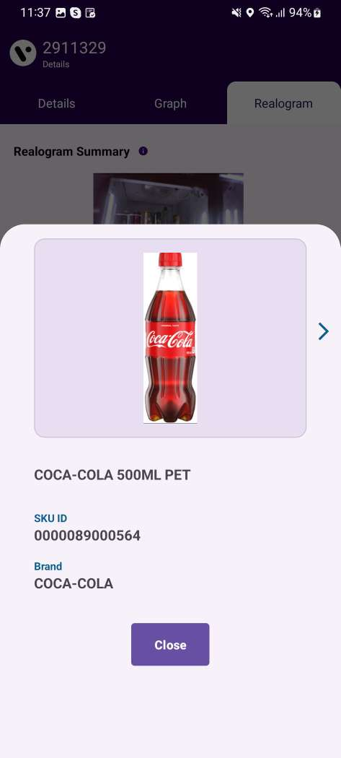
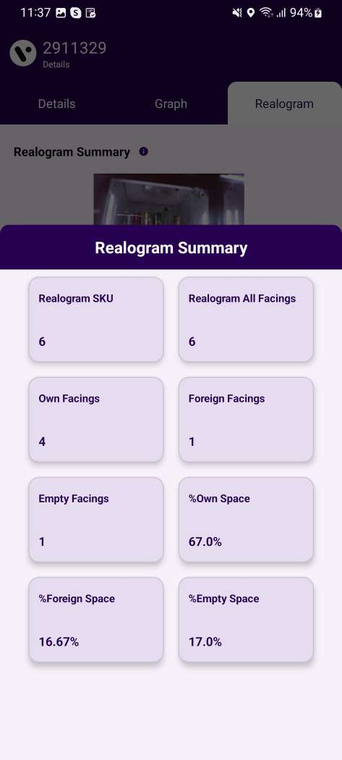
RELOGRAM SUMMARY
By tapping the "i" button on the Product Name, the Product Details can be viewed. The same applies to the Relogram summary for the Last Image.
© 2023 Vision Group

Slide 13
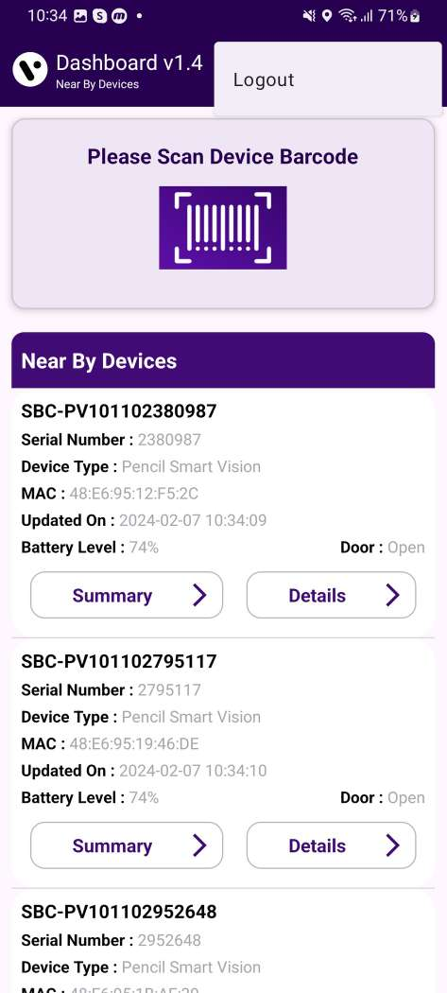
LOGOUT
User can log out of the application by selecting the "Logout" button from the menu located on the upper-right corner.
© 2023 Vision Group

Slide 14
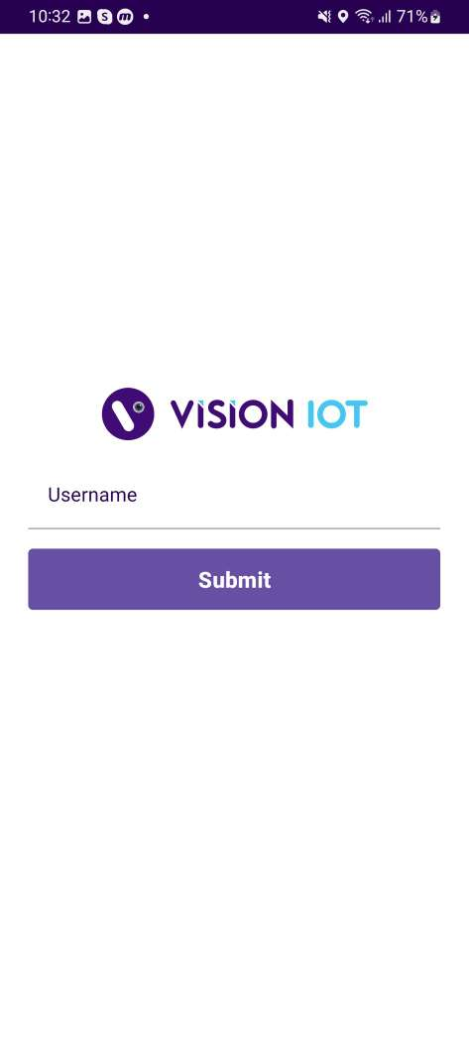
FORGOT PASSWORD
To reset your password for a server, please enter the username.
© 2023 Vision Group

Slide 15
Thank You!
© 2023 Vision Group

