Slide 1

Field Technician APP Guide
User Manual
May 2023
© 2023 Vision Group

Slide 2
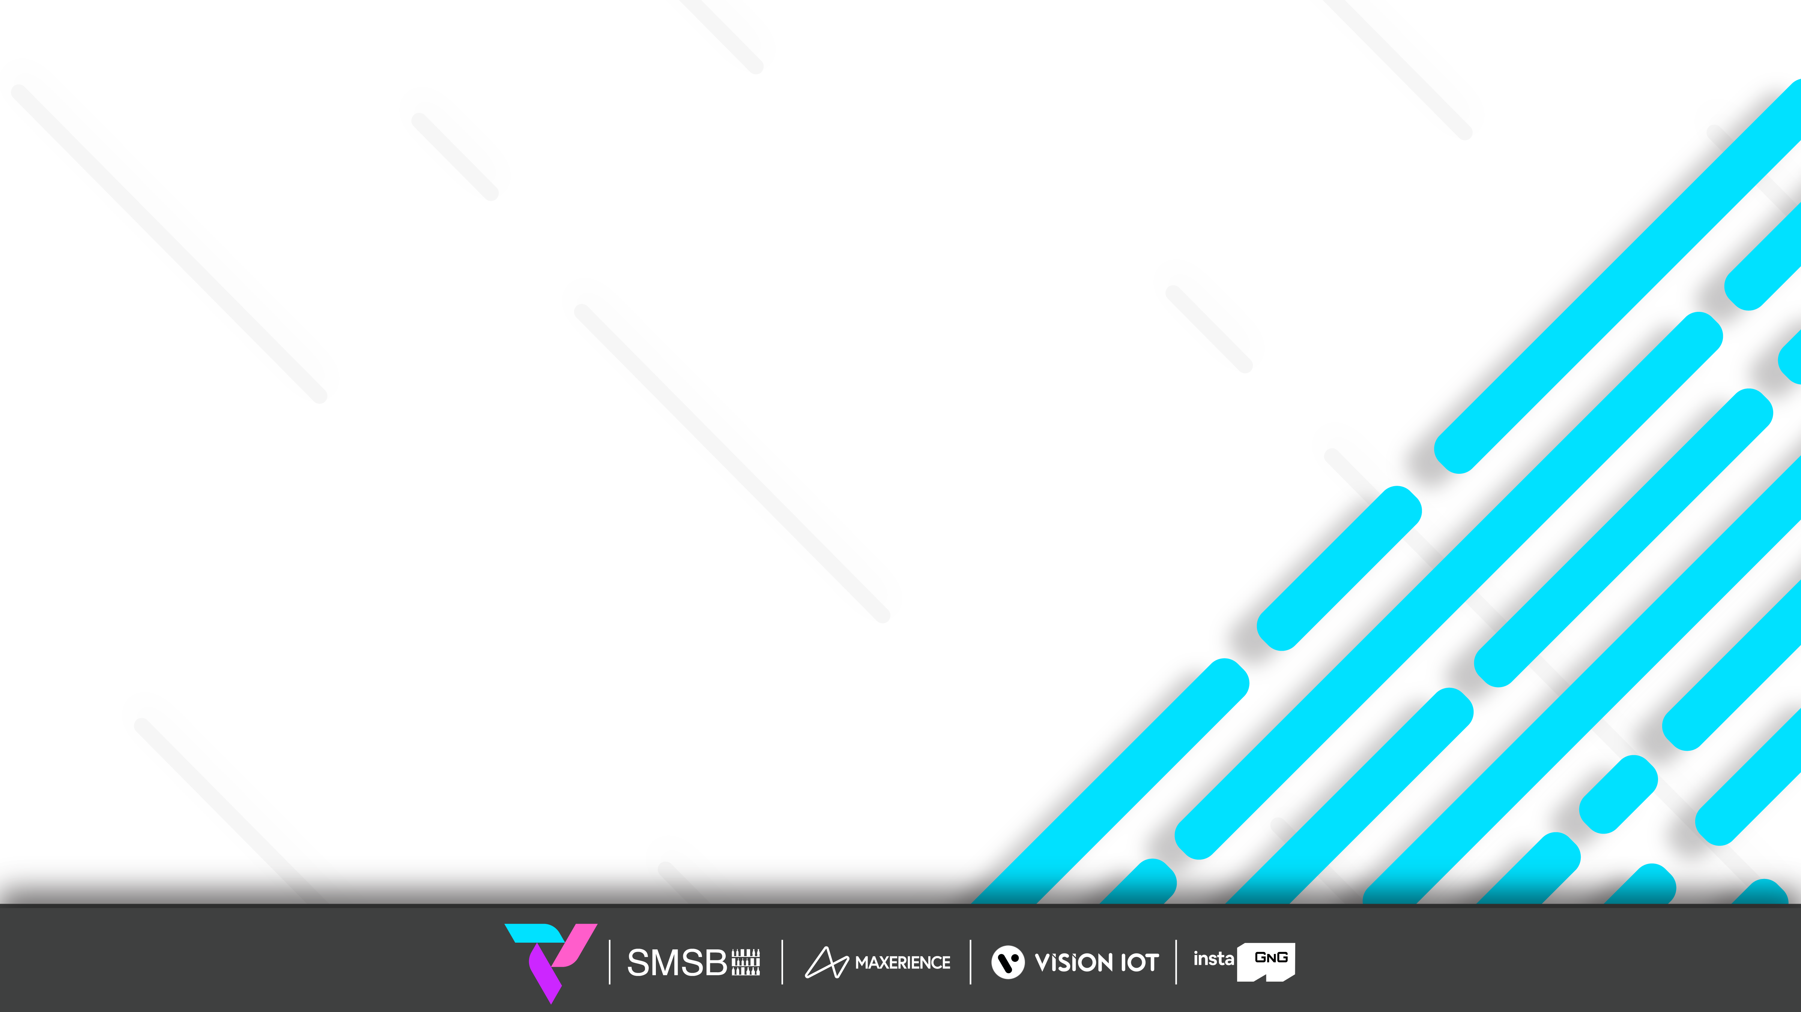
Features
Connect – Connect to the Associated Device
Controller status – Checks the Gateway device’s Last cellular status.
Error Messages – Shows Error messages generated by Controller.
Change Controller Settings – Supports in changing controller settings.
Add/Replace Controller – Add or replace controller for the available asset.
Remove Controller only – Remove Association of Controller with Asset.
Upgrade Firmware – Update firmware of Controller, if available.
Disconnect – Option to disconnect from the device.
© 2023 Vision Group

Slide 3
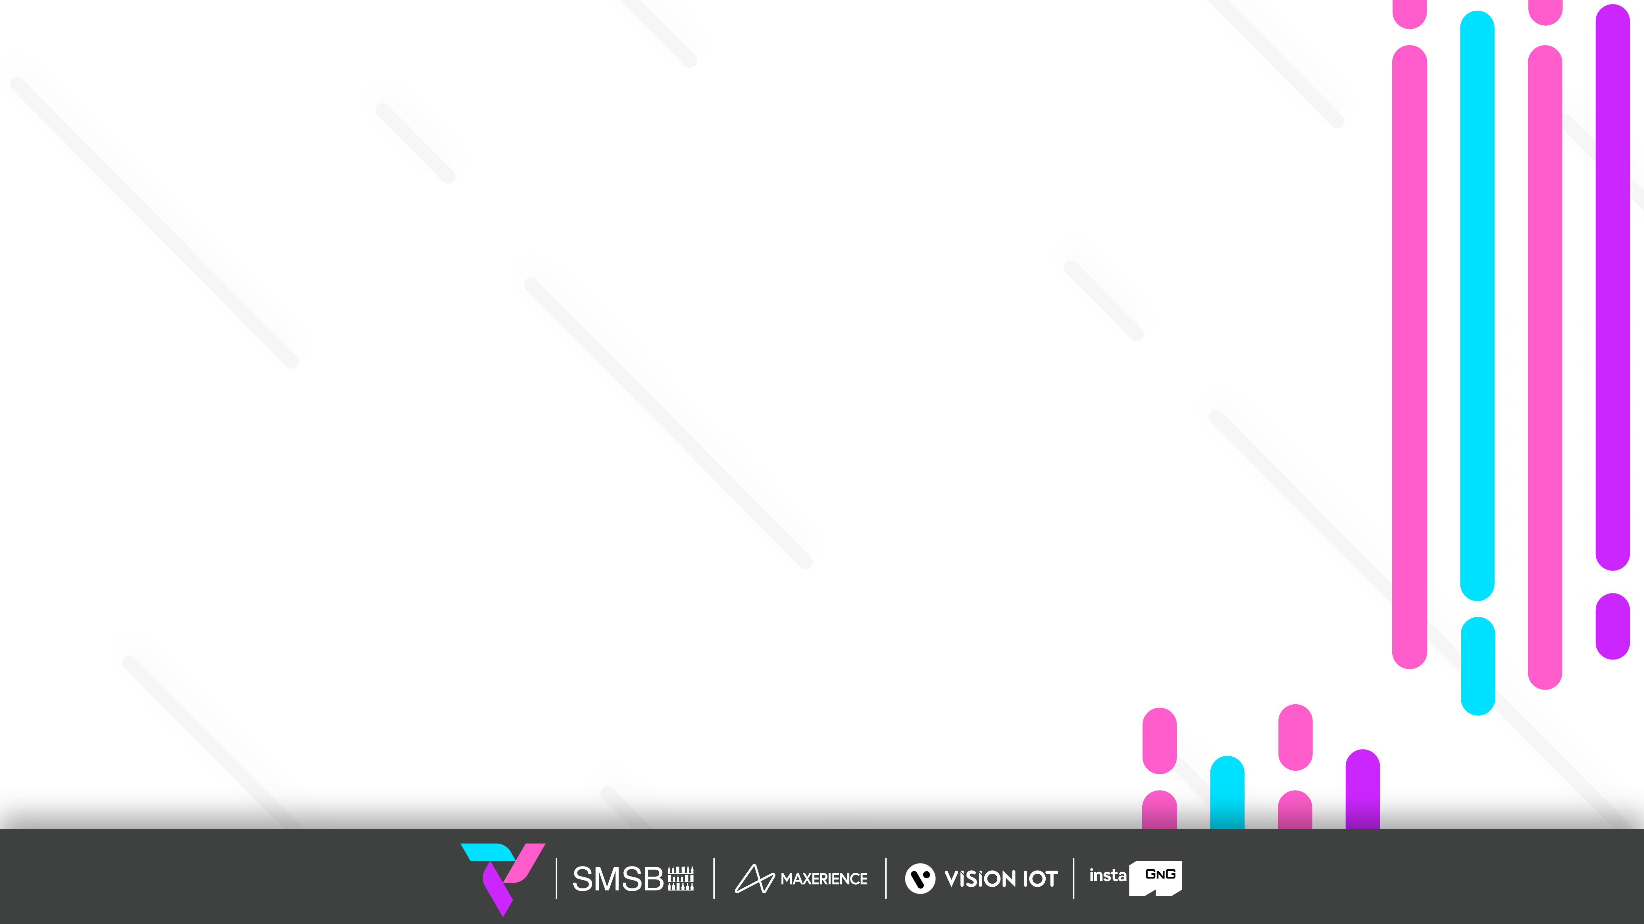
SYSTEM REQUIREMENT
Device | Android | iOS
Operating System | V8 or above | V13.0 & above. iPhone 8 & above.
Processor (CPU) | Min. quad-core processor | -
Camera | Min 5 MP with Autofocus and Flashlight | Min 5 MP with Autofocus and Flashlight
RAM | Min 4 GB | Min 4 GB
Bluetooth | BLE 4.2 and Above | BLE 4.2 and Above
Minimum free space | 4 GB | 4 GB
© 2023 Vision Group

Slide 4
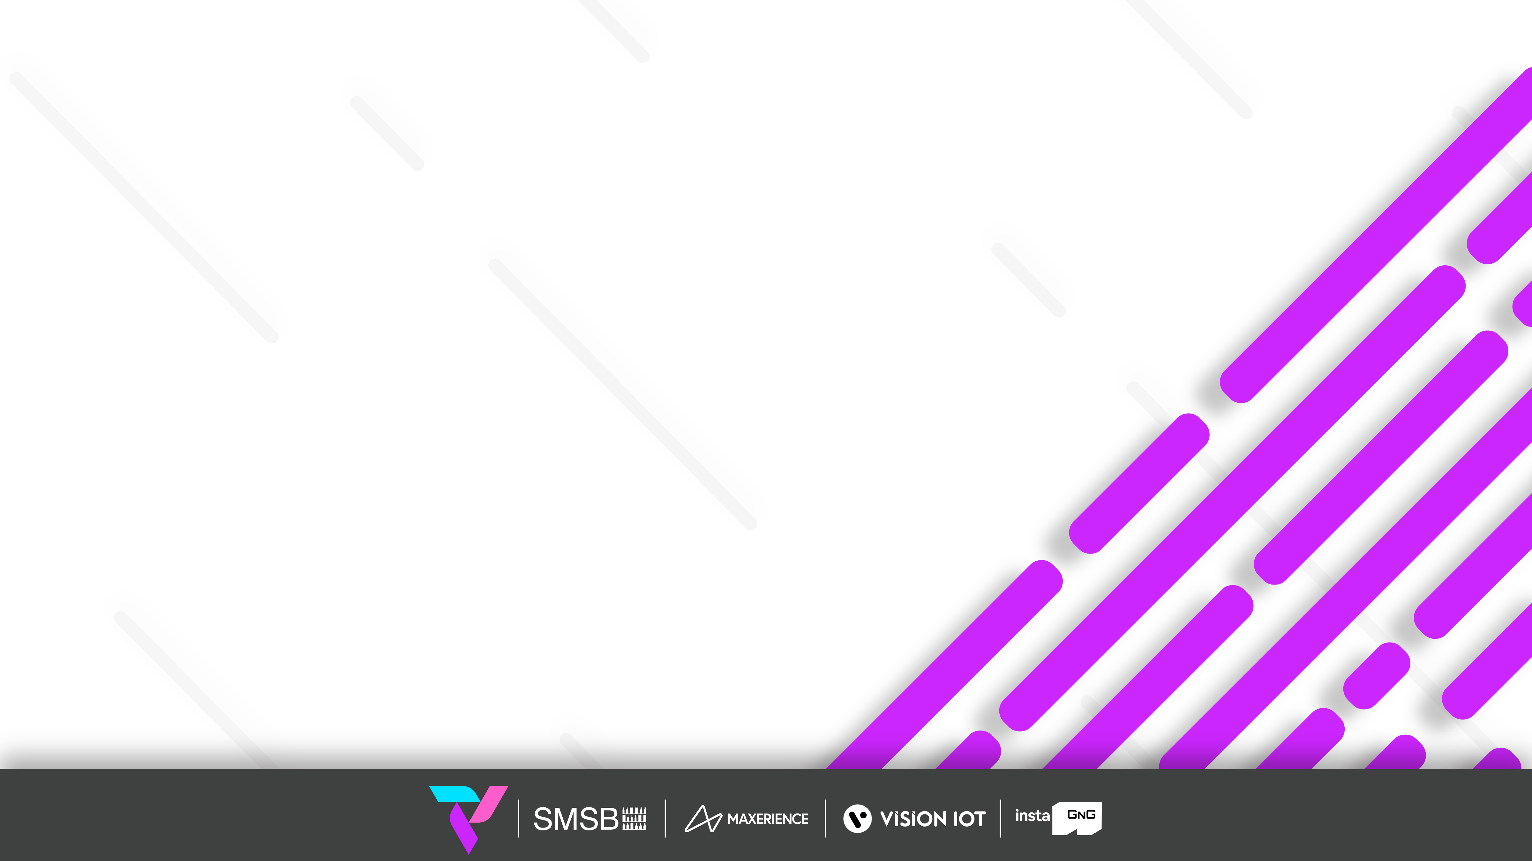
USER MANUAL
© 2023 Vision Group

Slide 5
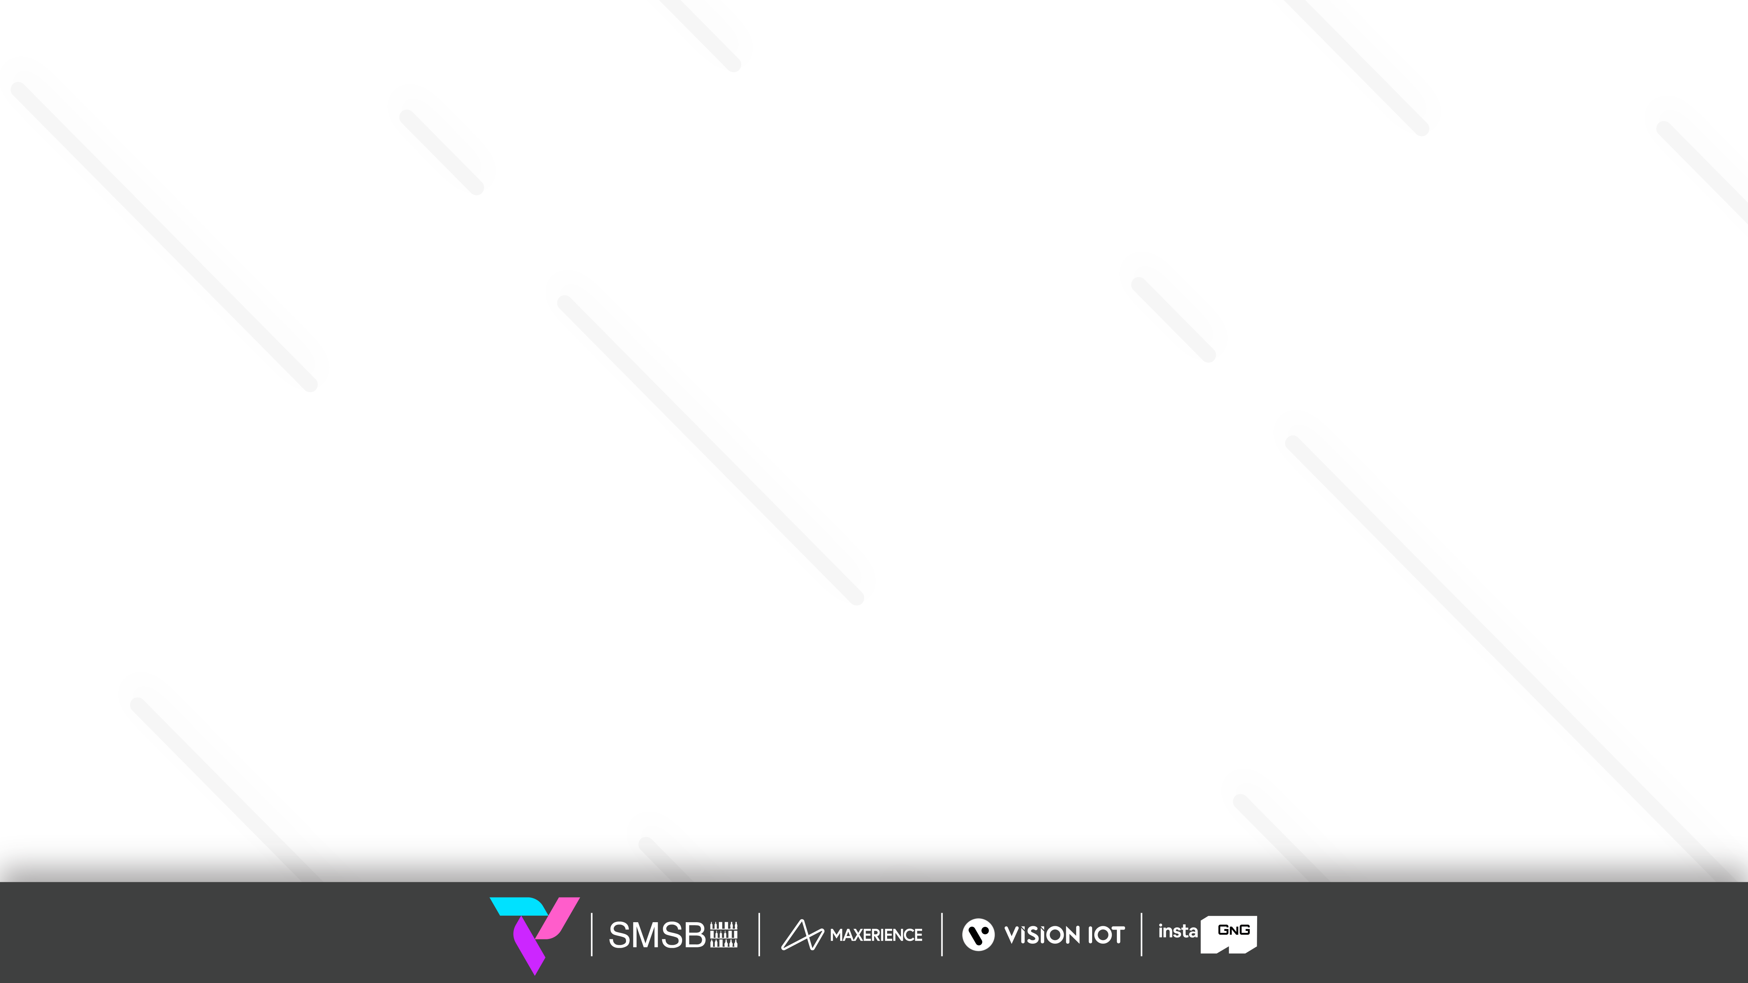
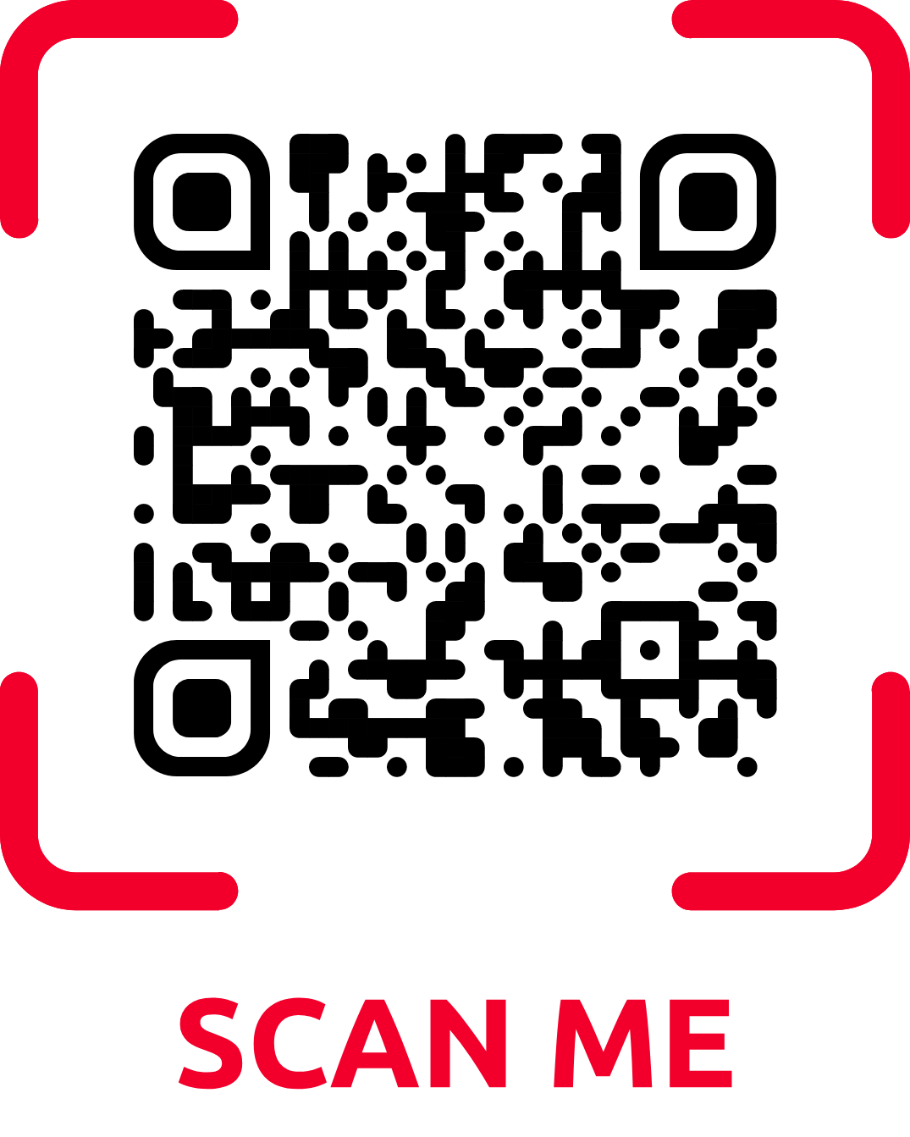
Download Link
Android application link
https://play.google.com/store/apps/details?id=com.visioniot.fieldtechnician.
iOS application link
https://apps.apple.com/in/app/field-technician-app/id6448693812
© 2023 Vision Group

Slide 6
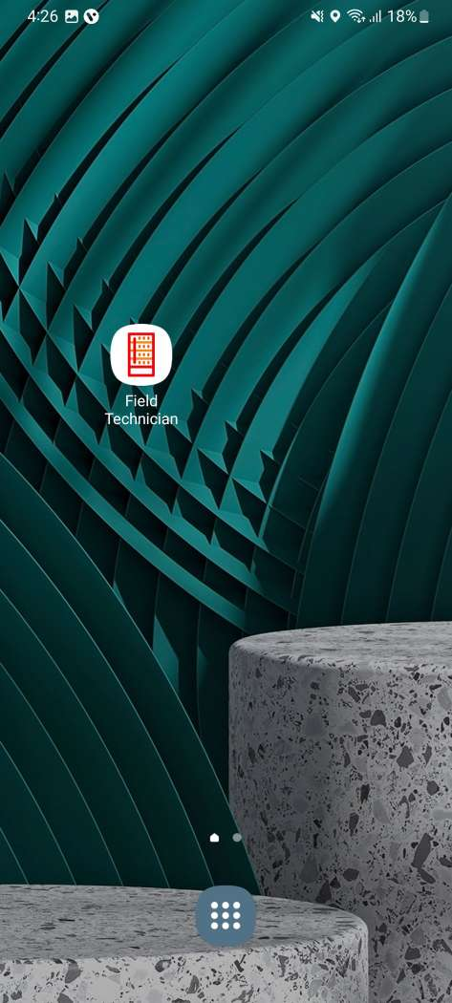
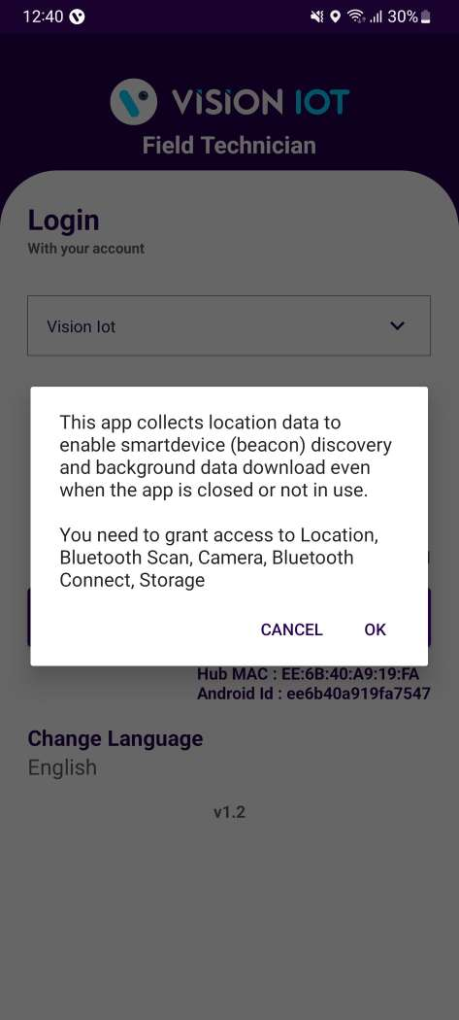
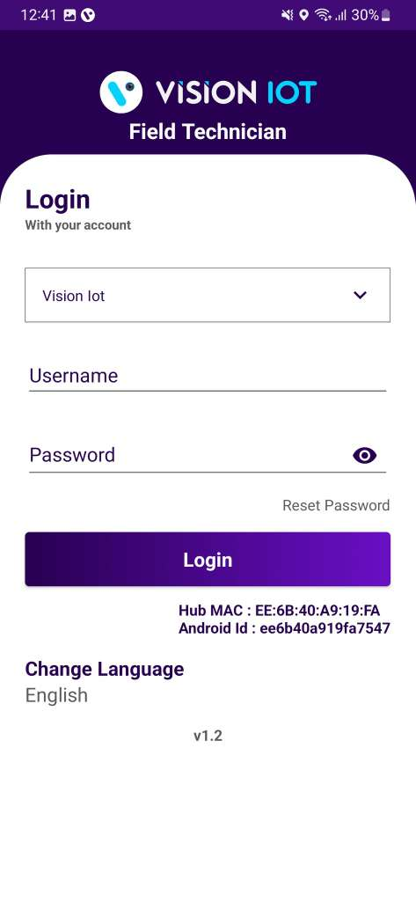
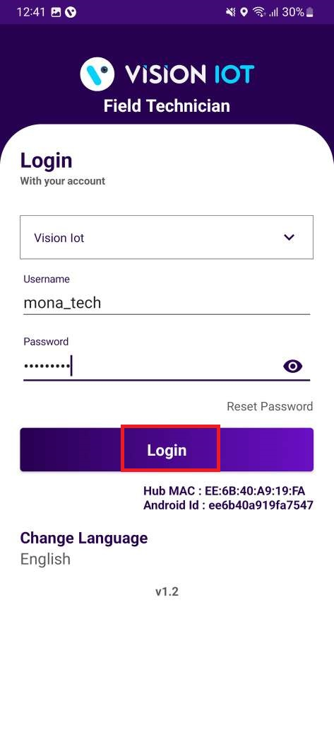
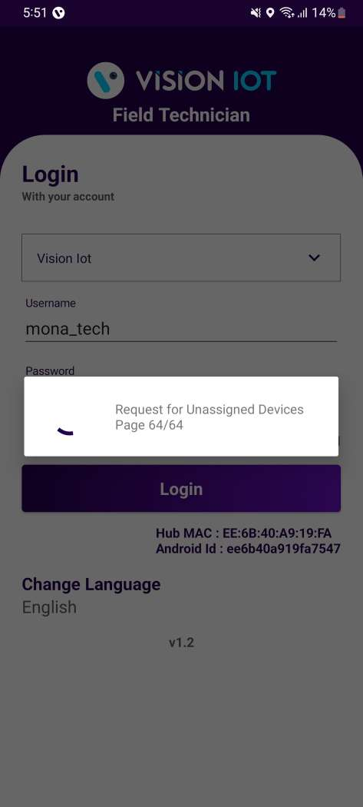
Application Login
Open VISION IOT’s “Field Technician” Application.
Allow Camera Permission, File and Media Permission, Location Permission(always allow), Nearby Device Permission.
Log in to the application using the credentials provided by your administrator
For TCCC client use only Visioniot server.
Enter valid credentials and tap on the Login button
Application will download necessary data from the cloud, and will redirect to home page
Notes:
Before installation of every new version delete the previous one.
Please ensure Bluetooth & Mobile Wi-Fi or Mobile Data must be ON the device.
© 2023 Vision Group

Slide 7
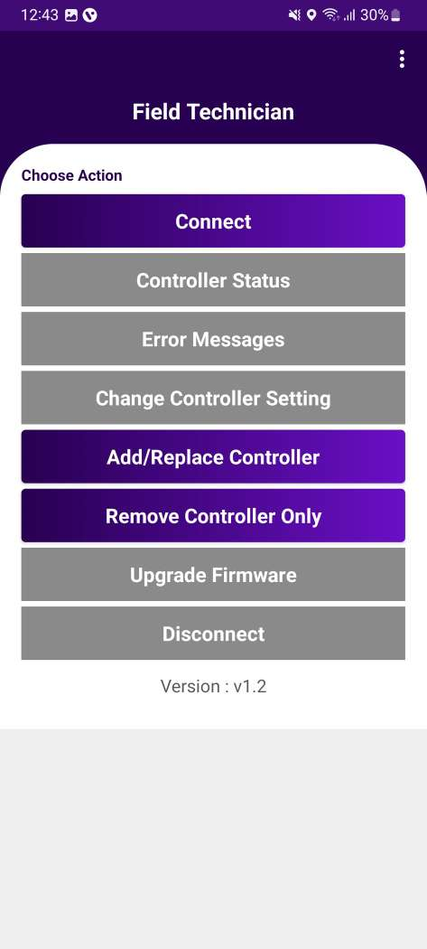
Choose Action
Connect – Connect to the Associated Device
Controller status – Checks the Gateway device’s Last cellular status.
Error Messages – Shows Error messages generated by Controller.
Change Controller Settings – Supports in changing controller settings.
Add/Replace Controller – Add or replace controller for the available asset.
Remove Controller only – Remove Association of Controller with Asset.
Upgrade Firmware – Update firmware of Controller, if available.
Disconnect – Option to disconnect from the device.
After successful login, the following screen will appear. Please choose an ACTION from the list as per the required operation. The options which are in “Grey” can’t be used
© 2023 Vision Group

Slide 8
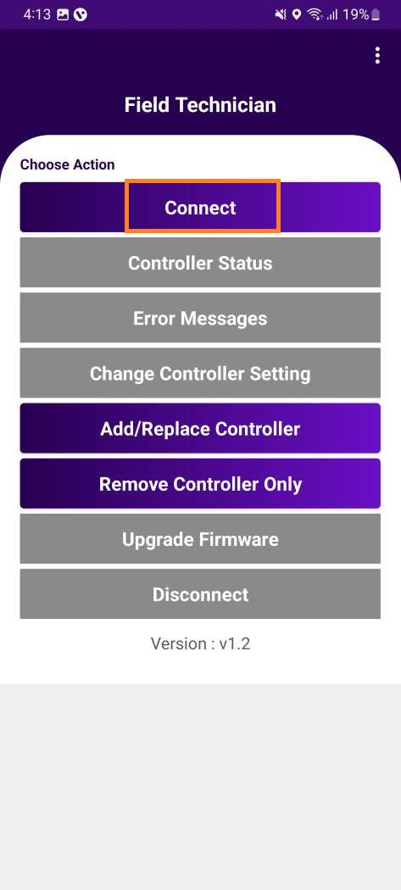
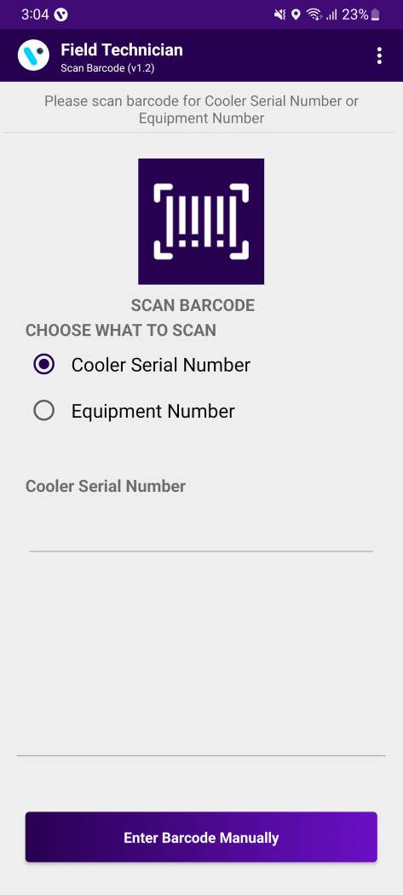
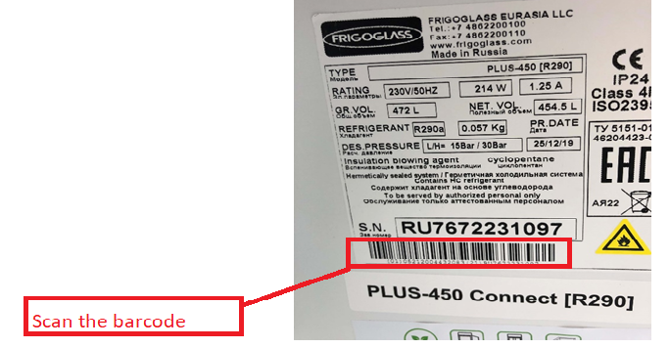
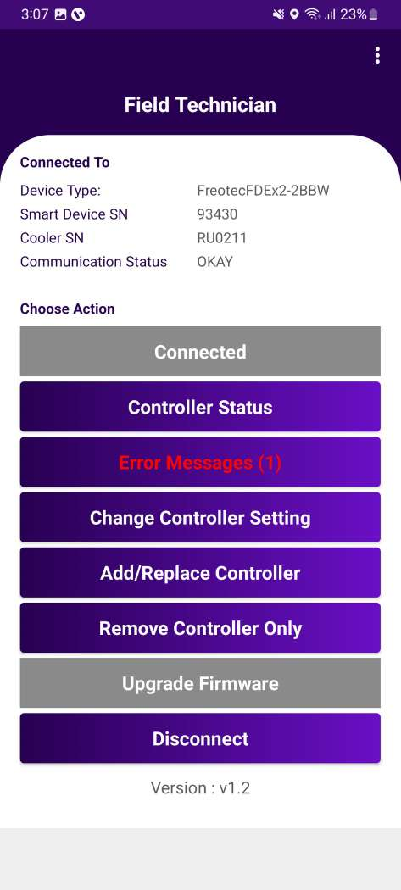
Connect
Image 9
Image 10
After successful login select Connect to the Device to initiate a connection with the controller.
Please enter manually or scan the barcode for the cooler serial number. (Image 9).
Device is connected successfully. (Image 10)
Note: This application supported only FDEX2.
© 2023 Vision Group

Slide 9
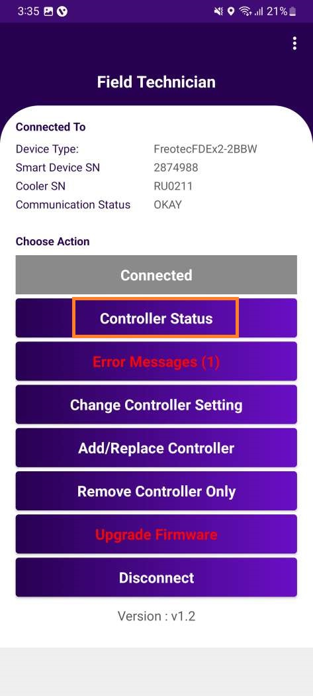
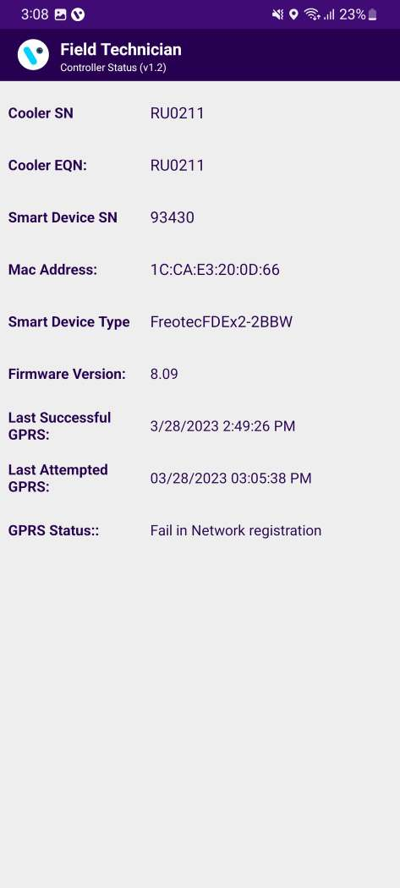
Controller Status
Date and Time when the controller last communicated with the portal will be displayed.
(Ping data transaction to confirm the connection is successful with the portal)

Slide 10
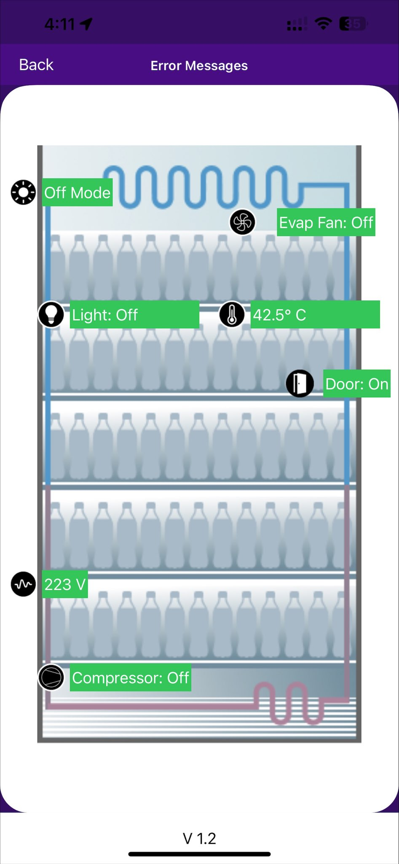
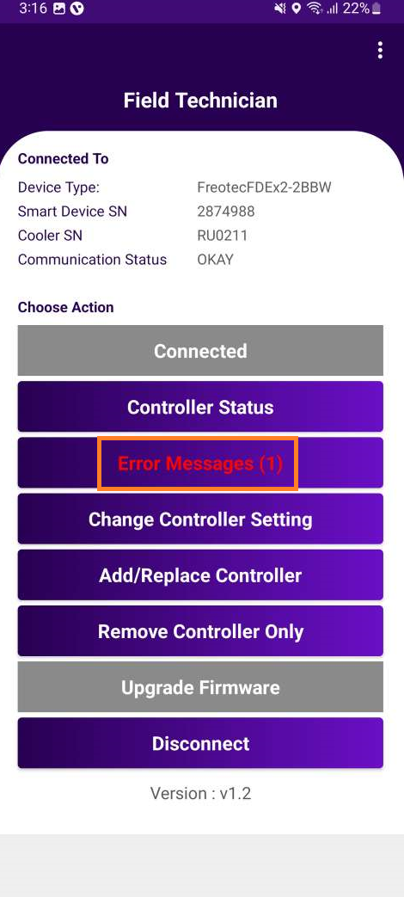
ERROR MESSAGE
Error Message
Mode
Refer Slide No. 19
Evaporator Fan status
Light Status
Appliance Temperature
Door Status
Cooler Voltage
Compressor Status
Helps user to easily diagnose the fault and identify a solution.
Application shows status of cooler and also error, if any.

Slide 11
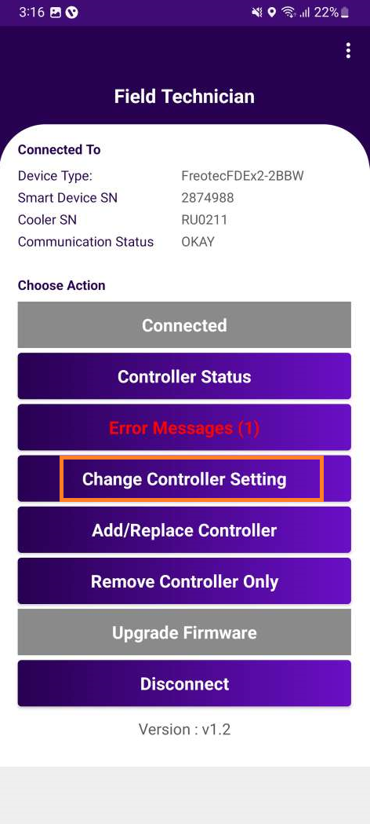
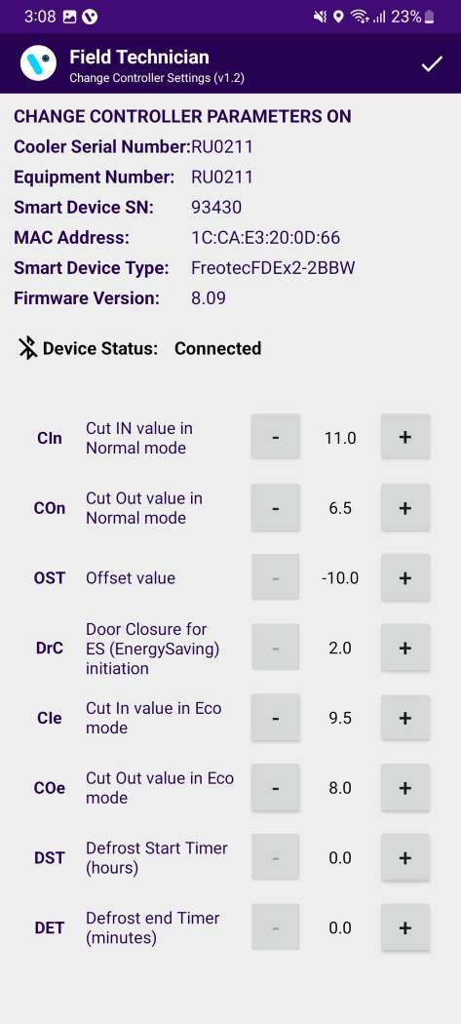
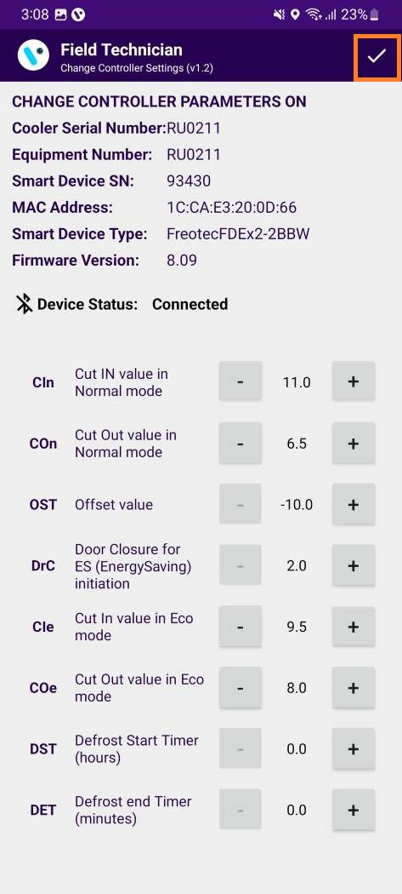
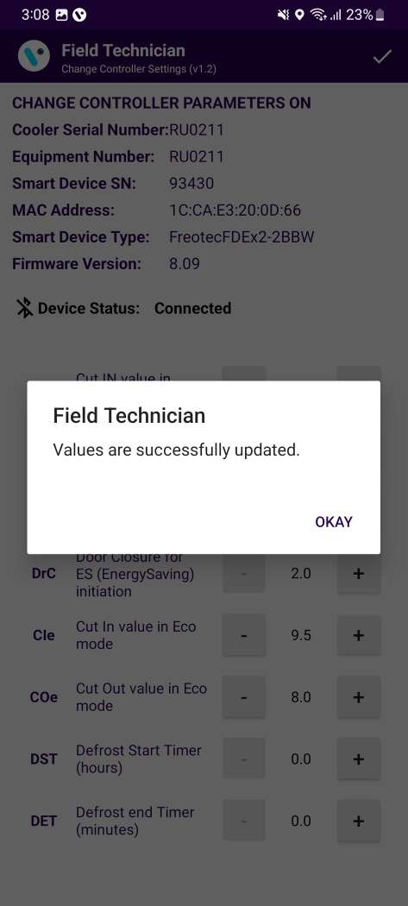
CHANGE CONTROLLER SETTING
Change Controller Settings
Image A
User can change all available settings for FDE controllers according to requirement.
After changing setting , user should click on “Right button “ (Image A).

Slide 12
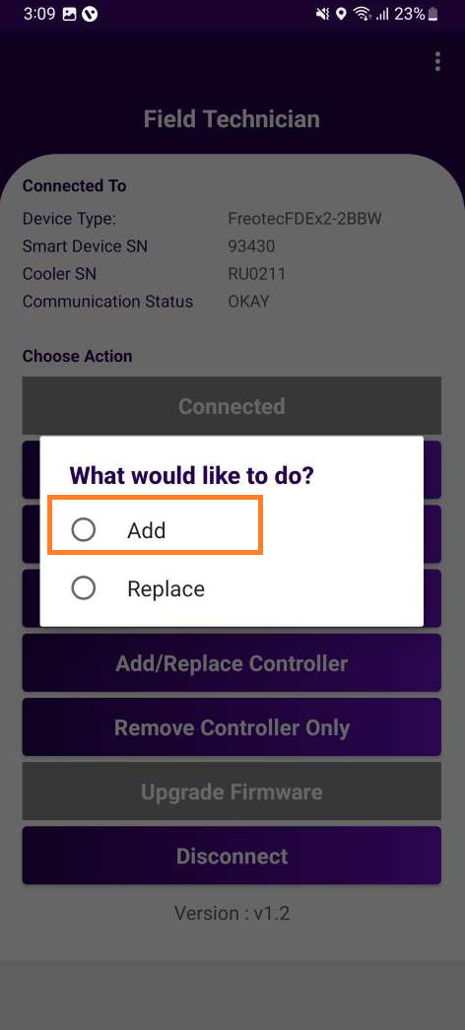
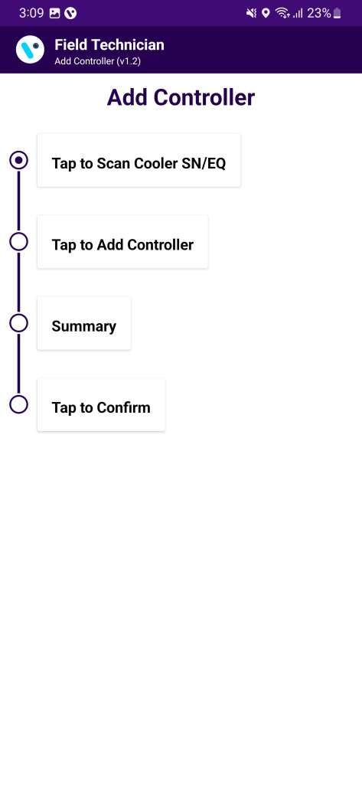
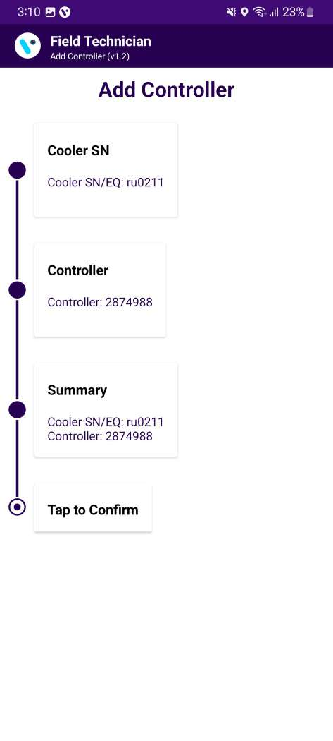
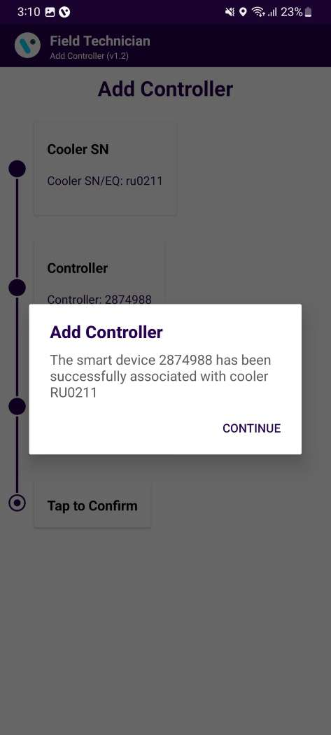
ADD CONTROLLER
ADD Controller
Image A
Image B
User click on “Add/Replace Controller” next one pop-up shows “ Add or Replace” (Image A) → User click on Add button→ Click on “Tap to scan cooler” scan or entered manually. → After that Tap on Add Controller – which will add Controller.→ Check all detail for add the controller seen as “Summary”. → User pop-up message (Image B).

Slide 13
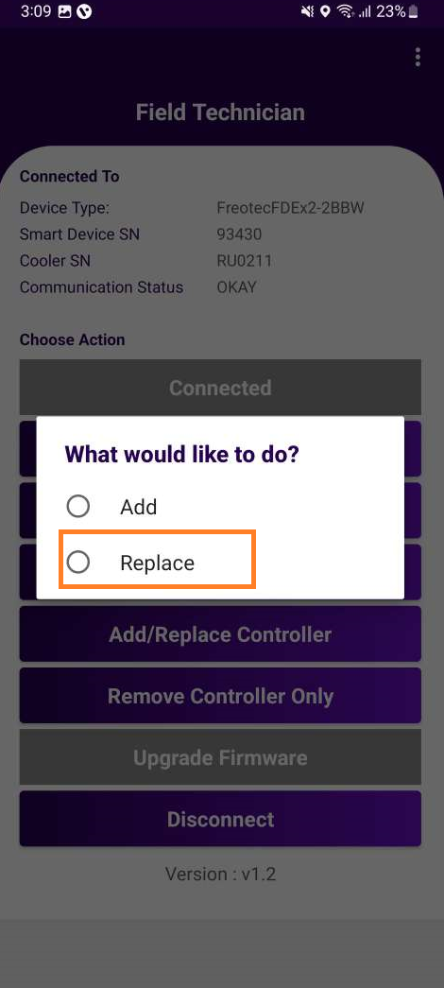
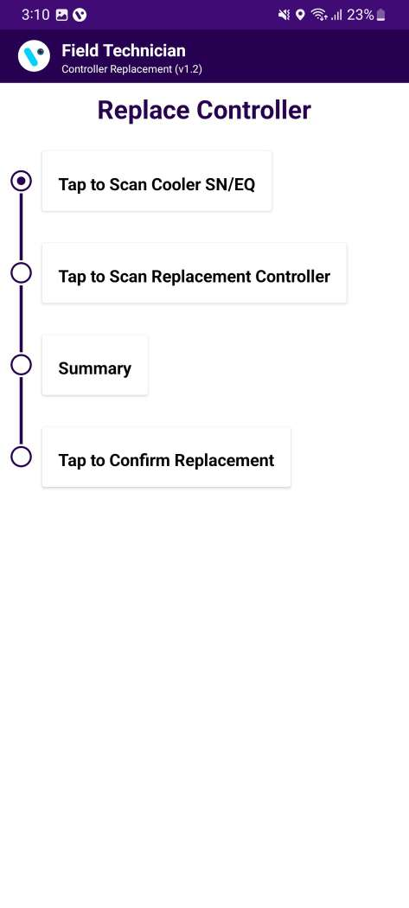
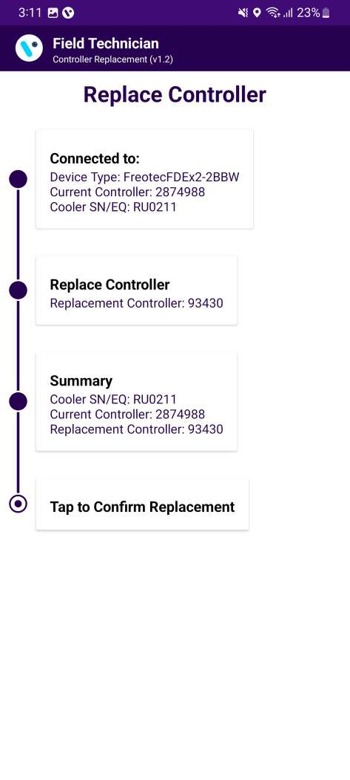
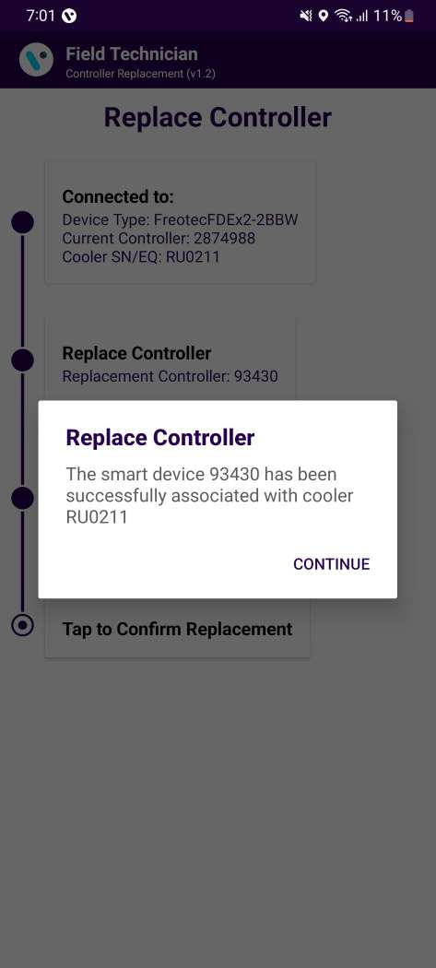
REPLACE CONTROLLER
Replace Controller
Image A
Image B
User click on “Add/Replace Controller” next one pop-up shows “ Add or Replace” (Image A) → User click on Replace button→ Click on “Tap to scan cooler” scan or entered manually. → After that Tap on Add Controller – which will replace Controller.→ Check all detail for add the controller seen as “Summary”. → User pop-up message (Image B).

Slide 14
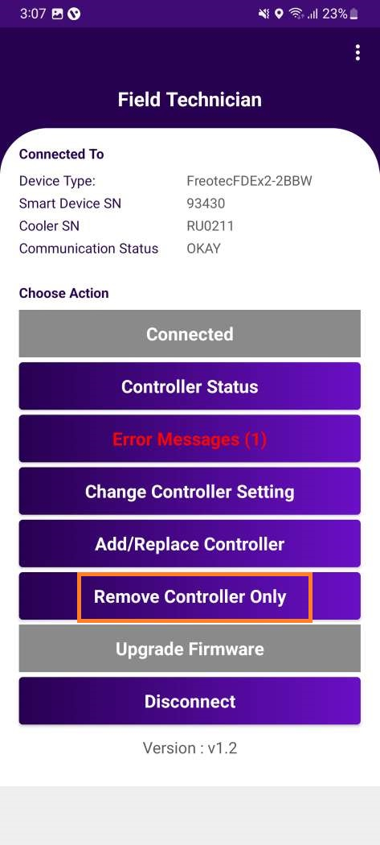

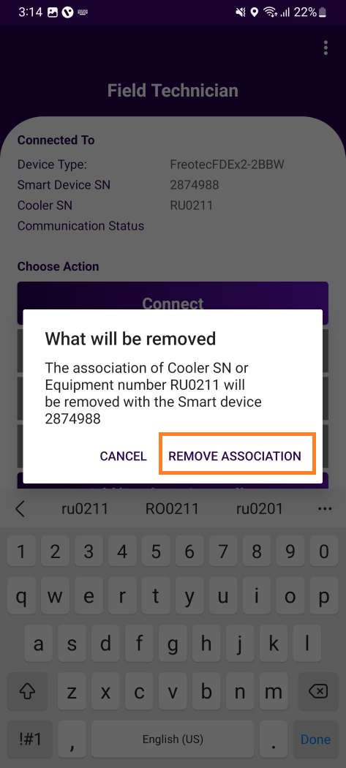
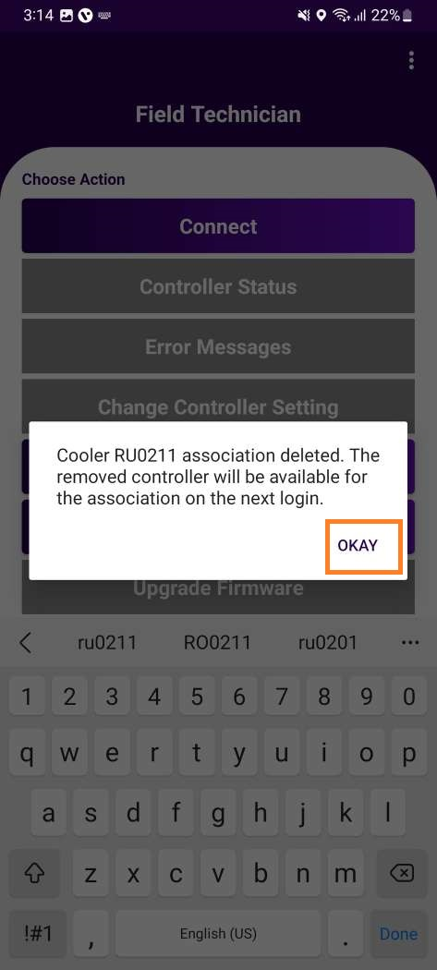
REMOVE CONTROLLER
Remove Controller
Image A
Image B
Scan the cooler serial number or enter manually cooler serial number to establish the details of the current controller
Click on “Remove association” button.(Image A)
Association was removed, and confirmation Pop-up generated.(Image B)

Slide 15
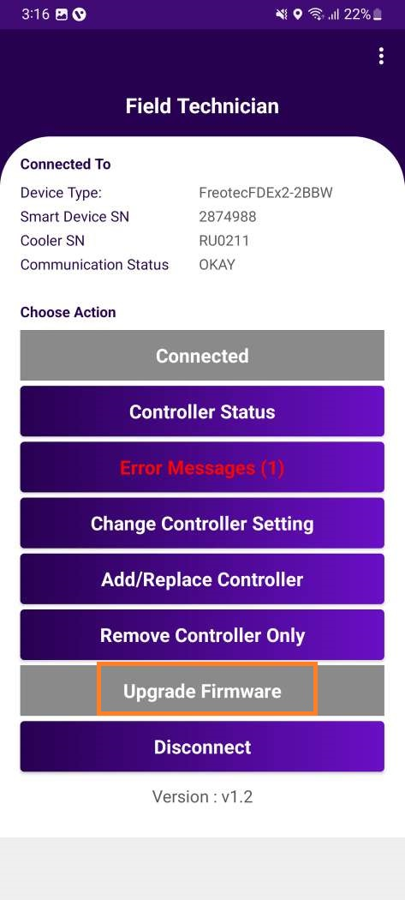
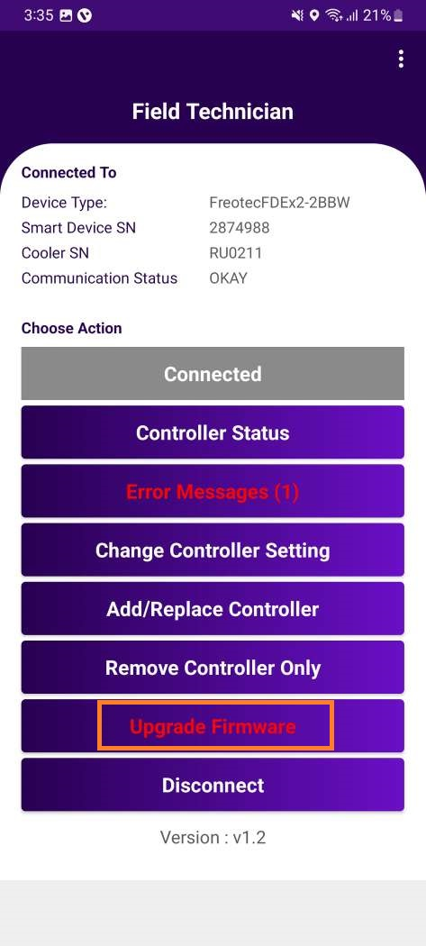
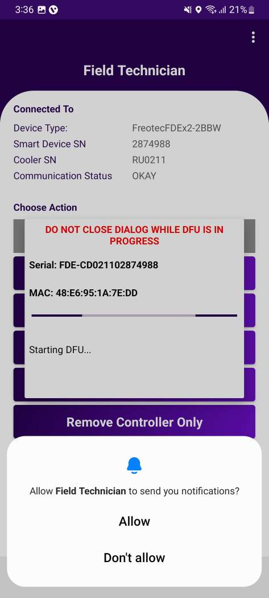
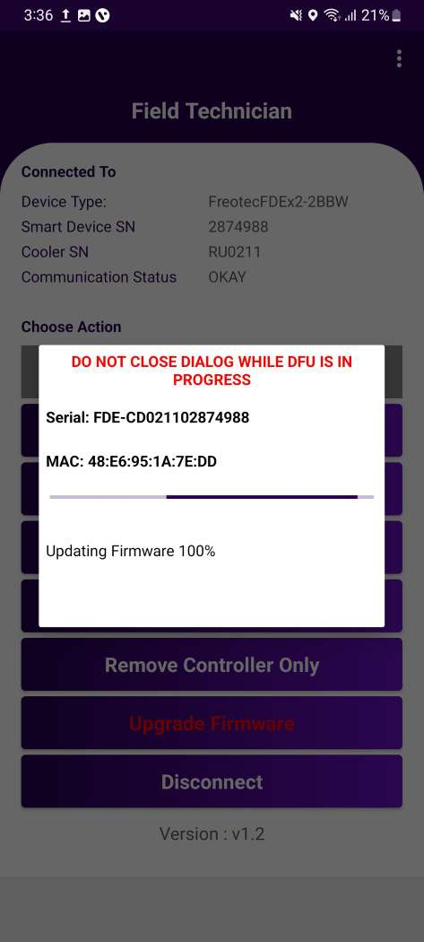
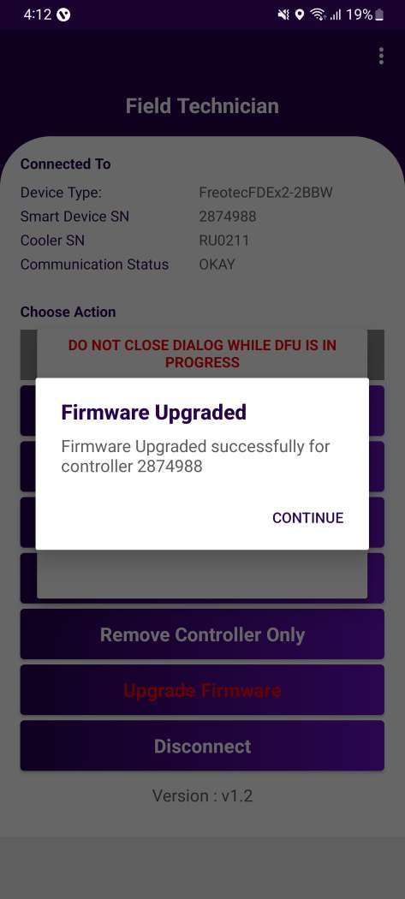
FIRMWARE UPDATE
Upgrade Firmware
Button is disabled, if no Firmware Update is available.
If new firmware is available, the button will be highlighted in “red”
User clicks on “upgrade firmware” button, the latest firmware from the Vision IOT platform will be updated to the cooler.
Pop-up “Updating Firmware”, when firmware update is in Progress.
Pop-up generated “Firmware Upgraded”, once the Firmware upgradation is completed.

Slide 16
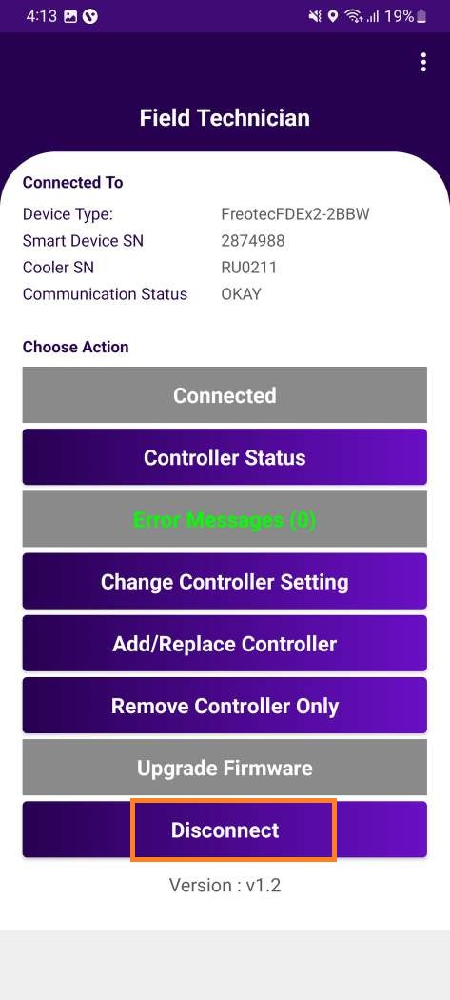
DISCONNECT
Disconnect
When user presses “Disconnect” button, it should disconnect the controller/device from the application.
Application returns to the home page with the default active buttons.

Slide 17
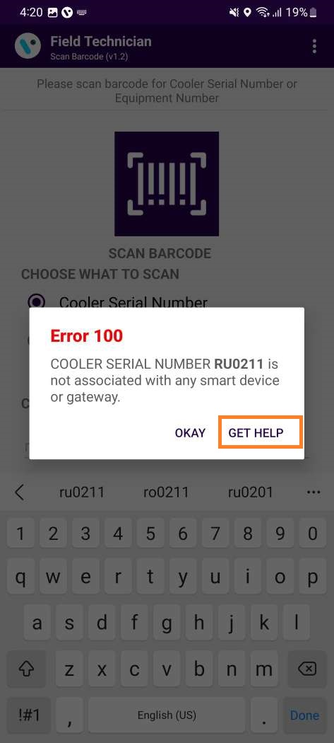
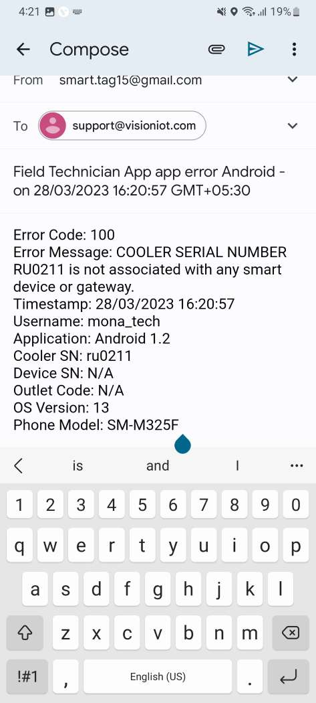
GET HELP
Get Help
If user gets any error in the application, click on the “Get Help” button.
When user clicks on “Get help” in application, it will redirect the user to the default email application on the mobile device and generate email.
If the mail application doesn’t log in, then one pop-up generated is “No mail application is available”.

Slide 18


Thank You!
support.iot@visiongroupretail.com
+1-833-593-0144 (USA Tollfree Number)
© 2023 Vision Group

Slide 19
MESSAGE
List of Modes
0 = Off Mode 1 = On Mode 2 = Wait Mode 3 = Defrost Mode 4 = Test Mode 5 = Pre-Defrost Mode 6 = Post-Defrost Mode 7 = Post-Defrost Recovery Mode 8 = Probe#1 faulty Mode 9 = Probe#2 faulty Mode 10 = Wait Mode Low Temperature Mode 11 = Wait Mode High Temperature Mode 12 = Off Position Mode 13 = Door Open Mode

Slide 20
MESSAGE
Error Message
Detailed Message | Short Message | Remark
Cooler SN or Equipment Number <Cooler SN> is associated with Gateway <GW SN> | Error 101 | If Cooler is available in the portal and not associated with any smart device but associated with any gateway.
Cooler SN or Equipment Number <Cooler SN> is associated with Smart Device <SD SN> | Error 102 | If Cooler is available in the portal and not associated with any gateway but associated with any smart device.
Cooler SN or Equipment Number <Cooler SN> is associated with Gateway <GW SN> and Smart Device <SD SN> | Error 103 | If Cooler is available in the portal but associated with Smart Device and the gateway.
Cooler SN or Equipment Number <Cooler SN> does not exist in portal | Error 104 | If the cooler does not available in the portal.
The smart device serial number and mac address not valid | Error 107 | If the user try to connect with the device but device serial number and mac address not available in the portal.
The cooler SN or Equipment Number already associated with different cooler | Error 108 | If the user try to connect with the device but device associated with different cooler SN.

Slide 21
MESSAGE
Error Message
Detailed Message | Short Message | Remark
Cooler SN or Equipment Number <Cooler SN> is not associated with any smart device or Gateway <GW SN> | Error 100 | If Cooler is available in the portal but not associated with any smart device or any gateway.
Duplicate Cooler SN on system, try with the equipment number or check with the Support Staff | Error 110 | Duplicate Cooler SN on a cloud, try with the Technical ID or check with the Support Staff.
Duplicate Equipment Number on system try with the Cooler SN or check with the Support Staff | Error 111 | If Duplicate Technical ID on system, try with the Cooler SN or check with the Support Staff.
Cooler SN or Equipment Number <Cooler SN> is on system but not assigned to user client | Error 112 | If the cooler is available in the portal but does not assign to user client.
Cooler SN or Equipment Number is already associated with different device | Error 109 | If the user try to associate the device but same cooler already associated with different device.

