Slide 1

SMART COOLER INSTALLATION
Android Installation Guide
September 2025
© 2025 Vision Group

Slide 2

APPLICATION FEATURES
Association – Associate the Smart Device and remove any existing association with the Cooler.
Device Scanning and Configuration – Check the device advertisement and configure settings as needed.
DFU (Direct Firmware Update) – Perform a direct firmware update for Smart Devices.
Data Download and Upload – Download data from and upload data to the Smart Devices.
Debug Logs – Enable application logging, collect data, and send the logs.
Fix Faulty Devices – Repair any faulty devices.
Test and Verify – Verify the functionality of the device after repairs.
© 2025 Vision Group

Slide 3
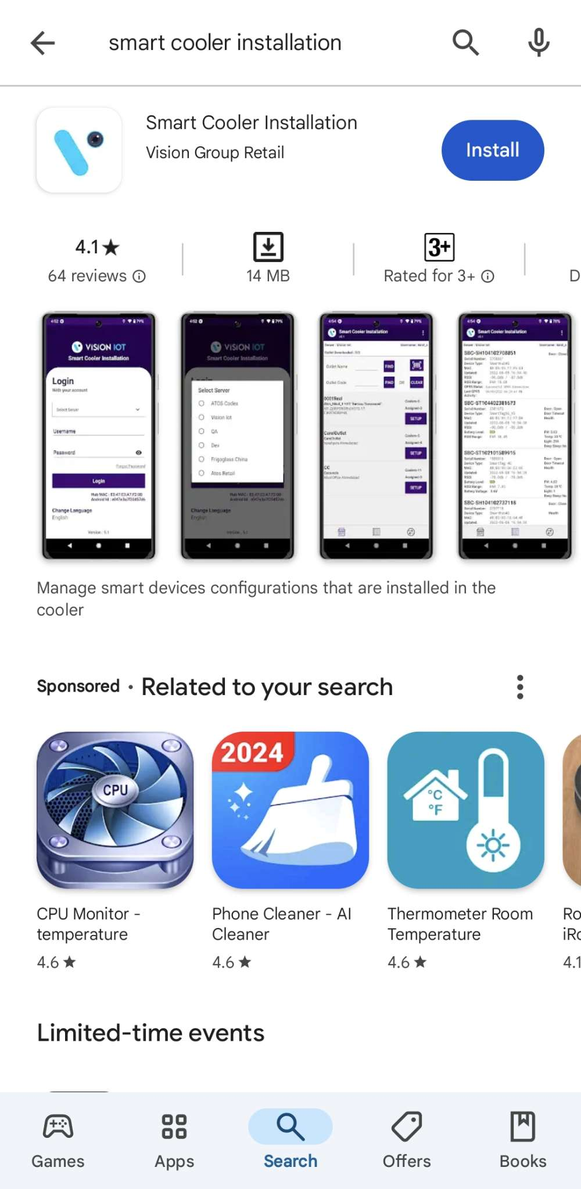
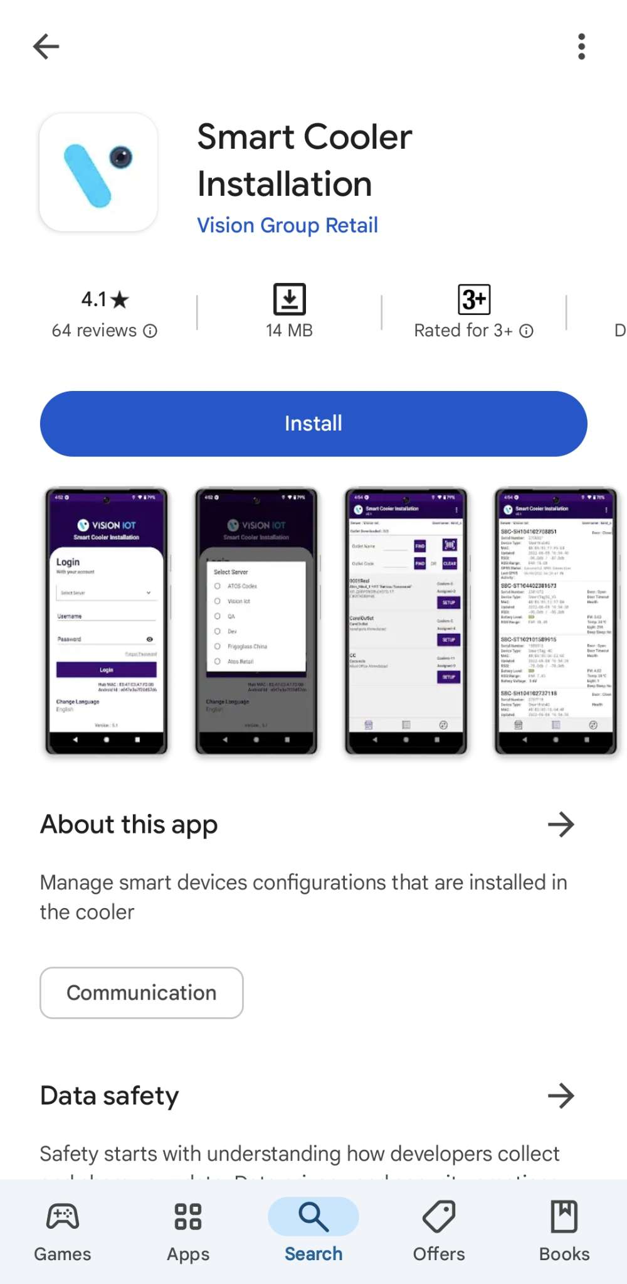
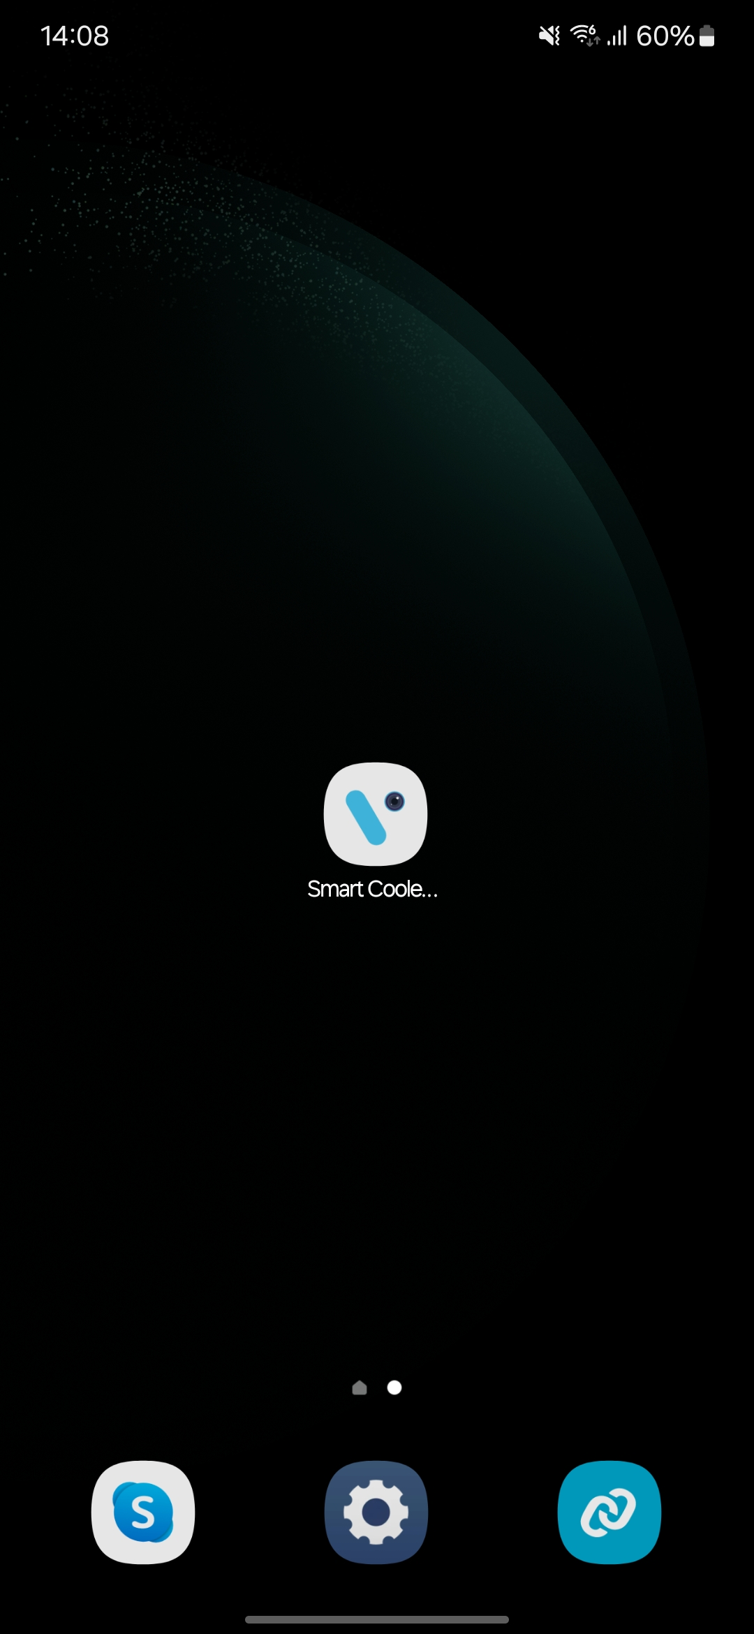
APPLICATION INSTALLATION
Please follow these instructions: Open the Play Store on an Android device. Search for the “SMART COOLER INSTALLATION” application and install it.
Removing the previous version of the application before installing the new one is preferable.
© 2025 Vision Group

Slide 4
APPLICATION PERMISSION
After initial installation and launch, the application will request permissions to access the camera, files and media, location, and nearby devices. These permissions need to be allowed.
Choose Server: The server designated for ATOS Codex should be used for CCH. A different server must be selected to serve other customers and for QA purposes.
LOCATION PERMISSION
For Location (so beacons can be found) - Choose Allow While Using for Android OS 12 and Above.
Then Go to the Settings > Application List > Location > Allow Location Access option is “Always”.
NOTIFICATION PERMISSION
Send notifications (to inform of data download) -> Choose “Allow”
BLUETOOTH PERMISSION
Access the Bluetooth (to scan barcodes) – the first prompt on the Outlet screen -> Choose “OK”.
© 2025 Vision Group

Slide 5
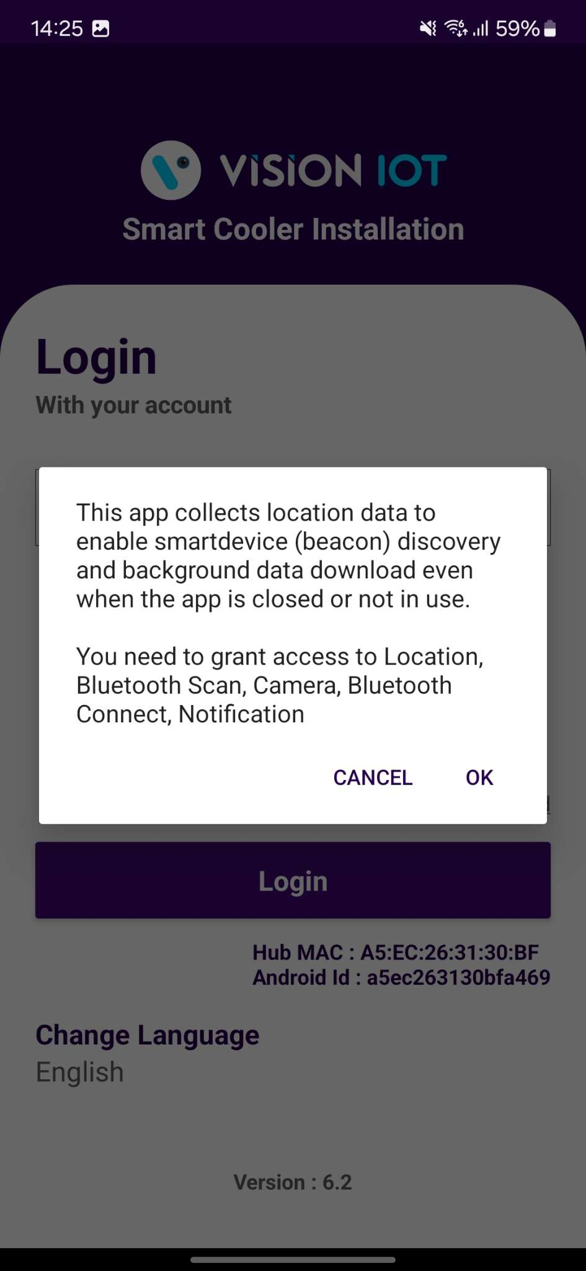
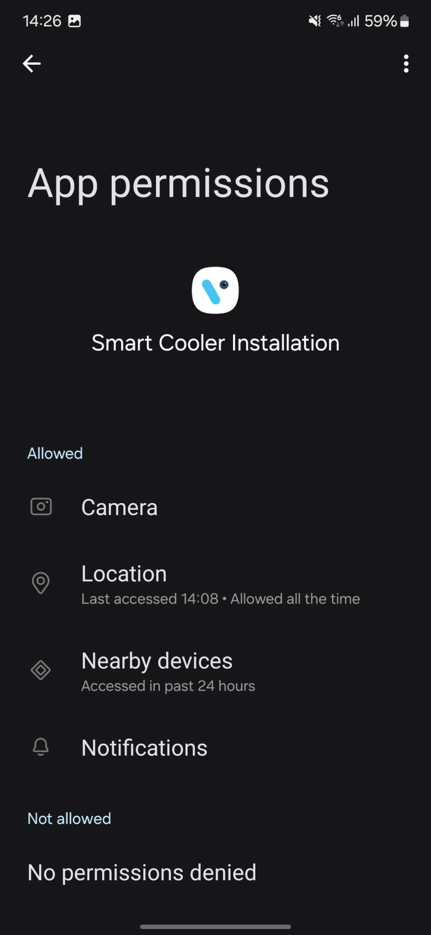
LOGIN
After successfully installing the Smart Cooler Installation Application, open it, and it will redirect you to the Login Page. Select the server from the server list and Login in to the application using the credentials provided by your administrator after successful login.
Remember to ensure Bluetooth & Mobile Wi-Fi or Mobile Data are ON in the device.
Bluetooth and location services should also be enabled.
The application requires an internet connection for initial login. After the initial login, the application can operate in Offline mode, provided that the same username & password used for the online login are used.
The Minimum Android version is 12 and Above.
© 2025 Vision Group

Slide 6
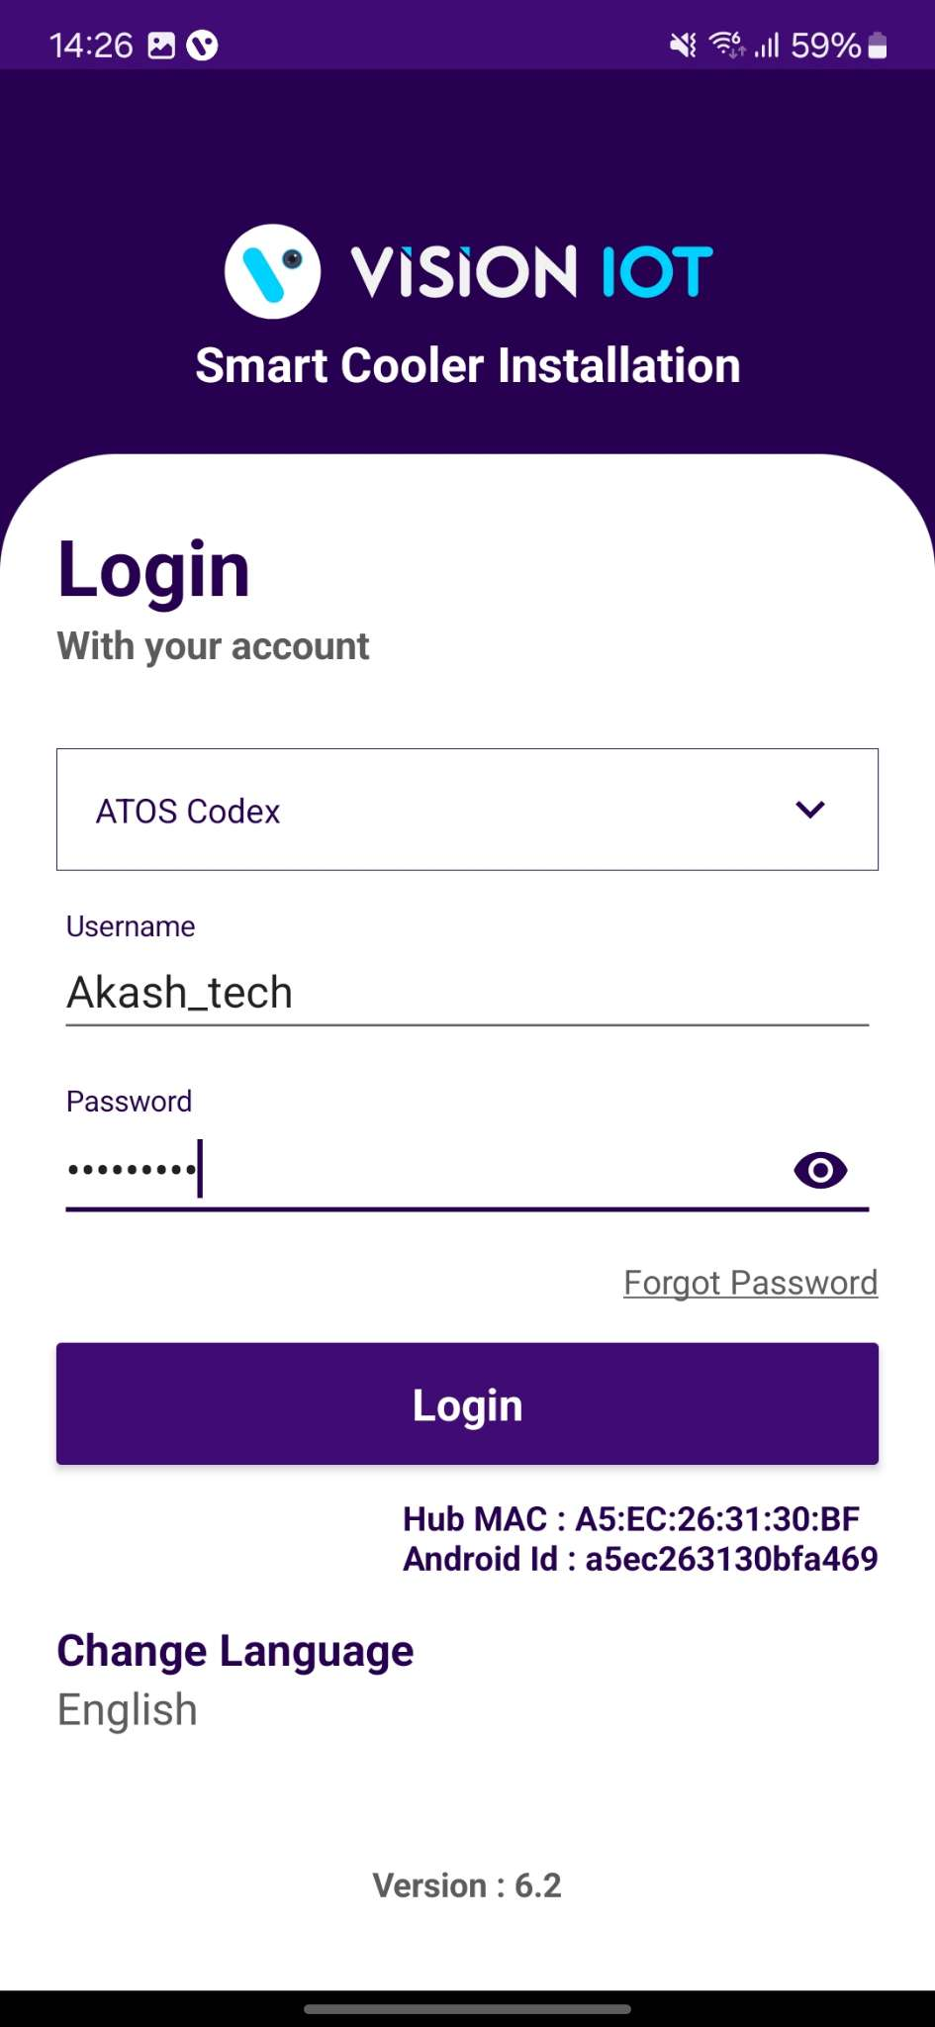
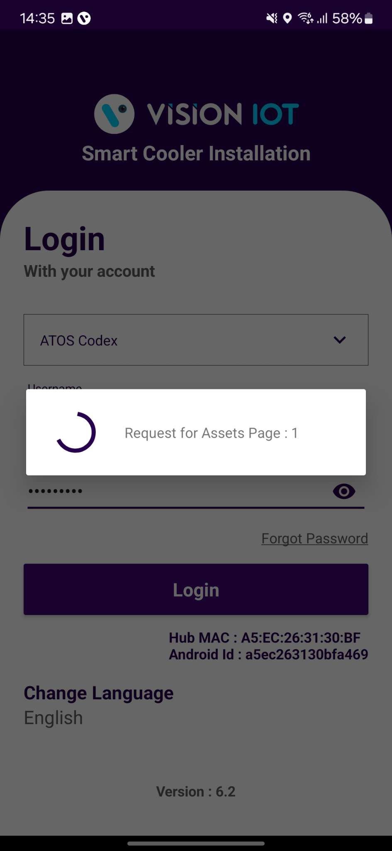
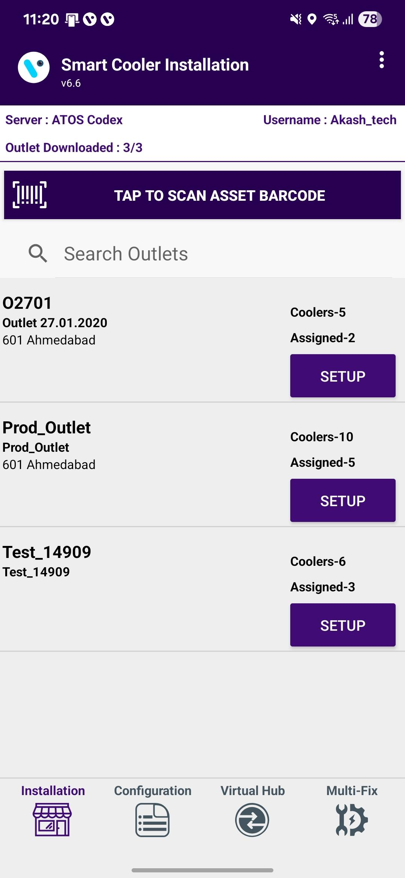
Provide valid credentials and tap on the Login button. Please be advised that the application will need some time to download data from the cloud.
Note – Internet connectivity is required for login; otherwise, the login will fail, and the application will display network errors.
© 2025 Vision Group

Slide 7
APPLICATION FUNCTIONS
1. Association Screen - Use for the Association and Remove Association.
2. Configuration Screen - Use to check the Device Advertisement and configure it.
3. VH Screen - Use for the Data Download and Upload to the Server.
4. Multi-Fix Screen - To Fix the Faulty Devices.
5. Test and Verify – Verify the functionality of the device after repairs.
6. Debug Logs – Enable application logging, collect data, and send the logs.
1
2
3
4
© 2025 Vision Group

Slide 8
ASSOCIATION SCREEN
Click on the Association Icon to move to the Association Screen.
Total number of outlets in the BD territory and how many have been loaded; outlets are loaded at startup.
Use this box to quickly search for the Asset Serial. If a cooler is found the association menu for this cooler will be shown.
Use this box to quickly search for the Outlet Code or Outlet Name. If an Outlet is found the result of the Outlet will be shown.
On successful login, a list of outlets will be shown.
Only Assigned User outlets will be shown, for each one the Outlet name, address & code will be displayed.
Coolers – 10
Shows the number of coolers in the outlet.
Associated – 3
Shows the number of coolers already associated/ provisioned.
Tap on Setup to enter the Outlet and view assigned and unassigned Coolers.
© 2025 Vision Group

Slide 9
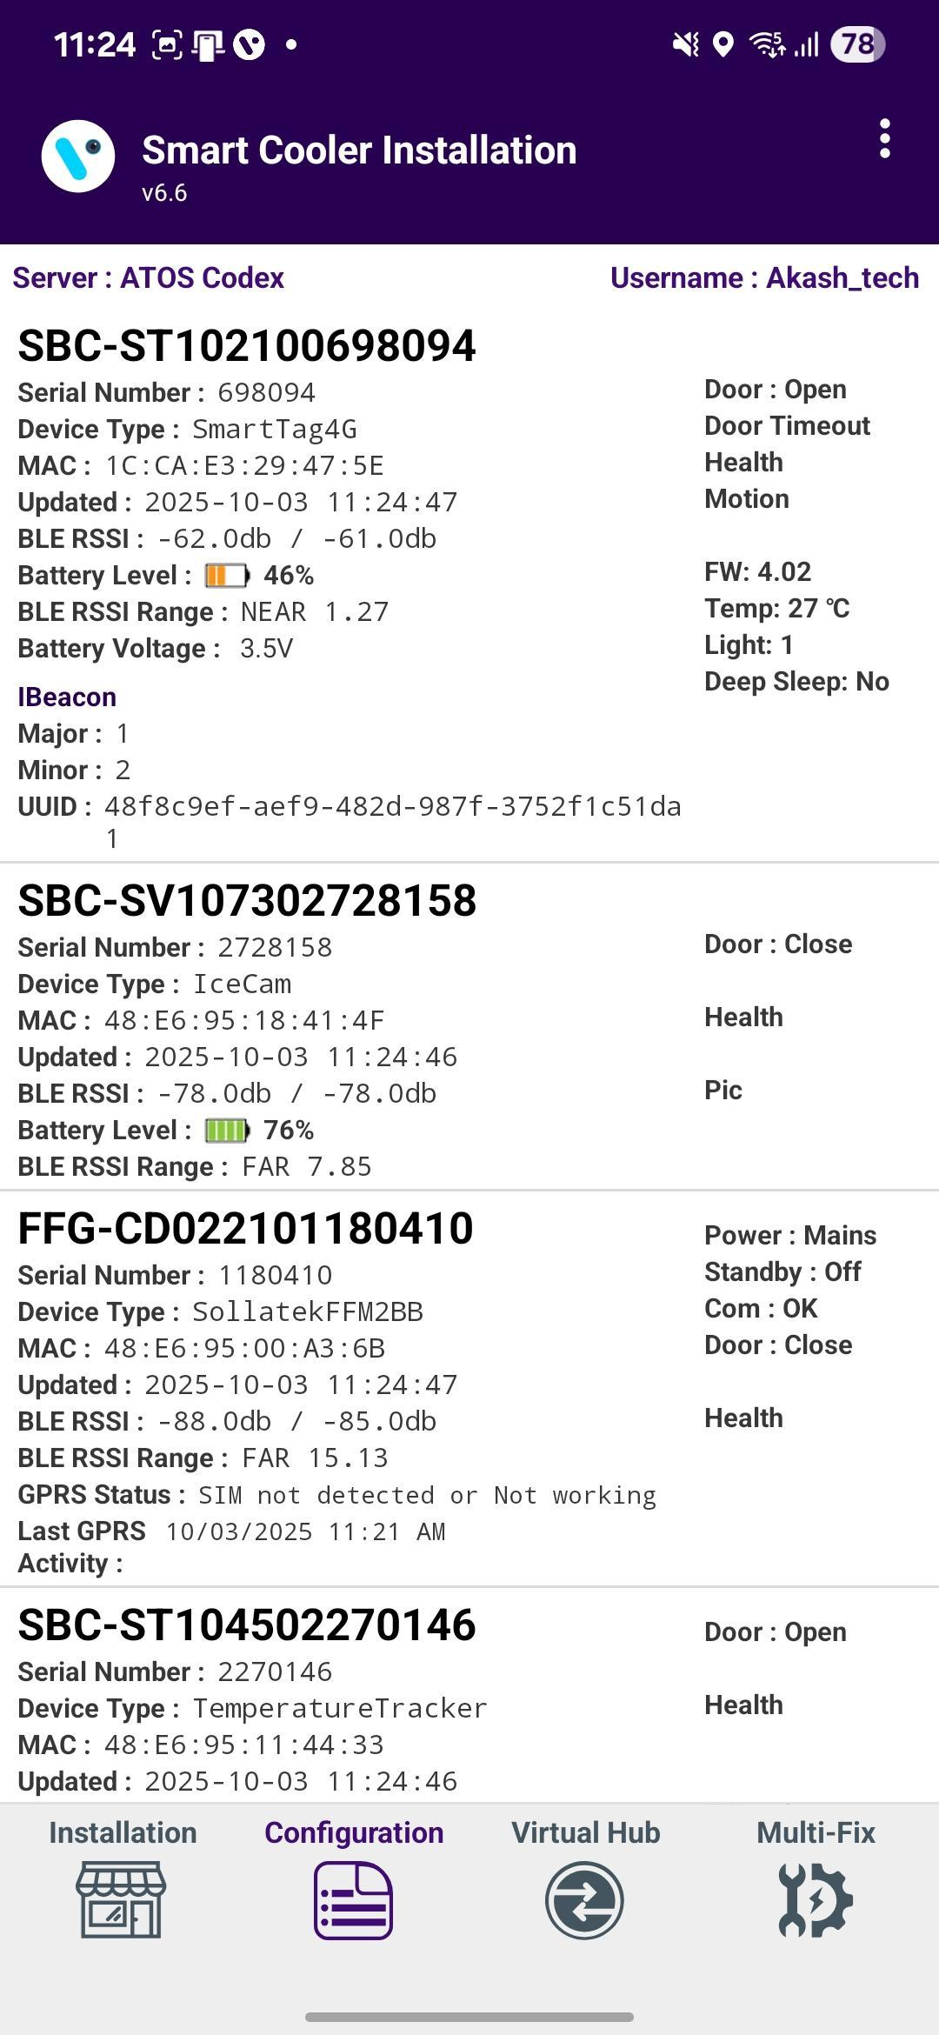
CONFIGURATION SCREEN
Click on the Configuration Icon to move to the Configuration Screen.
Smart Device # – Smart Device Serial Number
Smart Device Type – Type of Smart Device
MAC Address – Smart Device’s MAC Address
Updated – Last Update Time while Device found in Scan
RSSI – Range of Smart Devices in dB
Battery Level – Smart Device Battery Level(Green > Orange > Yellow > Red)
RSSI Range – Range of Smart Devices in meters
iBeacon Frame – Smart Devices iBeacon Advertisement Frame(Showing if Enable)
Major – Smart Device iBeacon Major value
Minor – Smart Device iBeacon Minor value
TX – Smart Device Transmit Power value
Distance – Range of Smart Devices in meters
UUID – Smart Devices iBeacon UUID Value
Standby – Flag Showing if Device is in Standby Mode
Door – Flag of Door Status is Open /Closed
Health – Flag of Health if available for Smart devices
Pic – Flag of Image if available for Smart devices
FW – Firmware Version of the Smart device
Temp – Current temperature Value of Cooler
Light – The light Status of the Cooler
Deep Sleep – Flag Showing if Device is in Deep Sleep Mode

Slide 10
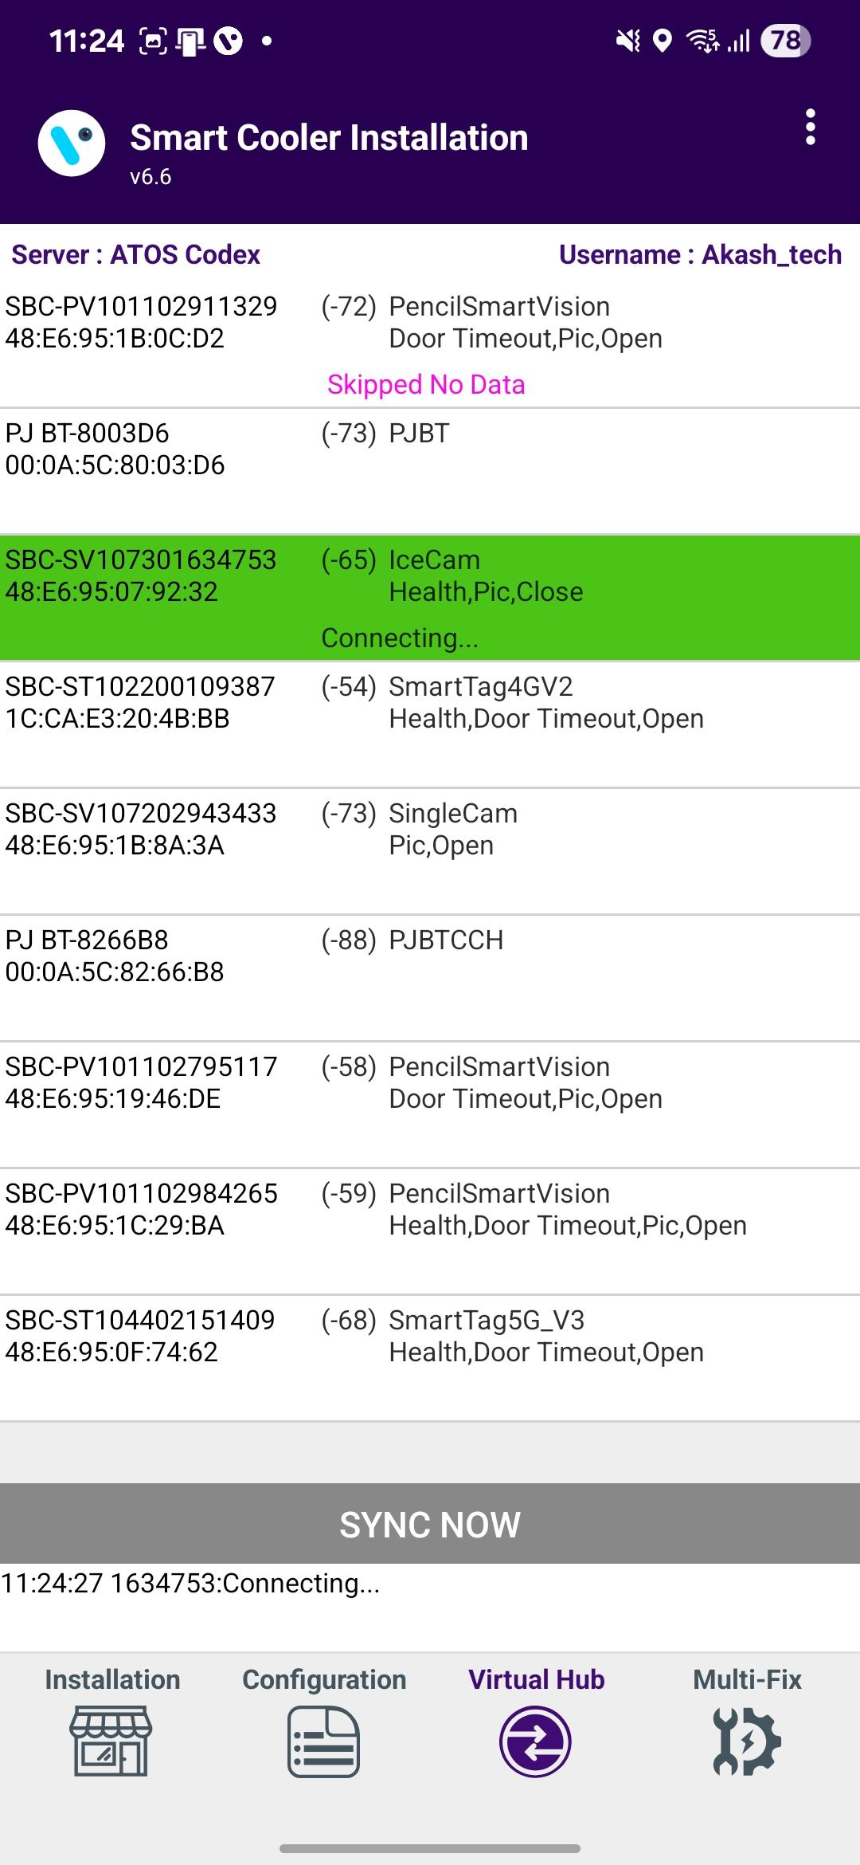
VH SCREEN
Click on VH Icon to move to VH Screen.
This section displays the nearest whitelisted devices from which the application can download smart device data and upload it to the server.
For each type of smart device, information such as sensor data flags, MAC address, and smart device serial number is provided.
The operational status of each smart device is managed by the application, with indicators for connection status, data download, and data upload.

Slide 11

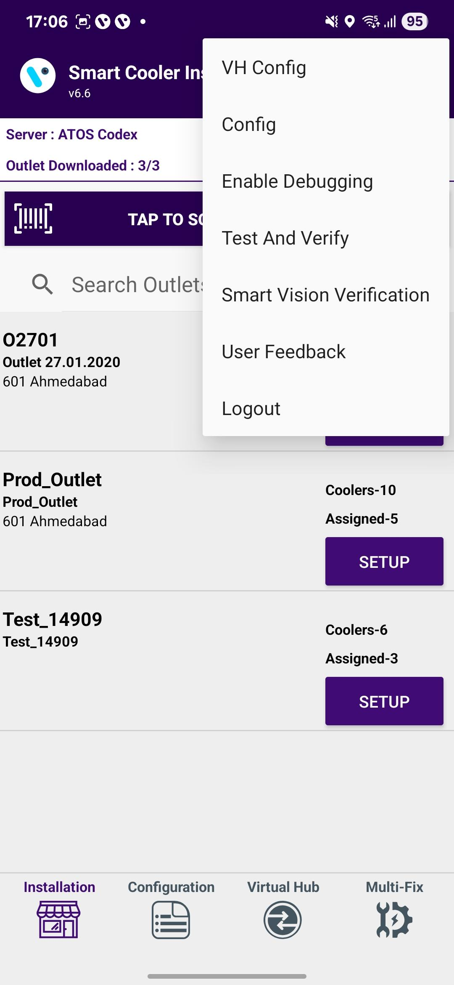
DEBUG LOGGING
A new “Enable Debugging” option in the app to help capture user activity for troubleshooting. Users can enable debugging from the 3-dots menu. A clear prompt informs users that all actions will be recorded until debugging is disabled.

Slide 12

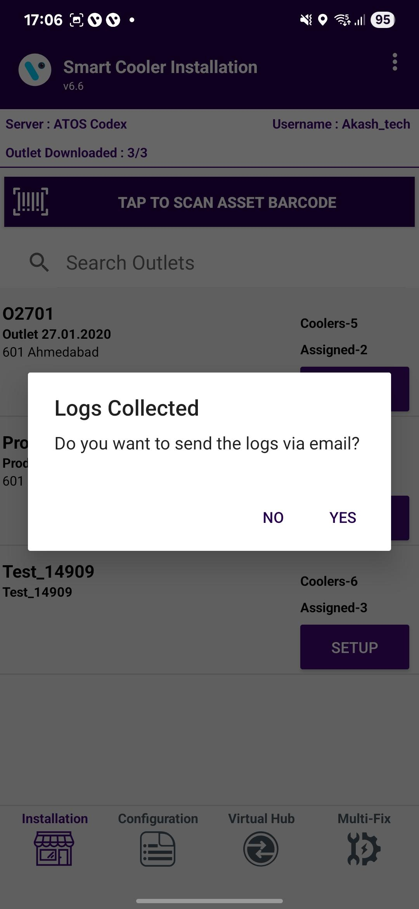
Logs are securely stored in a “.txt” file. When debugging is turned off, the app automatically prepares an email with the log file and sends it to our IoT Support Team.

Slide 13
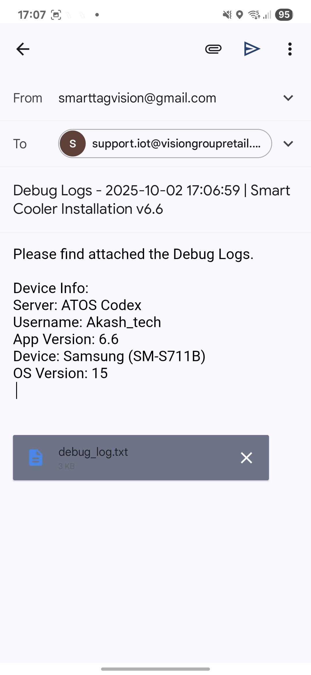
If users forget to disable debugging, logging will stop after 30 minutes, and a reminder pop-up will be shown. If the app is force-closed, the reminder pop-up will reappear when the app is launched again.

Slide 14
ASSOCIATION PROCESS
Selecting Asset – Using Barcode Scanning:
Click on the Barcode icon, and the Barcode scanning window will open.
Scan the cooler barcode using the barcode scanner – Position the camera of the mobile device in such a way that the barcode of the Cooler (Technical ID) is in the box.
Outlet will automatically be selected, and a menu will be shown for choosing the device that will be installed.
B. Alternative – Selecting Outlet by entering Outlet Code or Name:
If Scanning of the Cooler serial is not possible, enter either the Outlet Name or Outlet Code and Tap on “Find”.
C. Alternative – Selecting Outlet – Manual selection of cooler
If Scanning of the Cooler serial is not possible and the outlet code/name is not known, the User can manually select the outlet.
A
B
C
The application will allow one smart device and one smart gateway device to associate with an asset.
© 2025 Vision Group

Slide 15
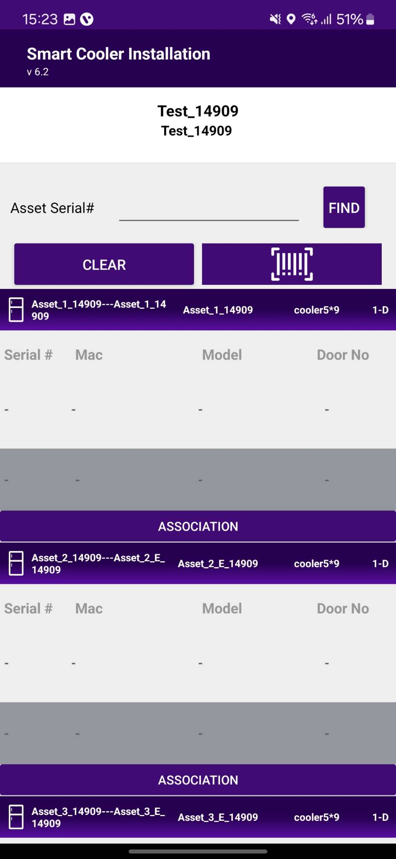
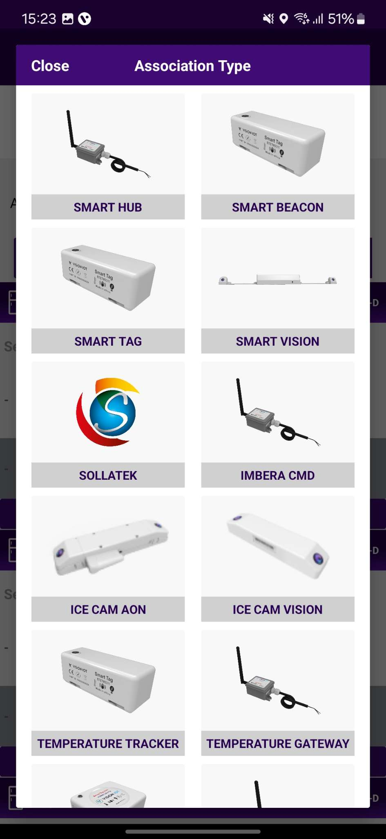
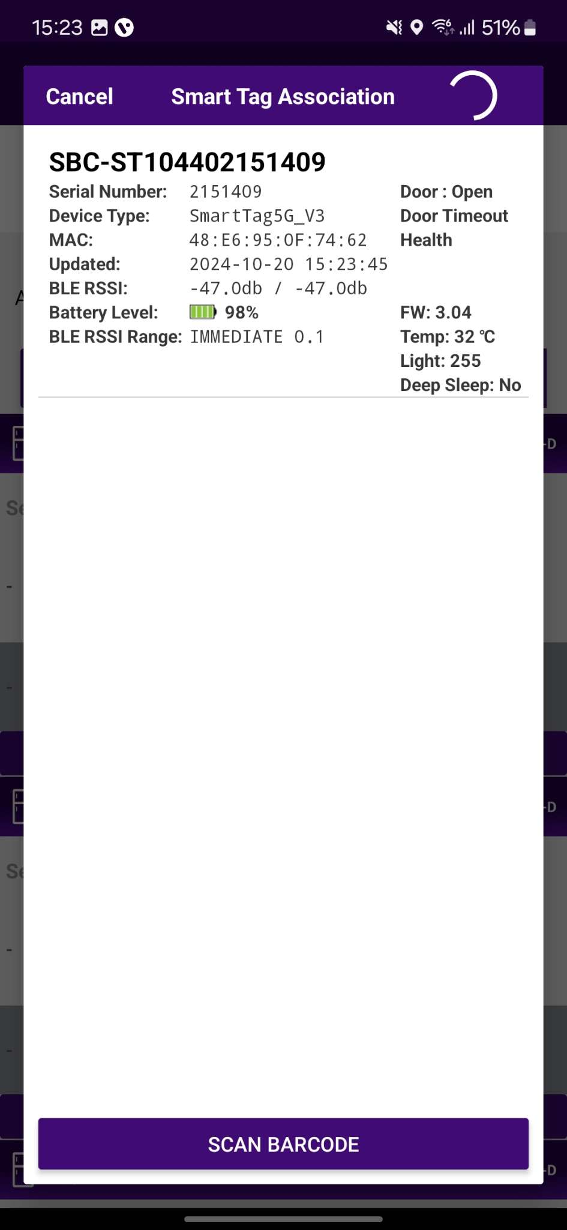
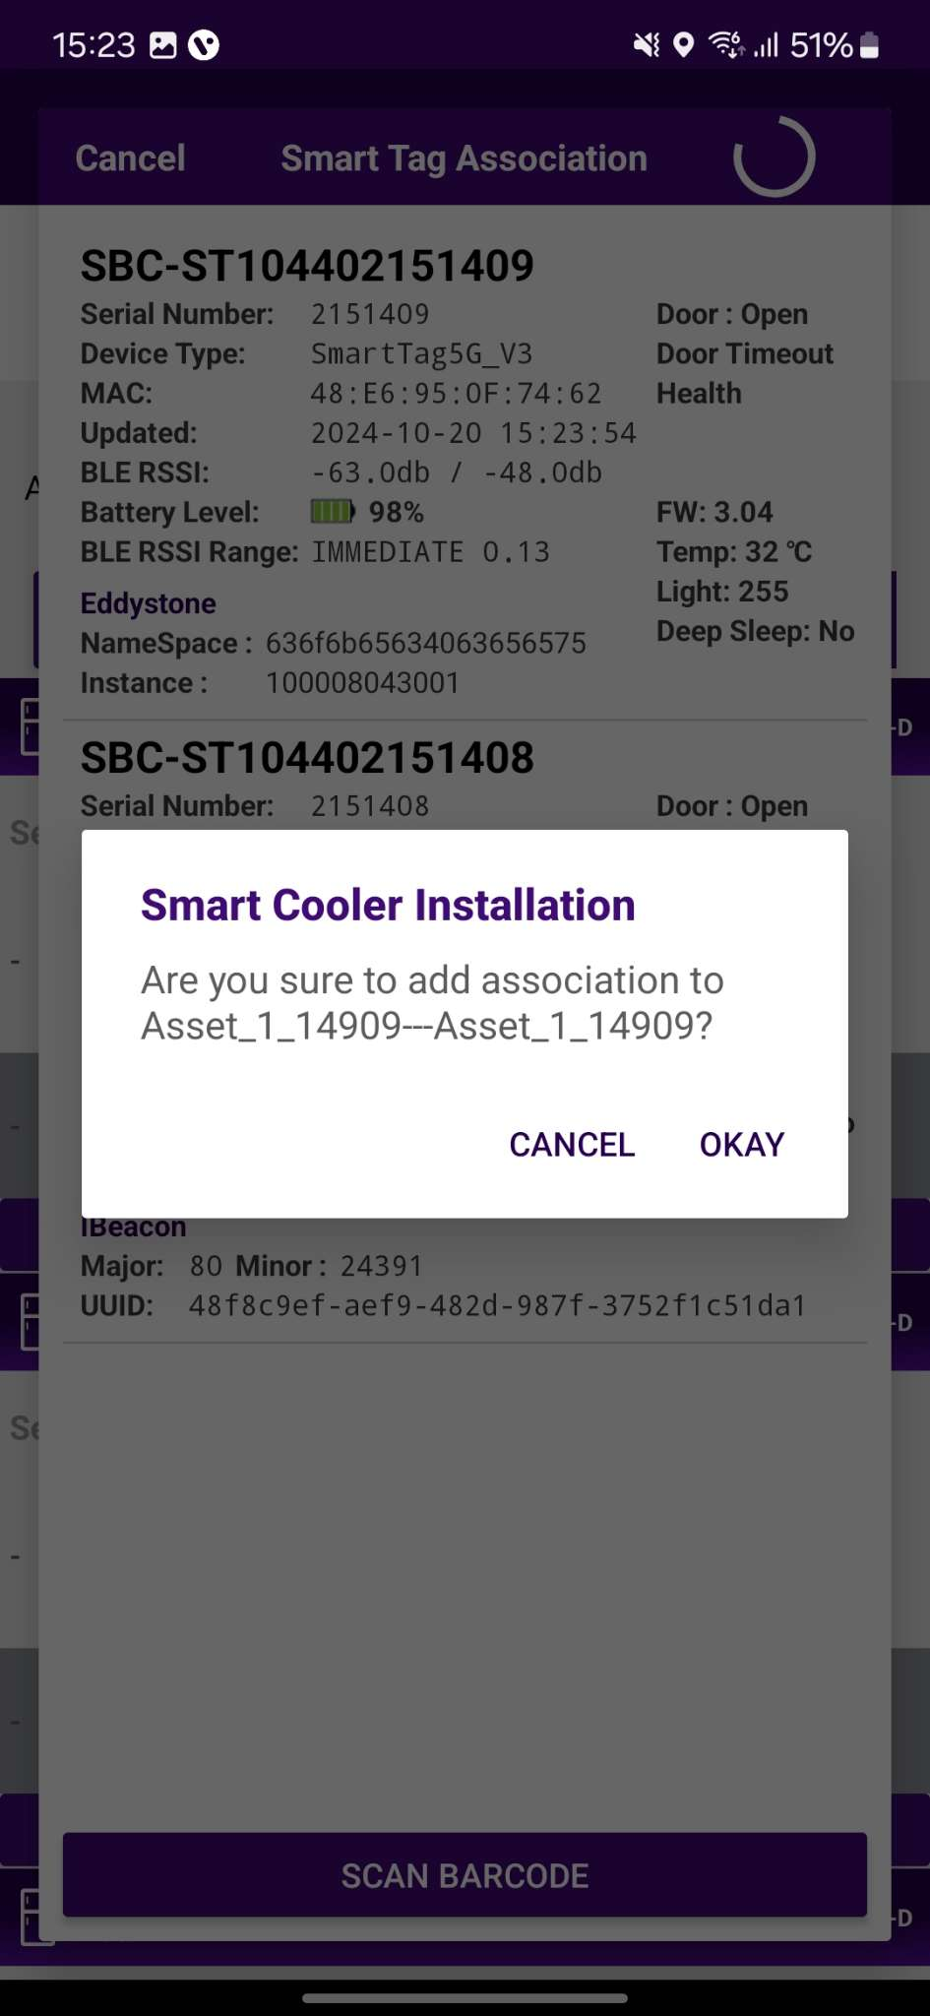
ASSOCIATION – SMART TAG (SMART DEVICE)
1. Selecting Cooler - A new window will open, allowing the User to select the cooler for the outlet selected manually. Click on “Association” to choose the asset to install.
2. Selecting Smart Device type - A new window will open to ask for the selection of device types to be associated with. Click on “SMART TAG ” to associate the SmartTag device.
The user will see a list of unassociated devices; the User can use the door status to identify the installed device.
© 2025 Vision Group

Slide 16
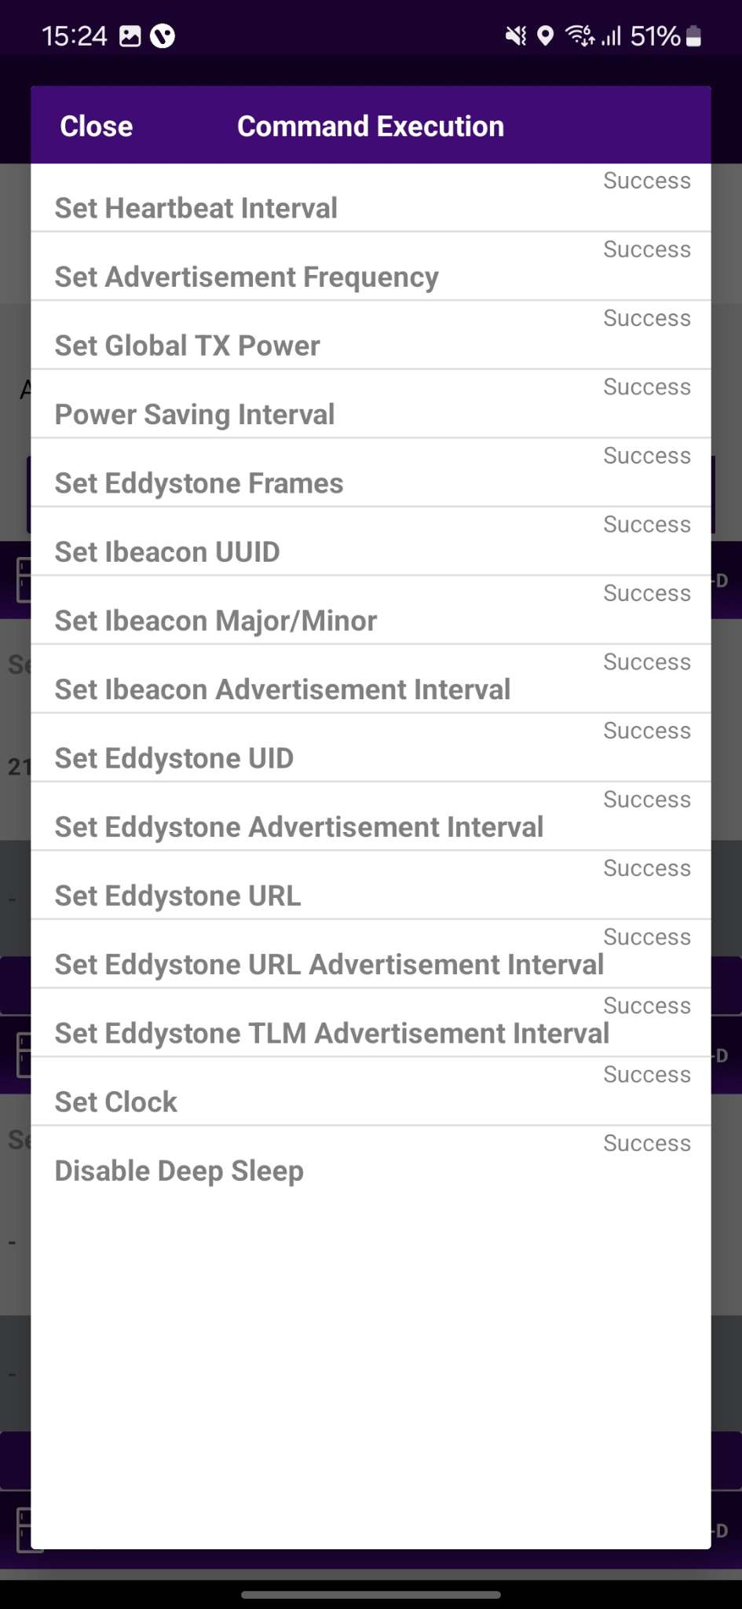
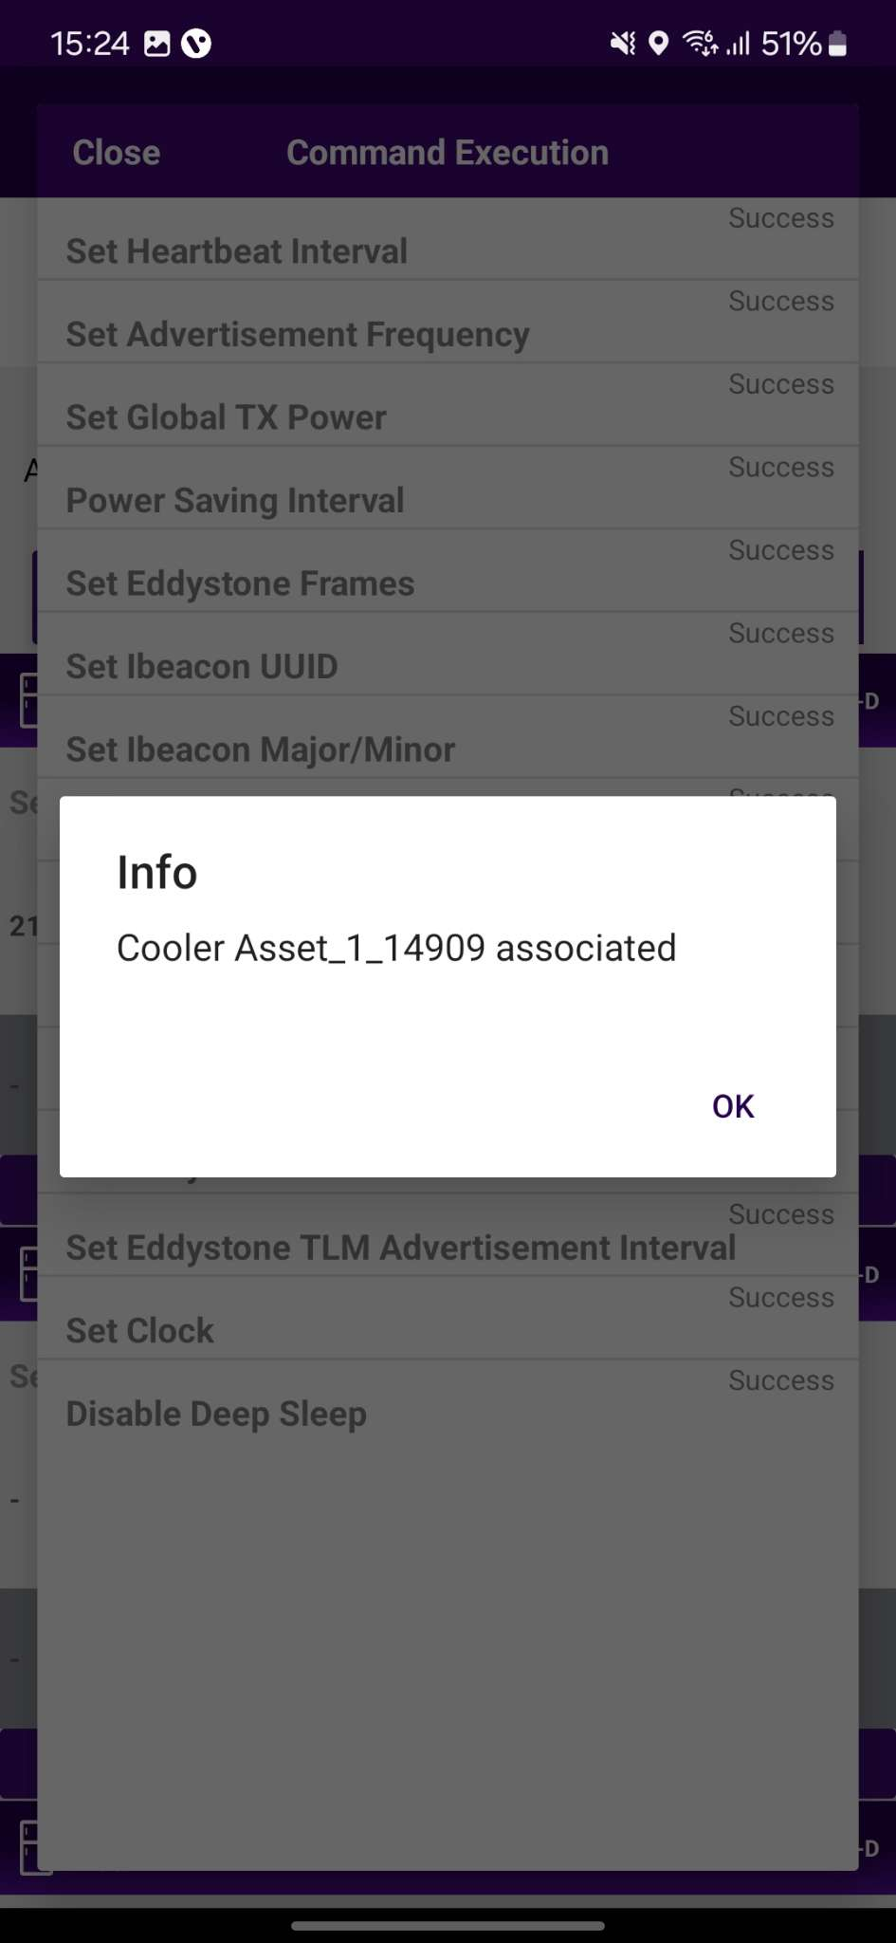
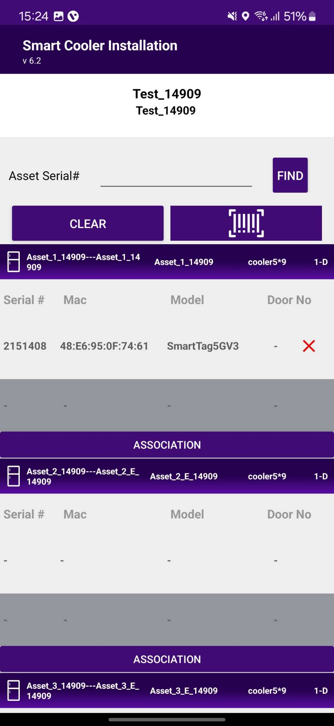
3. Selecting the Device to do the association with - After identifying the device, select it to start the installation process. The app will display a popup asking you to confirm the association. Click "OK" to confirm. Once the process is complete, you will be returned to the Outlet Screen, where you will see that the Proximity/Smart Tag is now associated with the Cooler.
4. Smart Device Configuration Setting - Upon selecting the device, the application will establish a connection, implement all configuration changes, and display a success message once the association is successful. Press "OK" to close the popup. When this window appears, it indicates that the device has been provisioned. The user can then press "Close" to return to the outlet screen.
Note: Please note the device only wakes up when the cooler Door is Open and Closed.
© 2025 Vision Group

Slide 17
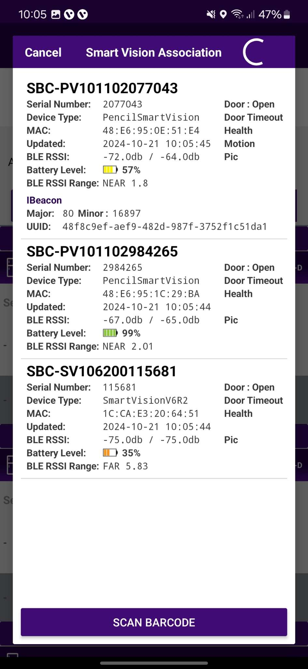
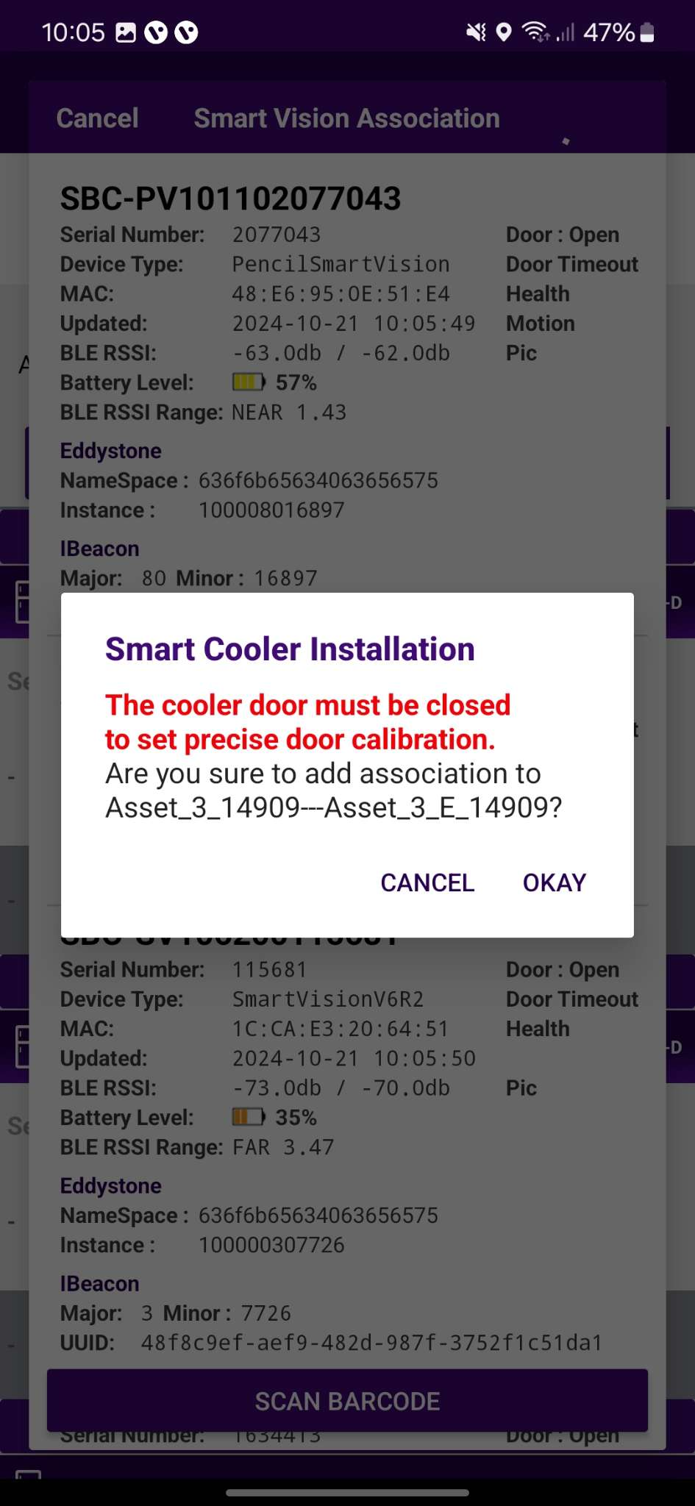
ASSOCIATION – SMART VISION (SMART DEVICE)
1. Selecting Cooler - A new window will open, allowing the User to select the cooler for the outlet selected manually. Click on “Association” to choose the asset to install.
2. Selecting Smart Device type - A new window will open to ask for the selection of device types to be associated with. Click on “SMART VISION ” to associate the SmartVision device.
The user will see a list of unassociated devices; the User can use the door status to identify the installed device.
© 2025 Vision Group

Slide 18
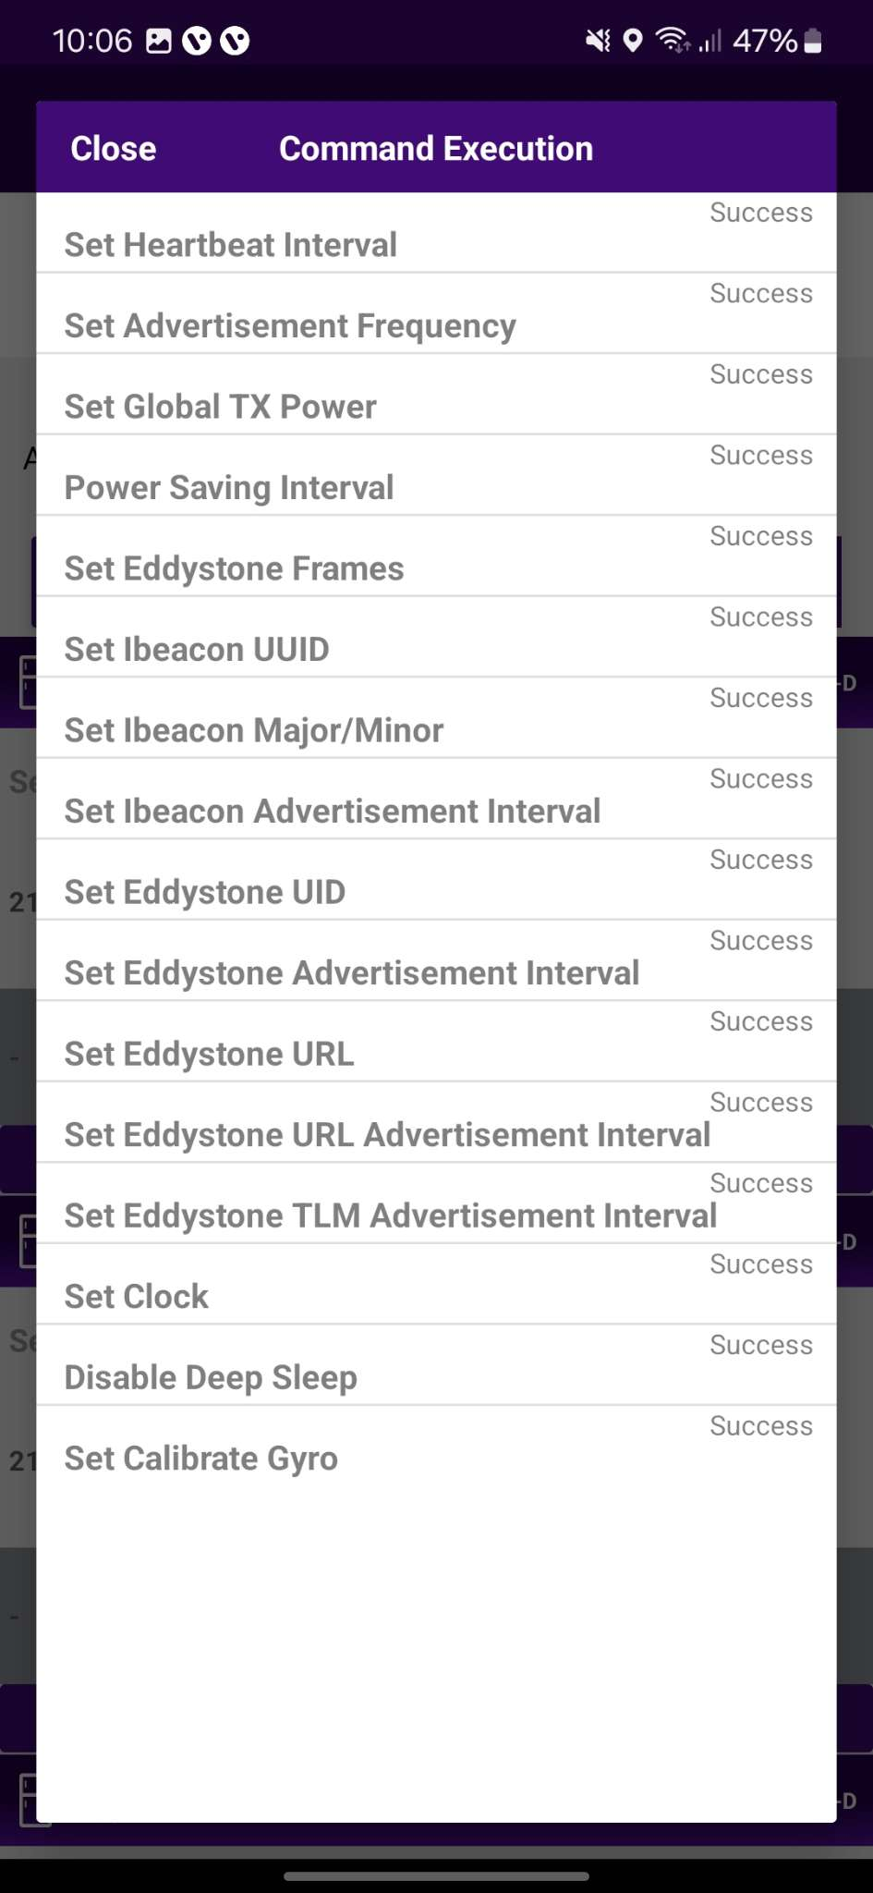
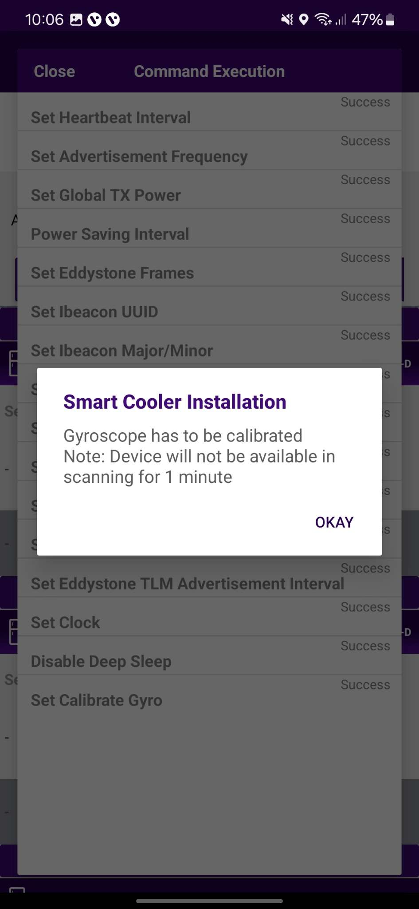
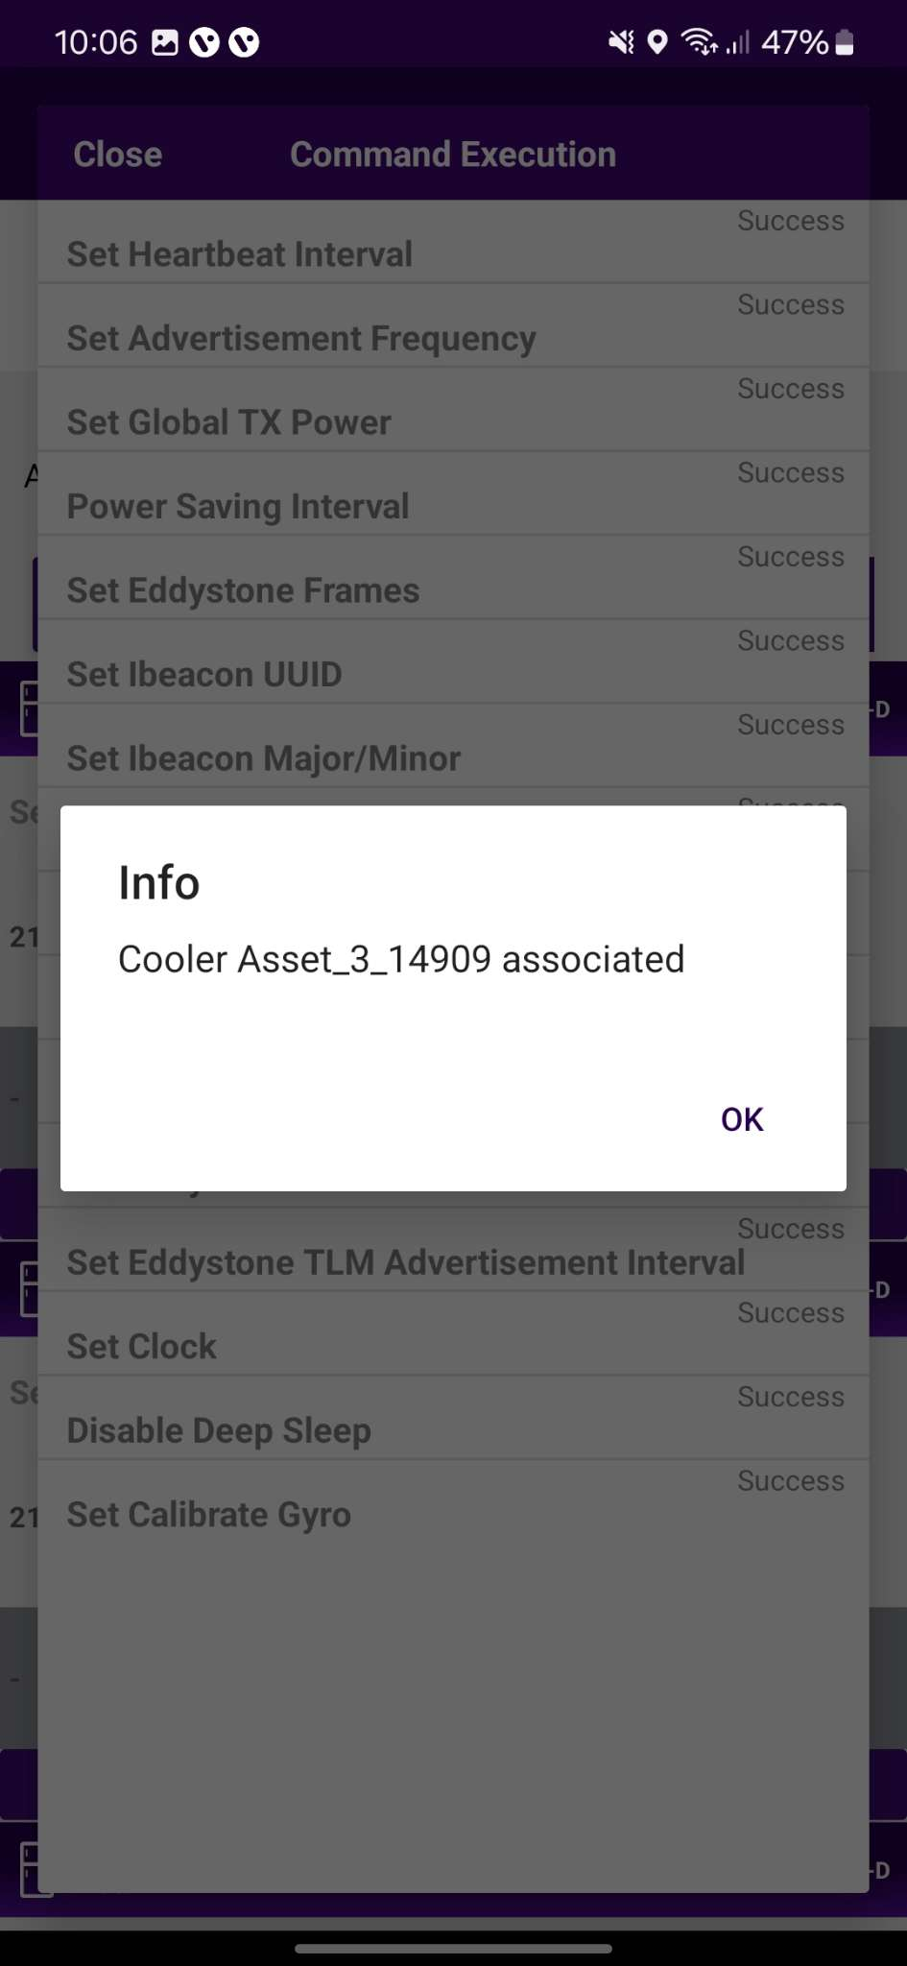
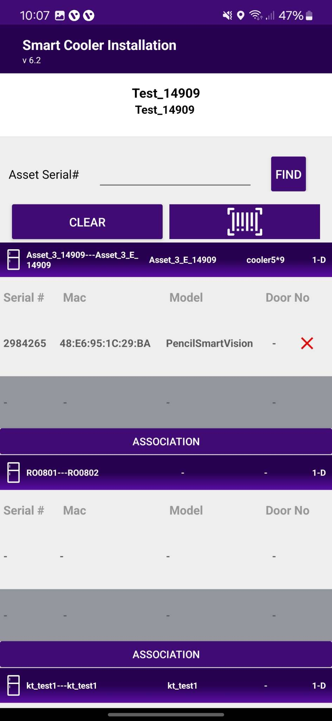
3. Selecting the Device to do the association with - After identifying the device, select it to begin the installation. The app will display a pop-up to confirm the association; click "OK" to confirm. Once the process is complete, you will be redirected to the Outlet Screen, where you will see that the Smart Vision is now associated with the Cooler. When this window appears, it indicates that the gyroscope has been calibrated. You can then press "OK" to return. When the door closes, a pop-up will appear; click "OK" to proceed.
4. Smart Device Configuration Setting - On selection of the device, the application will connect to the device, make all configuration changes and provide a status. A success message will appear after successful association. Press OK to close the pop-up. When this window appears, the device is provisioned, and the User can press close to return to the outlet screen.
Note: Please note the device only wakes up when the cooler Door is Closed for 15 seconds.
© 2025 Vision Group

Slide 19
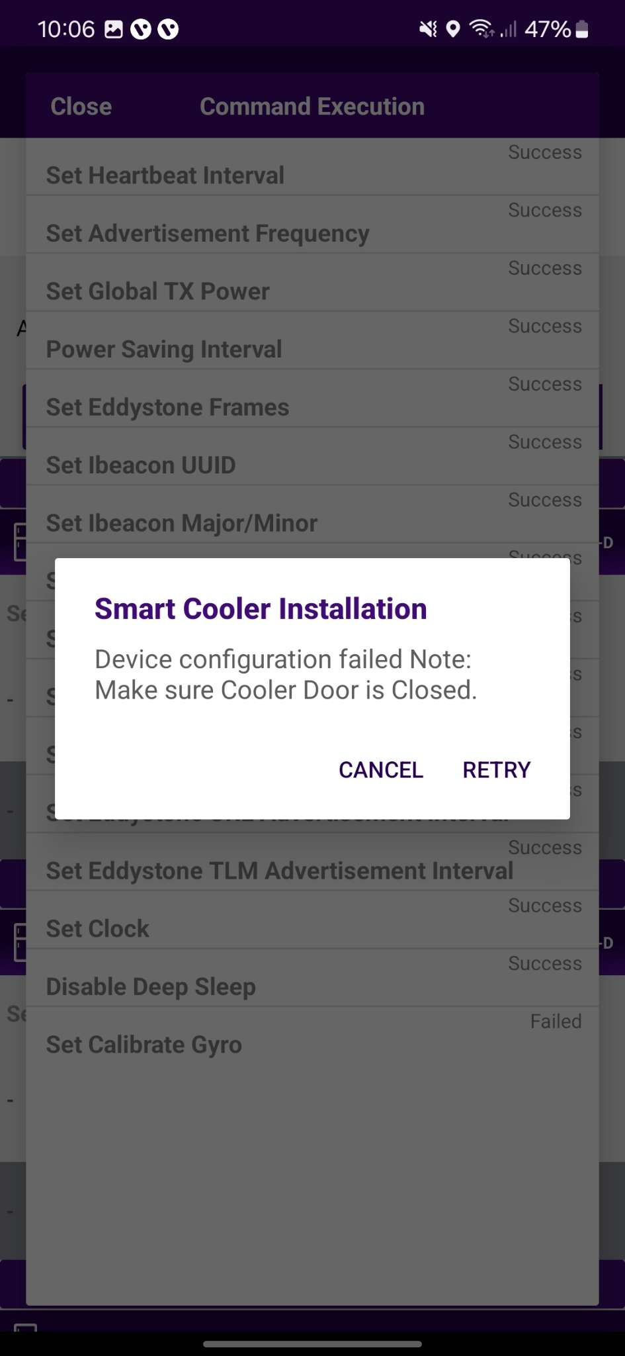
In case the gyro command is not getting a successful response, and it shows waiting or failed.
Waiting
Users can wait for 1 min and if the pop-up does not show then try again.
Failed
Check the door status if it’s “Open” then close the door and Tap on the “Retry”.
© 2025 Vision Group

Slide 20
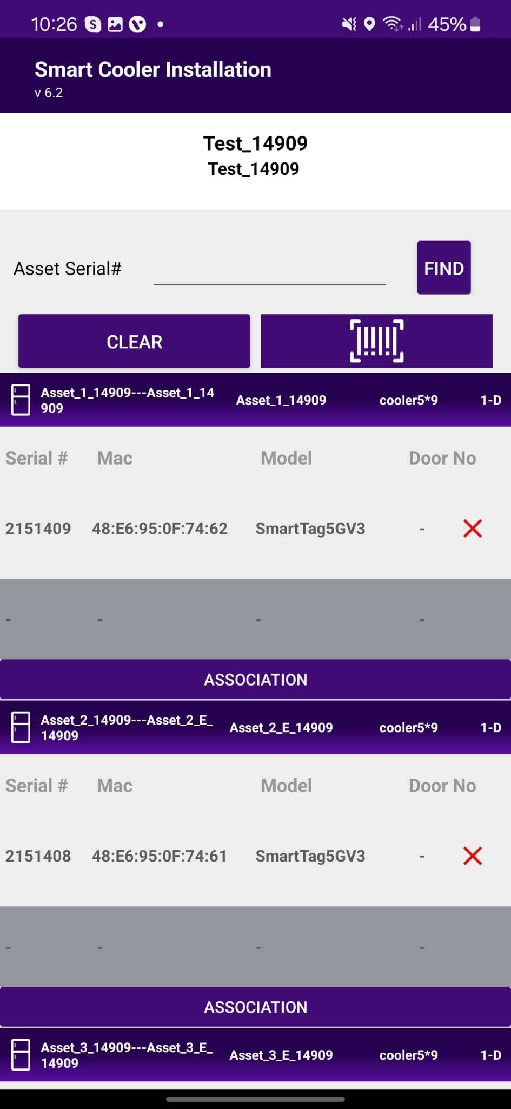
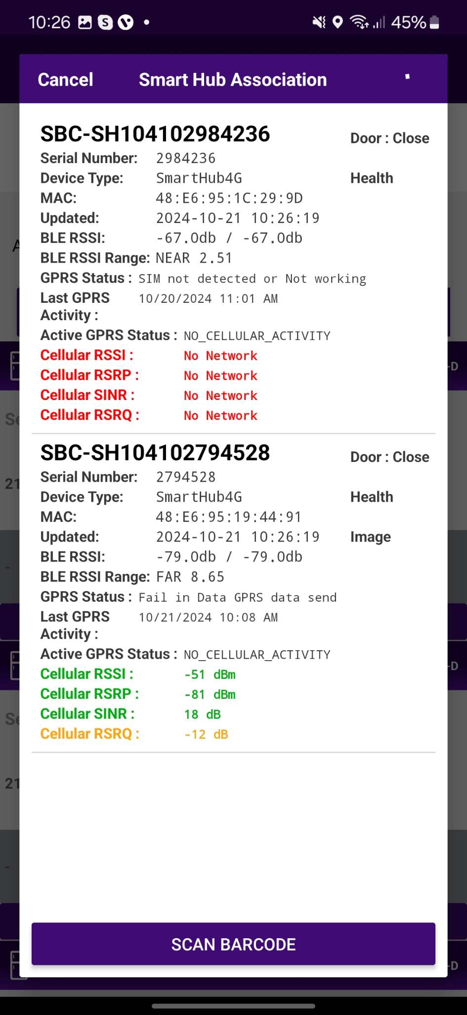
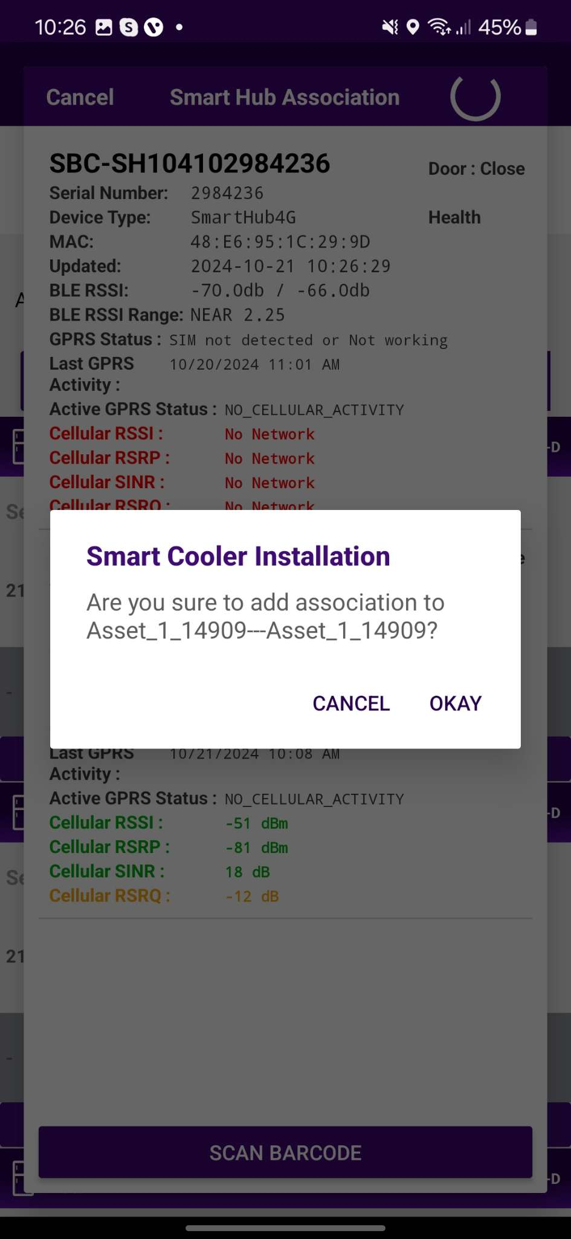
ASSOCIATION – SMART HUB (SMART GATEWAY)
1. Selecting Cooler - A new window will open, allowing the User to select the cooler for the outlet selected manually. Click on “Association” to choose the asset to install.
2. Selecting Smart Device type - A new window will open to ask for the selection of device types to be associated with. Click on “SMART HUB ” to associate the Smart HUB device. Now, Power on the Smart HUB device.
Note: Please note that the gateway device is powered on at association time.
© 2025 Vision Group

Slide 21
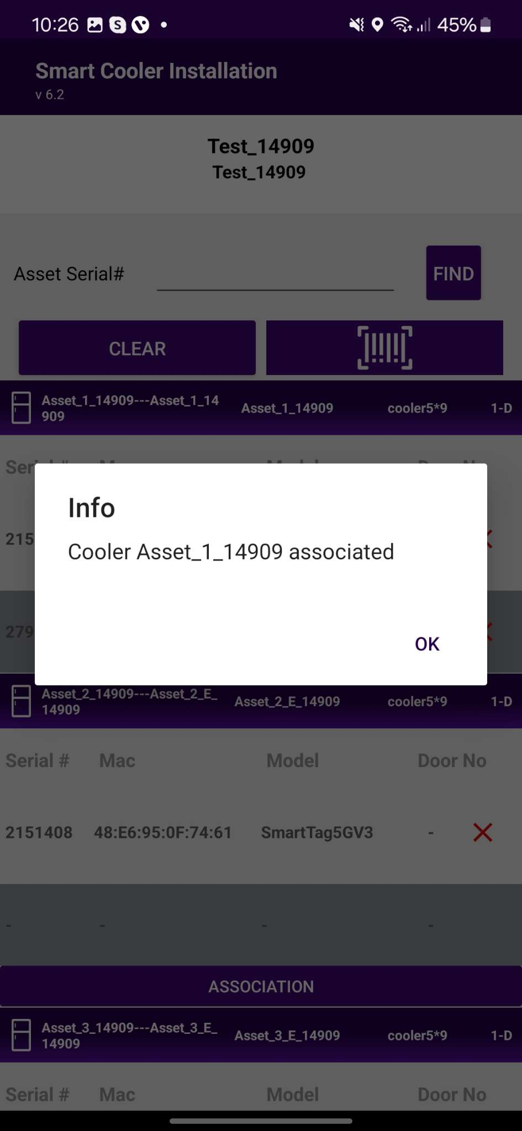
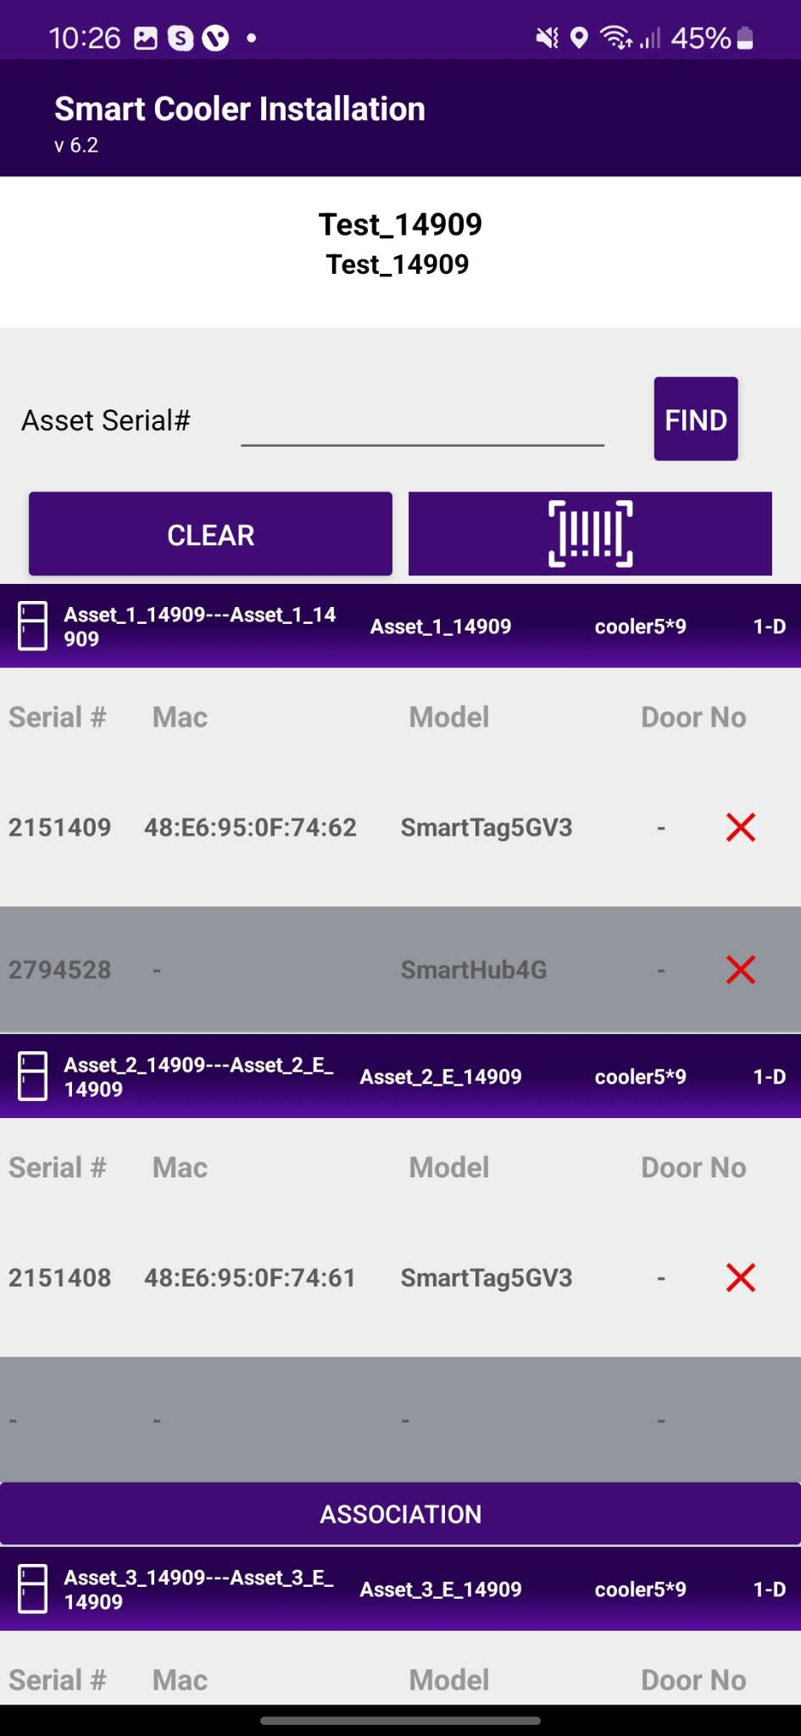
3. Selecting the Device to do the association with - After identifying the device, select it to initiate the installation. The app will display a pop-up to confirm the association. Click "OK" to confirm. Once the process is complete, you will be returned to the Outlet Screen, where you will see that the Smart Hub is now associated with the Cooler.
© 2025 Vision Group

Slide 22
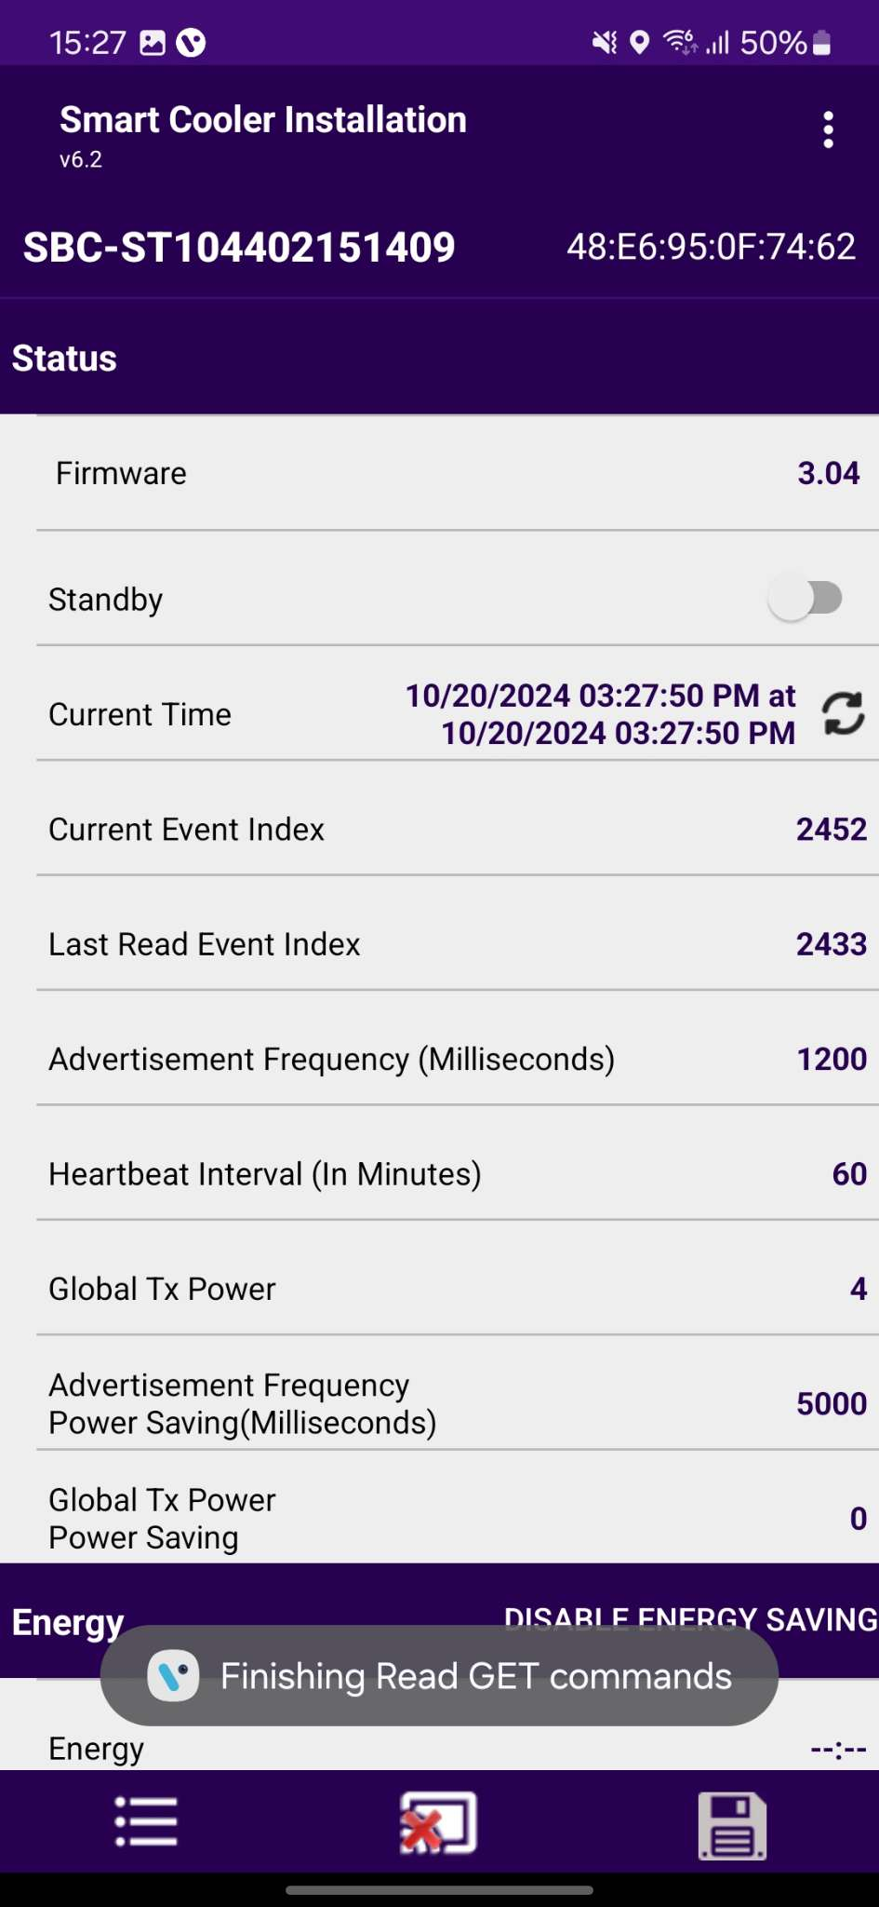
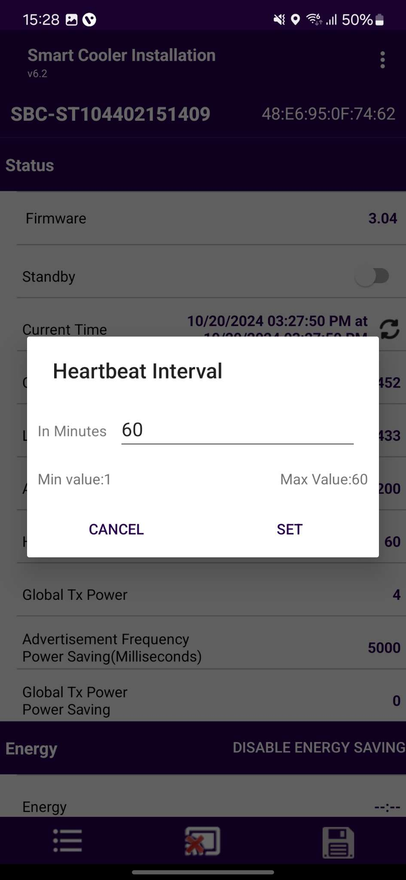
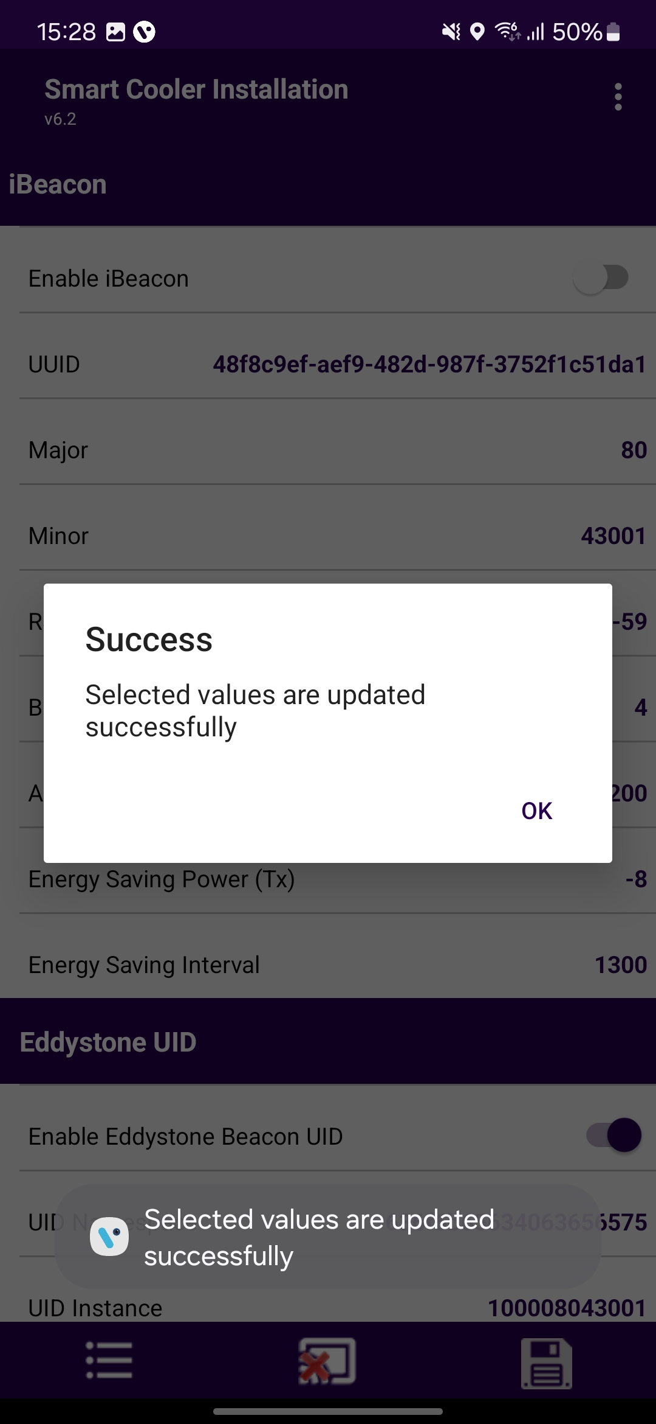

CONFIGURATION - SET HEALTH INTERVAL
After connecting to the device, the user can configure the following parameters: In the STATUS Parameters section, tap on "Heartbeat Interval (in Minutes).
Enter the desired interval value and press the "Set" button.
After changing the values, press the "SAVE" button at the bottom to save the settings on the device.
A
B
© 2025 Vision Group

Slide 23
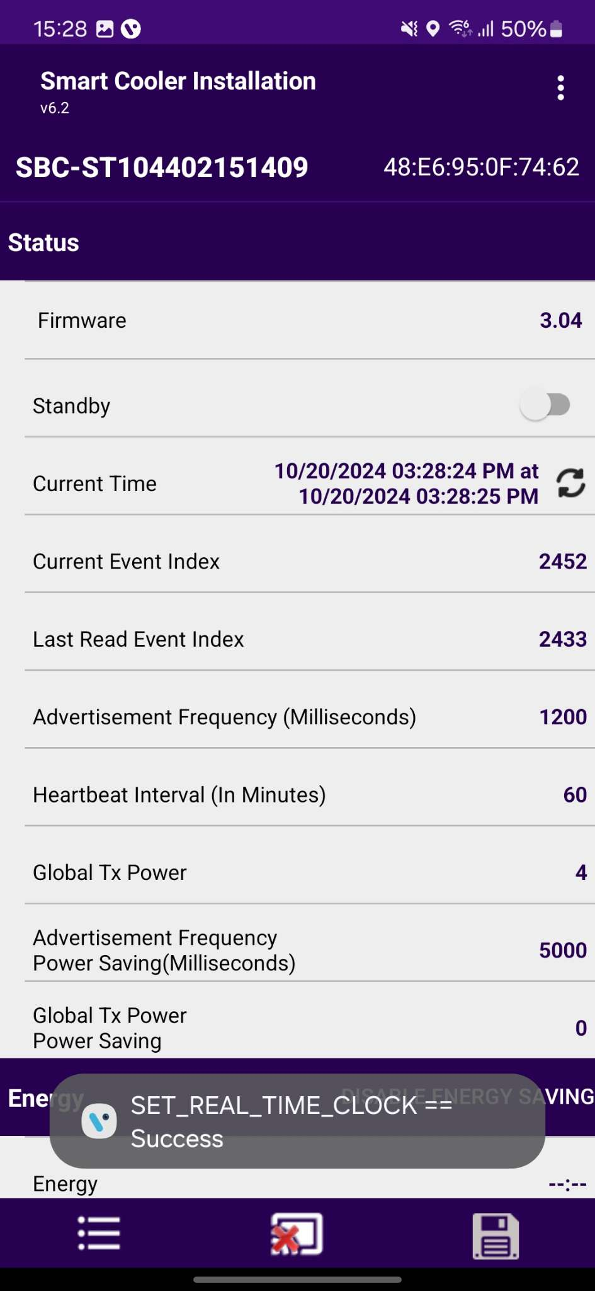
CONFIGURATION - SET CURRENT DATE TIME
After connecting with smart devices, tap on the Refresh button in STATUS > “Current Time” row to set the current time in the device.
After a Successful set, the clock time Pop-up message will show.
© 2025 Vision Group

Slide 24
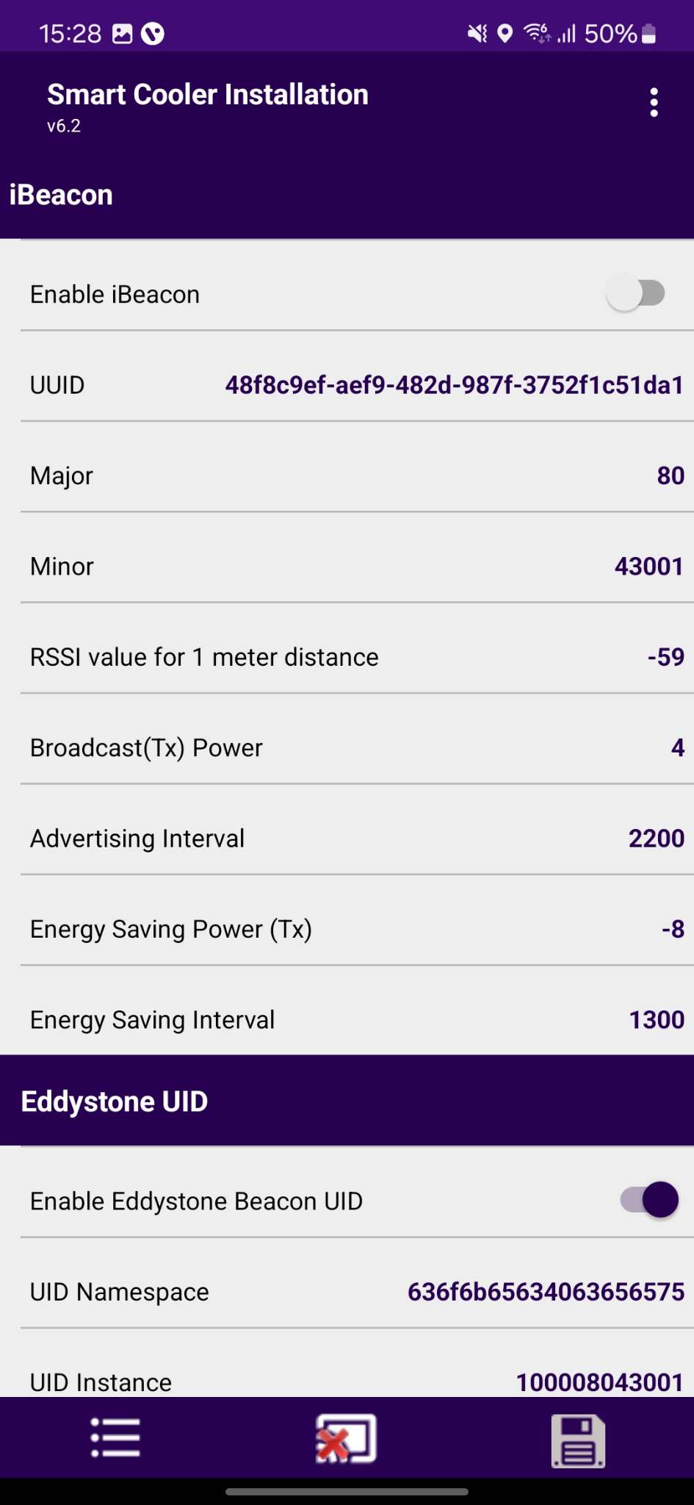
CONFIGURATION - SET IBEACON PARAMETERS
Enable/Disable iBeacon Frame
Toggle button to enable the iBeacon row to enable or disable the iBeacon frame in the iBeacon Raw.
After changing the values, press the SAVE button at the bottom to save it on the device.
© 2025 Vision Group

Slide 25
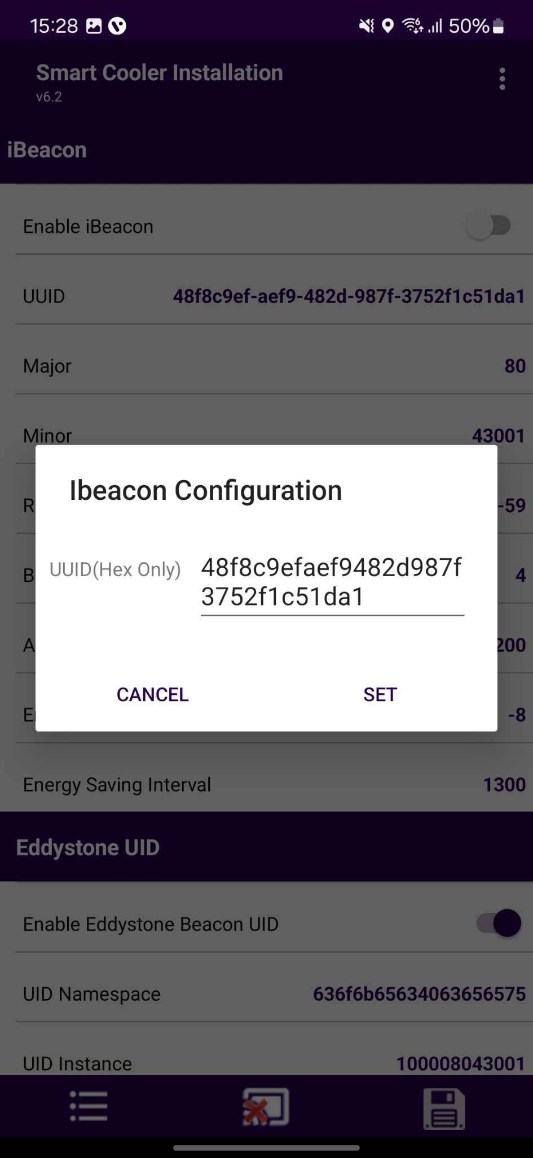
Set UUID
After connection, as shown in the figure, below the iBeacon bar touch on the UUID row.
Enter a 16-byte UUID and press “Set”.
After changing the values, press the SAVE button at the bottom to save it on the device.
© 2025 Vision Group

Slide 26
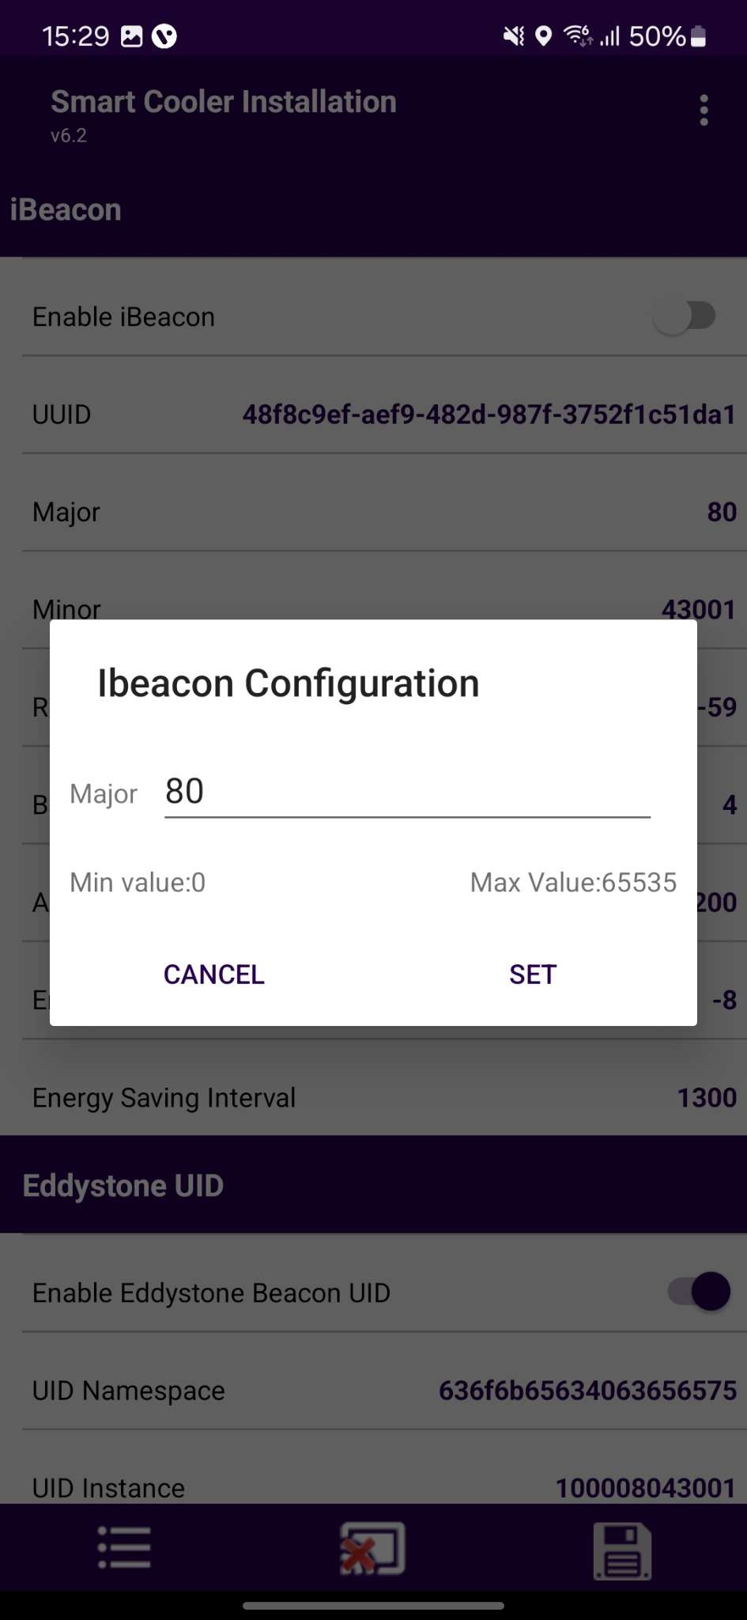
Set Major
After connection, as shown in the figure, below the iBeacon bar, there is a row for Major. Click on any row and write the value as shown below.
Enter the value and press “Set”.
After changing the values, press the SAVE button at the bottom to save it on the device.
© 2025 Vision Group

Slide 27
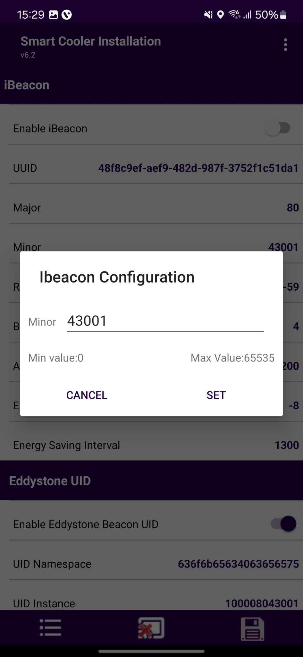
Set Minor
After connection, as shown in the figure, below the iBeacon bar, there is a row for Minor. Click on any row and write the value as shown below.
Enter the value and press “Set”.
After changing the values, press the SAVE button at the bottom to save it on the device.
© 2025 Vision Group

Slide 28
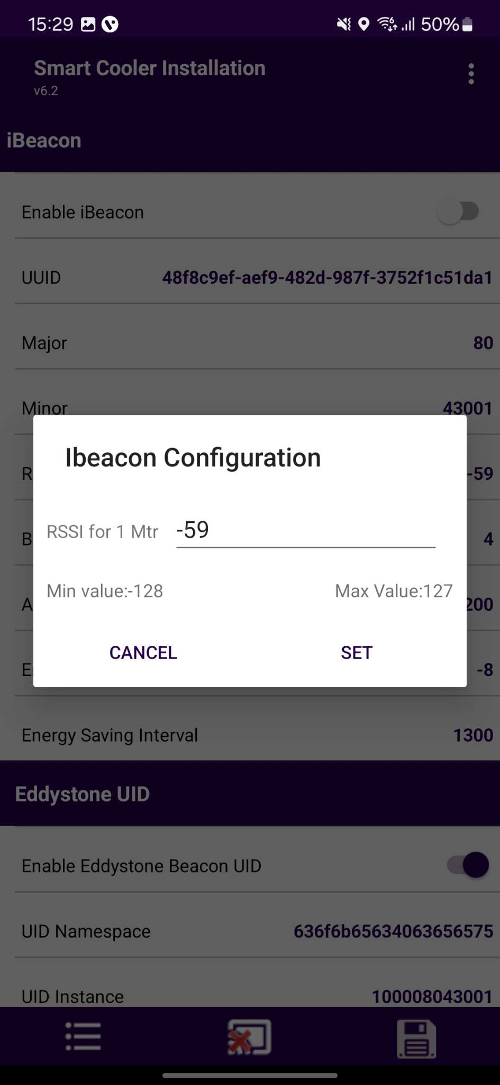
Set RSSI
After connection, as shown in the figure, below the iBeacon bar, there is a row for RSSI. Click on any row and write the value as shown below.
Enter the value and press “Set”.
After changing the values, press the SAVE button at the bottom to save it on the device.
© 2025 Vision Group

Slide 29
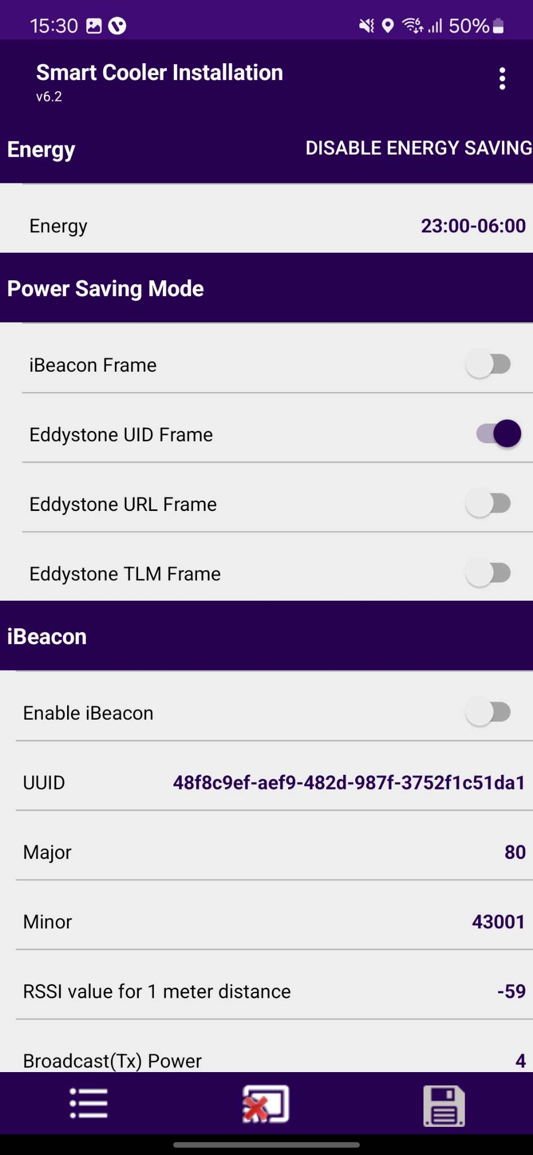
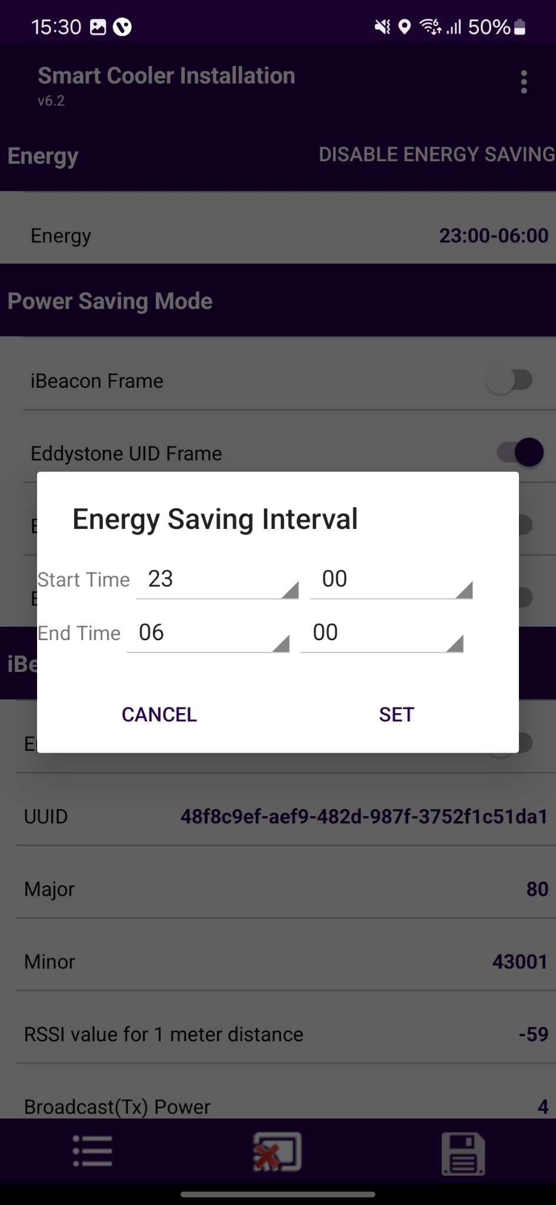
CONFIGURATION - ENERGY SAVING MODE
Set Energy saving mode
Users can set the time duration for saving the power by changing the advertisement interval and it transmits power for that user need to touch on the row Energy Saving Start/End time.
After changing the values, press the SAVE button at the bottom to save it on the device.
© 2025 Vision Group

Slide 30
Disable Energy Saving Mode
Users can disable the energy-saving mode by tapping on the “Disable Energy Saving” as shown in the image.
After changing the values, press the SAVE button at the bottom to save it on the device.
© 2025 Vision Group

Slide 31
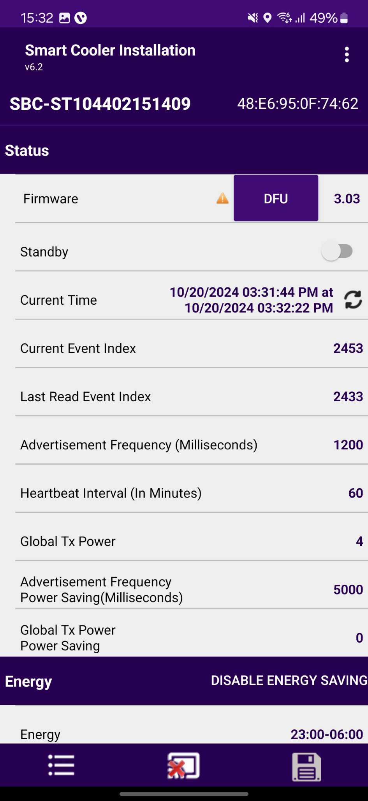
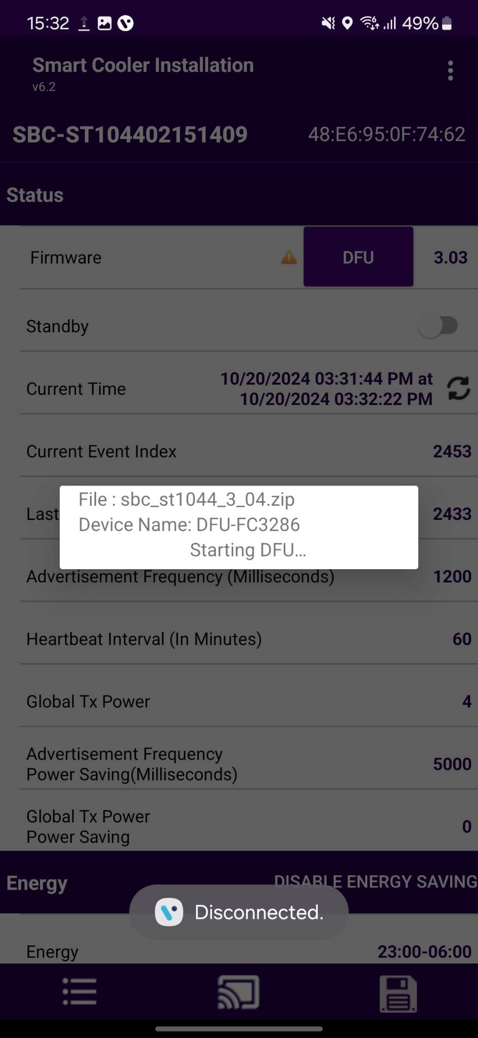
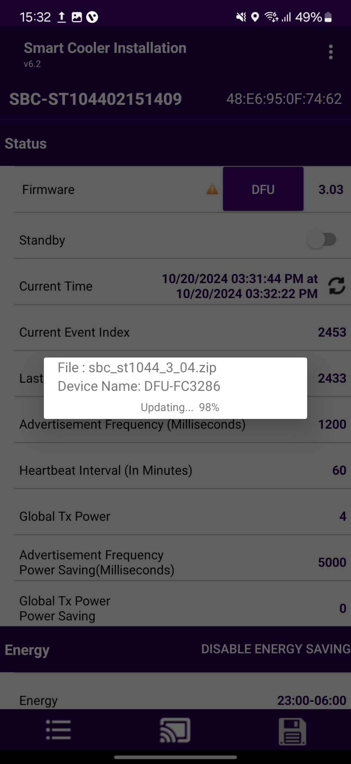

CONFIGURATION – DFU(DIRECT FIRMWARE UPDATE)
DFU - To perform a Direct Firmware Update (DFU) on the Smart device, click the Update DFU Button as illustrated in the image. If the device already has the latest firmware, the DFU flag will not be displayed.
After completing the DFU update, the user will see the DFU Upgrade Process. Once the DFU process is successfully finished, the user can check the upgraded firmware version of the smart device.
© 2025 Vision Group

Slide 32
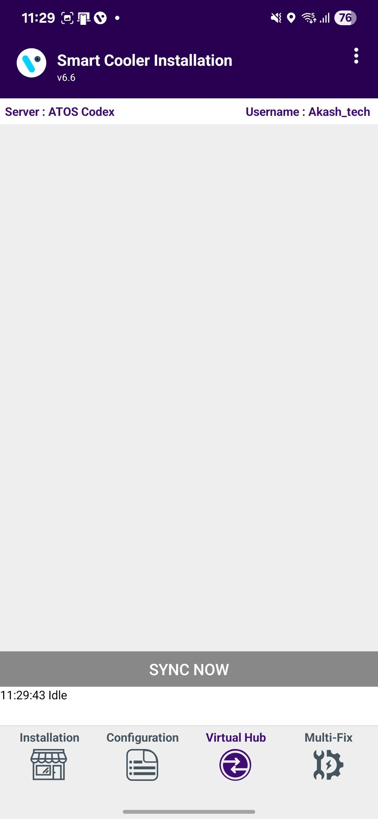
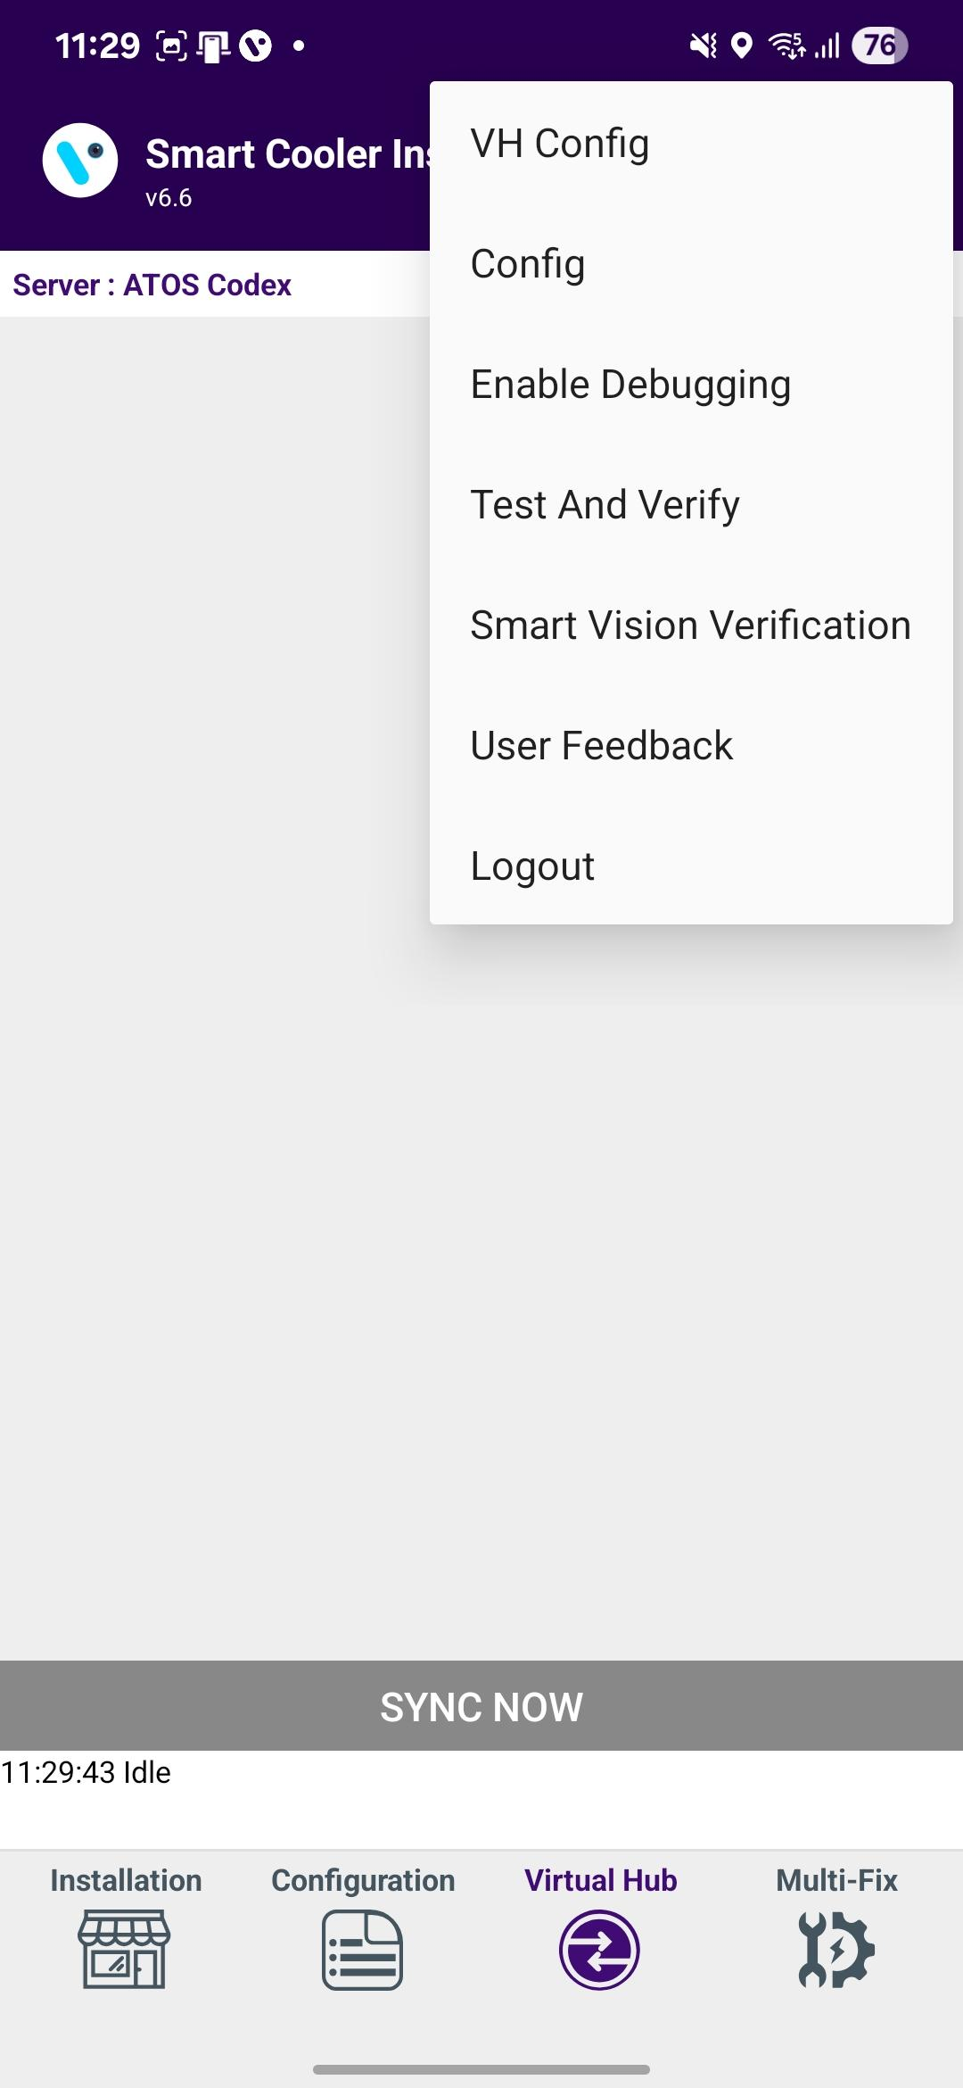
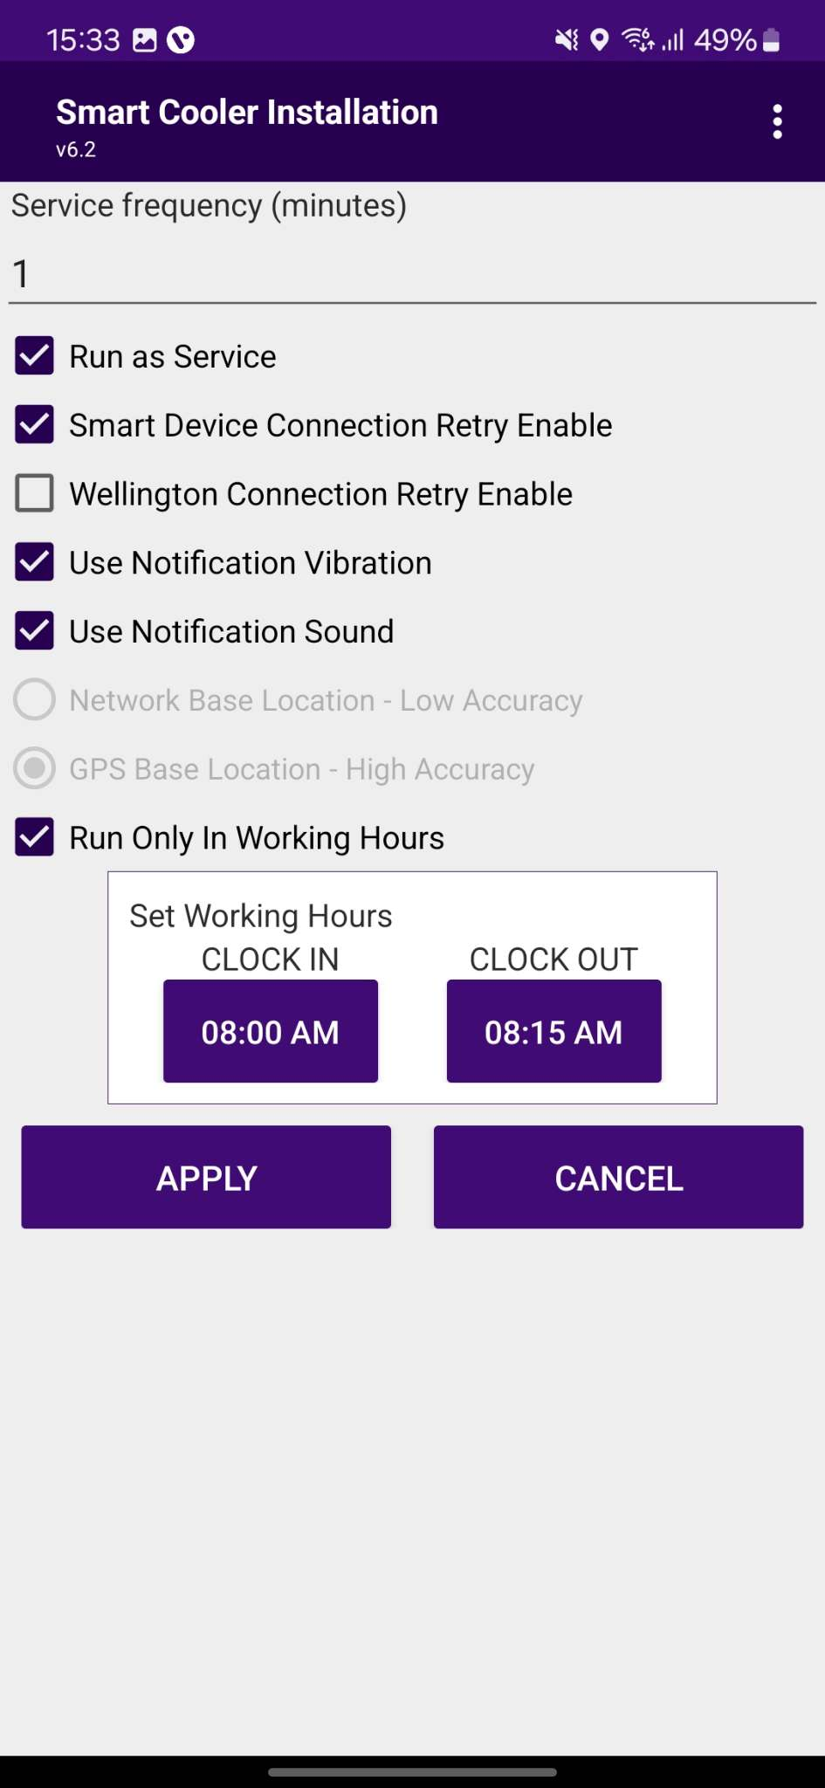
VH PROCESS (VIRTUAL HUB SCREEN PROCESS)
Select the Hamburger Menu(3 Dots/Options Menu) and then Select VH to access the VH Settings.
Run as Service must be checked to activate the VH.
After checking any one of the above, select “APPLY” to commit the settings.
© 2025 Vision Group

Slide 33
VIRTUAL HUB – SETTINGS/OPTION FOR VH SERVICES
1
Service Frequency: This is the delay between consecutive VH sessions.
Run as Service: Check this option if the VH must run.
Connection Retry Option: If the Smart Device or Wellington does not connect in one try, then it is used.
Use GPS Service: Check this option if the GPS service must be used to capture the location of the user.
Working Hours: VH will work during defined working hours.
2
3
4
5
© 2025 Vision Group

Slide 34
VIRTUAL HUB - NOTIFICATION SETTINGS
Enable Vibration – If this option is enabled, the user gets notified by vibration once the data download is complete.
Enable Notification Sound– If this option is enabled, the user gets notified by a sound once the data download is complete.
Notification enables the person collecting the data to identify the data download completion without checking the device manually.
1
2
© 2025 Vision Group

Slide 35
VH SCREEN – DATA DOWNLOAD ACCESS
Application data downloading from Smart Device’s and Upload.
Select here to access the virtual hub screen. All virtual hub activities can be monitored on this screen.
© 2025 Vision Group

Slide 36
VH SCREEN - COMPONENTS
This screen shows the connected devices, and you can monitor the VH data download and upload activities here.
When the phone application retrieves all the data from the device, it will display the message "Data Downloaded and Clock Set." After successfully reading data from all devices, the application will upload the data to the cloud. Once the data upload is complete, the application will indicate "Waiting for Next Execution."
Sync now can be selected to force a manual sync using the virtual hub
© 2025 Vision Group

Slide 37
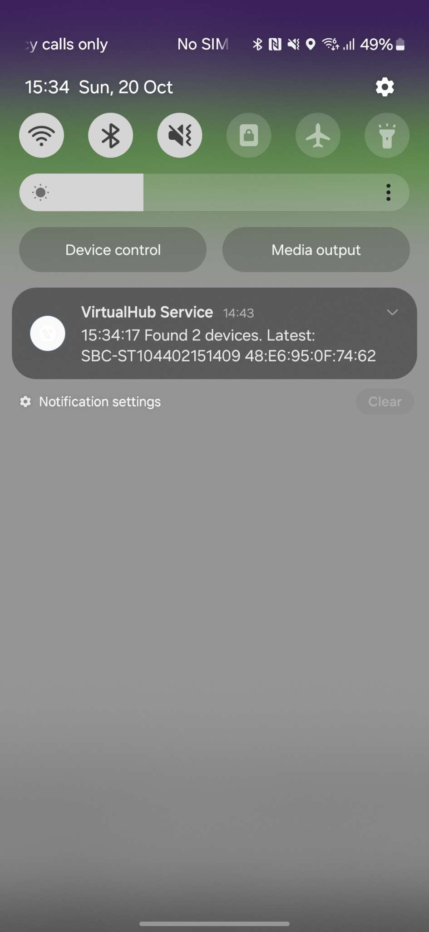
VH SCREEN - NOTIFICATION
Virtual Hub service status is updated by pulling down the notification while the application runs in the background.
© 2025 Vision Group

Slide 38


MULTI-FIX DEVICES - SMART DEVICES
Supported Devices For Multi-Fix: Smart Tags, Pencil Smart Vision, Sollatek FFMB, Sollatek GBR1, Sollatek FFXY
Ex. – Smart Tag 5GV3
Use the “Multi-Fix" feature to fix specific smart devices, as well as firmware version information and DFU functionality if the latest firmware is available for the scanned cooler.
Users can identify assets by scanning the barcode associated with the Cooler Serial Number (SN) or Technical ID. Additionally, users have the option to manually search for the barcode using the Cooler SN or Technical ID.
© 2025 Vision Group

Slide 39




The scanned device will be corrected with the actual smart device's serial number, upgraded to the latest firmware if available, and configured accordingly.
After completing the DFU process, the application starts to configure the device based on the device type and displays a success message once the entire process is complete.
© 2025 Vision Group

Slide 40

MULTI-FIX DEVICES – AON DEVICES
Supported AON Devices For Multi-Fix: Smart Tag AON, Sollatek FDEx2, Sollatek FFM2BB
Ex. – Smart Tag AON
Use the “Multi-Fix" feature to fix specific Smart Tag AON devices, as well as firmware version information and DFU functionality if the latest firmware is available for the scanned cooler.
Users can identify assets by scanning the barcode associated with the Cooler Serial Number (SN) or Technical ID. Additionally, users have the option to manually search for the barcode using the Cooler SN or Technical ID.
© 2025 Vision Group

Slide 41




To broadcast the Smart Tag AON device during scanning, it is necessary to provide 5 to 7 door cycles (door open and close) within 30 seconds.
The scanned device will be corrected with the actual smart device's serial number, upgraded to the latest firmware if available, and configured accordingly.
After completing the DFU process, the application starts to configure the device based on the device type and displays a success message once the entire process is complete.
© 2025 Vision Group

Slide 42



In the event of an error occurring while fixing the faulty Smart Tag AON Devices, Multi-Fix Logs will be automatically collected, along with the necessary details. An email will be drafted by the iOS application, providing an option to send it to the Vision IoT Support team.
© 2025 Vision Group

Slide 43

Ex. – Sollatek FDEx2
Use the “Multi-Fix" feature to fix specific Sollatek FDEx2 devices, as well as firmware version information and DFU functionality if the latest firmware is available for the scanned cooler.
Users can identify assets by scanning the barcode associated with the Cooler Serial Number (SN) or Technical ID. Additionally, users have the option to manually search for the barcode using the Cooler SN or Technical ID.
© 2025 Vision Group

Slide 44




The scanned device will be corrected with the actual smart device's serial number, upgraded to the latest firmware if available, and configured accordingly.
After completing the DFU process, the application starts to configure the device based on the device type and displays a success message once the entire process is complete.
© 2025 Vision Group

Slide 45
In the event of an error occurring while fixing the faulty Sollatek Devices, Multi-Fix Logs will be automatically collected, along with the necessary details. An email will be drafted by the iOS application, providing an option to send it to the Vision IoT Support team.
© 2025 Vision Group

Slide 46


TEST AND VERIFY – SMART DEVICES
This feature involves verifying fixed devices after addressing any faulty fix features to ensure accurate iBeacon and Eddystone advertisement frame values.
Users can identify assets by scanning the barcode using the Cooler Serial Number (SN) or Technical ID. Additionally, users have the option to manually search for the barcode associated with the Cooler Serial Number or Technical ID.
© 2025 Vision Group

Slide 47




The application is requesting a door cycle to verify the data from the smart device’s door sensor.
After completing the Door Cycle, the device will display the advertisement frame values alongside the smart device and cloud values. By pressing the Download Event button, users can log Door Events to verify the Door Event.
© 2025 Vision Group

Slide 48

TEST AND VERIFY – SMART TAG AON DEVICES
This feature involves verifying fixed devices after addressing any faulty fix features to ensure accurate iBeacon and Eddystone advertisement frame values, GPRS Intervals values, URL values, and APN values.
Users can identify assets by scanning the barcode using the Cooler Serial Number (SN) or Technical ID. Additionally, users have the option to manually search for the barcode associated with the Cooler Serial Number or Technical ID.
© 2025 Vision Group

Slide 49



The application is requesting a door cycle to verify the data from the smart device’s door sensor.
After completing the Door Cycle, the device will display the advertisement frame values alongside the smart device and cloud values. By pressing the Download Event button, users can log Door Events to verify the Door Event.
© 2025 Vision Group

Slide 50

TEST AND VERIFY – SOLLATEK DEVICES
This feature involves verifying fixed devices after addressing any faulty fix features to ensure accurate iBeacon and Eddystone advertisement frame values, GPRS Intervals values, URL values, and APN values.
Users can identify assets by scanning the barcode using the Cooler Serial Number (SN) or Technical ID. Additionally, users have the option to manually search for the barcode associated with the Cooler Serial Number or Technical ID.
© 2025 Vision Group

Slide 51




The application is requesting a door cycle to verify the data from the smart device’s door sensor.
After completing the Door Cycle, the device will display the advertisement frame values alongside the smart device and cloud values. By pressing the Download Event button, users can log Door Events to verify the Door Event.
© 2025 Vision Group

Slide 52


Thank You!
support.iot@visiongroupretail.com
+1-833-593-0144 (USA Tollfree Number)

