Slide 1

VH Lite
Android Installation Guide
November 2025
© 2025 Vision Group

Slide 2

APPLICATION FEATURES
CONNECT: Establish a connection with nearby third-party devices.
DATA DOWNLOAD: Download data from nearby Carel, Wellington, and Syos third-party devices.
DATA UPLOAD: Upload collected data from third-party devices to the server.
GHOST COOLER: Locate the Ghost Cooler and update its record in the server's Ghost Asset table for Wellington and Syos' third-party devices.
Note:
The whitelist functionality supports only two device types: Carel and Nexo.
Nexo device support has been removed from application version 7.4.
Occasionally, the login button may not appear on the login screen. This indicates that the app is fetching the latitude and longitude from the mobile device. Without this location information, users cannot log in.
© 2025 Vision Group

Slide 3
DEVICE SUPPORT AND CONTROL
SYOS SUPPORTED DEVICE: SYOS Beacon, SYOS Dongle
Scan and download data based on the client key assigned to the user.
WELLINGTON SUPPORTED DEVICES: Wellington SCS, Wellington CLICK
Data Download based on the Bottler Key assigned to User Clients.
CAREL SUPPORTED DEVICE: PJBT, IJBT, PJBT CCH, IJBT CCH
All devices are supported based on a whitelist logic specific to each logged-in user.
All configuration changes can only be added or updated on the portal. For any creation or modification, please contact the Project Manager or the Vision Support team at support.iot@visiongroupretail.com.
© 2025 Vision Group

Slide 4
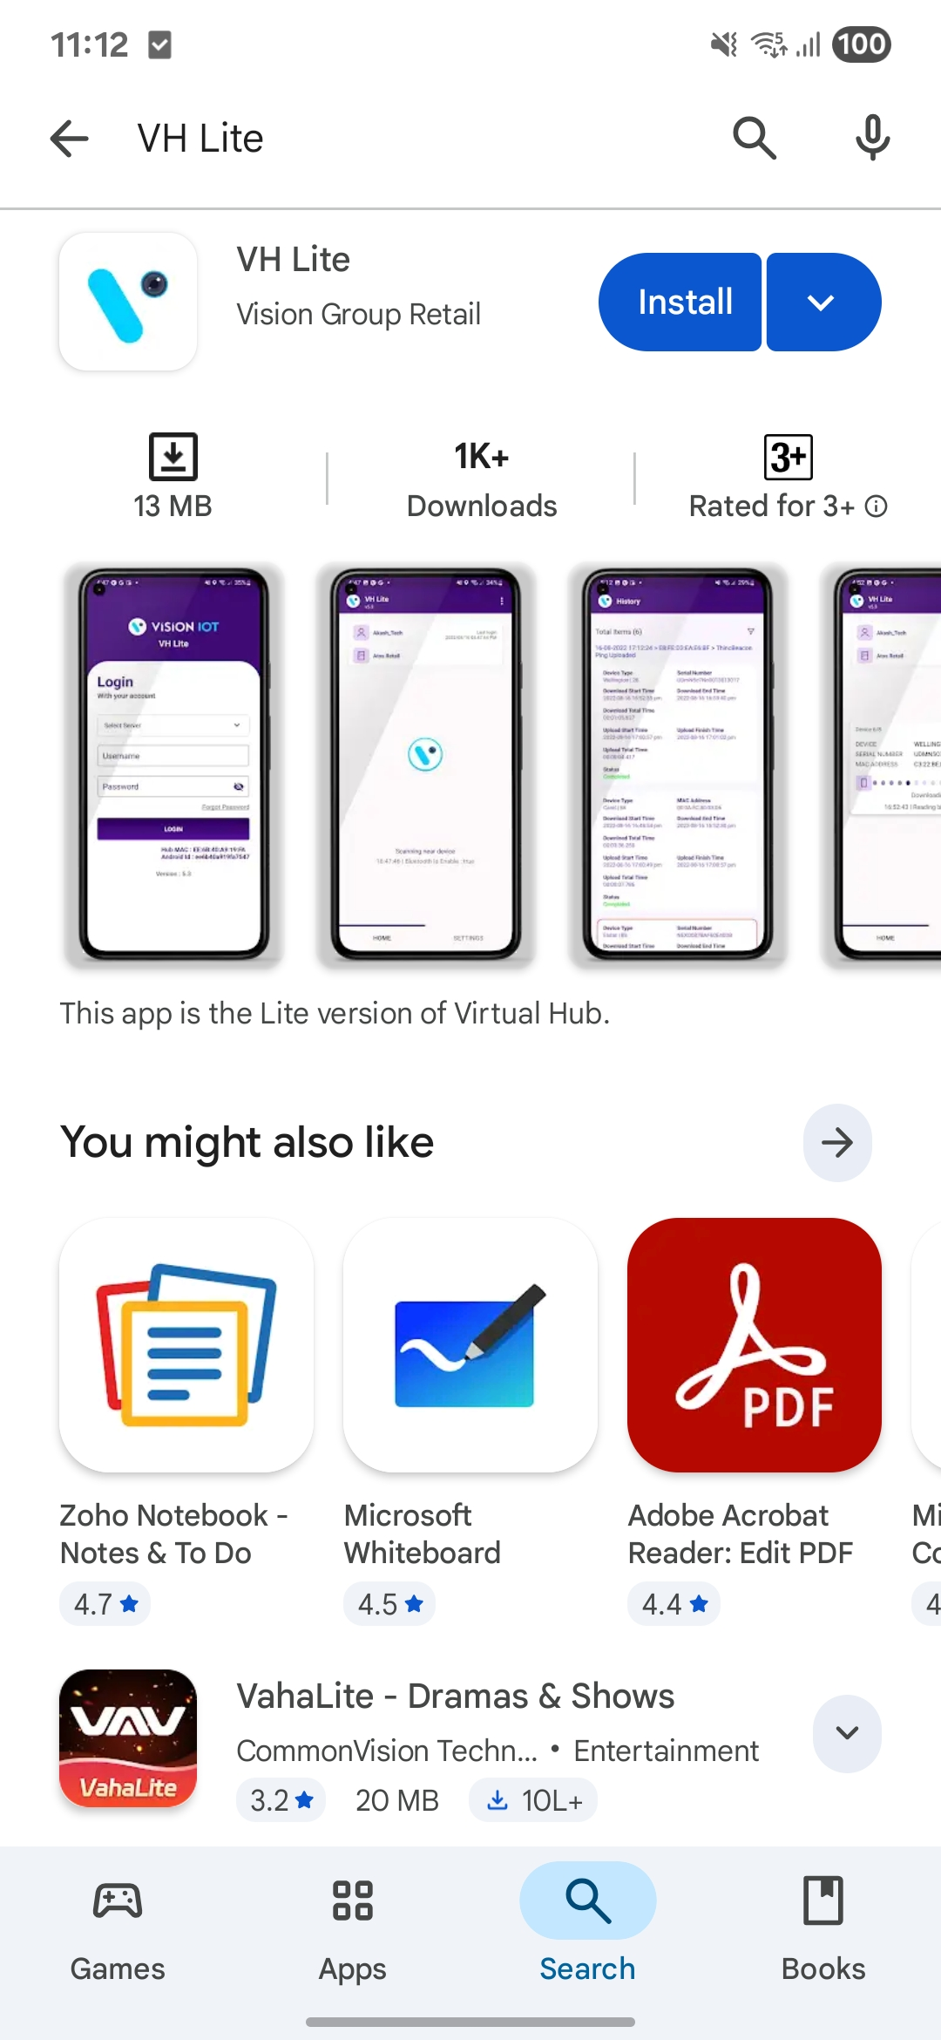
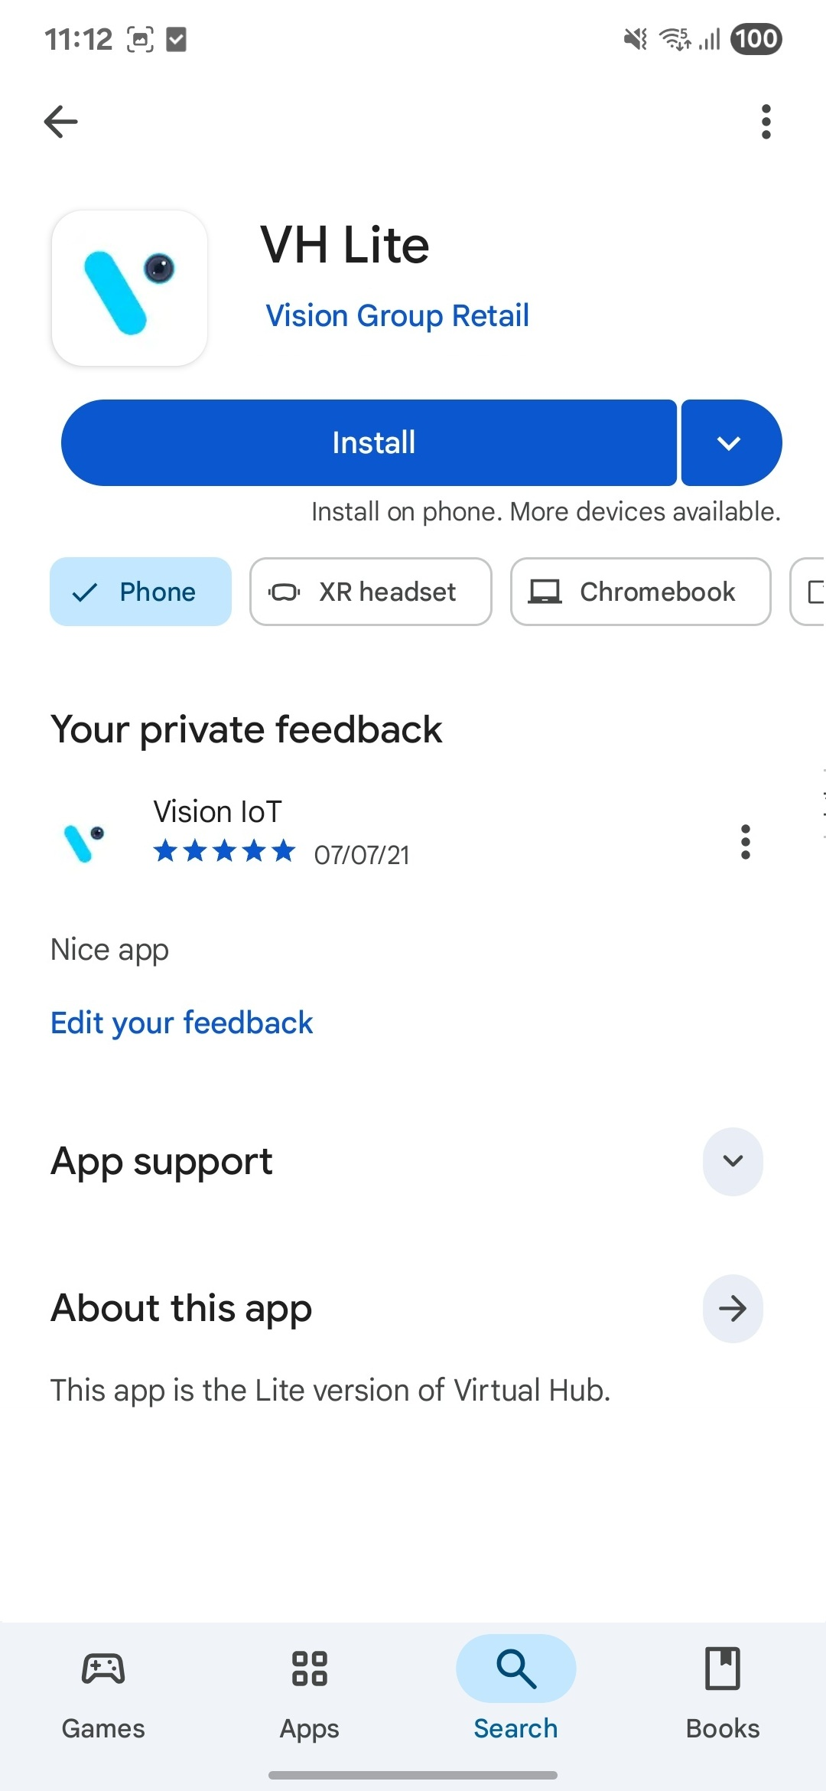
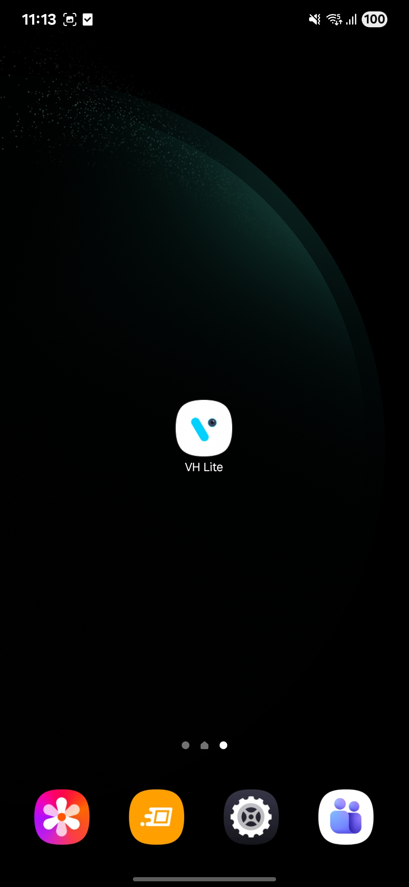
APPLICATION INSTALLATION
Please remember the following instructions: Please open the Play Store on an Android device, search for the "VH Lite" application, and install it.
Make sure to uninstall the previous version of the application before installing the new version.
© 2025 Vision Group

Slide 5
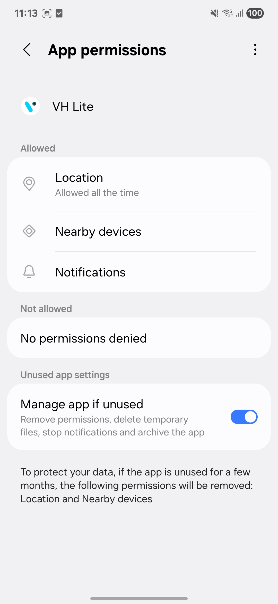
APPLICATION PERMISSION
After the initial installation and launch, the application will request permission to access files and media, location, and nearby devices. Users need to allow these permissions.
LOCATION PERMISSION
To enable beacon discovery, select 'Allow While Using' for Android OS 12 and above.
Navigate to Settings > Application List > Location and set "Allow Location Access" to "Always."
NOTIFICATION PERMISSION
- Enable notifications to receive alerts about data downloads. Select “Allow.”
BLUETOOTH PERMISSION
Enable Bluetooth to scan barcodes on the Outlet screen by selecting "OK" on the first prompt.
© 2025 Vision Group

Slide 6
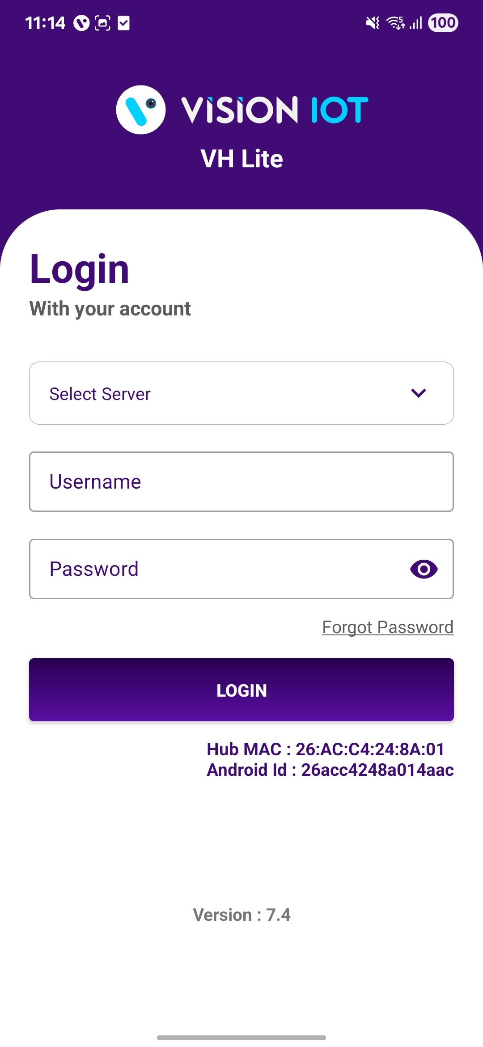
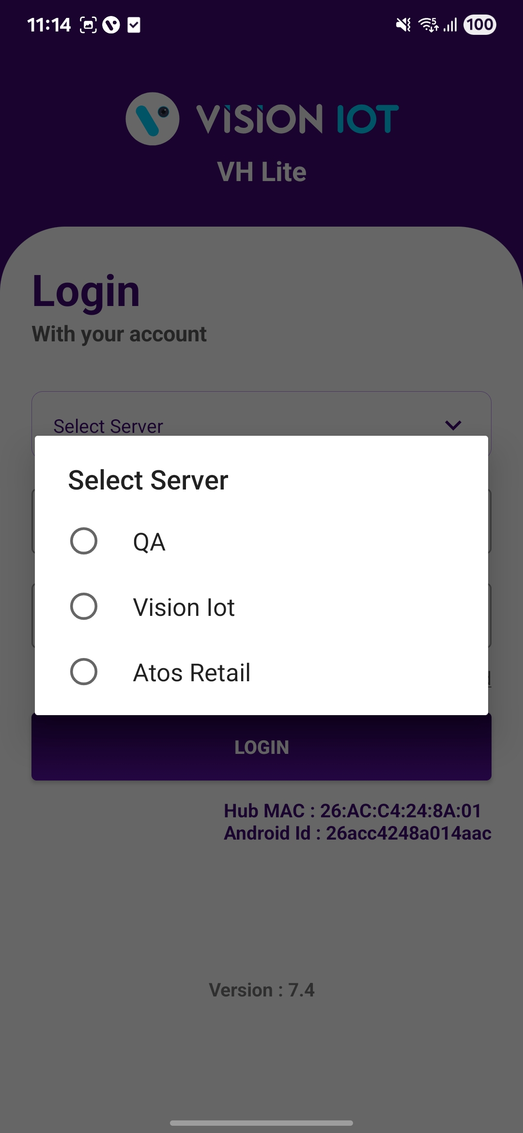
LOGIN
Once the User has successfully installed the VH Lite Application, open it to be redirected to the Login Page. From the server list, select the appropriate server and log in using the credentials provided by your administrator. This will enable access the application successfully.
Choose Server: The Vision IoT server should be chosen.
Make sure that Bluetooth and Mobile Wi-Fi or Mobile Data are turned on in your device.
Bluetooth and location services must be enabled.
An internet connection is required for the initial login to the application.
After the initial login, the application can operate in offline mode, as long as the same username and password used for the online login are provided.
Minimum device requirements: The device must have at least 4 GB of RAM and Bluetooth version 4.2 or higher.
The minimum operating system requirement for the mobile device is OS 12 or higher.
© 2025 Vision Group

Slide 7
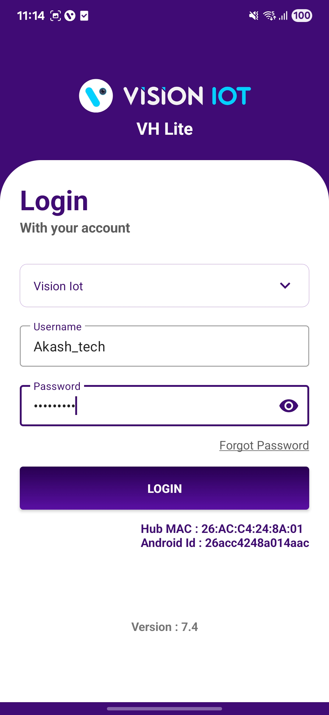
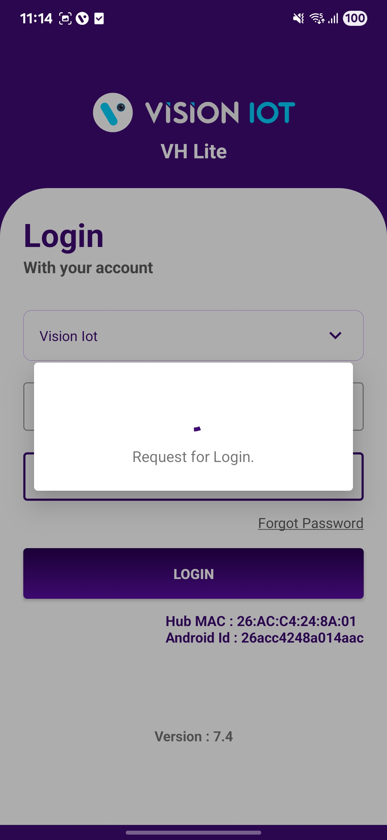
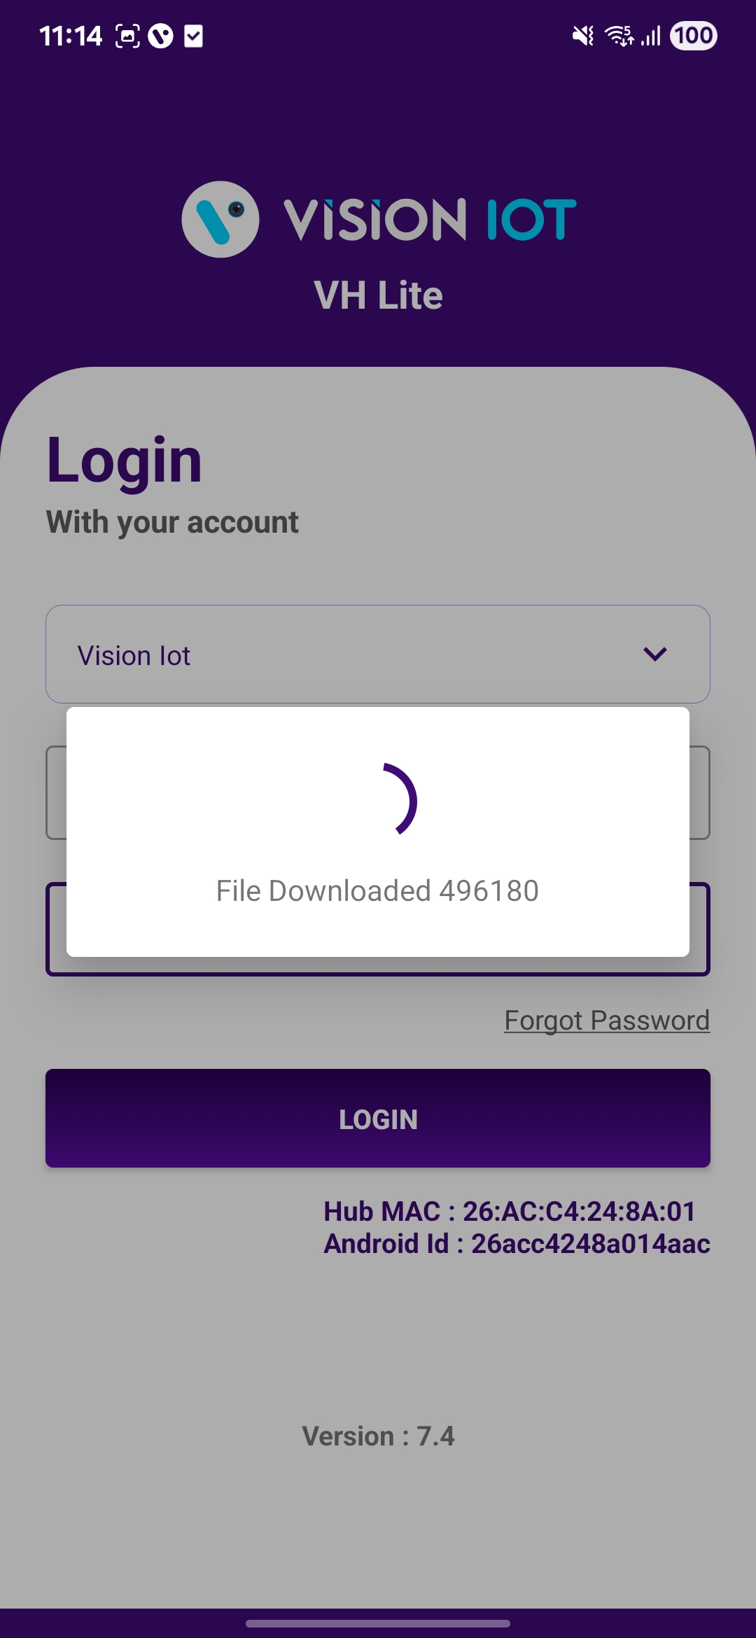
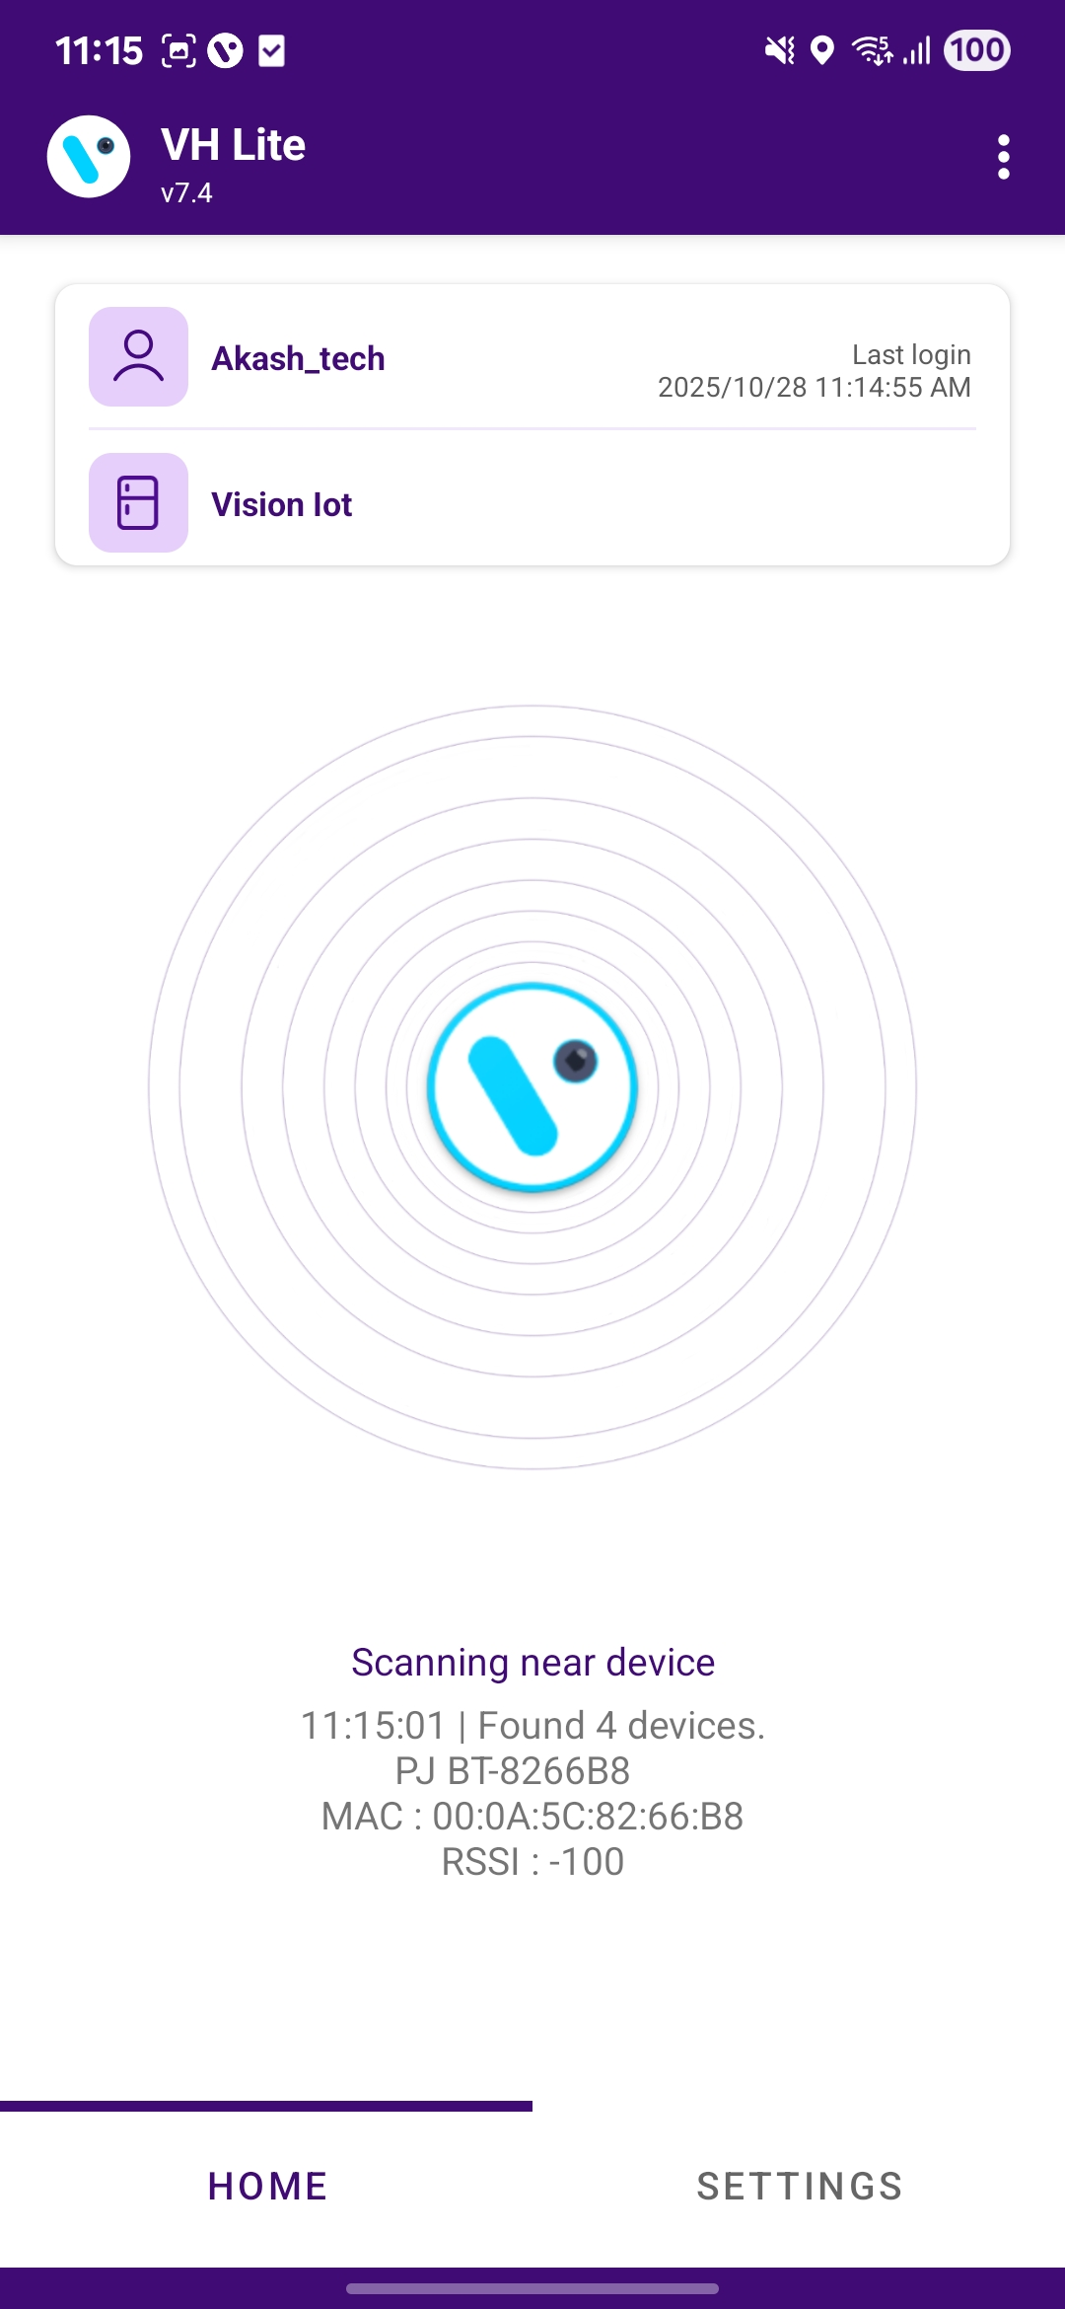
Please enter valid credentials and tap the Login button. Please be advised that the application may take some time to download the required data from the cloud.
Note: Internet connectivity is required for login; otherwise, the login will fail and the application will display network errors.
© 2025 Vision Group

Slide 8
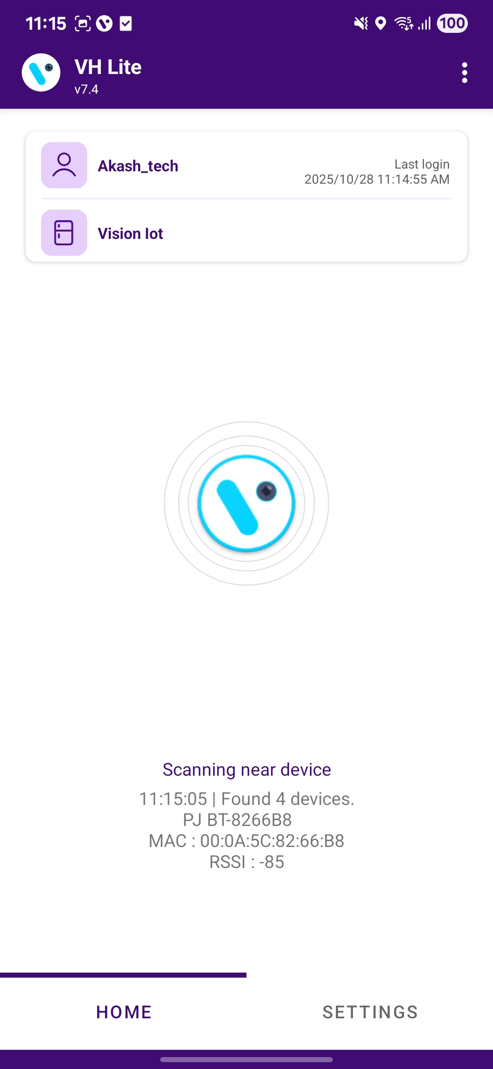
HOME SCREEN
History Menu (Hamburger Menu)
The server and Username are used at login time.
Scanning device information found in the advertisement.
Home Screen: This is the home screen of the application, where data can be downloaded and uploaded.
Setting Button: This is the Settings button of the application. Users can update the application settings as needed.
© 2025 Vision Group

Slide 9
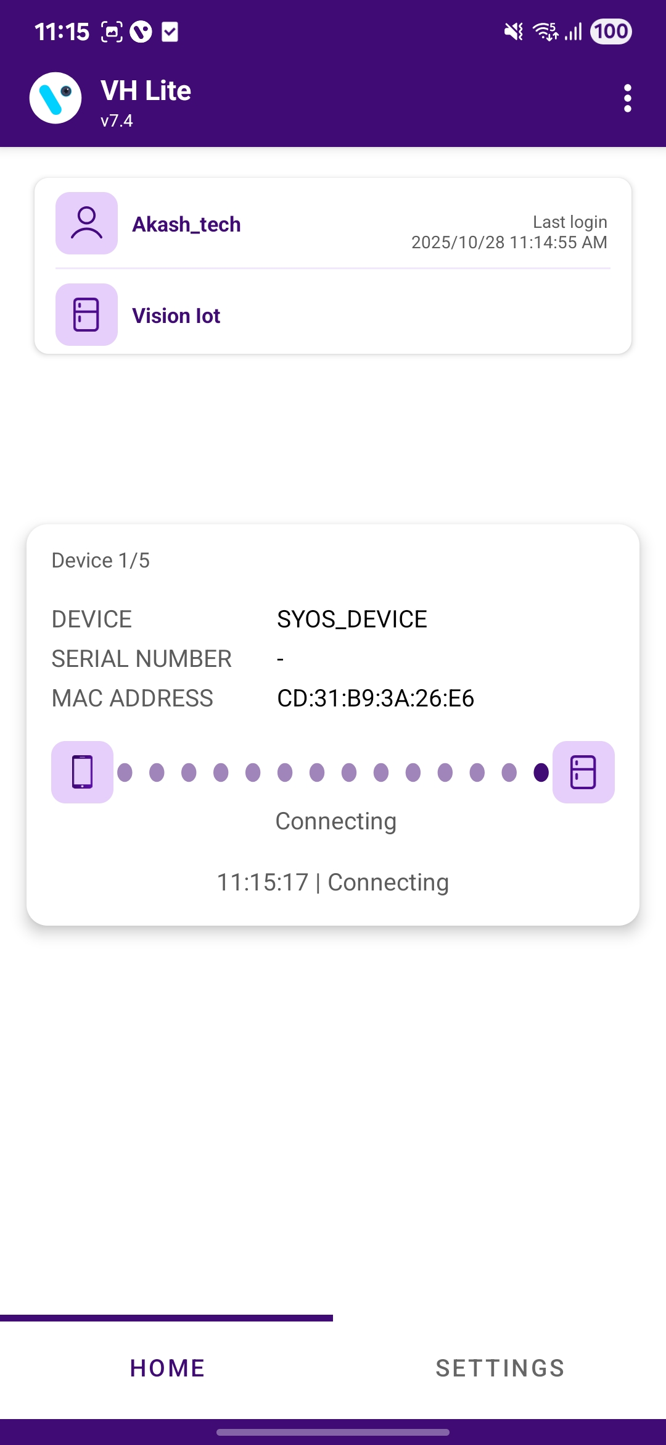
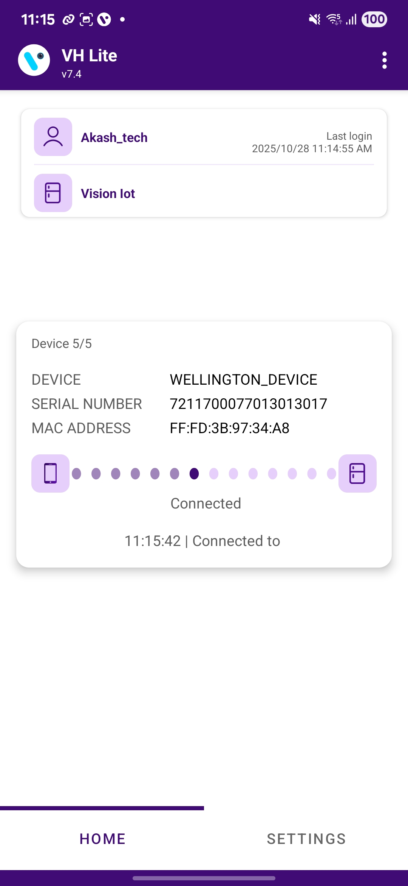
DEVICE CONNECTION AND DATA DOWNLOAD
Searching for devices and displaying the number of devices found.
Establishing a connection with the selected device.
The app connects to the device and collects the data.
© 2025 Vision Group

Slide 10
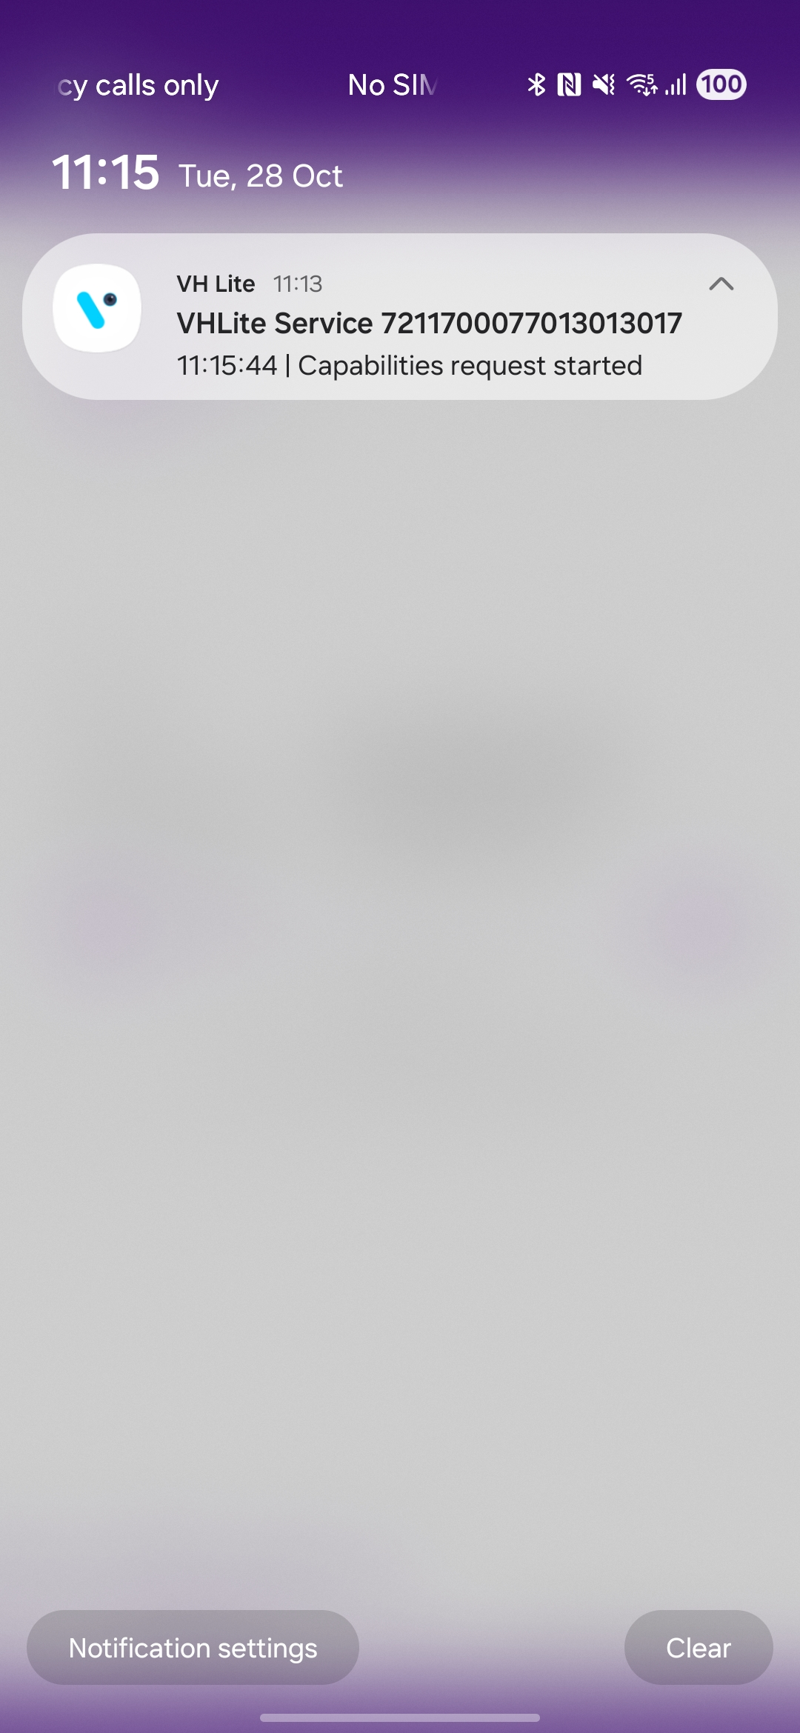
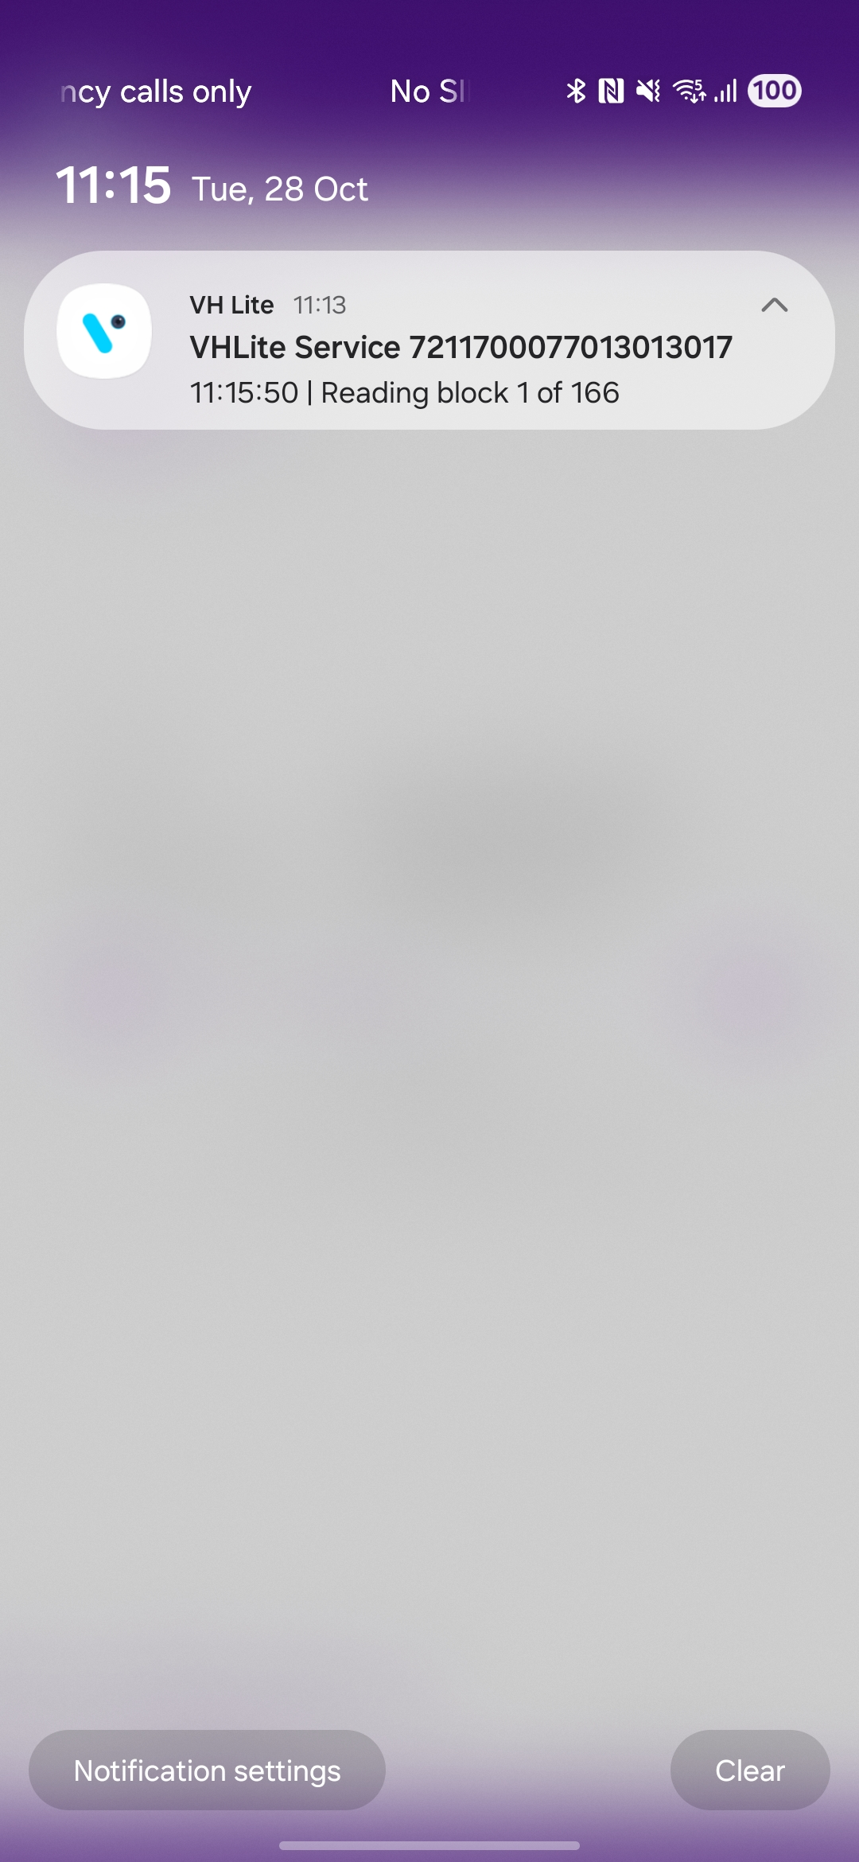
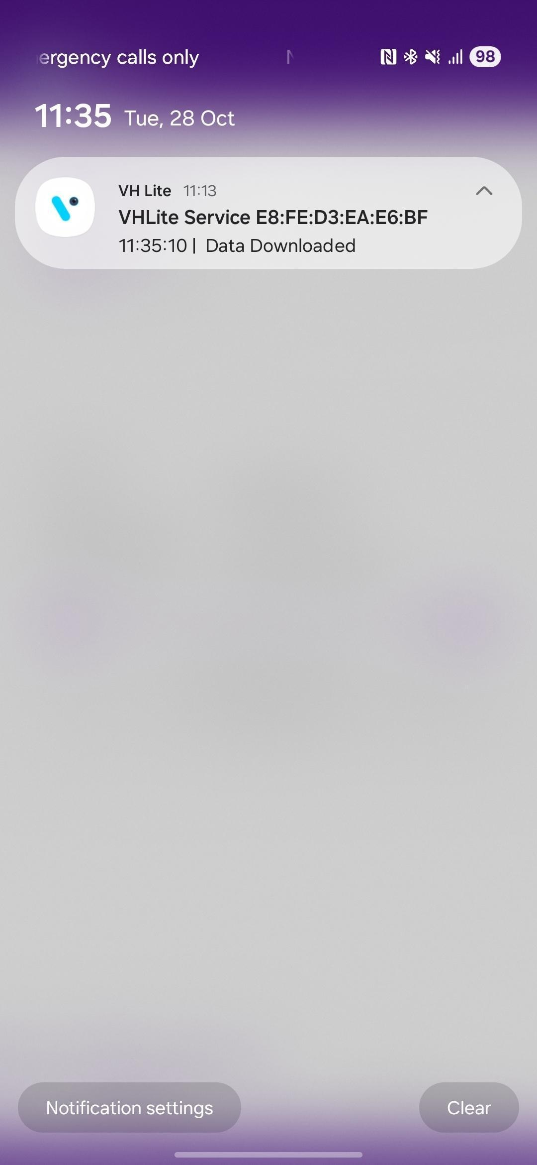
DEVICE DATA DOWNLOAD IN BACKGROUND
Searching for devices and displaying the number of devices found.
Connecting with the searched device.
The app connects to the device and collects the data.
© 2025 Vision Group

Slide 11
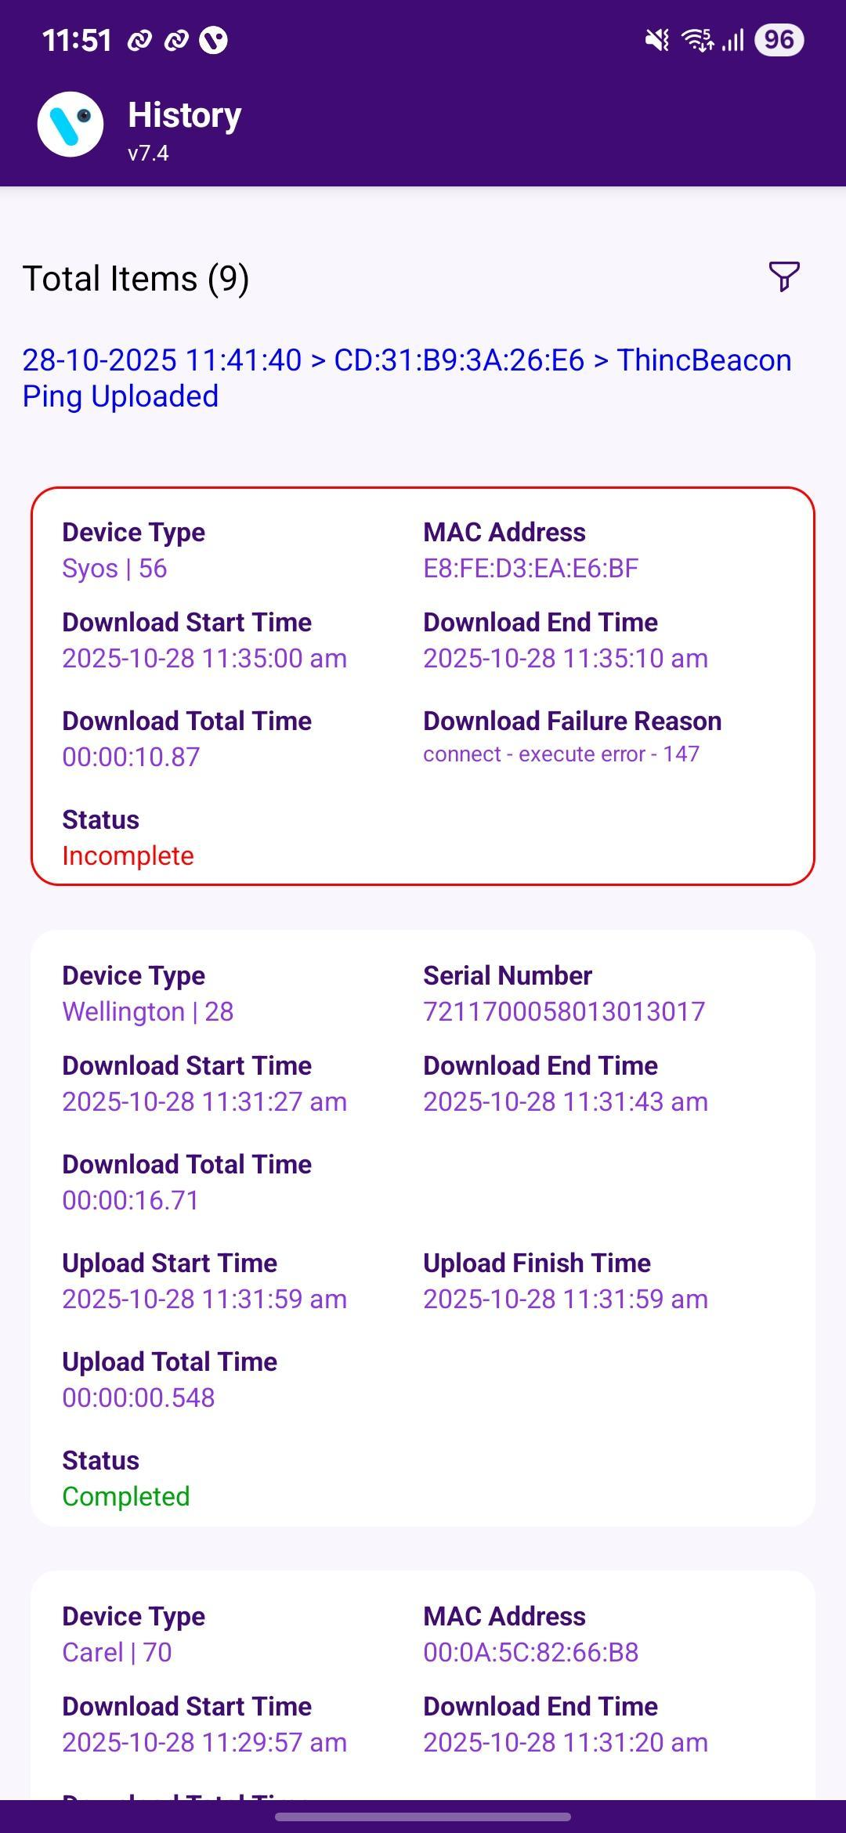
HISTORY SCREEN
Option to filter out historical data.
The data upload status of the last device is displayed here.
History of Data Downloads and Uploads with Device Serial Number, Date and Time, Status, and Device Type.
If data downloading and uploading fail, the status will be shown as Incomplete, and the box color will be red with an error message.
© 2025 Vision Group

Slide 12
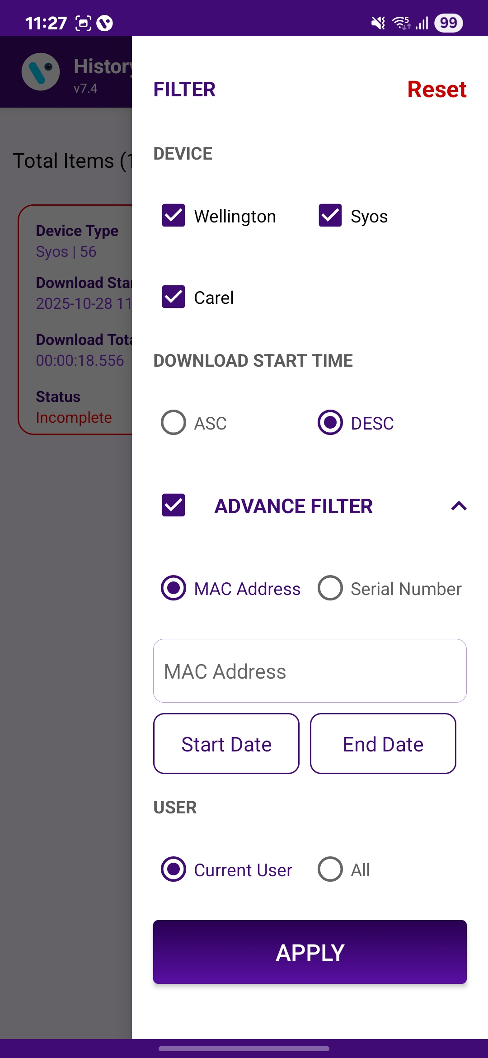
HISTORY FILTER
If tap the Reset button, all filters will be removed, and the settings will return to their default configuration.
If tap on only the Wellington device, then only the Wellington device is visible on the history page otherwise all are visible.
Show in ascending and descending form based on download start time.
The advanced filter must be enabled for the following function to work.
It works for both MAC addresses and serial numbers. If any searched serial number is available, only display its history.
The device history displays information from the Start Date to the End Date.
If the current user is tapped, display their data; otherwise, show data for all other users.
After making changes to the filter, click on “APPLY FILTER” to save your adjustments.
© 2025 Vision Group

Slide 13
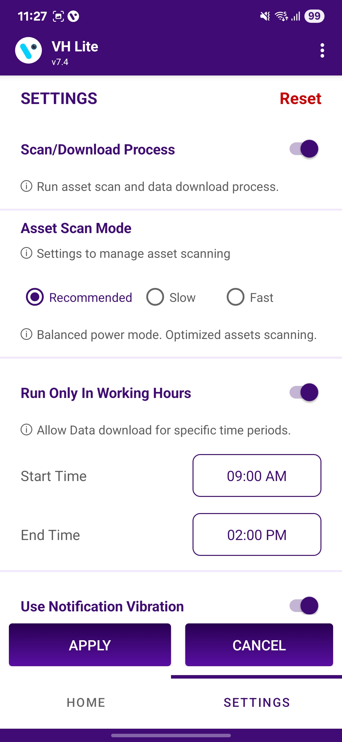
SETTING SCREEN
Reset :
    If the User taps the Reset button, all filter settings will be removed and the default settings will be restored.
Scan/Download Process:
    This option enables scanning and downloading data. If disabled, data collection from nearby devices stops.
Asset Scan Mode :
    Recommended: The device operates more slowly than in fast mode, but it uses a moderate amount of battery.
    Fast: The device scans in VH mode, but it consumes much battery.
    Slow: The device operates slowly while scanning in VH mode, but it consumes less battery.
Run Only in Working Hours :
    VH will operate only during scheduled working hours. Outside of these hours, VH processing is disabled, and the scan button is also unavailable.
1
2
3
© 2025 Vision Group

Slide 14
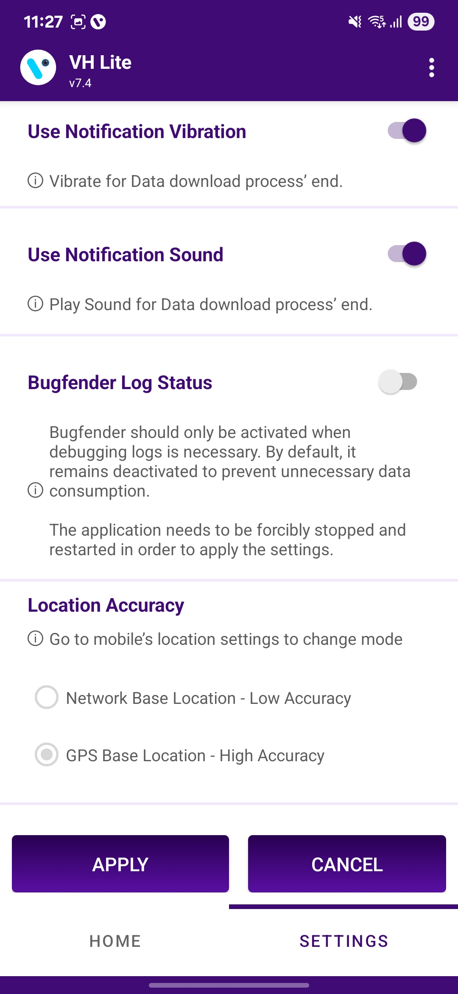
Use Notification Vibration :
    If this option is enabled, the user will be notified by vibration when the data download is complete.
Use Notification Sound :
    If this option is enabled, the user will receive a notification sound once the data download is complete.
Bugfender Log Status:
    If this option is enabled, the user receives the application log and actions sent to the Bugfender server.
Location Accuracy :
    By default, the application utilises the Google-based GPS for location tracking, operating in High Accuracy mode.
4
5
6
7
© 2025 Vision Group

Slide 15
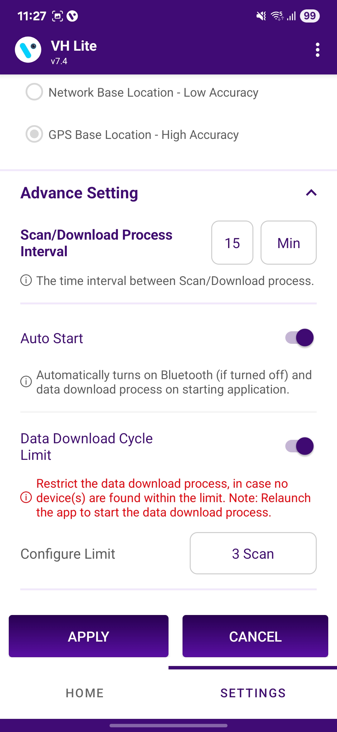
Scan/Download Process Interval:
    If the Scan Process Interval is set to 15 minutes, then the VH will attempt to find the device within that time frame. Users have the option to modify the Scan/Download Process Interval.
  Auto Start:
    If VH as a Service is enabled and both VH and Bluetooth are stopped, launching the app will automatically start both.
  Data Download Cycle Limit:
    If this option is enabled and the VH Stop Counter is set to 3 VH cycles, then the device did not enter scanning after completing the 3 scanning cycles.
  Data Download Cycle Limit
    If the data download cycle limit button is enabled, the VH Process will stop after the set cycle if no devices are found within that limit.
8
9
10
11
  After making changes in the Settings, press the “APPLY” button to save the changes, or use the “CANCEL” button to discard them.
© 2025 Vision Group

Slide 16

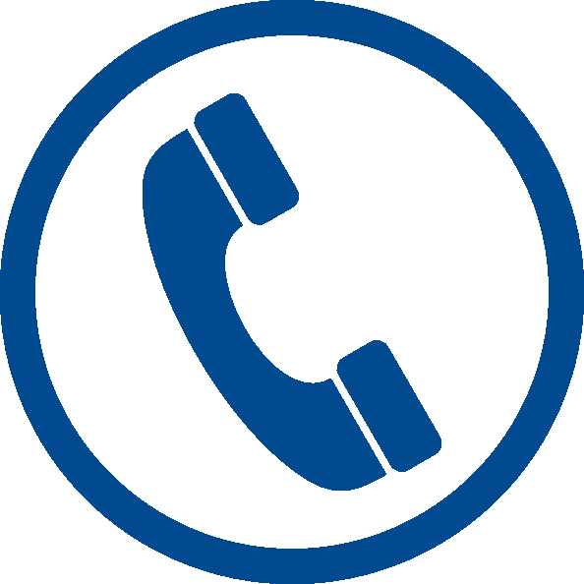
Thank You!
support.iot@visiongroupretail.com
+1-833-593-0144 (USA Tollfree Number)

