Slide 1

VH Lite
Android Installation Guide
November 2024
© 2024 Vision Group

Slide 2

APPLICATION FEATURES
CONNECT – Connect with the Third-party nearby Devices.
DATA DOWNLOAD – To download the data for the Third-party nearby Devices.
DATA UPLOAD – Upload Collected device data to the server.
GHOST COOLER – Find the Ghost cooler and update the record on the server in the Ghost Asset table.
Note:
Whitelist functionality supports only two device types Carel and Nexo.
The app will relate to the nearest device which is found in the whitelist.
Sometimes login button does not show on the login screen which means the app is fetching Lat-long from the mobile. without Lat-long users can’t allow to log in.
© 2024 Vision Group

Slide 3
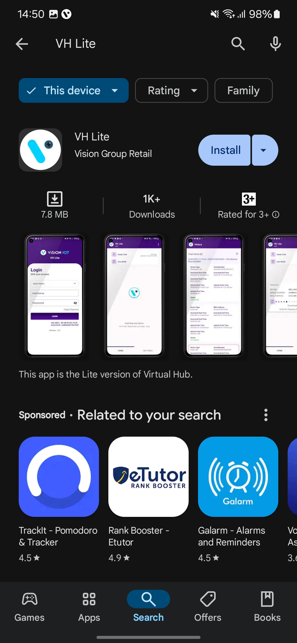
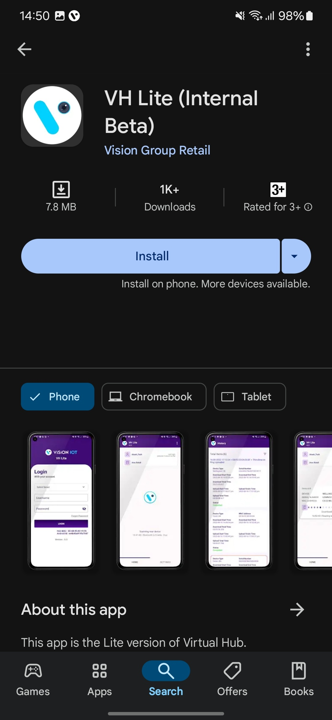
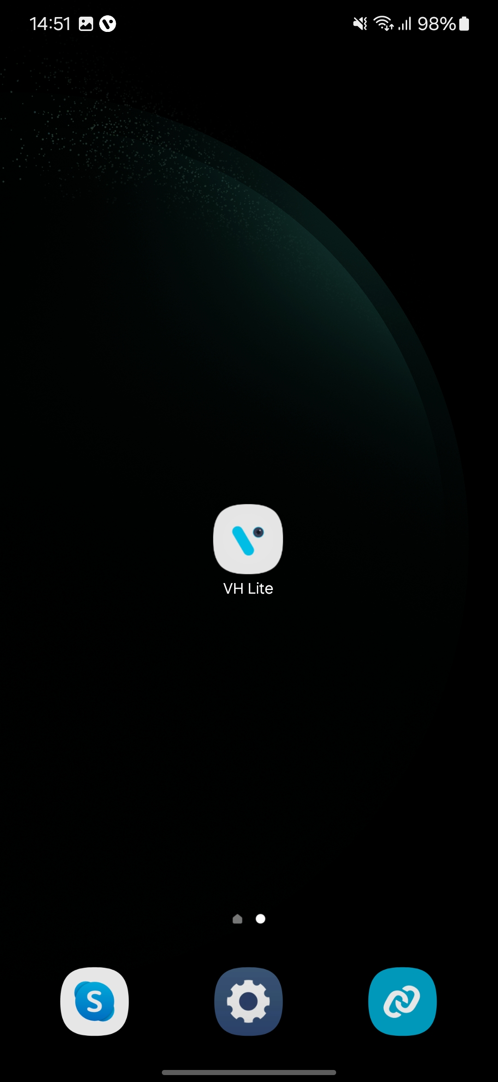
APPLICATION INSTALLATION
Please remember the following instructions: Open the Play Store on an Android device. Search for the “VH Lite" application and install it.
Remember to delete the previous version of the application before installing a new version.
© 2024 Vision Group

Slide 4
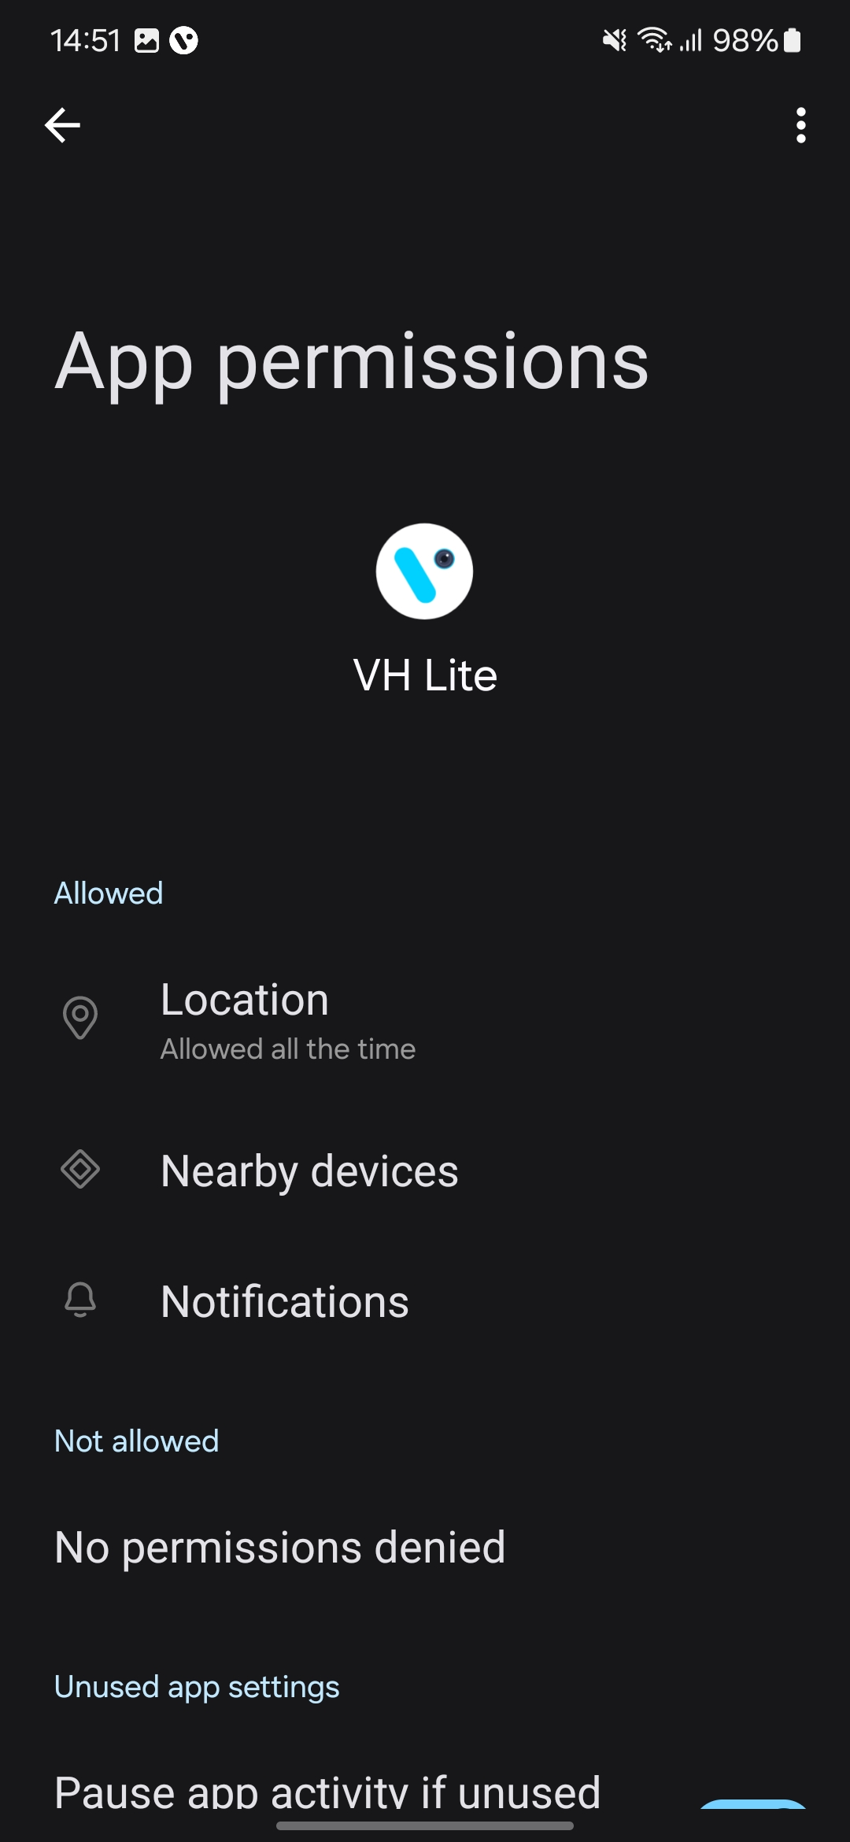
APPLICATION PERMISSION
After initial Installation & launch, the Application will ask for permission to access. File and Media Permission, Location Permission, and Nearby Device Permission Need to Allow.
LOCATION PERMISSION
For Location (so beacons can be found) - Choose Allow While Using for Android OS 10 and Above.
Then Go to the Settings > Application List > Location > Allow Location Access option is “Always”.
NOTIFICATION PERMISSION
Send notifications (to inform of data download) -> Choose “Allow”
BLUETOOTH PERMISSION
Access the Bluetooth (to scan barcodes) – the first prompt on the Outlet screen -> Choose “OK”.
© 2024 Vision Group

Slide 5
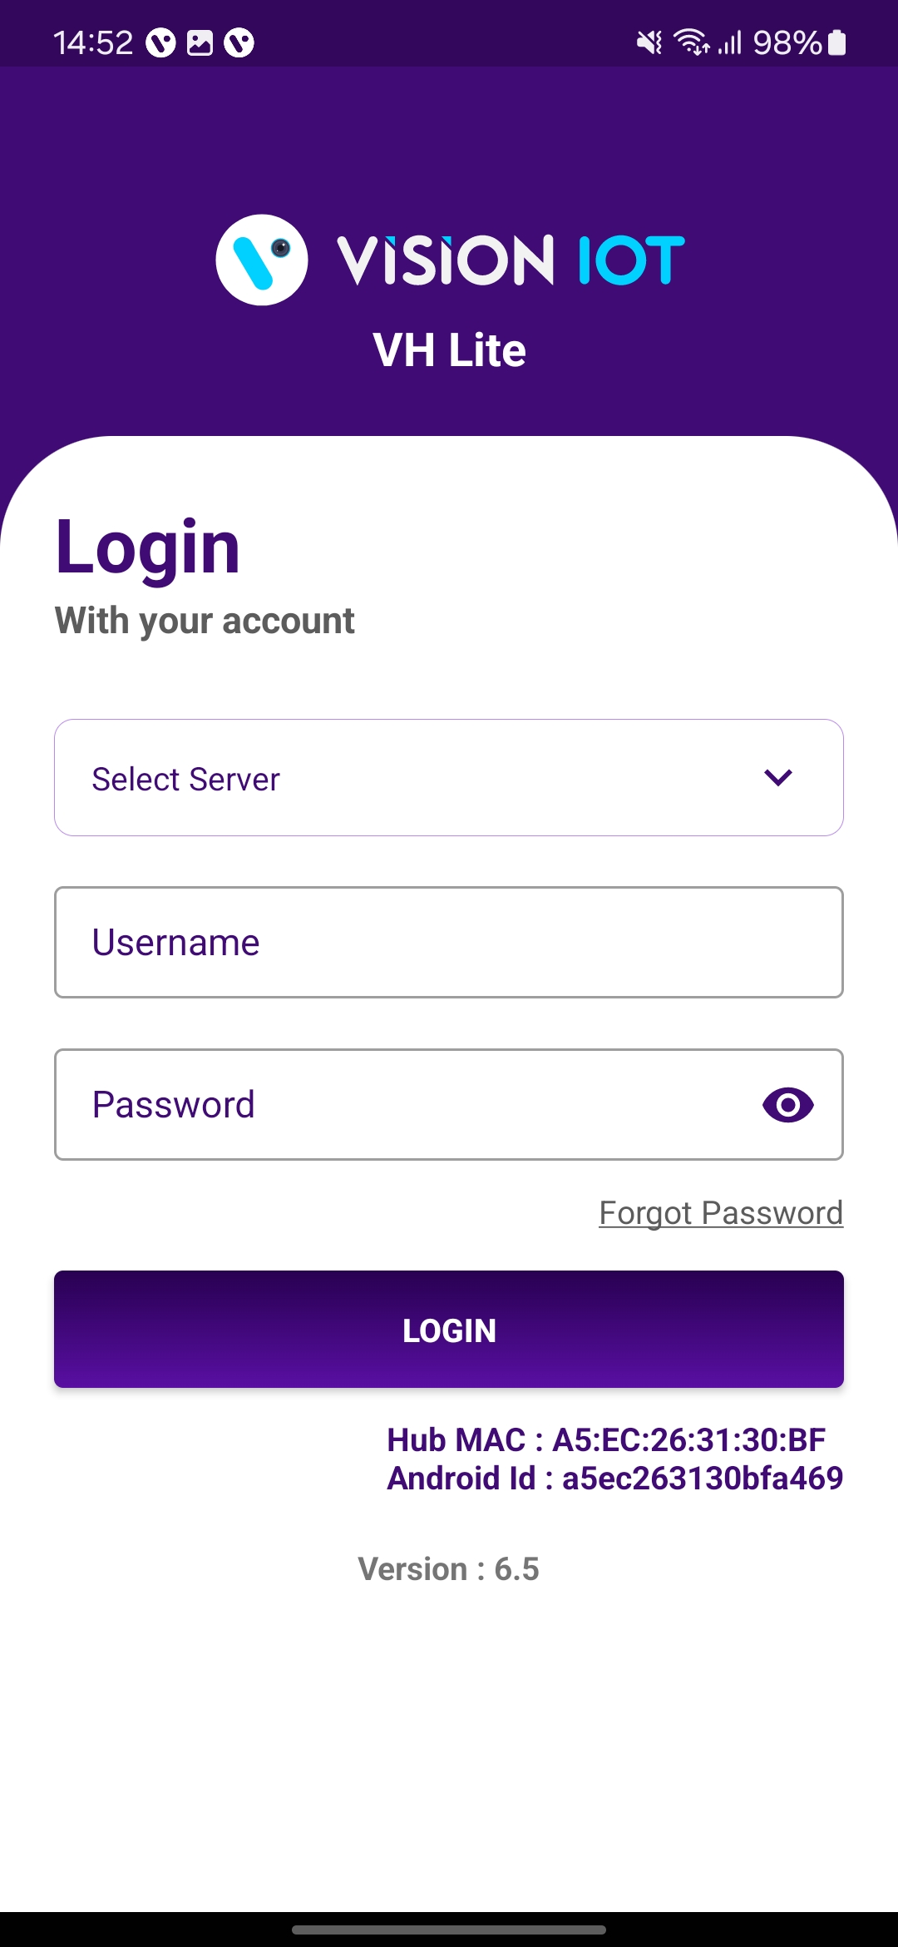
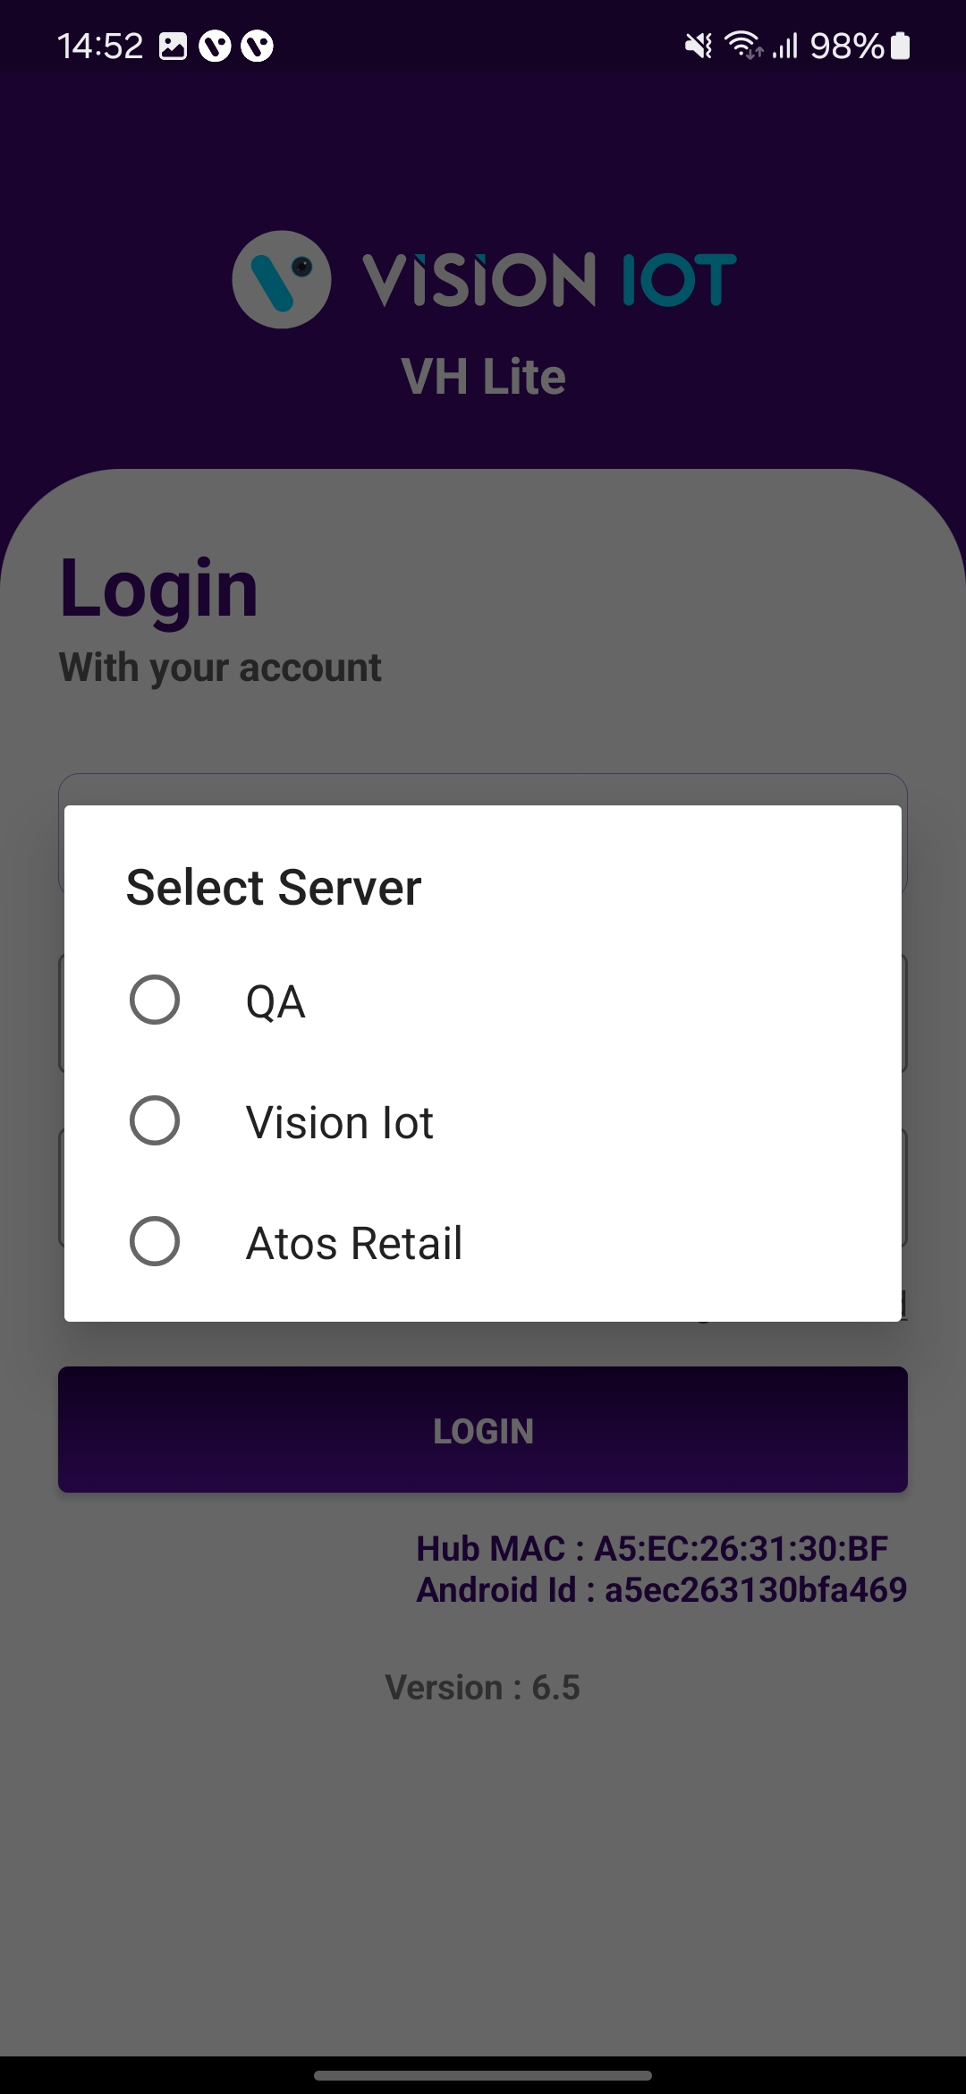
LOGIN
After successfully installing the Smart Cooler Installation Application, open it, and it will redirect you to the Login Page. Select the server from the server list and Log in to the application using the credentials provided by your administrator to successfully log in.
Choose Server: The server should be Vision IOT to choose.
Ensure Bluetooth & Mobile Wi-Fi or Mobile Data are ON in the device.
Bluetooth also should be enabled as well as location services.
The application requires an internet connection for initial login.
After the initial log in the application can work in Offline mode provided that the same username & password as the one in the online login is used.
Minimum device requirements – Device Has RAM 4 GB and above and Bluetooth Version 4.2 and above.
The Minimum OS version of mobile is OS 10 and Above.
© 2024 Vision Group

Slide 6

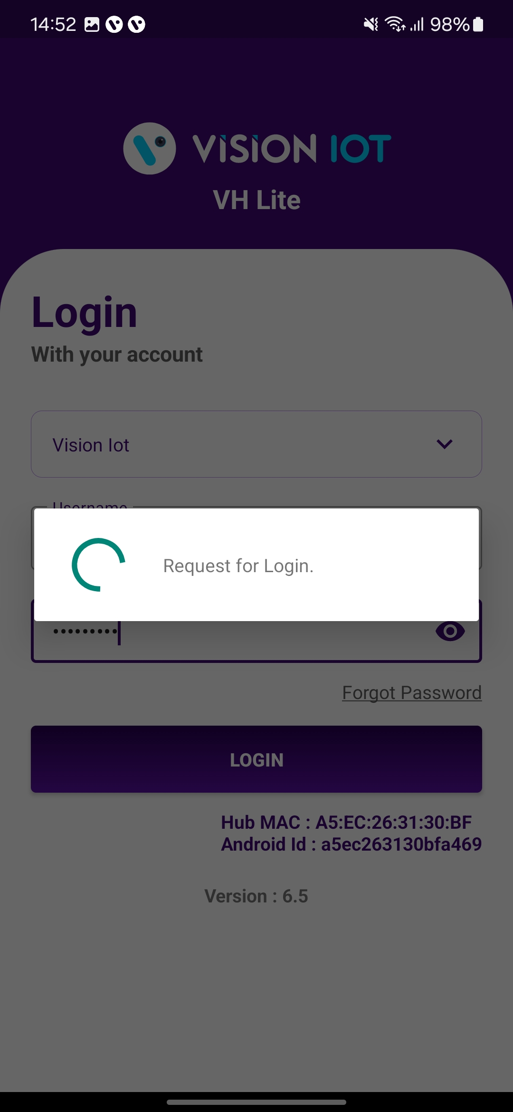
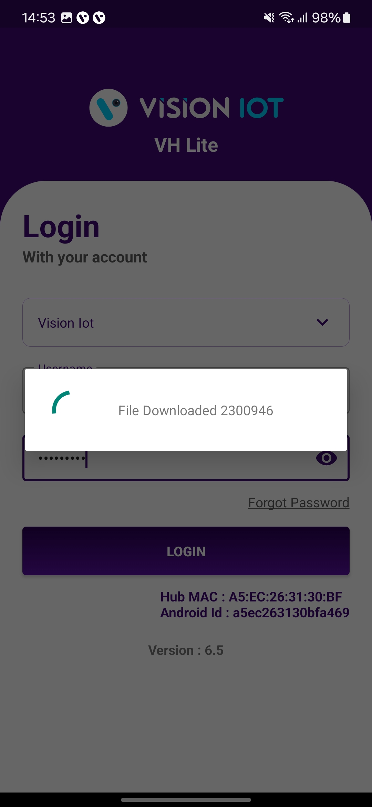
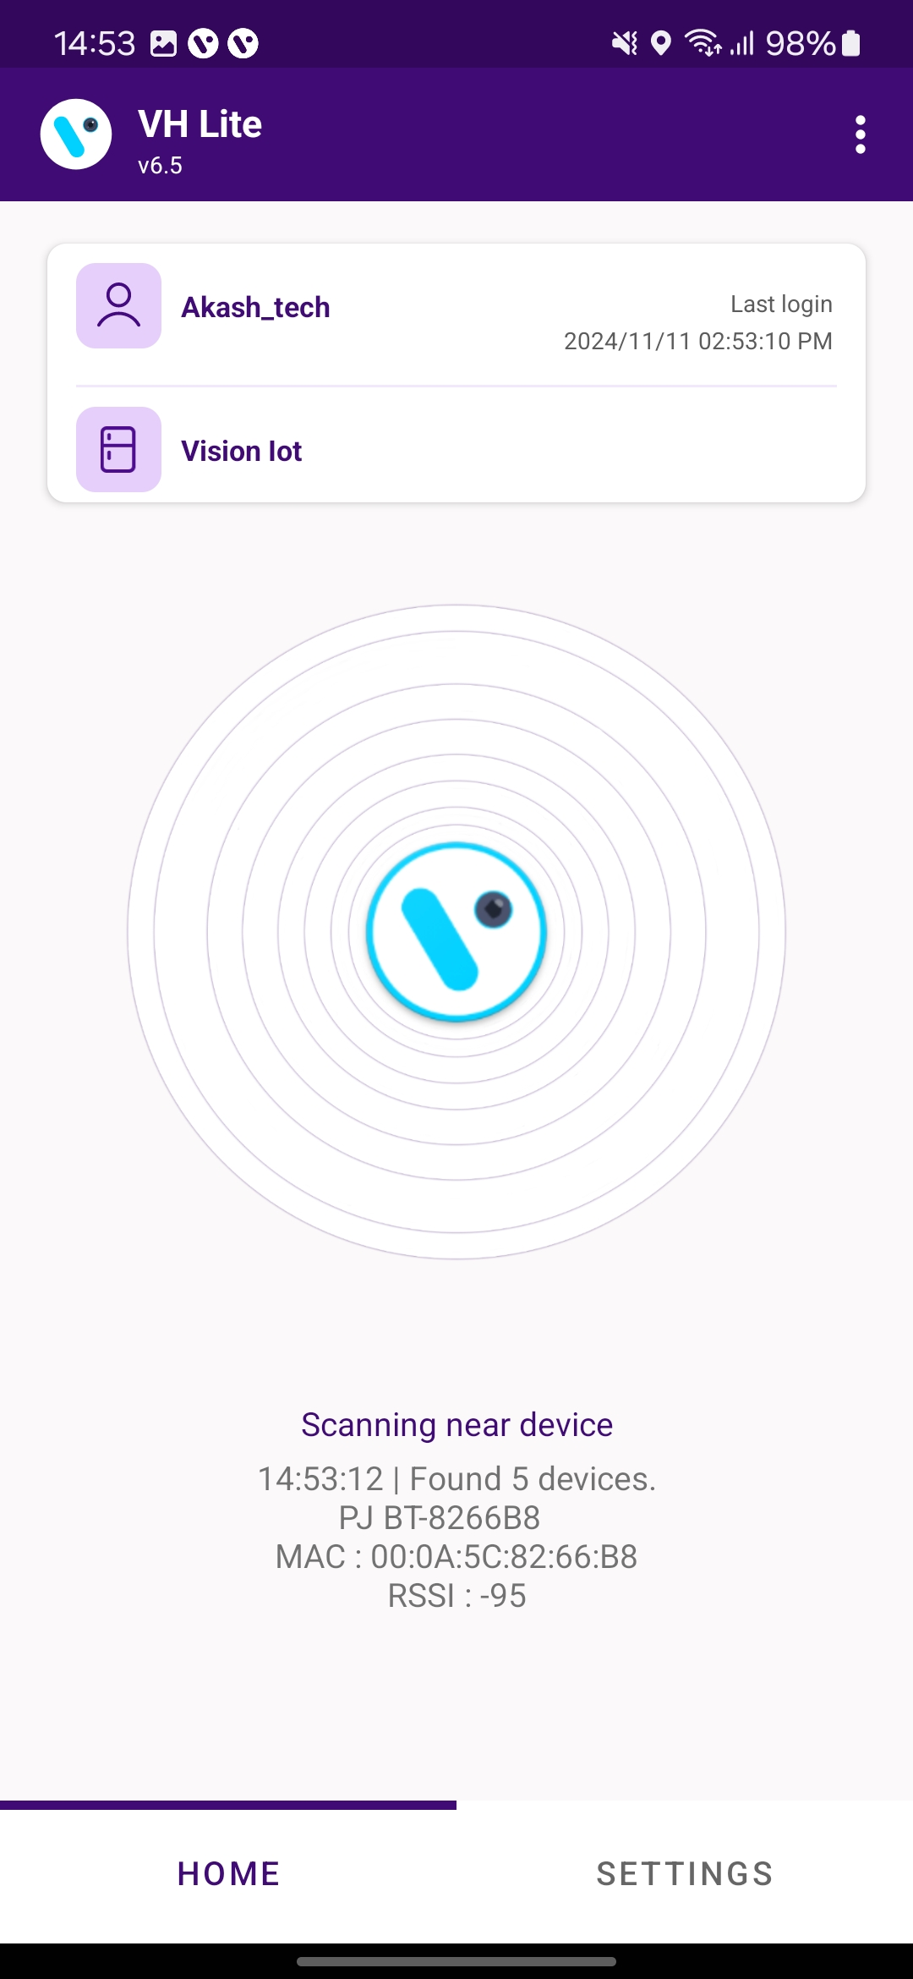
LOGIN (Cont’d)
Provide valid credentials and tap on the Login button, please be advised that the application will need some time to download data from the cloud.
Note: Internet connectivity is required during login otherwise login will fail, and the application will show network errors.
© 2024 Vision Group

Slide 7
HOME SCREEN
Virtual Hub Menu (Hamburger Menu)
The server and Username are used at login time.
Scanning information of Device found in Advertisement.
Home Screen: This is the Home Screen of the Application where Data is downloaded and Uploaded.
Setting Button: This is the Setting button of the Application using the User can update the Application Settings as per need.
© 2024 Vision Group

Slide 8
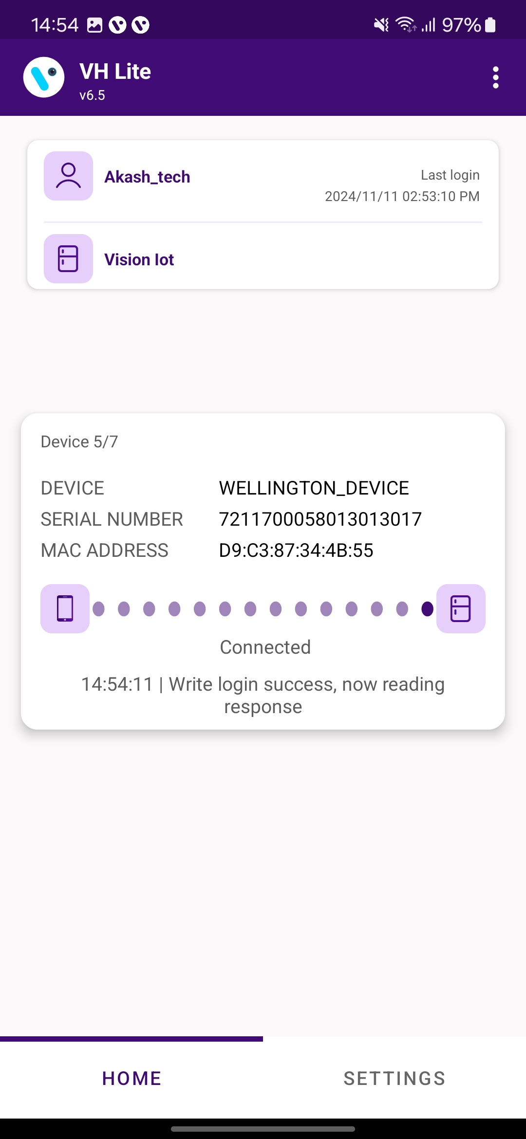
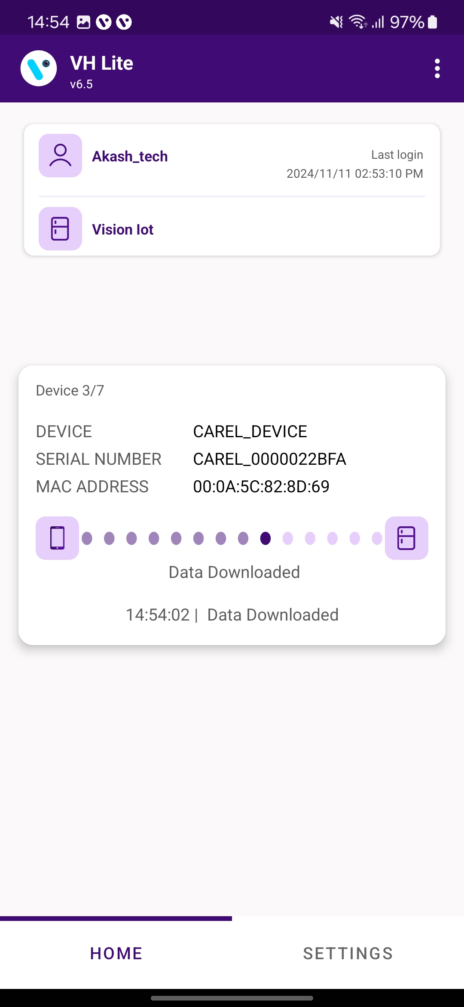
DEVICE CONNECTION AND DATA DOWNLOAD
Searching Devices and showing the number of devices found.
Connecting with the Searched device.
The app connects with the device and the data collected.
© 2024 Vision Group

Slide 9
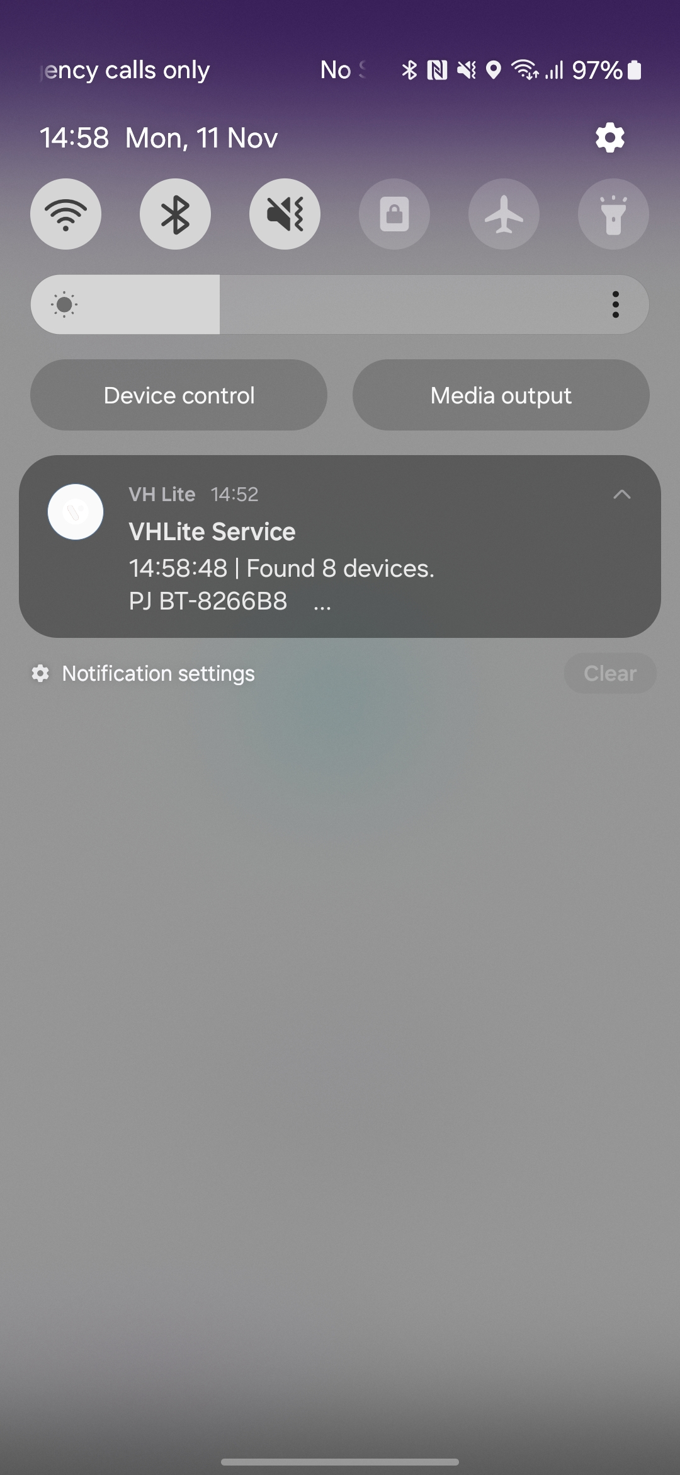
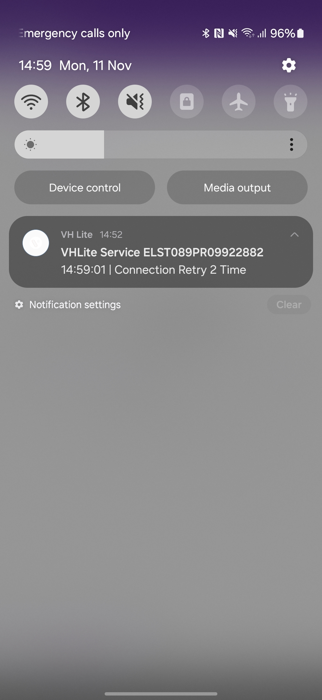
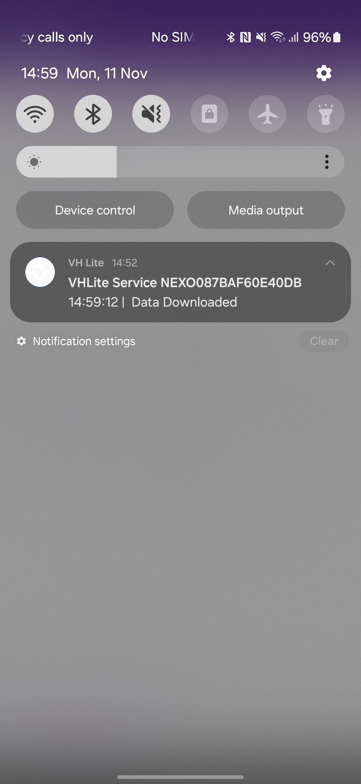
DEVICE DATA DOWNLOAD IN BACKGROUND
Searching Devices and showing the number of devices found.
Connecting with the Searched device.
The app connects with the device and the data collected.
© 2024 Vision Group

Slide 10
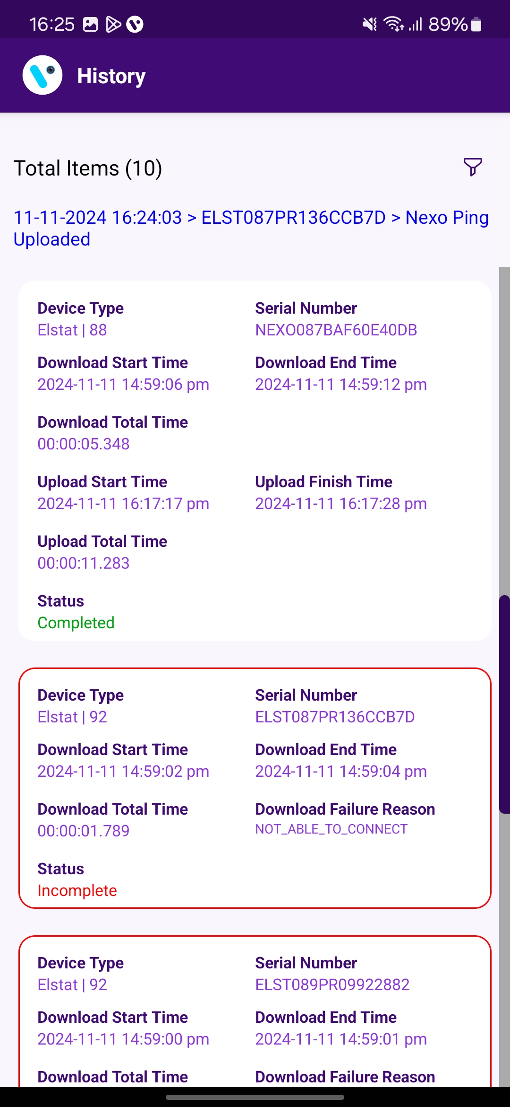
HISTORY SCREEN
Filter Option to filter out History Data
Here, the Last device's data uploading status showing.
Data Downloading and Uploading History with Device Serial Number, Date and Time, Status and Device type.
If data downloading and uploading is unsuccessful then showing Status is Incomplete and a box color is red with the error.
© 2024 Vision Group

Slide 11
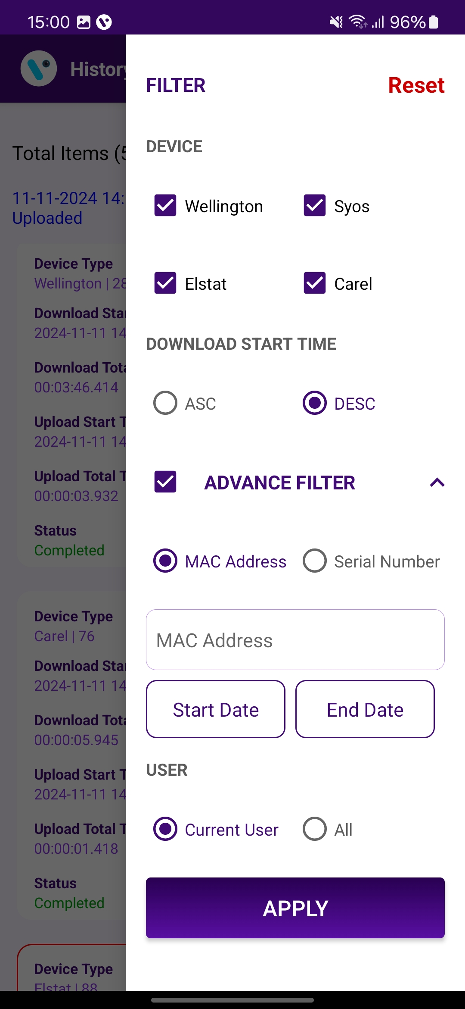
HISTORY FILTER
If tap on the Reset button, All filters are removed, and the default setting.
If tap on only the Wellington device, then only the Wellington device is visible on the history page otherwise all are visible.
Show in ascending and descending form based on download start time.
The advance filter is enabled then the below function works.
It’s works for MAC Address and Serial Number. If any Searched serial number is available, then show only this Serial Number History.
The device history shows between the Start Date and to End date.
If tap on the current user, then show current user data otherwise all other users’ data is visible.
After changes in the filter, press “APPLY FILTER”.
© 2024 Vision Group

Slide 12
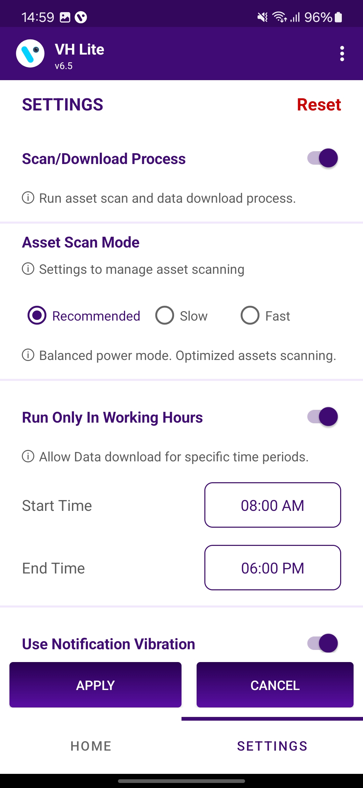
SETTING SCREEN
Reset :
If tap on the Reset button, All filter settings are removed and set the default setting.
Scan/Download Process:
This is the Enabled option to Scan and Download the Data. If Disabled, then getting stops collecting the Nearby device’s data.
Asset Scan Mode :
Recommended > The Device becomes slow compared to fast mode, but It consumes a moderate battery.
Fast > Device comes fast while scanning in VH, but It consumes more battery.
Slow > Device comes slowly while scanning in VH, but It consumes less battery.
Run Only in Working Hours :
VH will work during scheduled hours of work. Without working hours VH processing is disabled even the scan button is disabled.
1
2
3
© 2024 Vision Group

Slide 13
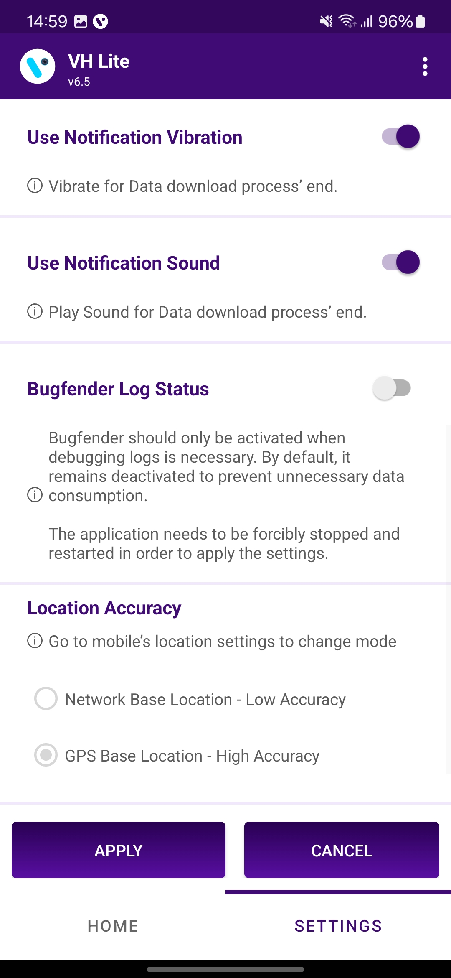
SETTING SCREEN (Cont’d)
4
Use Notification Vibration :
If this option is enabled the user gets notified by vibration once the data download is complete.
Use Notification Sound :
If this option is enabled the user gets notified by Sound once the data download is complete.
Bugfender Log Status:
If this option is enabled the user gets sent the application log and actions to the Bugfender server.
Location Accuracy :
By default, the Application uses the Google-based GPS Base Location with High Accuracy mode.
5
6
7
© 2024 Vision Group

Slide 14
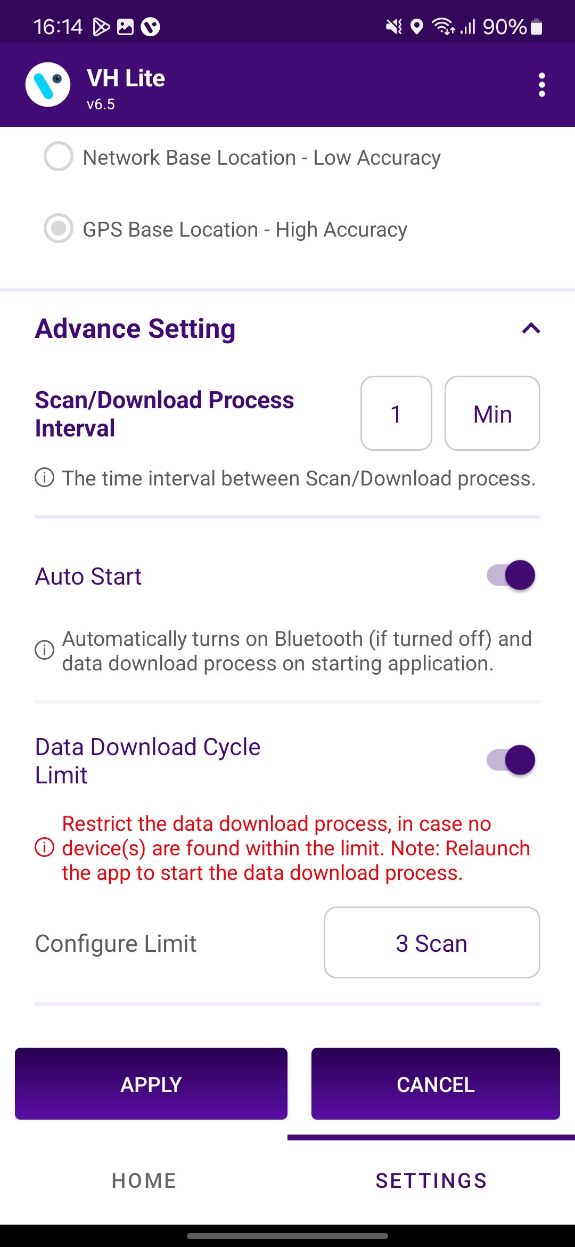
SETTING SCREEN (Cont’d)
Scan/Download Process Interval:
If 15 min, then VH tries to find the device in 15 min. Users can modify that.
Auto Start:
Auto Start > If VH as Service enables and VH and Bluetooth are already stopped, then when the user launches the app, both automatically start.
Data Download Cycle Limit:
If this option is enabled and the VH Stop Counter is set in 3 VH cycles then the device did not come in scanning post 3 scanning cycles completed,
Data Download Cycle Limit
If the data download cycle limit button is enabled then after the set cycle in this option, the VH Process will be stopped if there is no device found in the set cycle limit.
8
9
10
11
After changes in the Settings, press the “APPLY” Button to apply the changes and by “CANCEL” button to Cancel the Modified Changes.
© 2024 Vision Group

Slide 15


Thank You!
support.iot@visiongroupretail.com
+1-833-593-0144 (USA Tollfree Number)

