Slide 1

VISION DFU APPLICATION
Application Guide
Oct 2023
© 2023 Vision Group

Slide 2


PREREQUISITE
As prerequisites for the update process, the following steps need to be taken:
The list of devices should be shared with the Vision Group at support.iot@visiongroupretail.com.
Ensure that valid user credentials have been received from Vision IoT.
An Android phone is required, which should have an operating system of version 10 or above, and Bluetooth 4.2 or above.
For the DFU process from the application, coolers that have the device installed need to be powered on. Alternatively, the direct device needs to be powered on.
Keep application running nearby devices

Slide 3
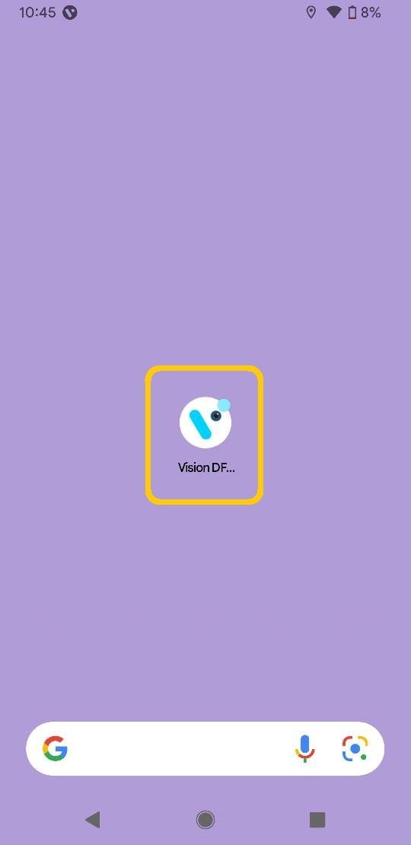
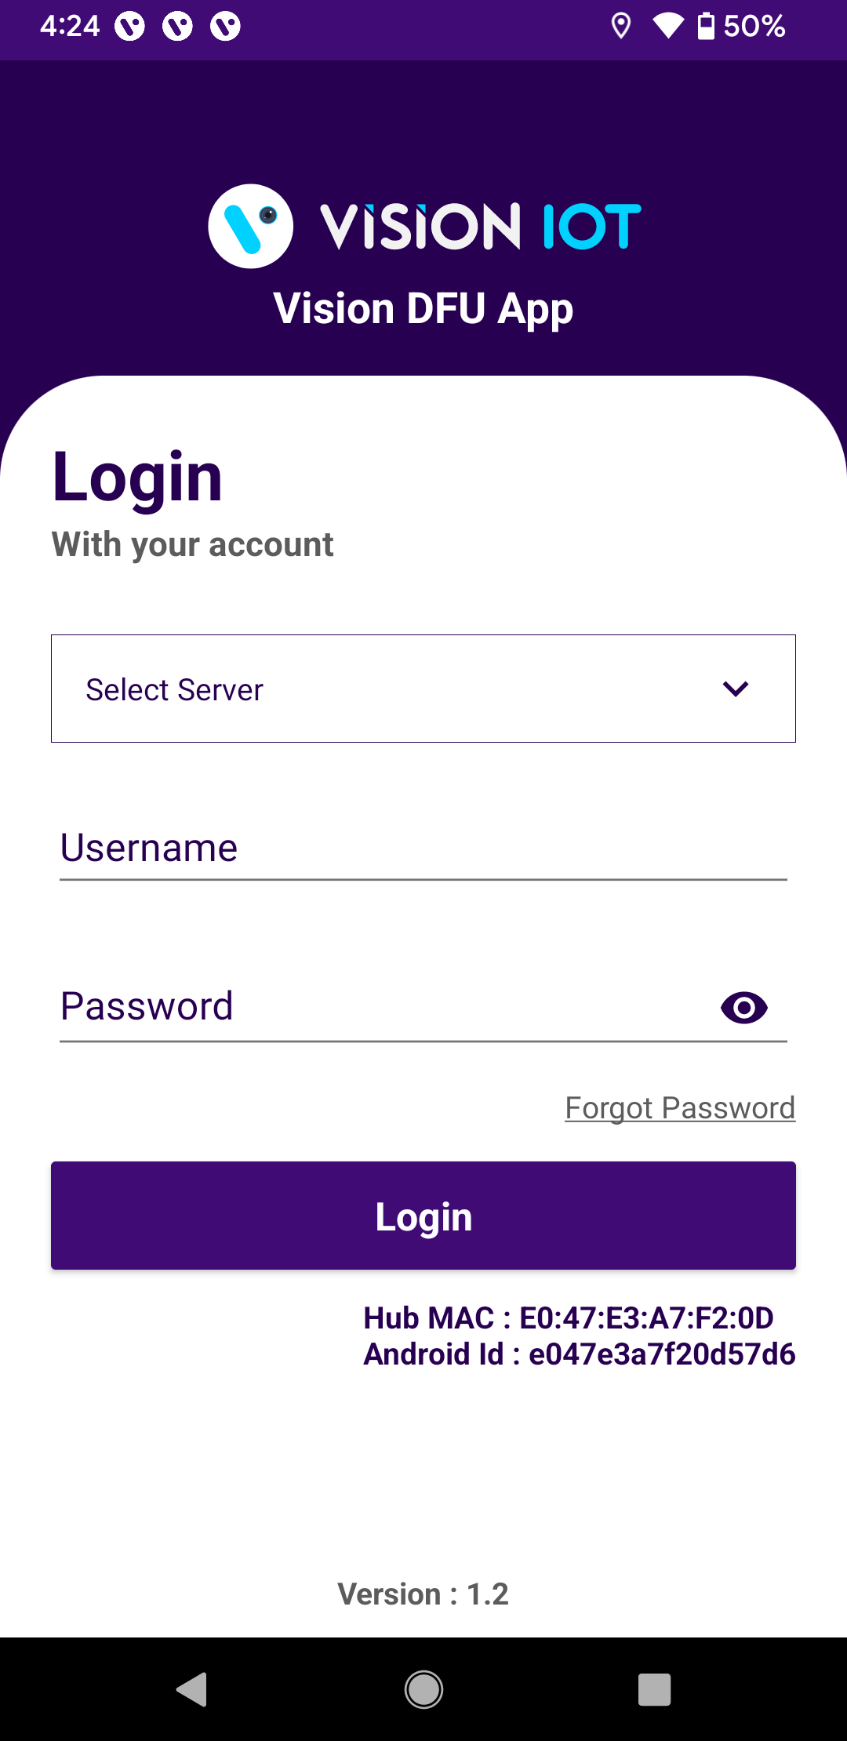
APPLICATION INSTALLATION
Use the links provided from vision group for the “VISION DFU” Application Installation.
The installation application is compatible only with Smartphones having Android V8.0 and above.
Open Vision DFU Application.
Login in the application using the credentials provided by your administrator – after successful login, the user will be directed to the DFU screen.
Note:
Ensure that the previous version is removed before installing each new version.
Please ensure Bluetooth and mobile Wi-Fi or Mobile Data are ON the device.
© 2023 Vision Group

Slide 4
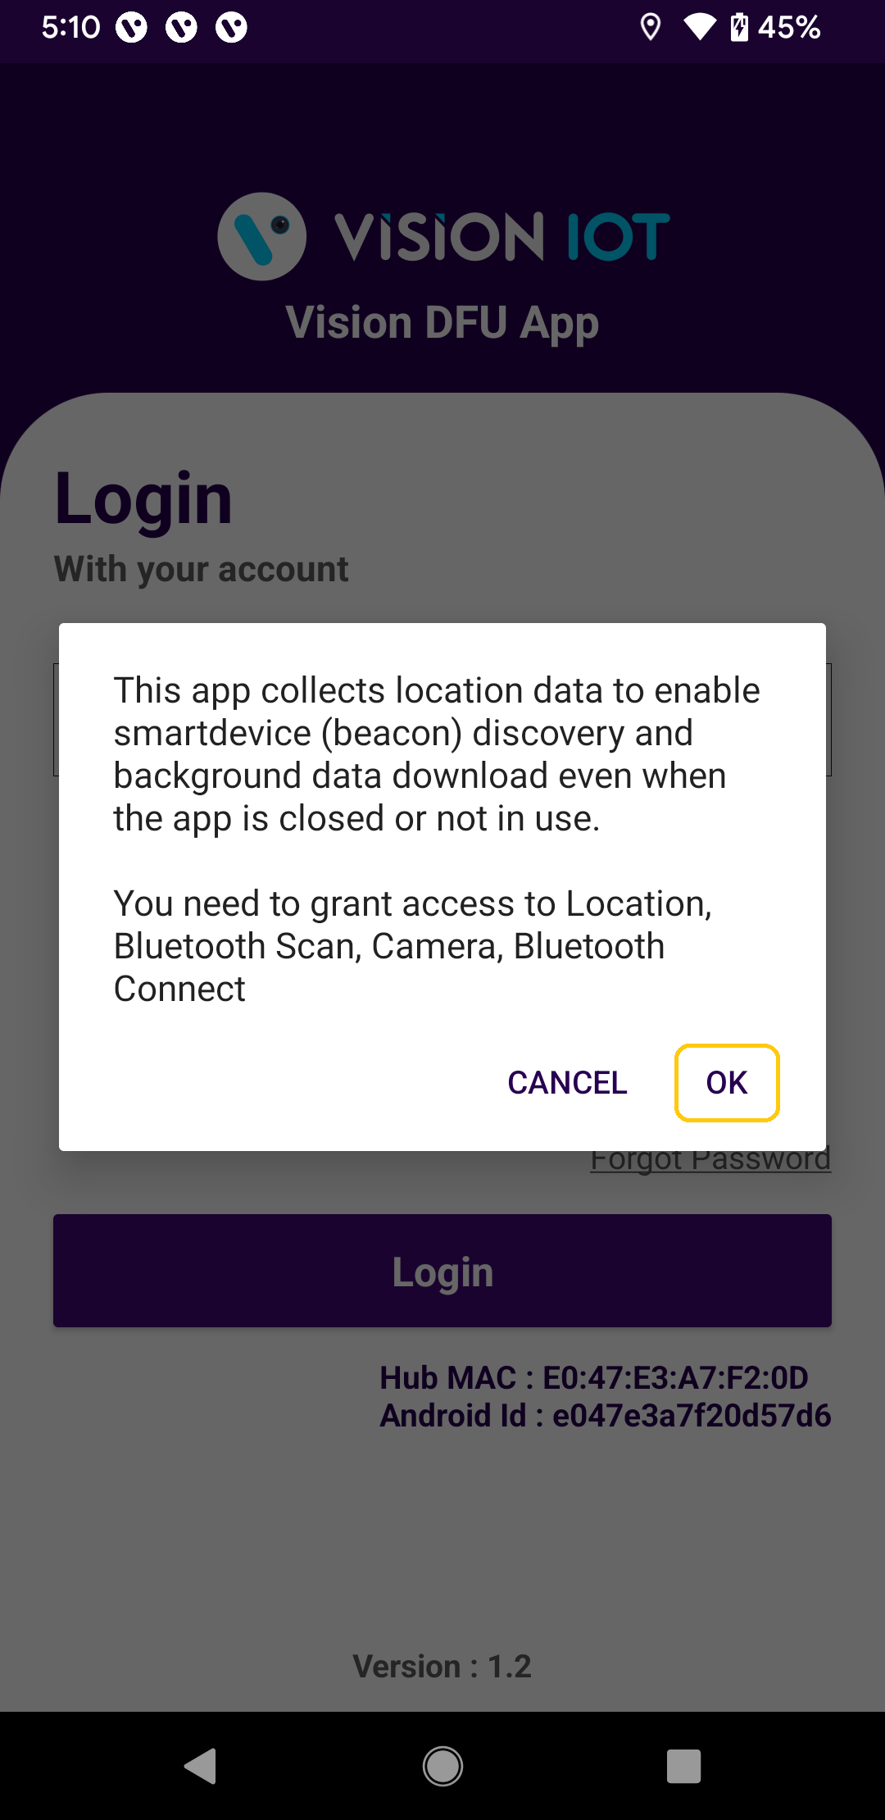
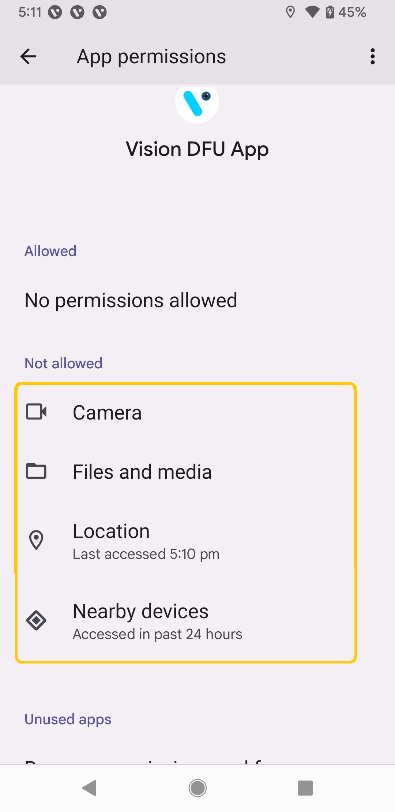
APPLICATION PERMISSION
After initial installation and launch, the Application will ask for permission to access.
Following Access Required :
Camera Permission
File and Media Permission
Location Permission,
Nearby Device Permission
Location (necessary to find beacons), select ‘Allow While Using App’ according to your handset’s OS.
Navigate to your phone’s settings, then to ‘App Permissions’, and then to ‘Location’. Ensure the ‘Allow Location Access’ option is set to ‘Always’.
Similarly, other permissions such as File and Media, Camera, and Nearby Device should also be allowed.
© 2023 Vision Group

Slide 5
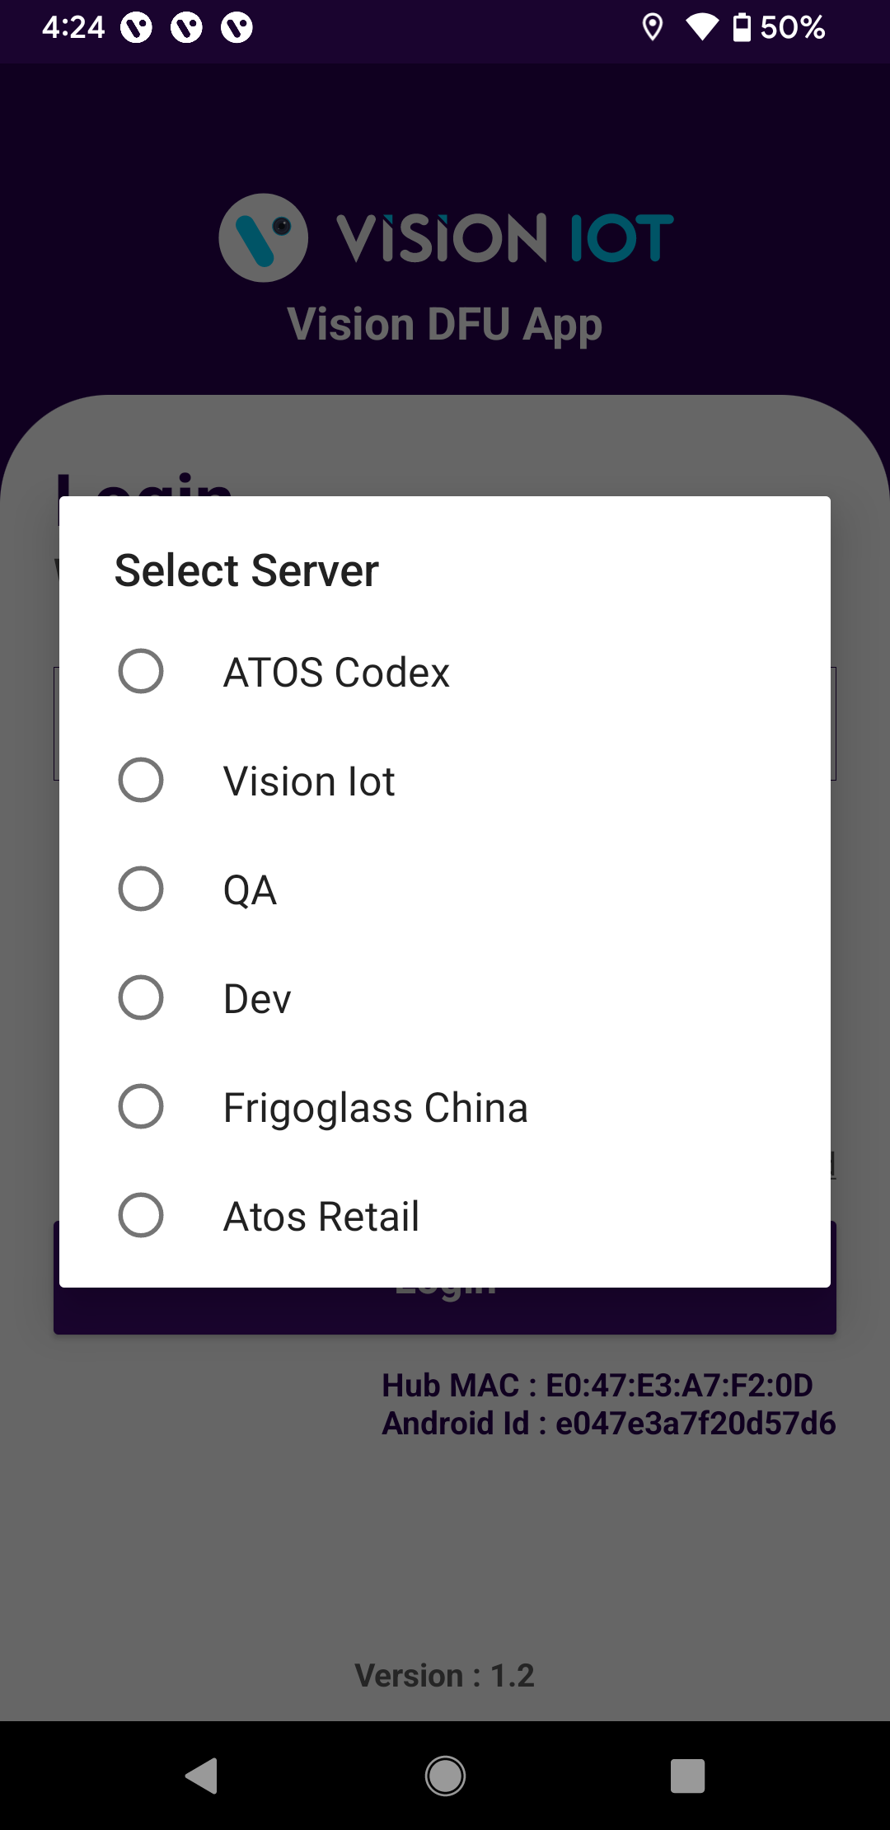
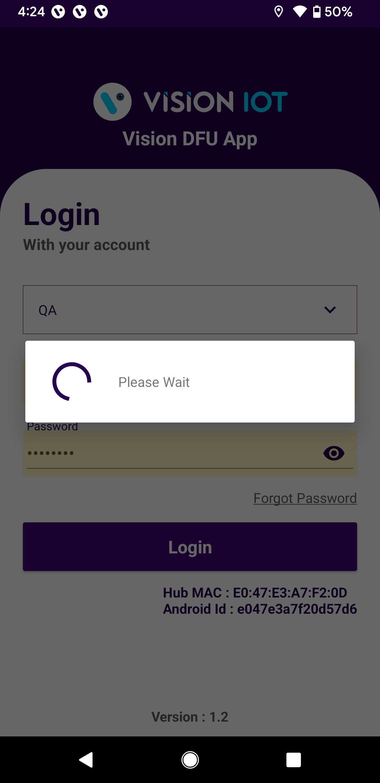
LOGIN
Open the Application, and the application will redirect to the Login Page.
Select the server from the server list and log in with valid Credentials.
Choose Server:[Vision IOT]
Bluetooth also should be enabled as well as location services.
The application requires an internet connection for initial login.
After the initial log-in the application can work in Offline mode provided that the same username & and password as the one in the online login is used.
Minimum device requirements – Device Has 4 GB and Up RAM at least and Bluetooth Version 4.2 and above.
Minimum OS version is 10.0 and Above.
© 2023 Vision Group

Slide 6
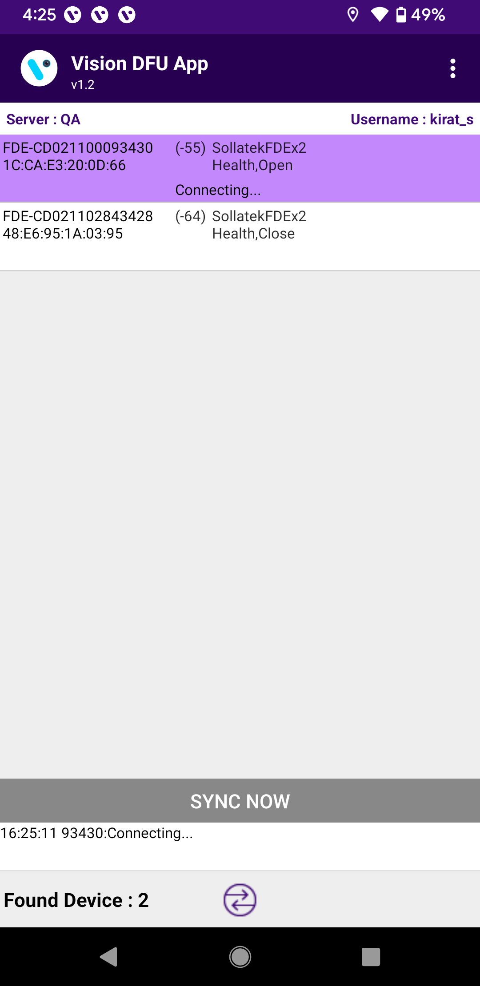
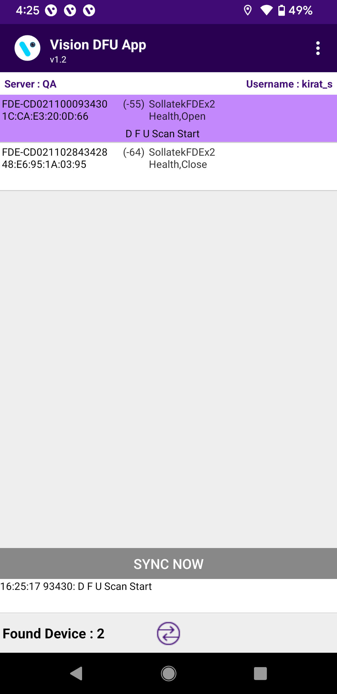
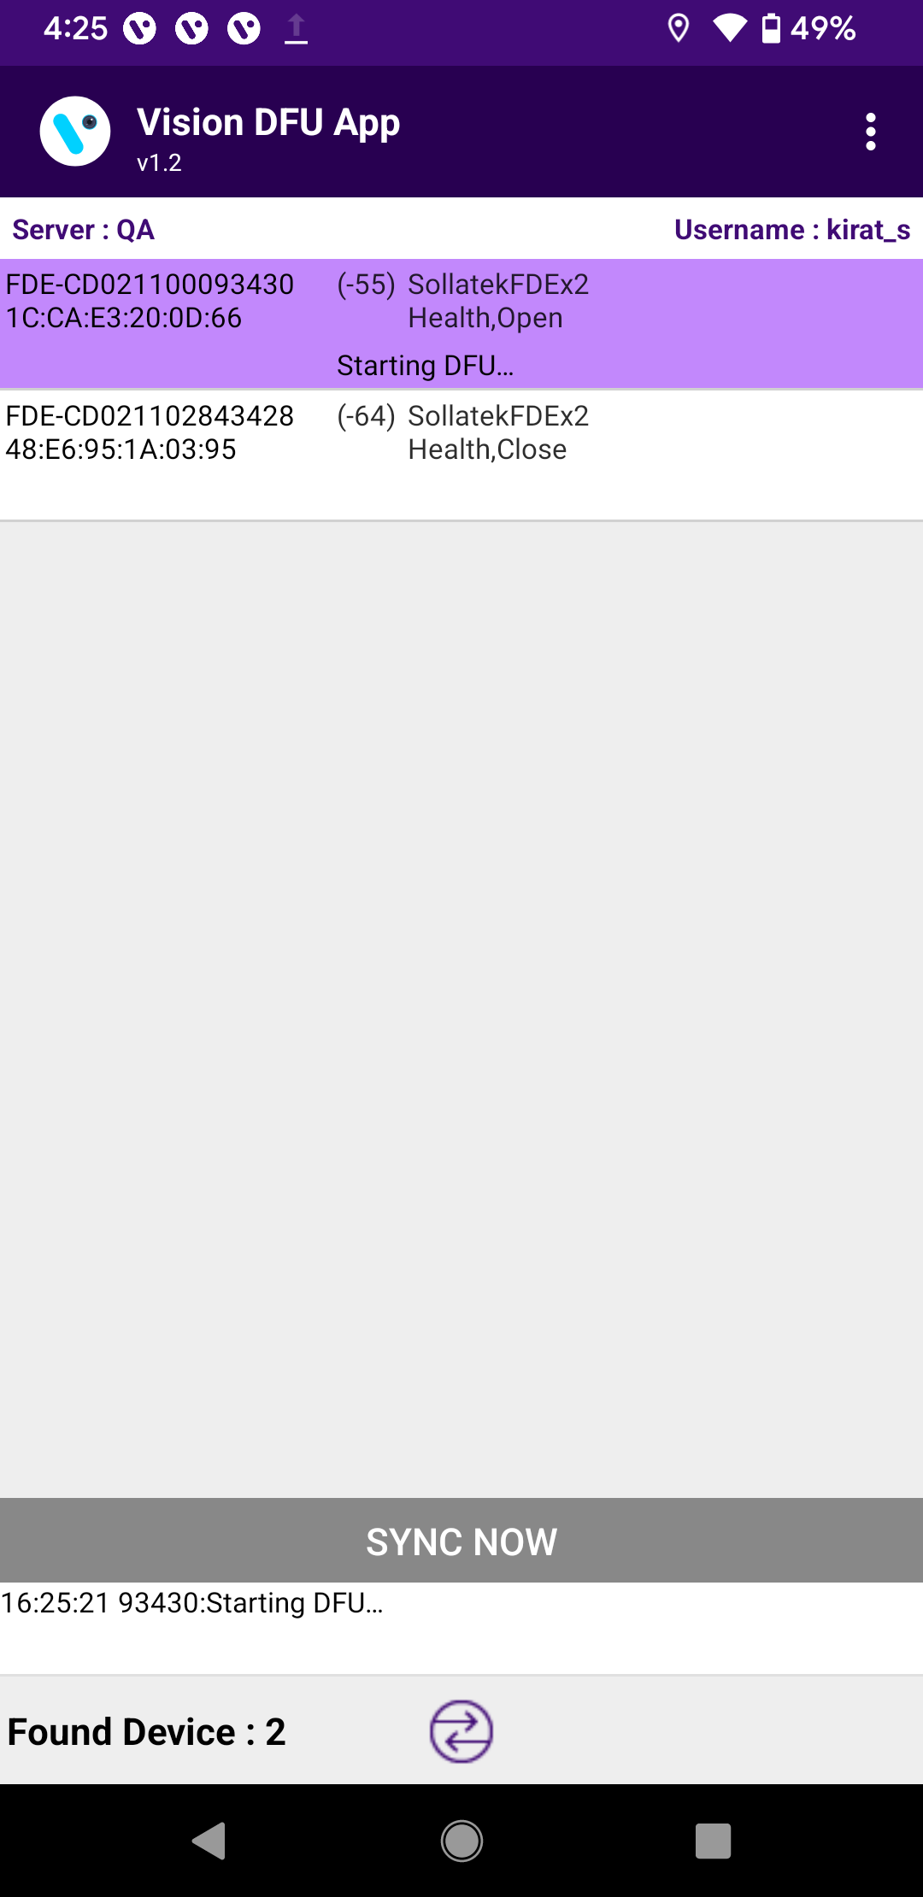

DFU PROCESS
Shows the Nearby Available Unassigned Devices → Auto Update the Smart Device to Latest FW.
© 2023 Vision Group

Slide 7
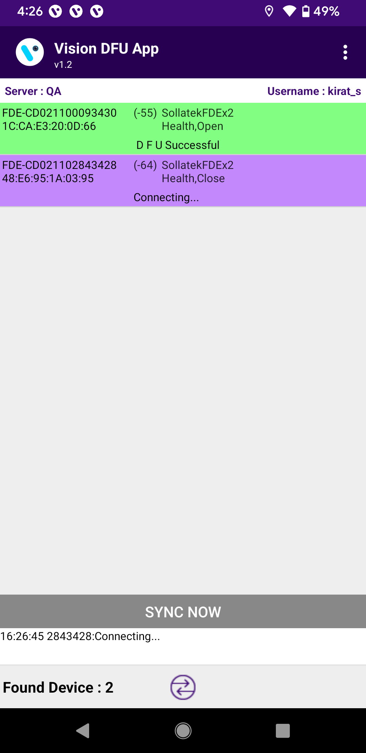
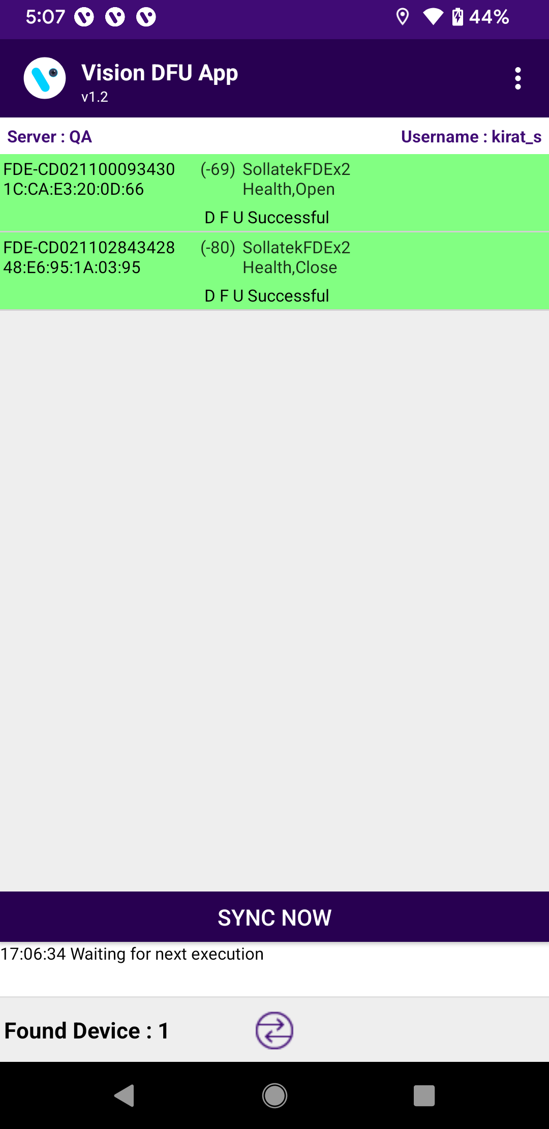
Upon successful completion of a device’s firmware update (DFU), the application automatically moves to the next device in the list for its firmware update.
Once all scanned devices have successfully completed the DFU, the “SYNC NOW” button becomes active. Users can either manually initiate the process by pressing this button or allow the application to automatically start the process after a pre-set interval of 1 minute.
© 2023 Vision Group

Slide 8
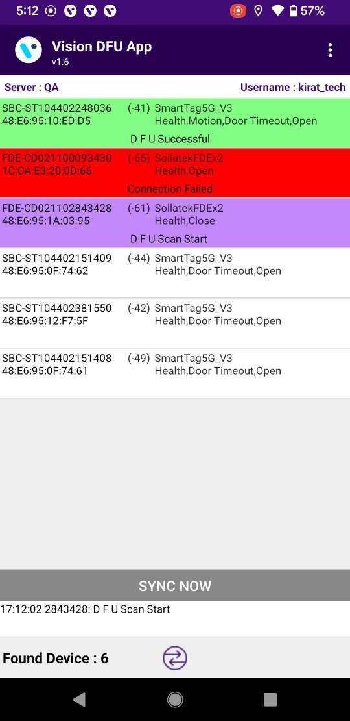
If any device fail to upgrade latest firmware application shows it as in red highlighted. User can go to DFU status list later and do DFU manually using “DFU” button.
© 2023 Vision Group

Slide 9
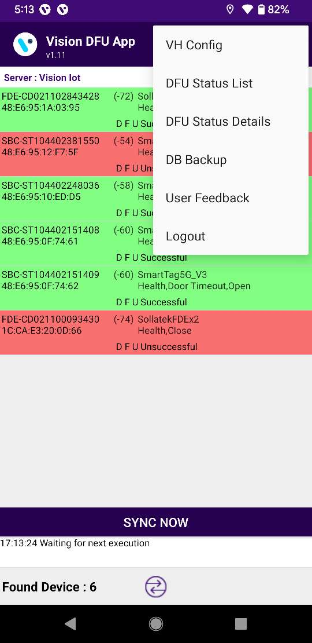
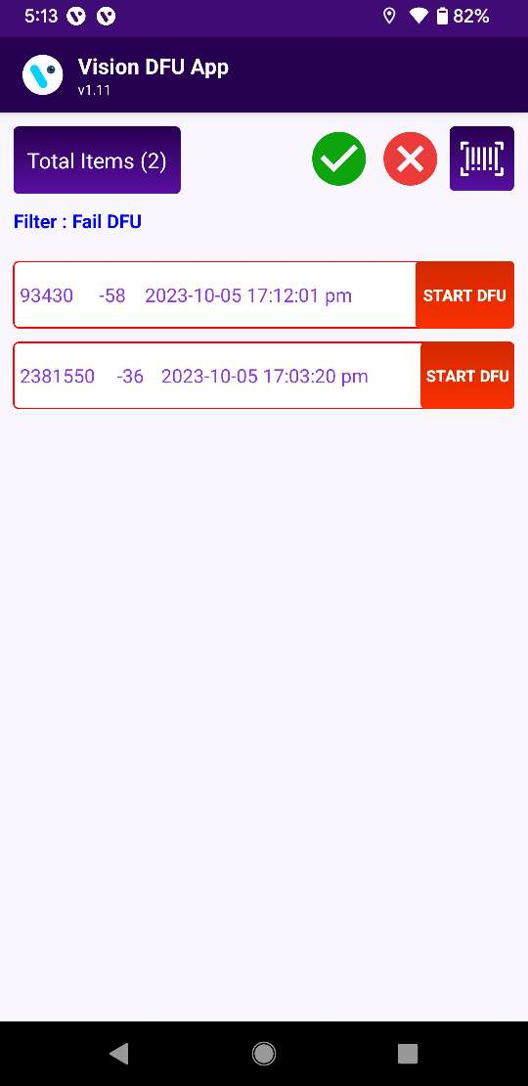
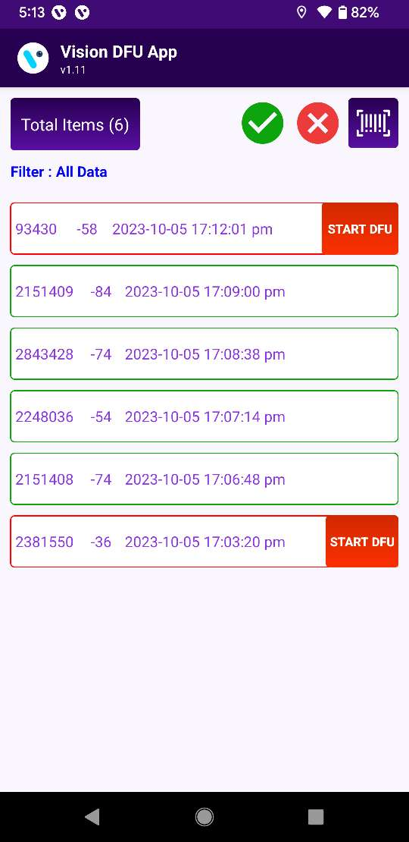
DFU STATUS LIST
Press on menu button top right side which provides different option.
Select “DFU Status List” it will show all device list for Success OR Fail.
Filter : It is showing current applied filter.
By default, it set to “Fail” only.
© 2023 Vision Group

Slide 10
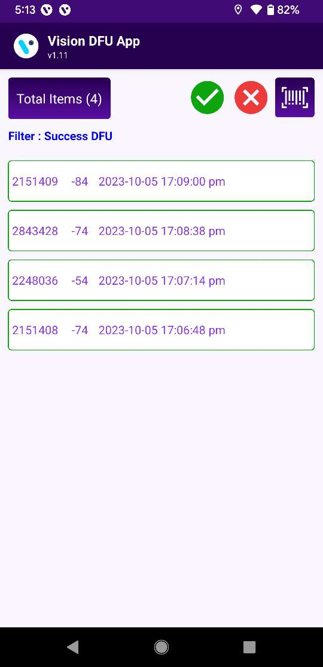
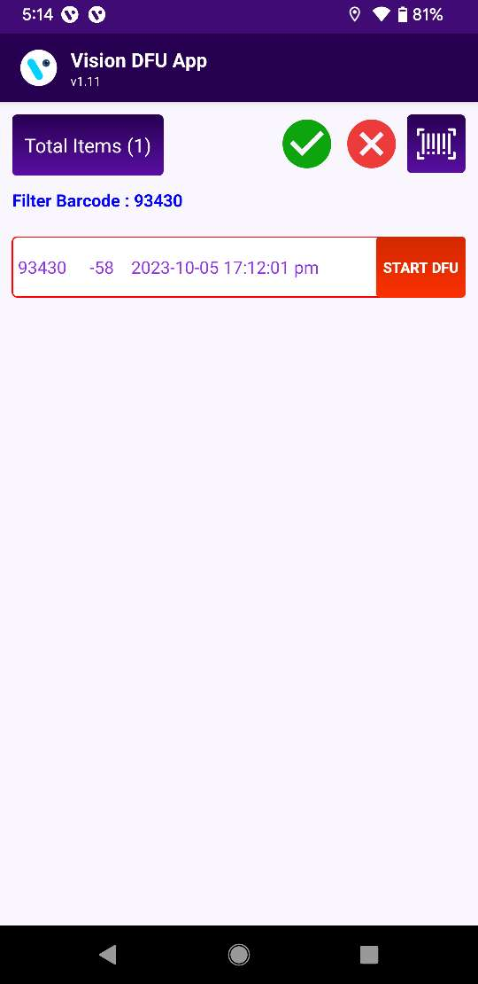
User can select devices list for only success, only fail, all device Or using barcode scan for specific device.
© 2023 Vision Group

Slide 11
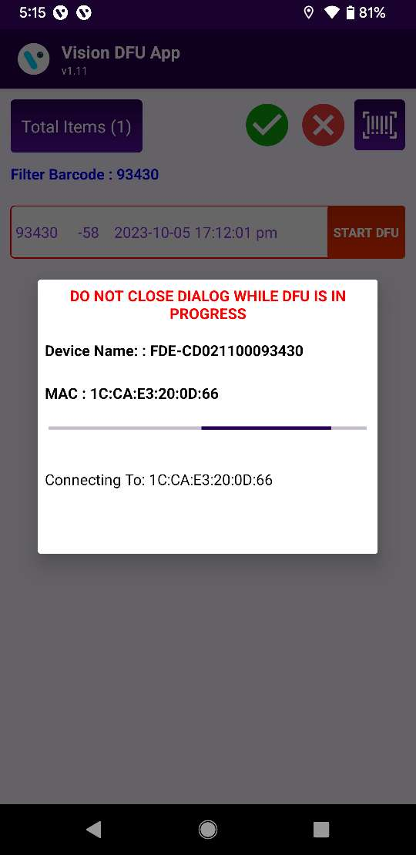
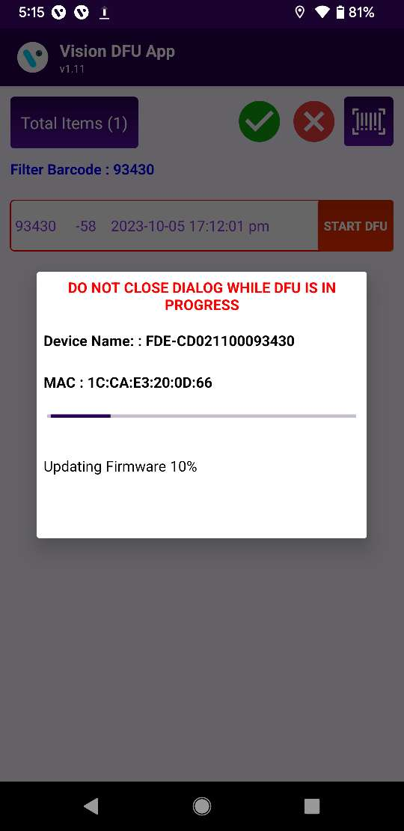
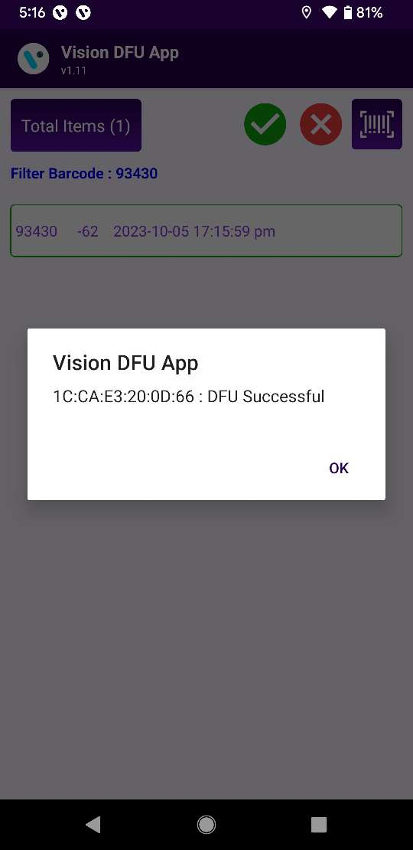
DFU RETRY (Device status list)
For fail case user need to press “Start DFU” for manual upgrade in fail devices.
© 2023 Vision Group

Slide 12
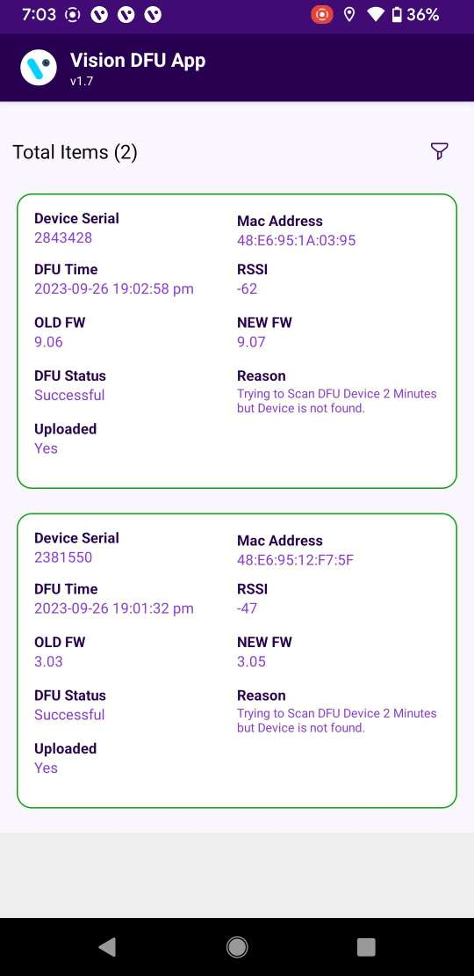
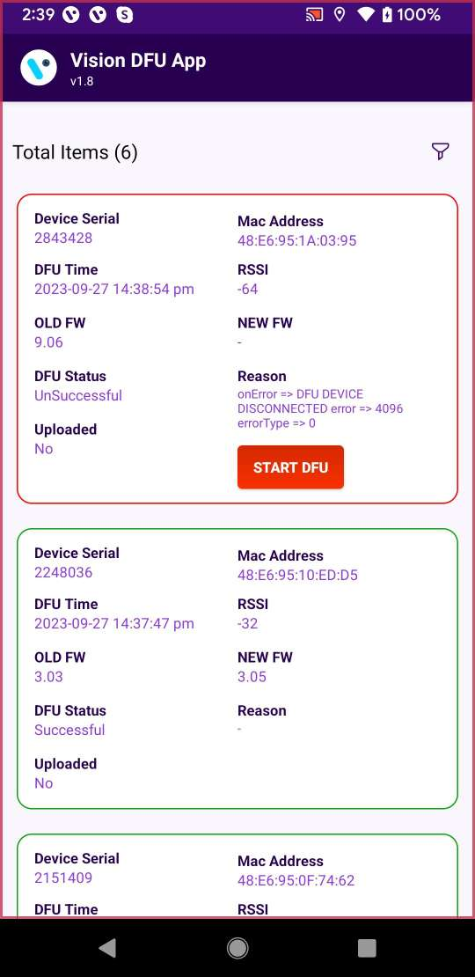
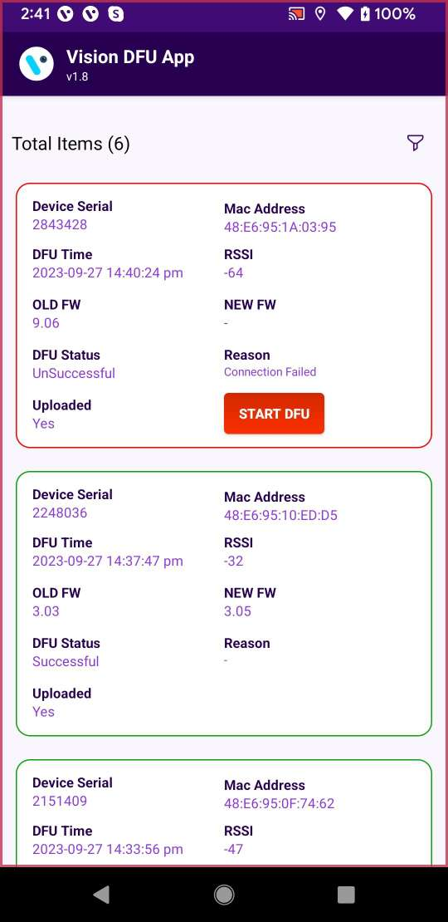
DFU STATUS DETAILS
Press on menu button top right side which provides different option.
Select “DFU Status” it will show all device list for Success OR Fail.
© 2023 Vision Group

Slide 13
FAIL REASON
Connection Failed:
Check cooler/Device power On
Check Cooler/Device is near by phone (within 5-meter radius)
press “start DFU” button from DFU status list
DFU device disconnected :
Keep cooler/device power on and press “start DFU” button from DFU status list
© 2023 Vision Group

Slide 14
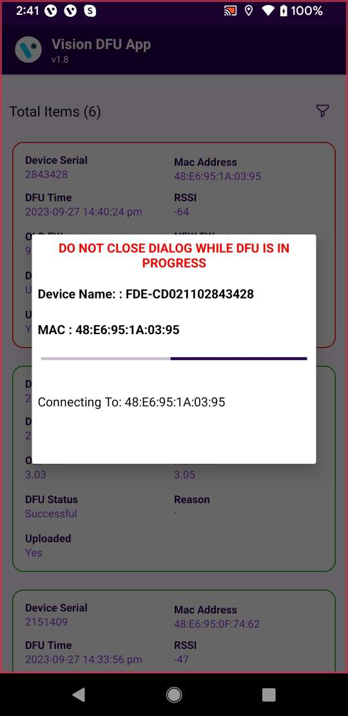
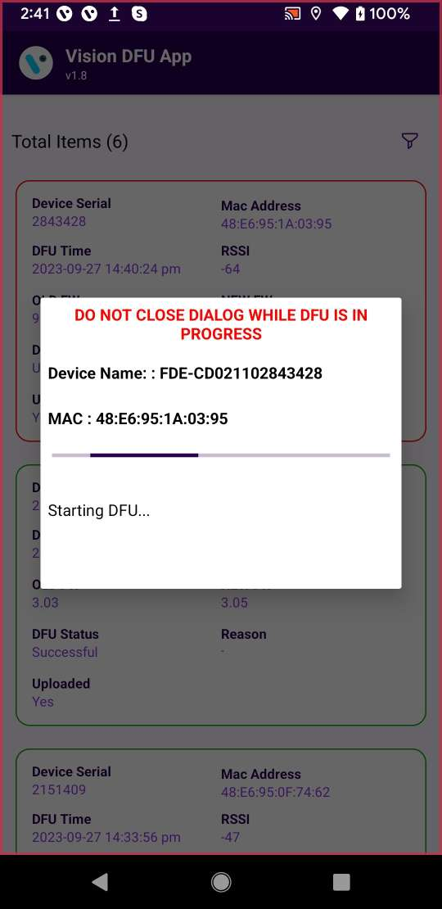
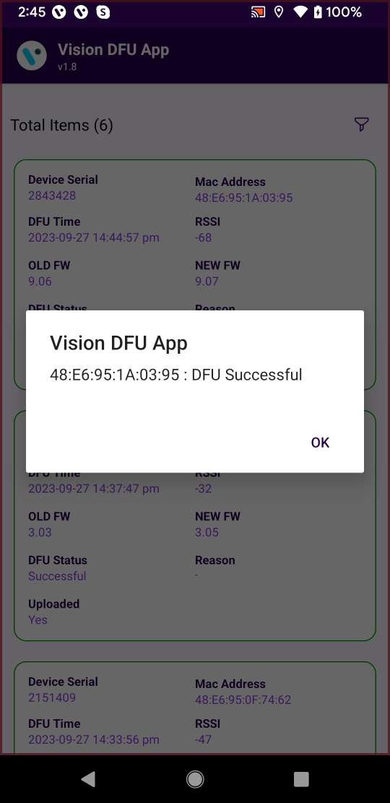
DFU RETRY
For fail case user need to press “Start DFU” for manual upgrade in fail devices.
© 2023 Vision Group

Slide 15
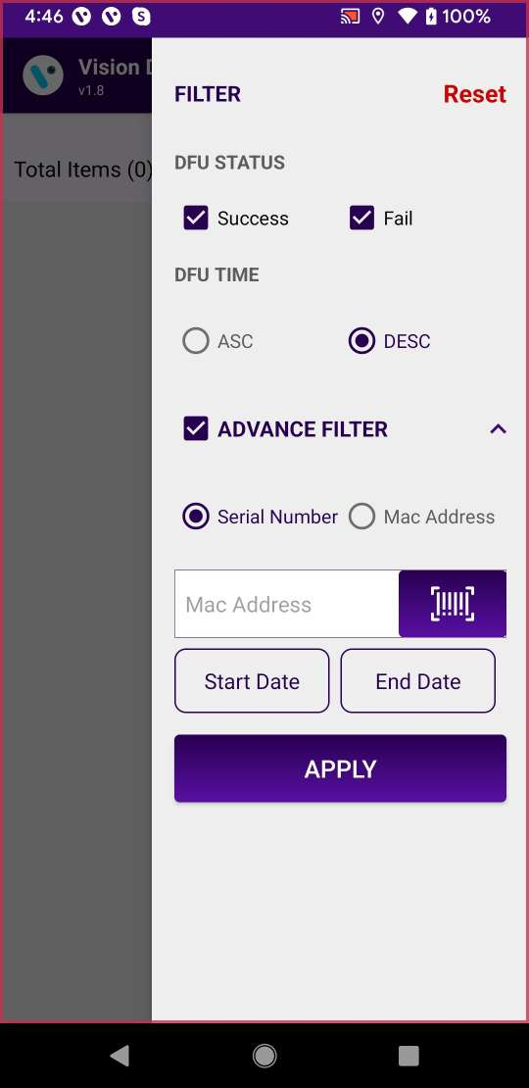
DFU STATUS FILTER
1
1 Reset: It will reset all filter to default.
2 Success: Mark this box to show successful DFU device list.
3 Fail: Mark this box to show DFU failure device list.
4 DFU TIME: User can see list based on ascending Or descending order based on DFU done time.
5 Advance filter:
5a. User can filter device based on device serial number OR MAC, user can enter device serial manually or use barcode scanner.
5b. User can filter device date based on date.
6 User need to press “APPLY” button after update any filter configuration.
2
3
4
5
© 2023 Vision Group

Slide 16
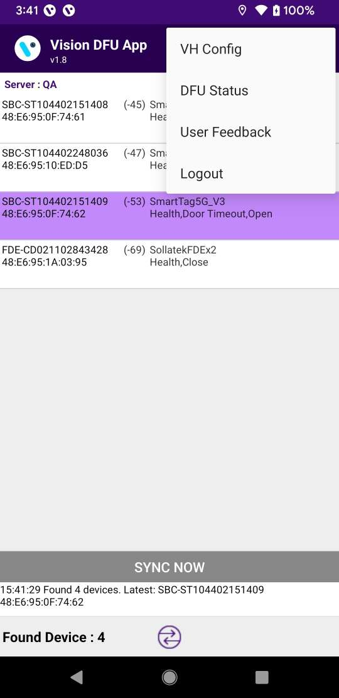
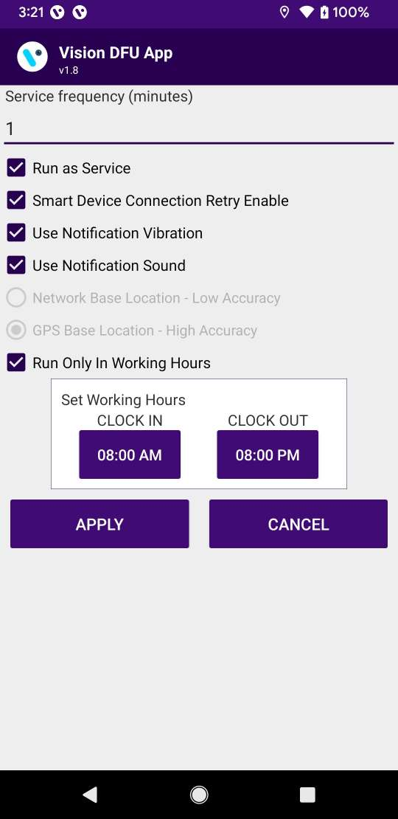
SETTINGS/OPTION FOR VH SERVICES
1
2
1 Service Frequency: This is the delay between consecutive DFU sessions.
2 Run as Service: Check this option for DFU process run.
3 Connection Retry Option: If the Smart Device does not connect in one try then it will retry connection .
4 Working Hours: DFU process will work during define working hours.
3
4
© 2023 Vision Group

Slide 17
NOTIFICATION SETTINGS
1
1 Enable Vibration – If this option is enabled the user gets notified by vibration once the data download is complete.
2 Enable Notification Sound– If this option is enabled the user gets notified by a sound once the data download is complete.
Notification enables the person collecting the data to identify the data download completion without checking the device manually.
2
© 2023 Vision Group

Slide 18
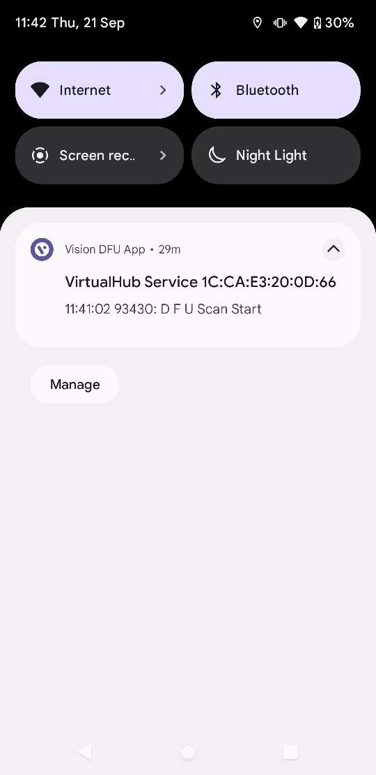
NOTIFICATION
Pull down the notification to check the DFU service status when the application runs in the background.
© 2023 Vision Group

Slide 19
Thank You!
© 2023 Vision Group

